Slide 1
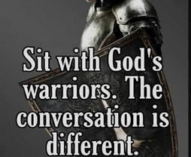
Spiritual Warfare
10% Satan’s Tactics
90% How We Respond
Remember… With God We Are Not
Helpless
Hopeless
We Are Powerful!!

Slide 2
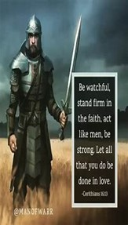
Repeat
These are the 2 Most Important Hours of My Week – Help Me to Cherish Them
I Am Here Today to Worship
Not to Be Entertained
I Am Singing to An Audience of One
Accept My Worship Oh Lord!

Slide 4
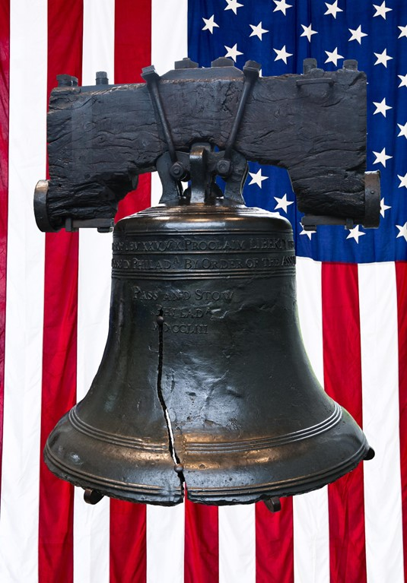
Let Freedom Ring!!!
Edward Church June 29, 2025
July 4, 2025

Slide 5
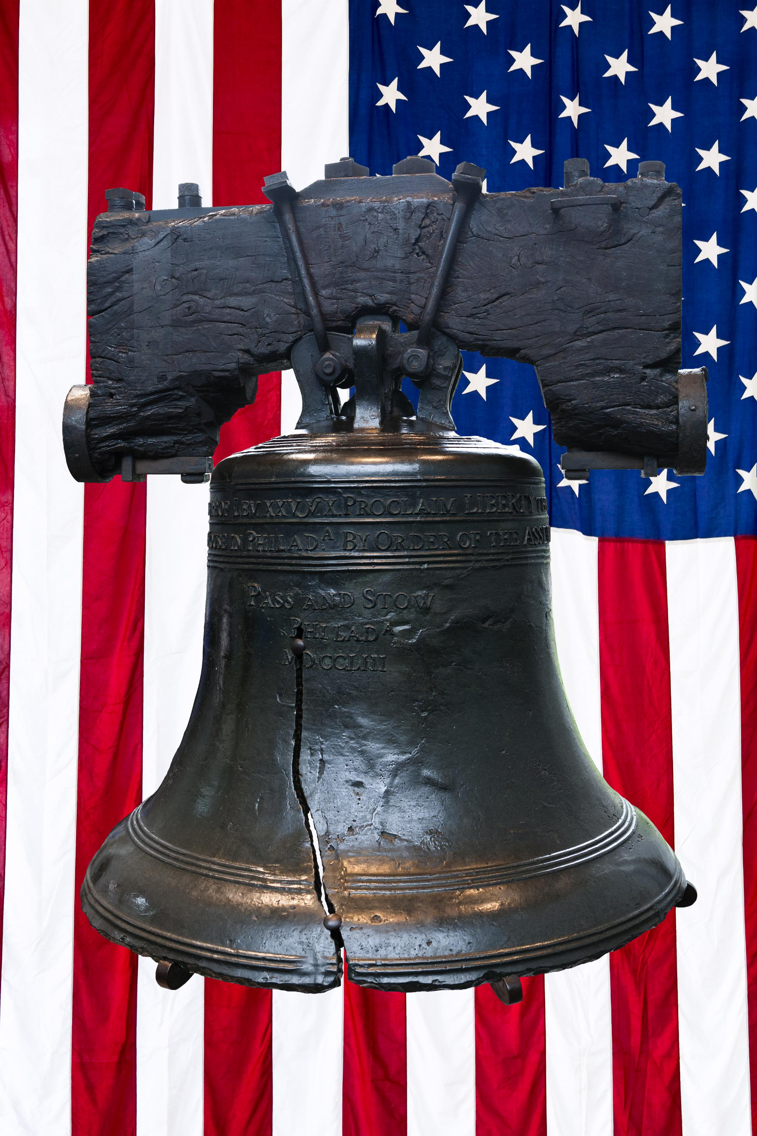
Britain Was the World’s Superpower
Had the Better Defense…
…More Money Than America
The 13 Colonies Lacked
Professional
Army
Navy
Militiamen
Lightly Armed,
Had Little Training
But It Did Not Stop Them
Notes:
---
The independence movement was fueled by the efforts of remarkable individuals who risked everything for freedom. Figures like George Washington, Thomas Jefferson, and others played crucial roles in the struggle for independence.
Image source: Microsoft 365 content library

Slide 6
Members of the Second Continental Congress in 1776, were considered…
…Rebel and traitor by the King.
  Rewards had been Posted
Largest British Armada ever Assembled in New York harbor.
Affixing Your Name to the Document Meant You Pledged Your…
  Life
  Fortune
  Sacred Honor
….to the Cause of Freedom
Notes:
---
The independence movement was fueled by the efforts of remarkable individuals who risked everything for freedom. Figures like George Washington, Thomas Jefferson, and others played crucial roles in the struggle for independence.
Image source: Microsoft 365 content library

Slide 7
On July 4, 1776
56 - Representatives from All 13 Colonies Signed…
Declaration of Independence.
The 56 Signers Included…
Two Future Presidents
Three Vice Presidents
Ten Members of Congress
Notes:
---
The independence movement was fueled by the efforts of remarkable individuals who risked everything for freedom. Figures like George Washington, Thomas Jefferson, and others played crucial roles in the struggle for independence.
Image source: Microsoft 365 content library

Slide 8
The Hope of Freedom
The Founding Fathers Knew there was a Better Way
The Better Way was Freedom
It Was Costly
But It Was Worth the Price
So
July 4, 1776
Declaration of Independence
Notes:
---
The independence movement was fueled by the efforts of remarkable individuals who risked everything for freedom. Figures like George Washington, Thomas Jefferson, and others played crucial roles in the struggle for independence.
Image source: Microsoft 365 content library

Slide 9
The Cost of Freedom
First
The Writers Separated…
…Themselves from their Past
The Declaration Cut Ties…
…Declared Freedom
…Declared War
Notes:
---
The independence movement was fueled by the efforts of remarkable individuals who risked everything for freedom. Figures like George Washington, Thomas Jefferson, and others played crucial roles in the struggle for independence.
Image source: Microsoft 365 content library

Slide 10
The Cost of Freedom
First
The We Too Must Separate…
…from Our Past
Like 13 Colonies we were Out Gunned
But
If We Declare Freedom…
    Repent
    Resist (expect)
  Because We Declare War!!!
Notes:
---
The independence movement was fueled by the efforts of remarkable individuals who risked everything for freedom. Figures like George Washington, Thomas Jefferson, and others played crucial roles in the struggle for independence.
Image source: Microsoft 365 content library

Slide 11
The Cost of Freedom
First
If We Declare Freedom…
  Repent
  Replace
  Rest
⁶ For when we were yet without strength, in due time Christ died for the ungodly. Rom 5:6
New Living Translation
⁶ When we were utterly helpless, Christ came at just the right time and died for us sinners.
Notes:
---
The independence movement was fueled by the efforts of remarkable individuals who risked everything for freedom. Figures like George Washington, Thomas Jefferson, and others played crucial roles in the struggle for independence.
Image source: Microsoft 365 content library

Slide 12
The Cost of Freedom
Secondly
The Writers Fought the Good FIght
Whatever It Took for Freedom
Even If It Meant Their Lives
God Backed Them!!!
Notes:
---
The independence movement was fueled by the efforts of remarkable individuals who risked everything for freedom. Figures like George Washington, Thomas Jefferson, and others played crucial roles in the struggle for independence.
Image source: Microsoft 365 content library

Slide 13
The Cost of Freedom
Secondly
We Need to Fight the Good Fight
Whatever It Takes for Freedom
Even If It Means Our Lives
God Will Back Us!!!
Revelation 12:11 NLT
And they have defeated him by the blood of the Lamb and by their testimony. And they did not love their lives so much that they were afraid to die.
Notes:
---
The independence movement was fueled by the efforts of remarkable individuals who risked everything for freedom. Figures like George Washington, Thomas Jefferson, and others played crucial roles in the struggle for independence.
Image source: Microsoft 365 content library

Slide 14
The Treasure of Freedom
Brought a Promise of New Life
Revolution Changed America
Politically
Socially
Economically
Spiritually
Notes:
---
The independence movement was fueled by the efforts of remarkable individuals who risked everything for freedom. Figures like George Washington, Thomas Jefferson, and others played crucial roles in the struggle for independence.
Image source: Microsoft 365 content library

Slide 15
The Treasure of Freedom
Brought a Promise of New Life
Spiritual Revolution Changed Us
Politically
Socially
Economically
Spiritually
John 8:36 Amp
So if the Son liberates you [makes you free men], then you are really and unquestionably free.
Notes:
---
The independence movement was fueled by the efforts of remarkable individuals who risked everything for freedom. Figures like George Washington, Thomas Jefferson, and others played crucial roles in the struggle for independence.
Image source: Microsoft 365 content library

Slide 16
The Declaration of Independence
Brought War and Peace
And a Better Life
Our Declaration of Dependence
Brought War and Peace
And a Better Life
John 10:10 Amp
The thief comes only in order to steal and kill and destroy. I came that they may have and enjoy life, and have it in abundance (to the full, till it ^{[a]}overflows).
Notes:
---
The independence movement was fueled by the efforts of remarkable individuals who risked everything for freedom. Figures like George Washington, Thomas Jefferson, and others played crucial roles in the struggle for independence.
Image source: Microsoft 365 content library

Slide 17
This Weeks Challenge
Consider the
  Price
  Power
  Personal
Galatians 5:1
Stand fast therefore in the liberty wherewith Christ hath made us free, and be not entangled again with the yoke of bondage.
Galatians 5:1 Amp
In [this] freedom Christ has made us free [and completely liberated us]; stand fast then, and do not be hampered and held ensnared and submit again to a yoke of slavery [which you have once put off].
Notes:
---
The independence movement was fueled by the efforts of remarkable individuals who risked everything for freedom. Figures like George Washington, Thomas Jefferson, and others played crucial roles in the struggle for independence.
Image source: Microsoft 365 content library

Slide 19
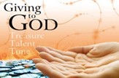
Repeat
I Lift My Offering to You
Let It Please You Oh Lord
This is My Seed
Although It Leaves My Hand
It will Never Leave My Life
You Will Multiply It!
Accept My Seed Oh Lord!

Slide 20
While visiting a water show, a tourist asked one of the divers, "Why do
scuba divers always fall backward off their boats To which the diver replied, "If they fell forward, they'd still be in the boat."
>>>Today's Thot
My favorite essential oil is bacon grease.

