Slide 1

Spiritual Warfare
10% Satan’s Tactics
90% How We Respond
Remember… With God We Are Not
Helpless
Hopeless
We Are Powerful!!

Slide 2
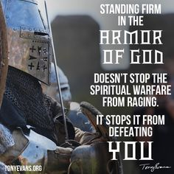
Repeat
These are the 2 Most Important Hours of My Week – Help Me to Cherish Them
I Am Here Today to Worship
Not to Be Entertained
I Am Singing to An Audience of One
Accept My Worship Oh Lord!

Slide 3

Repeat
I Lift My Offering to You
Let It Please You Oh Lord
This is My Seed
Although It Leaves My Hand
It will Never Leave My Life
You Will Multiply It!
Accept My Seed Oh Lord!

Slide 5
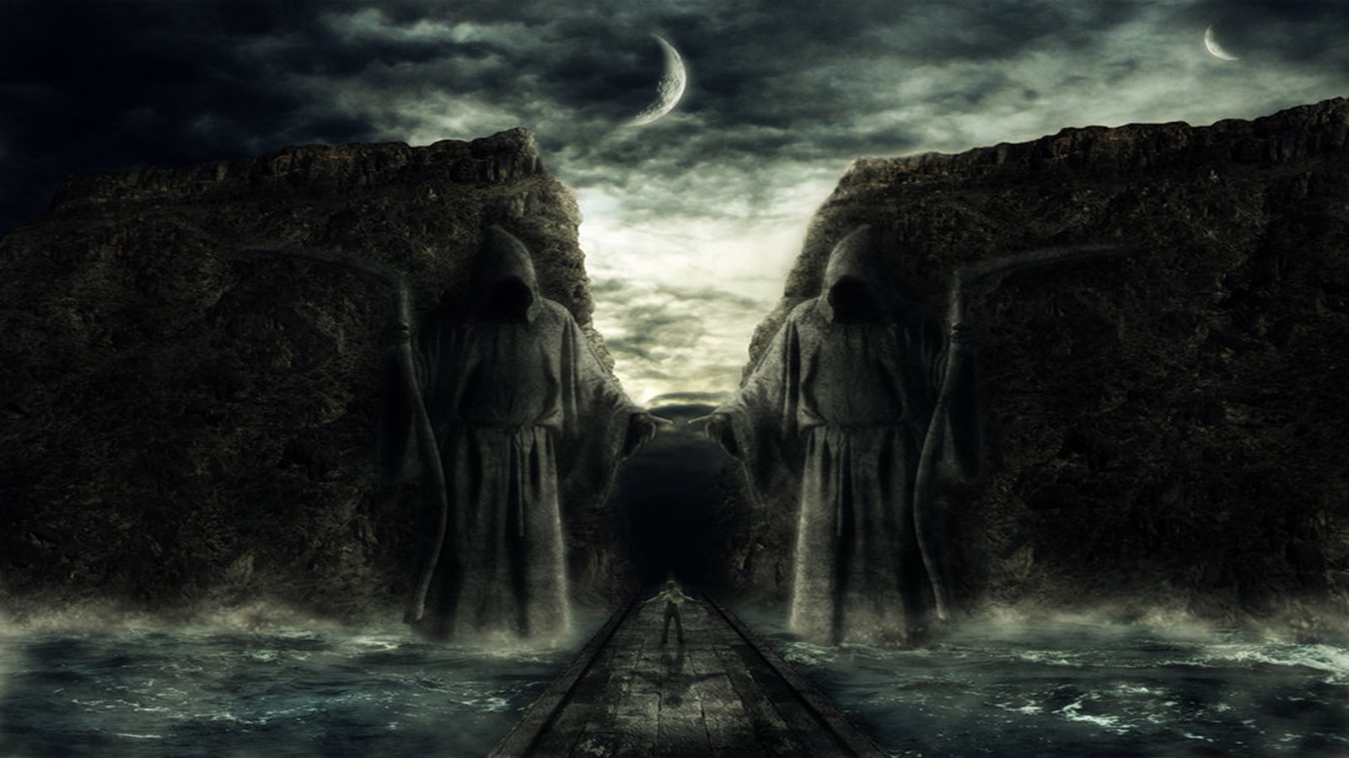

Passing Through
Dark Valleys pt 1
(Dealing with Adversity)
Psalms 23:4
Edward Church
July 6, 2025

Slide 6
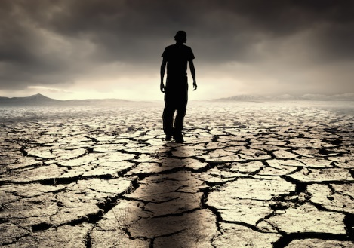
What Do You Get in a Land Where All You Have Is…
…Sunshine Every Day
…and No Rain?
“a Desert”
  Balance -none
  Blocked- growth stunted
  Blank- Unthankful
  Bland- boring

Slide 7
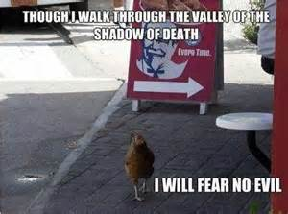
Examples of Life's Valleys
The Valley of…
  Trouble -Josh. 7:26
  Weeping -Psa. 84:6
  Deep Darkness -Ps. 23:4

Slide 8
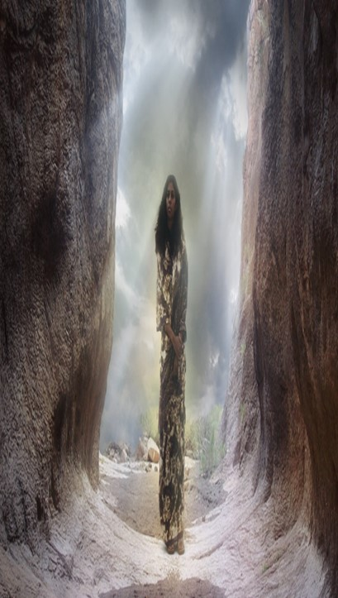

Dark Valleys Are…
Unavoidable
"Mankind is born for trouble as surely as sparks fly upward." Job 5:7
Unpredictable
  You can’t plan them or time them (usually worst poss time)
  "Disaster after disaster is reported, for the whole land is destroyed. Suddenly my tents are destroyed, my tent curtains, in a moment." -Jeremiah 4:20 (HCSB)
Impartial
"He causes His sun to rise on the evil and the good, and sends rain on the righteous and the unrighteous." -Matt 5:45 (HCSB)

Slide 9
Dark Valleys Are…
  Unavoidable
  Unpredictable
  Impartial
Temporary
        Valleys…
          Have a Beginning also an End
          Don’t Last Forever
          Are Not Our Permanent Residence
"The suffering won’t last forever. It won’t be long before this generous God who has great plans for us in Christ—eternal and glorious plans they are!—will have you put together and on your feet for good" -1 Peter 5:10 (MSG)

Slide 10
Dark Valleys Are…
  Unavoidable
  Unpredictable
  Impartial
  Temporary
Have a Purpose
"You rejoice in this, though now for a short time you have had to be distressed by various trials so that the genuineness of your faith—more valuable than gold, which perishes though refined by fire—may result in praise, glory, and honor at the revelation of Jesus Christ." -1 Peter 1:6-7 (HCSB)

Slide 11
Dark Valleys Are…
Have a Purpose
  God has a reason for taking you through dark valleys.
  valley full of doubt, despair, discouragement, or defeat
  financial valleys, relationship, emotional, spiritual valleys
  God Promises .. You will get through them in time
Every Problem Has a Purpose
  little ones, inconsequential ones, irritating ones.
  God can teach you character
  He wants to change you, mature you
  Faith is Built in the Valleys of Life

Slide 12
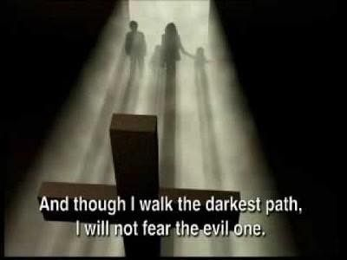
Psalm 23:4 (NLT2)
⁴ Even when I walk through the darkest valley, I will not be afraid, for you are close beside me. Your rod and your staff protect and comfort me.

Slide 13
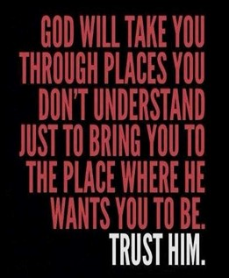
This Week’s Challenge:
Instead of asking God to remove you from your valley,
Ask Him to show you how to use your current situation to:
    Grow closer to Him
    Minister to others
    Demonstrate His faithfulness
    Share His light with those in darkness

Slide 15
A group of friends went deer hunting and paired off in twos for the day.
That night, one of the hunters returned alone, staggering under the weight of an eight-point buck.
"Where's Henry?" the others asked.
"Henry had a stroke of some kind. He's a couple of miles back up the trail," the successful hunter replied.
"You left Henry laying out there and carried the deer back?" they inquired.
"A tough call," nodded the hunter. "But I figured no one is going to steal Henry!"

