Slide 2
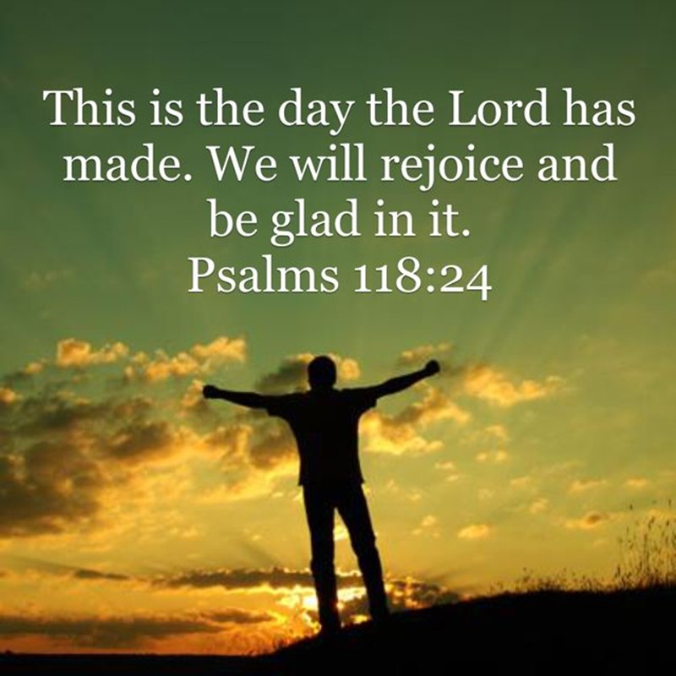
This is the Day –pt1
Edward Church
July 20, 2025
Psalm 118:24

Slide 3
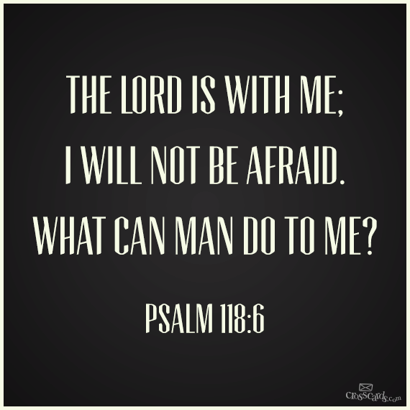
What a Powerful Reminder that Every Day is a Gift from God
Every Moment an Opportunity to Rejoice in His Goodness
Recognize His Hand in Our Lives
In the Light or in the Dark
Rest Assured that the Lord Is With Us
…He Is For Us
…Working All Things Together for Our Good

Slide 4
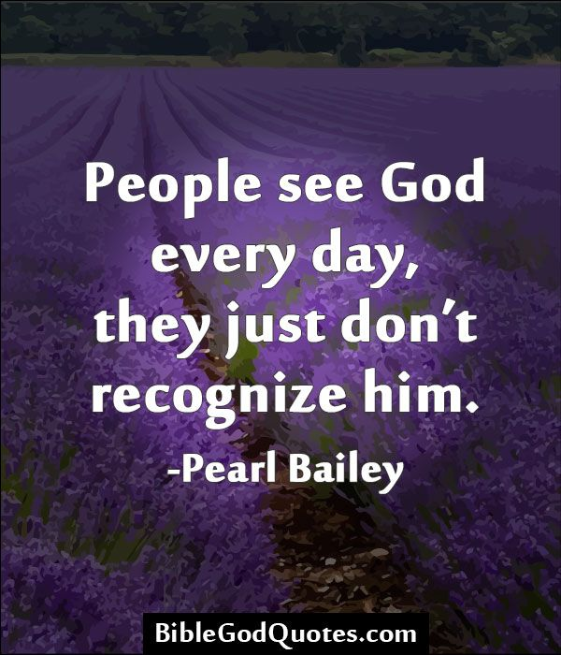
Recognizing the Lord in Every Experience
In The Hustle And Bustle of Our Daily Lives…
…It's Easy to Lose Sight Of God's Presence.
Caught Up In Routines, Worries, Ambitions
Forgetting God Is Right There With Us,

Slide 5
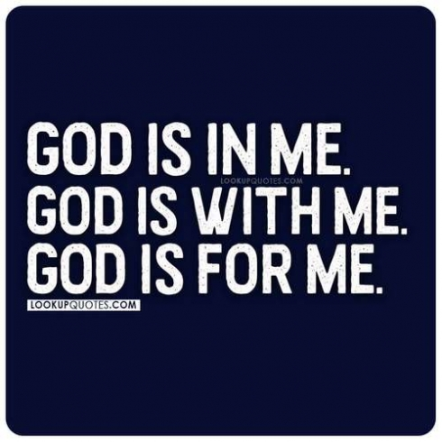
Recognizing the Lord in Every Experience
Every Moment, Every Experience.
He's There When We Wake Up,
When We Lay Down
He's There In Our Joys / Sorrows…
…In Our Victories / Defeats.

Slide 6
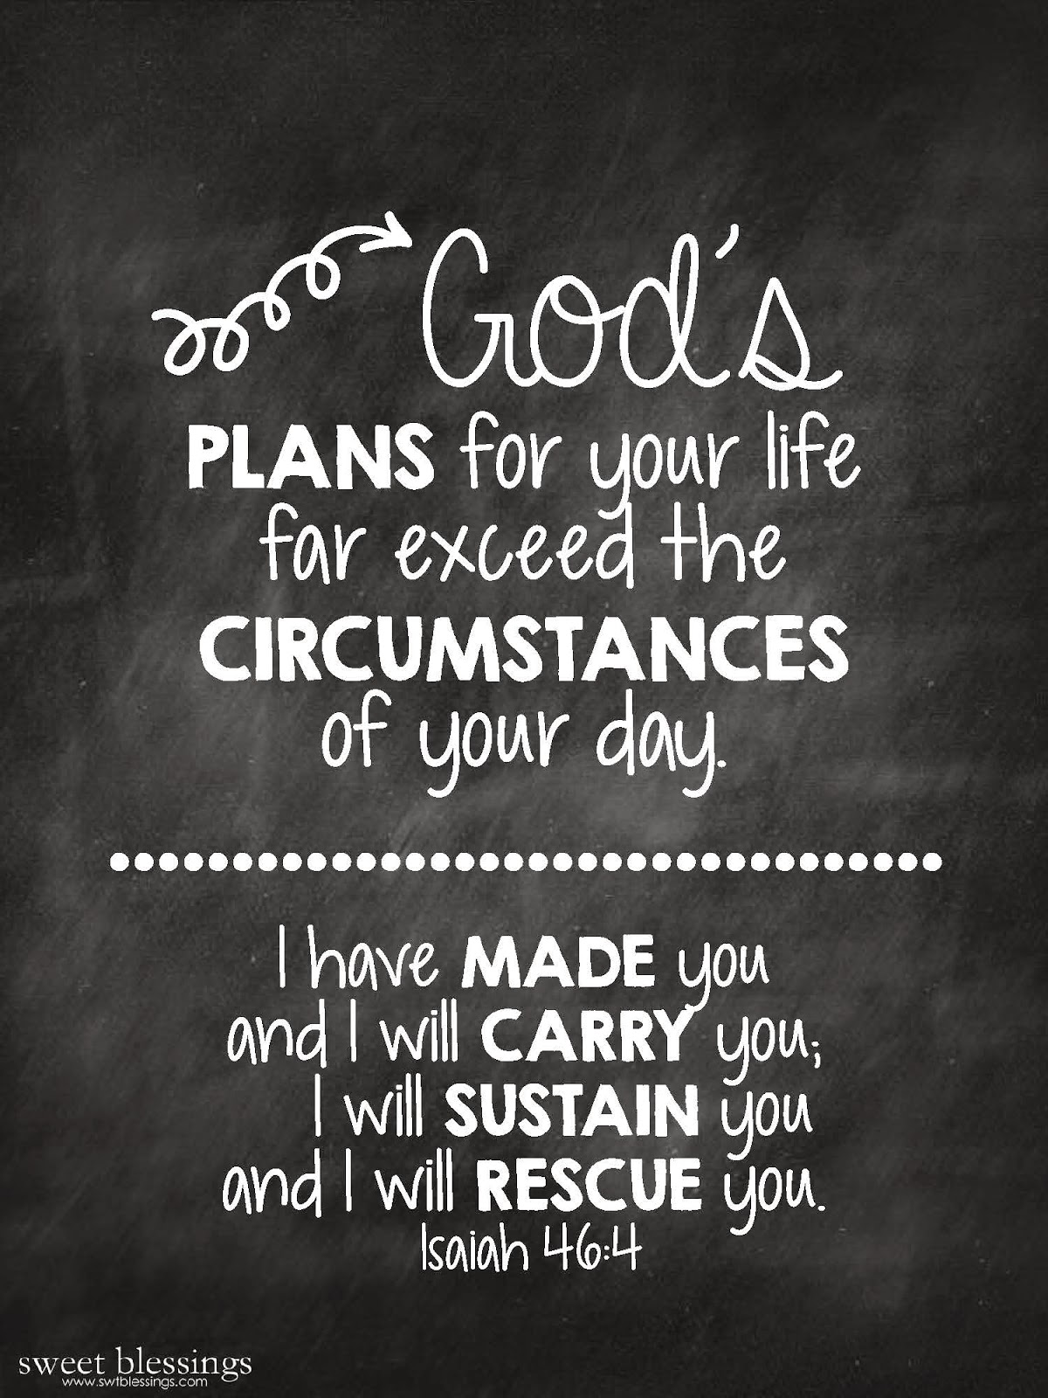
Recognition of God's Presence in Every Experience…
…Can Transform the Way We Live
It Can Bring A Sense of Purpose and Meaning…
…To Even the Most Mundane Tasks.
It Can Fill Us With Joy and Gratitude…
…Even in the Midst of Trials and Tribulations.

Slide 7
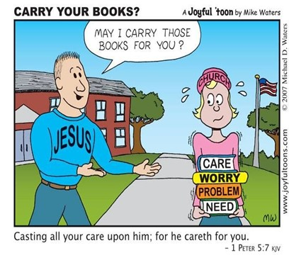
Recognition of God's Presence in Every Experience…
…Can Transform the Way We Live
It Can Give Us A Sense of Peace and Contentment…
…Even When Things Don't Go Our Way.
How Do We Train Our Hearts /Minds To…
…See God's Hand in Everything?

Slide 8
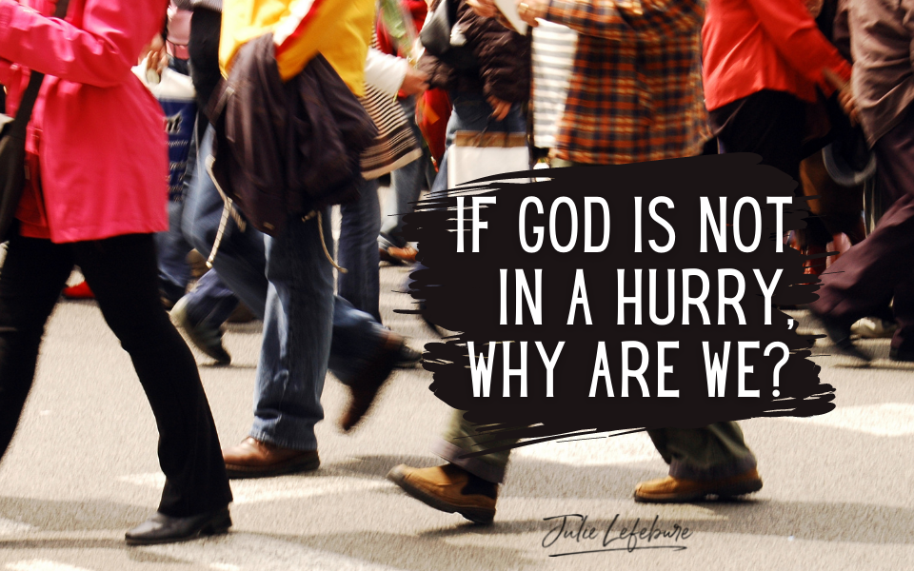
First, We Need to Slow Down
Life can be so fast-paced, busy, full of distractions
We rush from one thing to the next
always looking ahead, planning for the future
we miss the present
We miss the moment and God

Slide 9
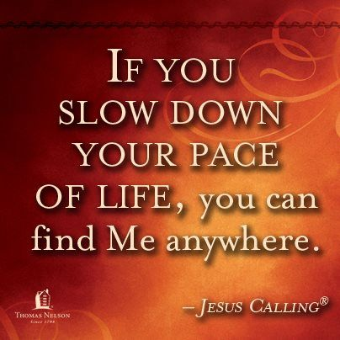
First, We Need to Slow Down
Slow Down
Take The Time…
…To Be Still
…To Be Present
…To Be Aware
take the time to notice the beauty around us,
the blessings in our lives,
the presence of God in every moment

Slide 10
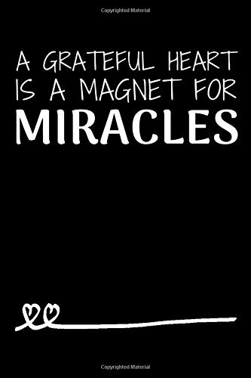
Second, We Need to Cultivate a Grateful Heart
Gratitude is a Powerful Practice
Shifts Our Focus From What We Lack …
…To What We Have.
It Helps Us to See the Good In Every Situation…
…Blessing In Every Trial
…Grace In Every Hardship
We Need To Make it a Habit to Thank God for …
…Every Moment, Every Experience, Every Blessing

Slide 11
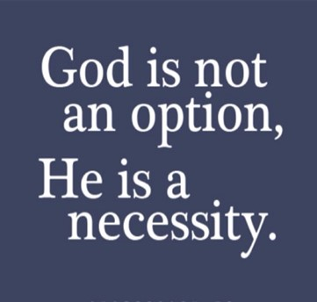
Third, We Need to Trust in God's Sovereignty
God is in Control.
He is the Creator of All Things…
…Sustainer of All Things,
…Ruler of All Things.
Nothing Happens Without His Knowledge, Permission, Purpose.

Slide 12
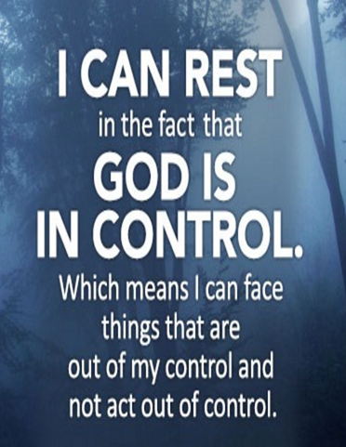
Third, We Need to Trust in God's Sovereignty
We Need to Trust In His Sovereignty.
Trust
He is working all things together for our good,
He is using every experience, moment,
for His glory and our growth

Slide 13
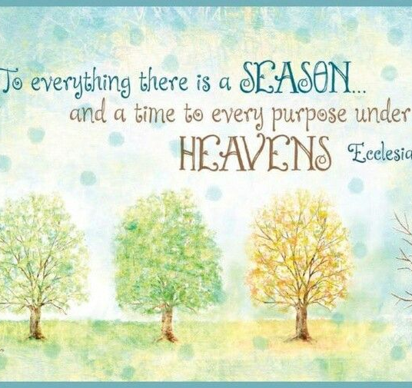
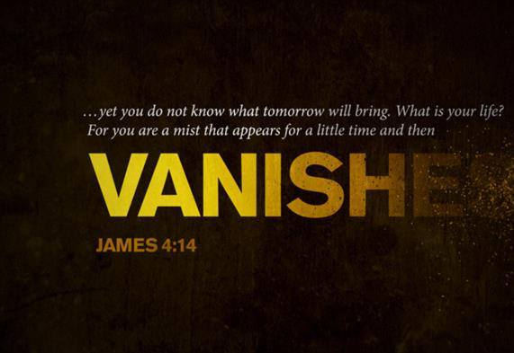
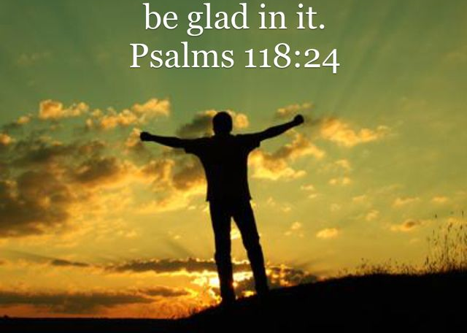
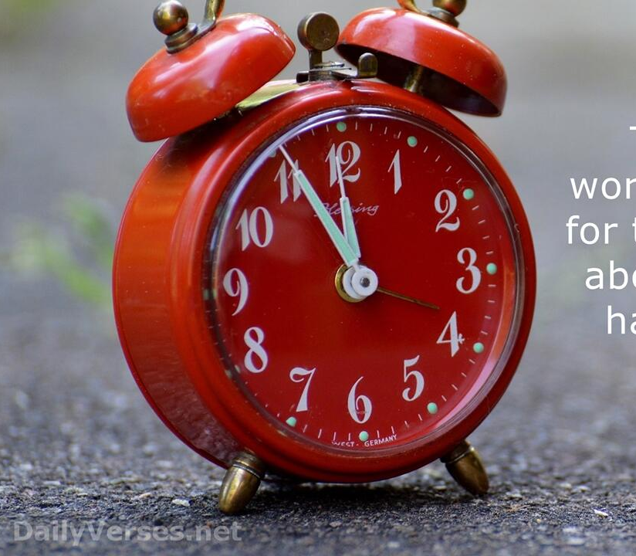
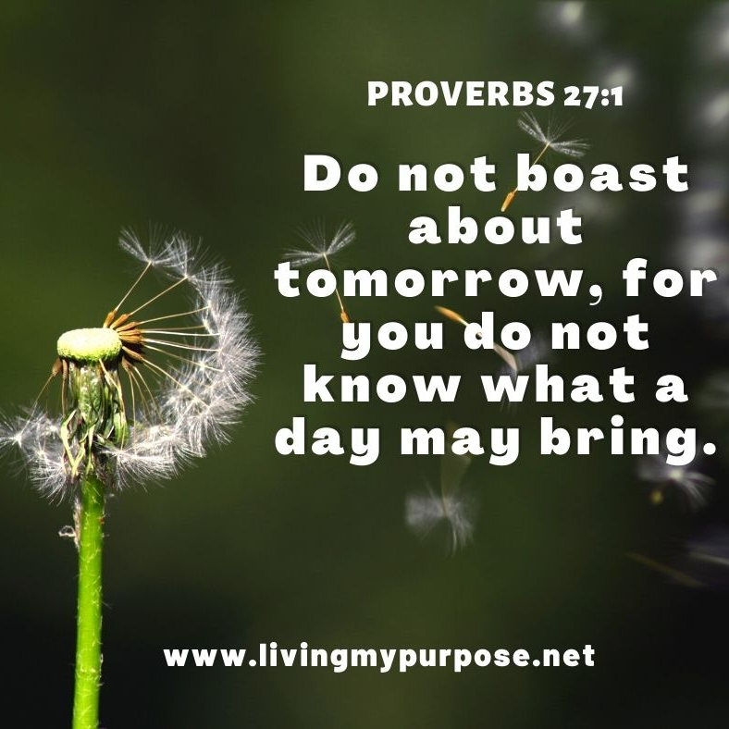
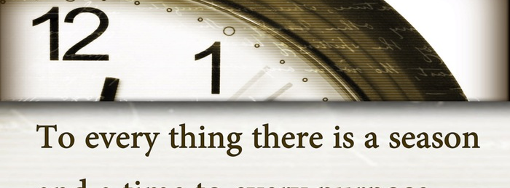
Week’s Challenge… Cultivate Daily Gratitude
  Begin Each Morning by Acknowledging the Day as a Gift.
  Reflect on Specific Blessings
  (health, relationships, opportunities)
  To Shift Focus from Challenges to God’s Provision.
  Keep a Gratitude Journal…
  …Noting 3 Things You’re Thankful For Daily

Slide 15
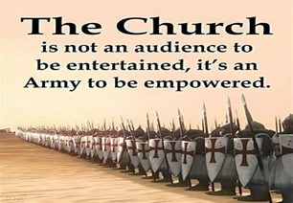
Repeat
These are the 2 Most Important Hours
of My Week
– Help Me to Cherish Them
I Am Here Today to Worship
Not to Be Entertained
I Am Singing to An Audience of One
Accept My Worship Oh Lord!

Slide 16
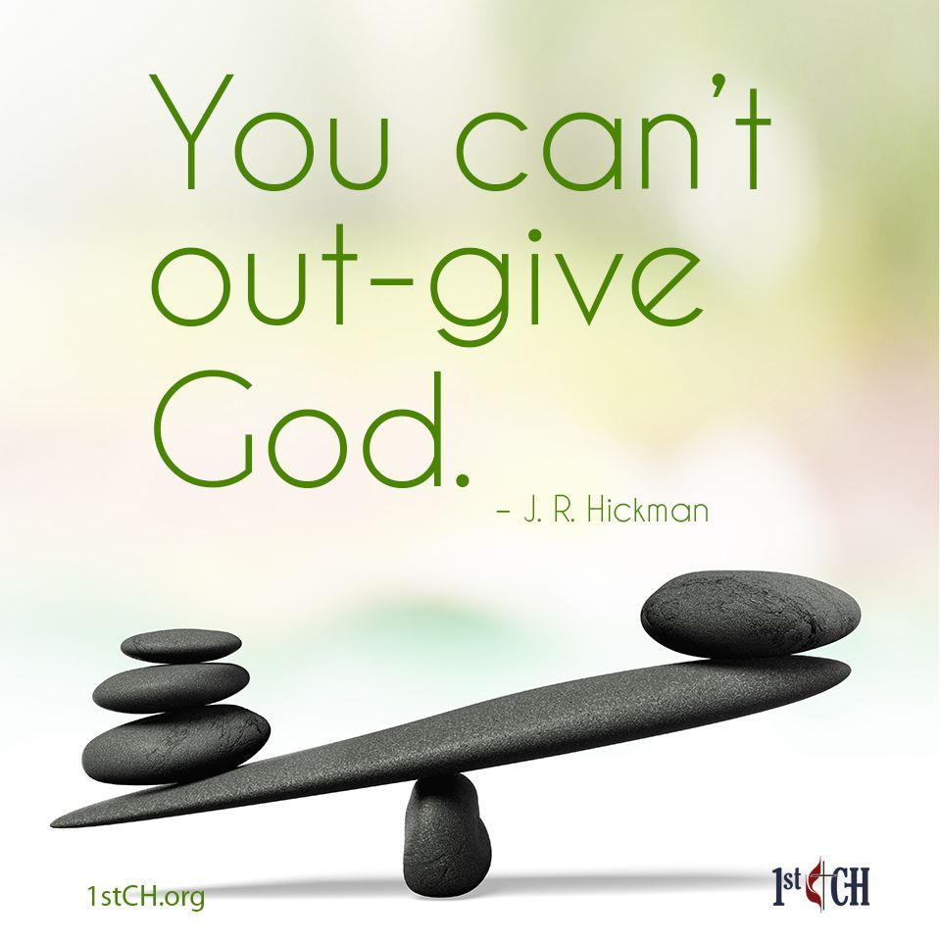
Repeat
I Lift My Offering to You
Let It Please You Oh Lord
This is My Seed
Although It Leaves My Hand
It will Never Leave My Life
You Will Multiply It!
Accept My Seed Oh Lord!

Slide 18
Eight-year-old Nina brought her report card home from school. Her marks were good...mostly A's and a couple of B's.
However, her teacher had written across the bottom: "Nina is a smart little girl, but she has one fault. She talks too much in school. I have an idea I am going to try, which I think may break her of the habit."
Nina's dad signed her report card, putting a note on the back:
"Please let me know if your idea works on Nina because I would like to try it out on her mother."

