Slide 1
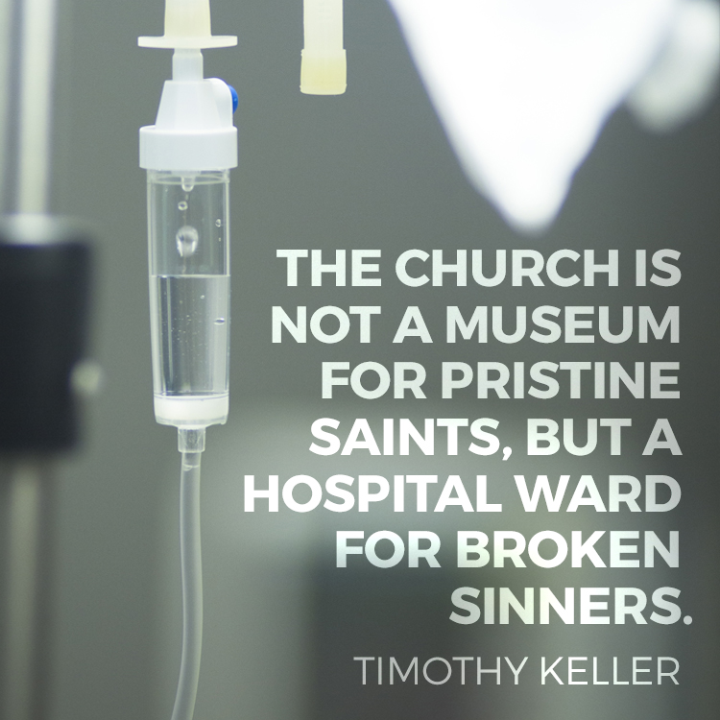

Slide 2
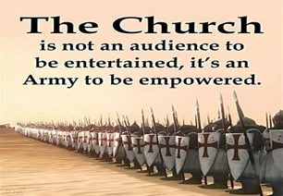
Repeat
These are the 2 Most Important Hours
of My Week
– Help Me to Cherish Them
I Am Here Today to Worship
Not to Be Entertained
I Am Singing to An Audience of One
Accept My Worship Oh Lord!

Slide 3

Repeat
I Lift My Offering to You
Let It Please You Oh Lord
This is My Seed
Although It Leaves My Hand
It will Never Leave My Life
You Will Multiply It!
Accept My Seed Oh Lord!

Slide 4
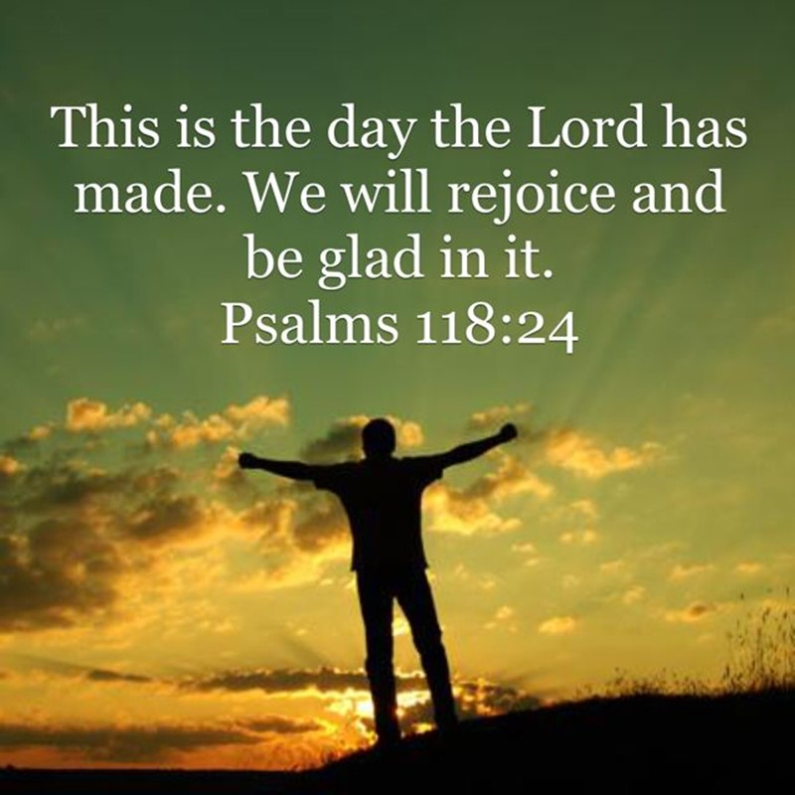
This is the Day –pt2
Edward Church
July 27, 2025
Psalm 118:24

Slide 5
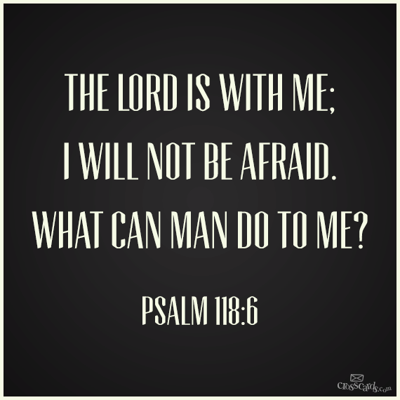
What a Powerful Reminder that Every Day is a Gift from God
Every Moment an Opportunity to Rejoice in His Goodness
Recognize His Hand in Our Lives
In the Light or in the Dark
Rest Assured that the Lord Is With Us
…He Is For Us
…Working All Things Together for Our Good

Slide 6
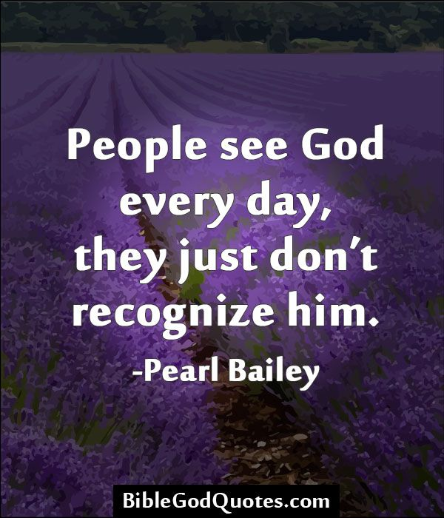
Recognizing the Lord in Every Experience
In The Hustle And Bustle of Our Daily Lives…
…It's Easy to Lose Sight Of God's Presence.
Caught Up In Routines, Worries, Ambitions
Forgetting God Is Right There With Us,

Slide 7
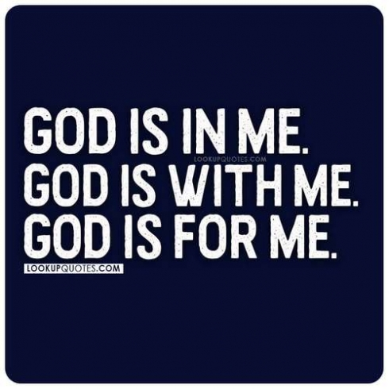
Recognizing the Lord in Every Experience
Every Moment, Every Experience.
He's There When We Wake Up,
When We Lay Down
He's There In Our Joys / Sorrows…
…In Our Victories / Defeats.

Slide 8
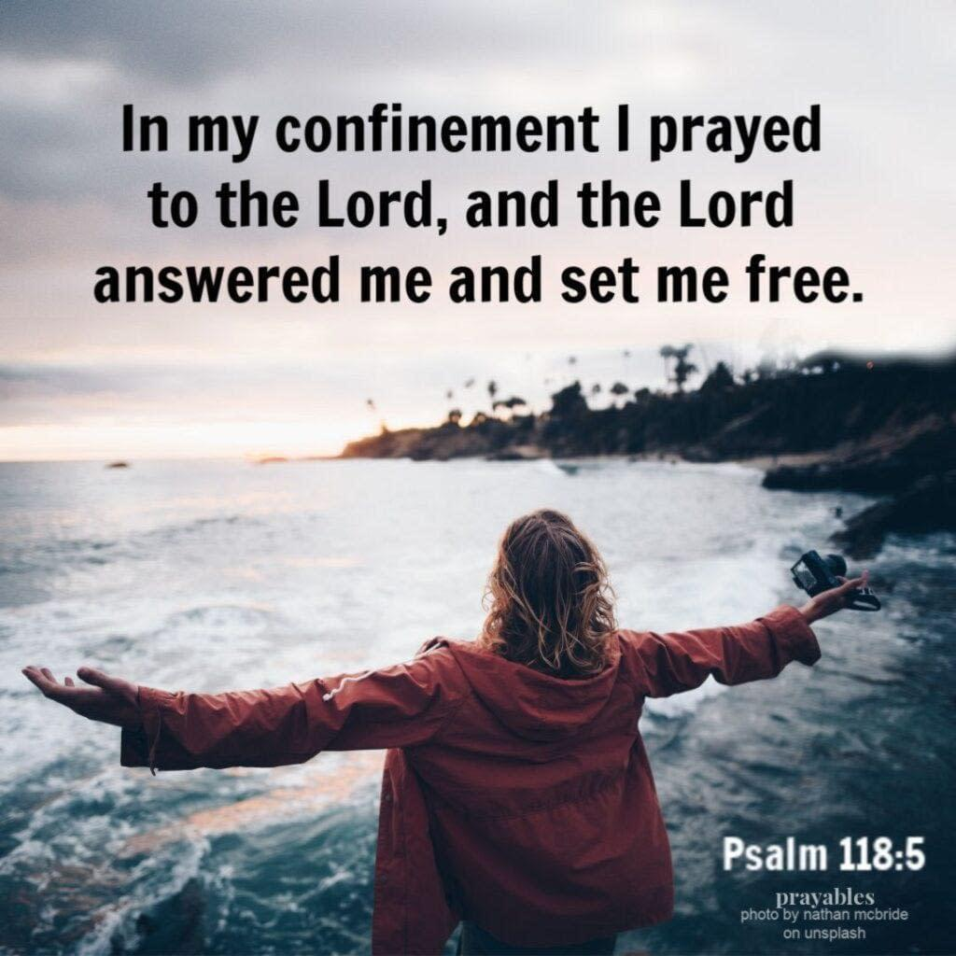
Lying Behind the Praise in this Psalm
there Appears to Be a Great Deal of Pain
“In my anguish I cried to the LORD,
and he answered by setting me free.” (5)
Then in verses 10-13
“All nations surrounded me, but …name of the LORD I cut them off.
They surrounded me on every side…name of the LORD I cut them off.
They swarmed around me like bees, but they died out as quickly as burning thorns; in the name of the LORD I cut them off.
I was pushed back and about to fall, but the LORD helped me.

Slide 9
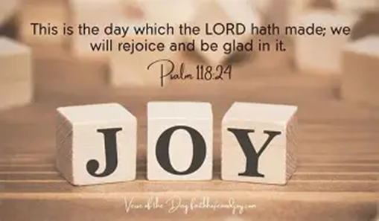
In this Psalm Are 7 Things
We All Need
When These Are Present
It Produces
Overwhelming
Peace
Joy
No Matter the Circumstances

Slide 10
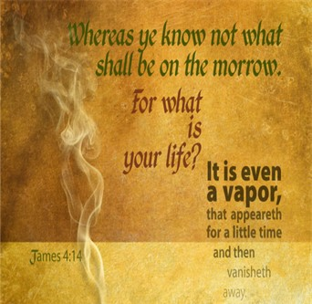
#1- God’s Challenge
This Psalm Presents Us w- a Powerful Challenge
One That Could Not only Change Our Lives
And Improve Our Lives
It Could Even Save Our Lives
The Challenge is to Live in the Present
In This Moment
Impossible to Live More than One Day At a Time

Slide 11
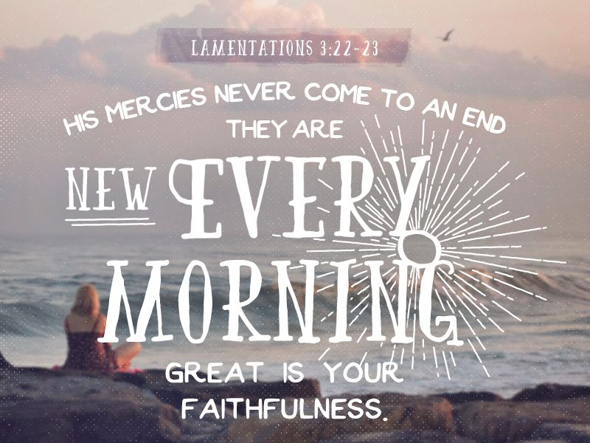
#2- Focus on His Compassion (1-2)
Mercy= With Hold What I Deserve
Amazing This Psalm Starts With Mercy
Too Many Are Focused On Yesterday …
Mistakes, Sins, Bad Decisions
Lamentations 3:22-23 NKJ
²² Through the Lord’s mercies we are not consumed, Because His compassions fail not. ²³ They are new every morning; Great is Your faithfulness.

Slide 12

#3- Stand in Confidence
“The Lord is for me.” (6)
As The Psalmist Penned the Words of this Psalm,
He Understood …
World Was Against Him.
Devil Was Against Him.
His Own People Were Against Him.
But He Knew God Was For Him.
When the Lord is On Our Side There Are…
…No Circumstances Too Great for Us to Handle.

Slide 13
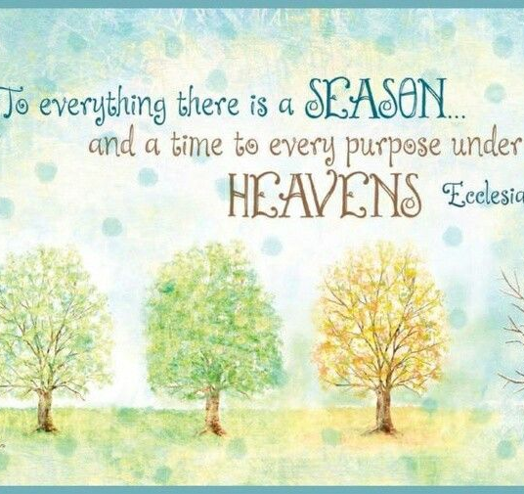
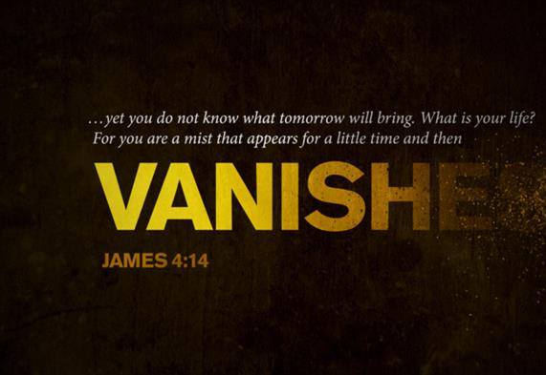
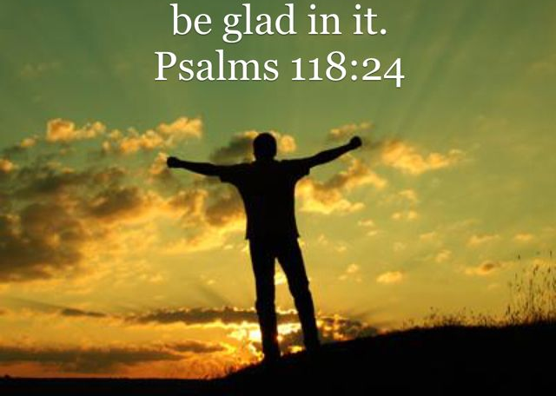
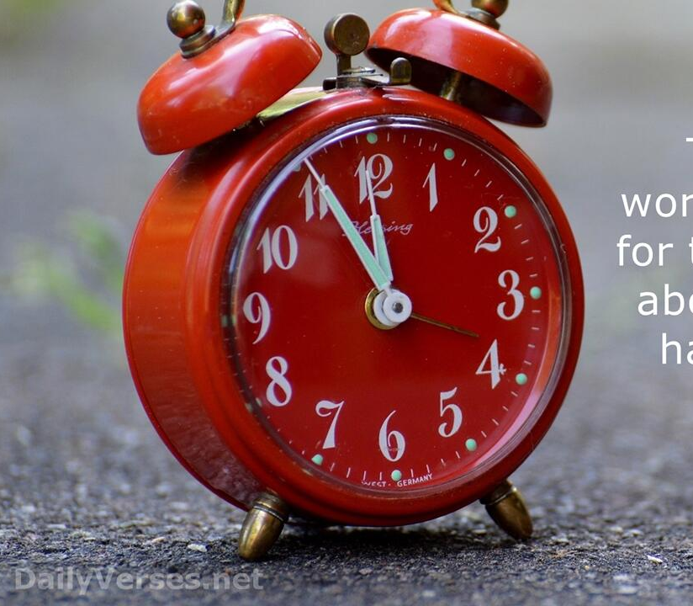
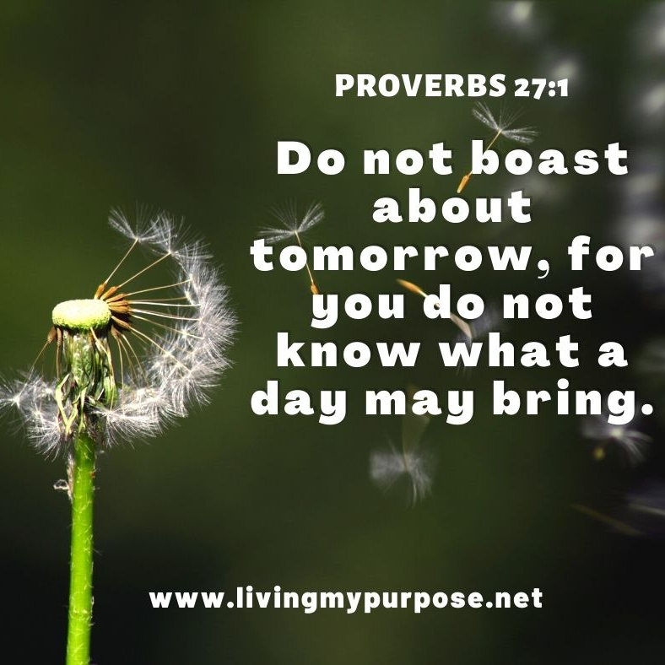
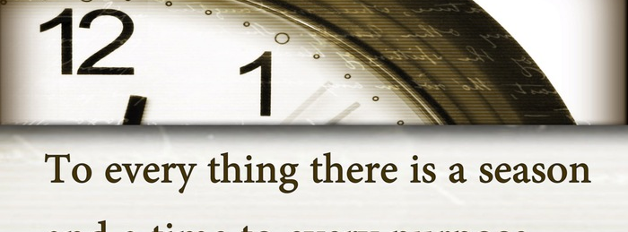
Weeks Challenge… Face These Challenges
Begin Each Morning by Acknowledging the Day as a Gift.
Reflect on Specific Blessings
(health, relationships, opportunities)
Shift Focus to Challenges Found in this Psalm
Challenge Your Self to Accept and Practice Them

Slide 15
A husband, who is not the most outgoing guy, relents to his wife's months of nagging to take her out dancing.
During the evening one guy on the dance floor is giving it large - break dancing, moon walking, back flips, the works.
Seeing this performance, the wife turns to her husband and says: "See that guy? 25 years ago he proposed to me and I turned him down."
Her husband replies, "Looks like he's still celebrating!!!"

