Slide 1
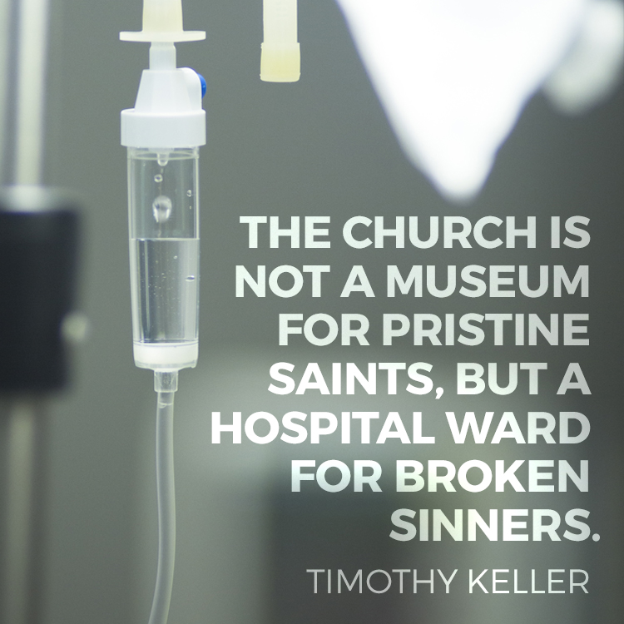

Slide 2
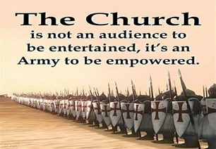
Repeat
These are the 2 Most Important Hours
of My Week
– Help Me to Cherish Them
I Am Here Today to Worship
Not to Be Entertained
I Am Singing to An Audience of One
Accept My Worship Oh Lord!

Slide 3
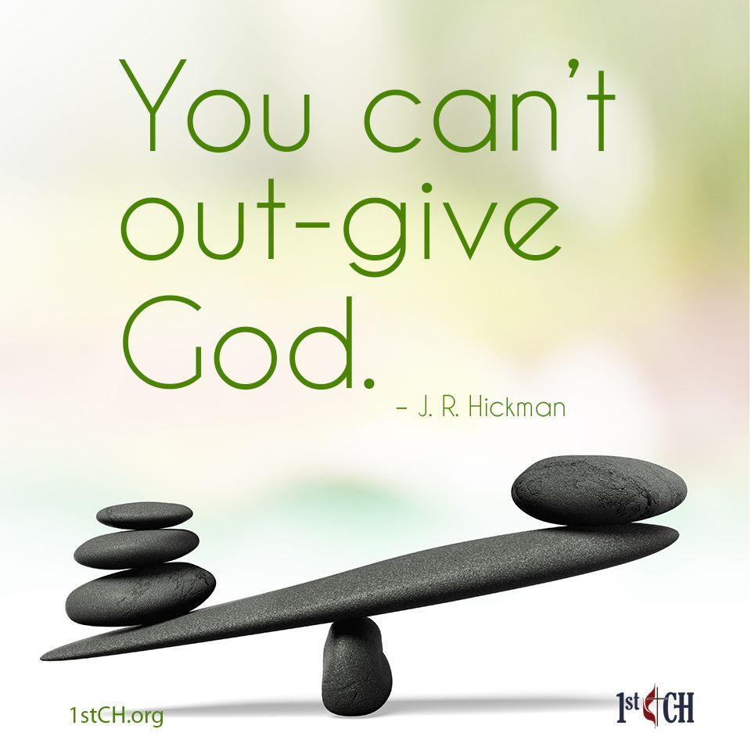
Repeat
I Lift My Offering to You
Let It Please You Oh Lord
This is My Seed
Although It Leaves My Hand
It will Never Leave My Life
You Will Multiply It!
Accept My Seed Oh Lord!

Slide 5
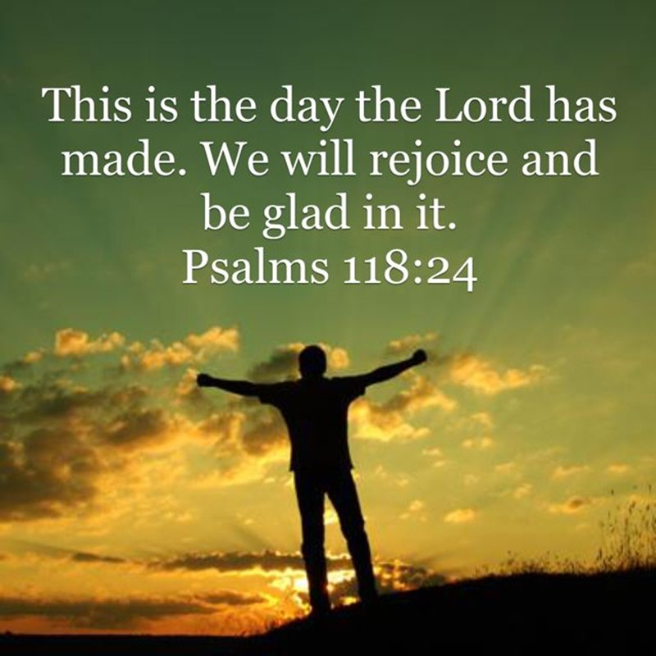
This is the Day –pt3
Edward Church
August 3, 2025
Psalm 118:24

Slide 6
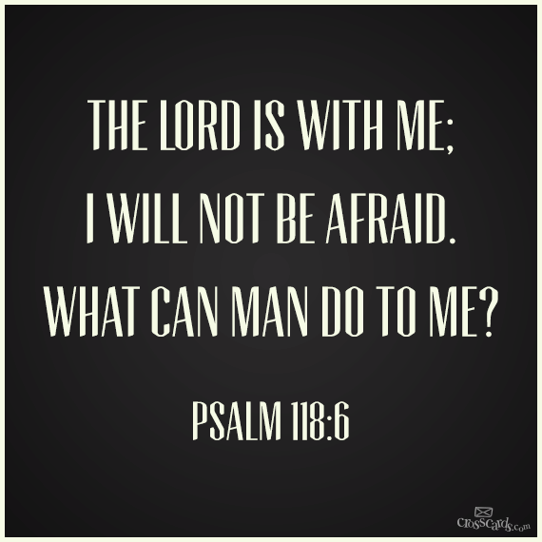
What a Powerful Reminder that Every Day is a Gift from God
Every Moment an Opportunity to Rejoice in His Goodness
Recognize His Hand in Our Lives
In the Light or in the Dark
Rest Assured that the Lord Is With Us
…He Is For Us
…Working All Things Together for Our Good

Slide 7
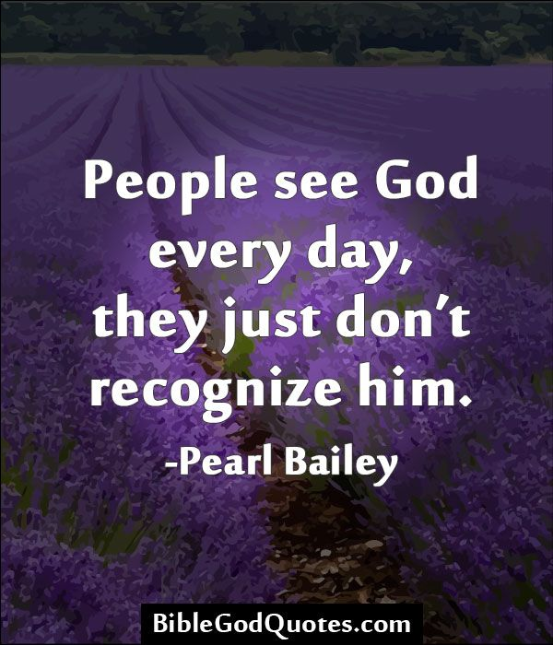
Recognizing the Lord in Every Experience
In The Hustle And Bustle of Our Daily Lives…
…It's Easy to Lose Sight Of God's Presence.
Caught Up In Routines, Worries, Ambitions
Forgetting God Is Right There With Us,

Slide 8
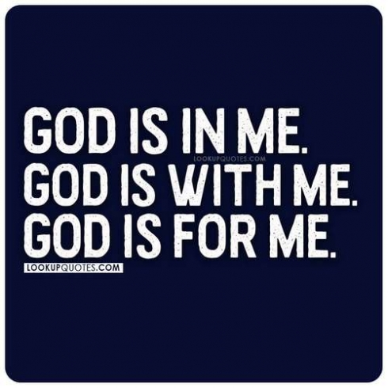
Recognizing the Lord in Every Experience
Every Moment, Every Experience.
He's There When We Wake Up,
When We Lay Down
He's There In Our Joys / Sorrows…
…In Our Victories / Defeats.

Slide 9
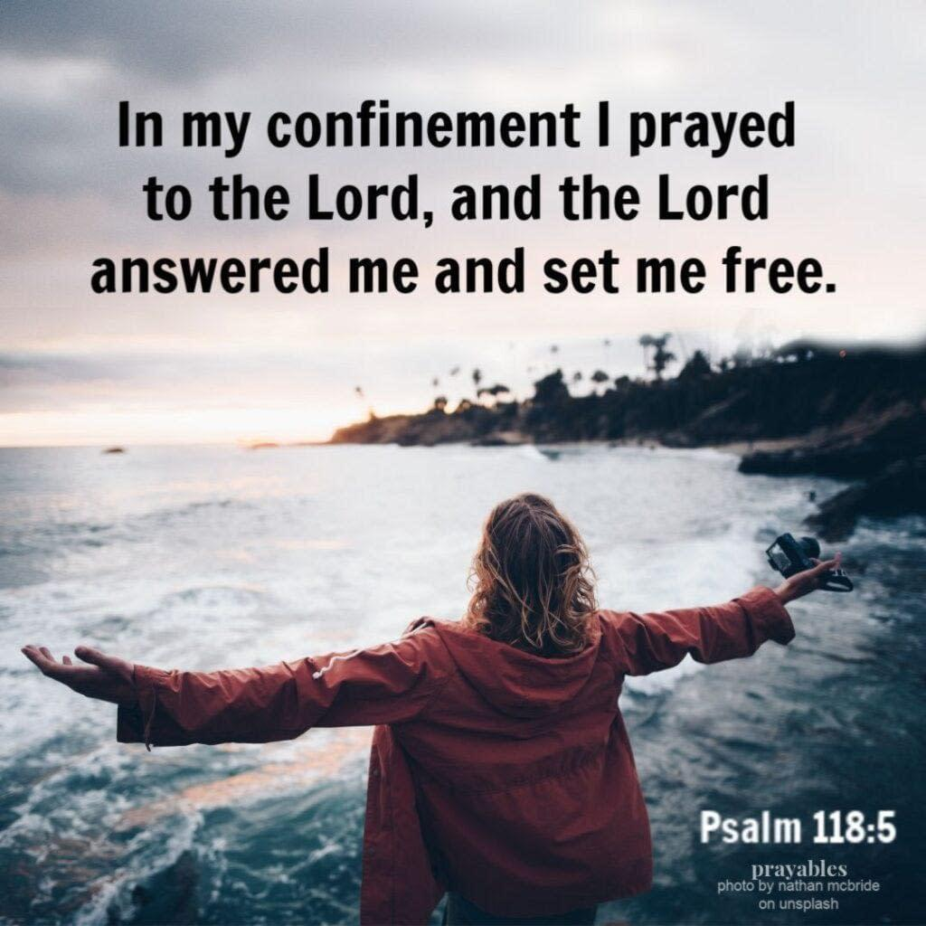
Lying Behind the Praise in this Psalm
there Appears to Be a Great Deal of Pain
“In my anguish I cried to the LORD,
and he answered by setting me free.” (5)
Then in verses 10-13
“All nations surrounded me, but …name of the LORD I cut them off.
They surrounded me on every side…name of the LORD I cut them off.
They swarmed around me like bees, but they died out as quickly as burning thorns; in the name of the LORD I cut them off.
I was pushed back and about to fall, but the LORD helped me.

Slide 10
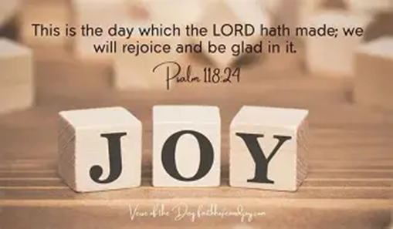
In this Psalm Are 7 Things
We All Need
When These Are Present
It Produces
Overwhelming
Peace
Joy
No Matter the Circumstances

Slide 11
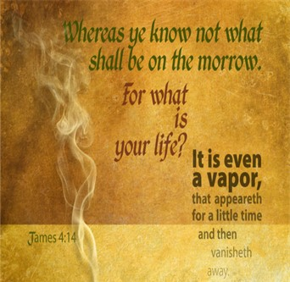
#1- God’s Challenge
This Psalm Presents Us w- a Powerful Challenge
One That Could Not only Change Our Lives
And Improve Our Lives
It Could Even Save Our Lives
The Challenge is to Live in the Present
In This Moment
Impossible to Live More than One Day At a Time

Slide 12
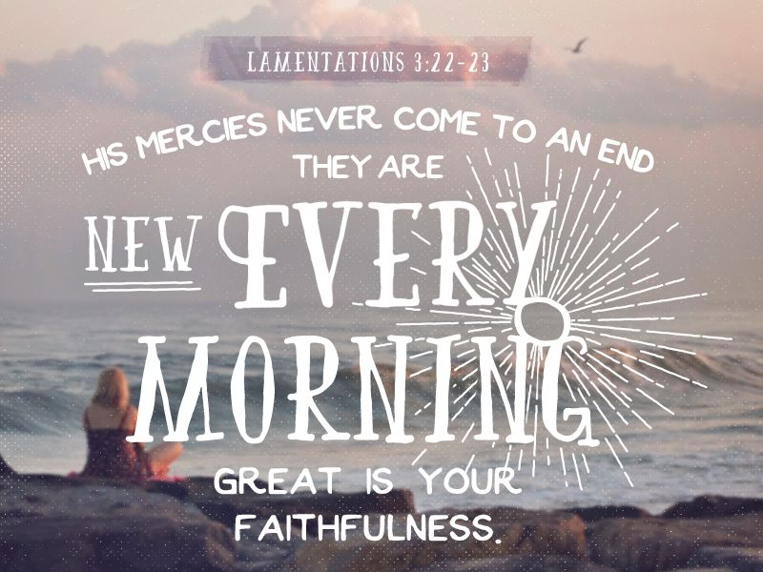
#2- Focus on His Compassion (1-2)
Mercy= With Hold Punishment I Deserve
Amazing This Psalm Starts With Mercy
Too Many Are Focused On Yesterday …
Mistakes, Sins, Bad Decisions
Lamentations 3:22-23 NKJV
²² Through the Lord’s mercies we are not consumed,
Because His compassions fail not.
²³ They are new every morning;
Great is Your faithfulness.

Slide 13

#3- Stand in Confidence
“The Lord is for me.” (6)
As The Psalmist Penned the Words of this Psalm,
He Understood …
World Was Against Him.
Devil Was Against Him.
His Own People Were Against Him.
But He Knew God Was For Him.
When the Lord is On Our Side There Are…
…No Circumstances Too Great for Us to Handle.

Slide 14
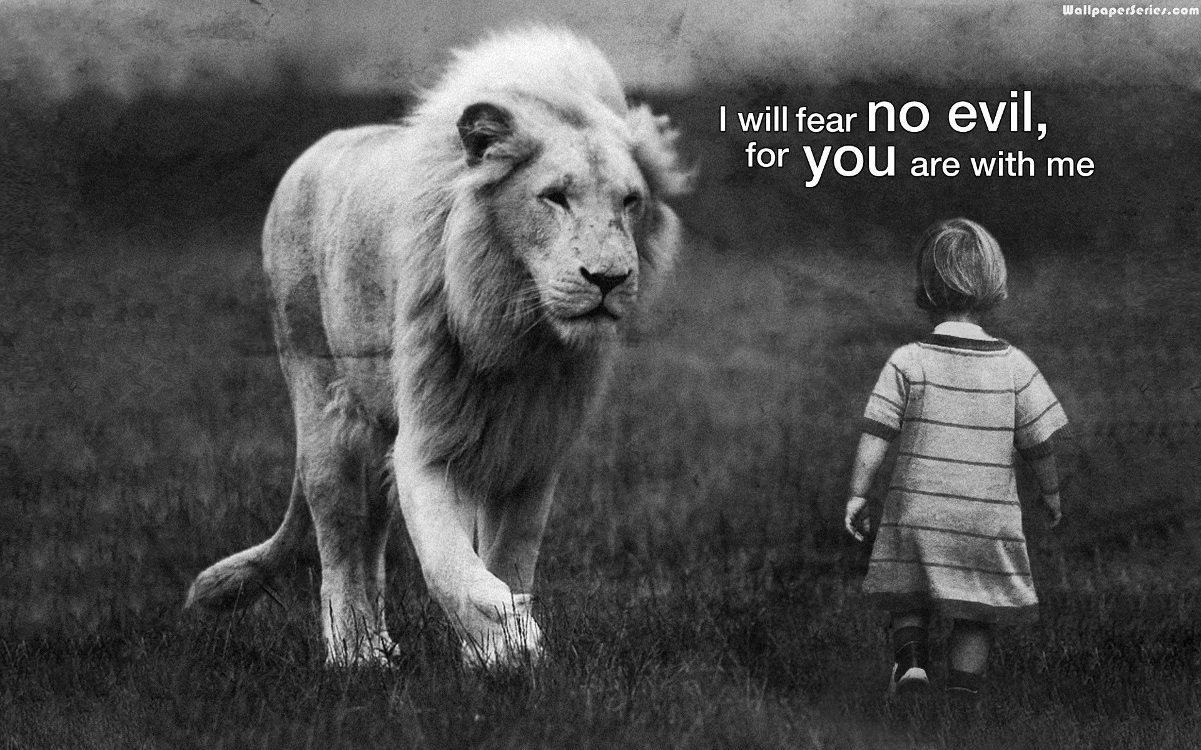
#4- Approach Each Day With Courage
“I will not fear; What can man do to me.” (6)
The psalmist did not say that he should not suffer,
…but that he would not fear.
He understood that God’s love for him
…outweighed man’s hatred of him.
Therefore, setting God’s love over against man’s hatred,
…he felt that he had no reason to be afraid.

Slide 15
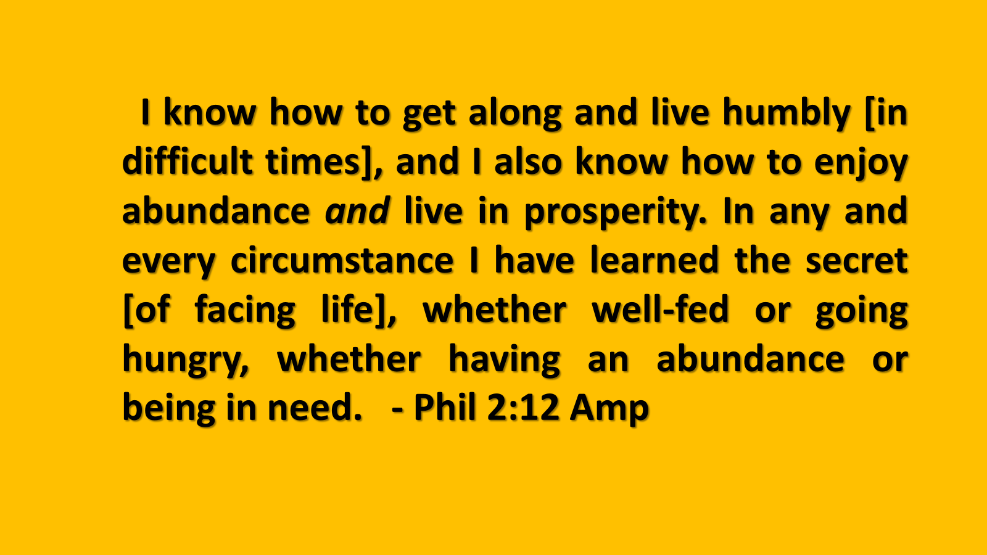
#5- Approach Each Day With Contentment
“This is the day which the Lord has made;
Let us rejoice and be glad in it.” (24)
Contentment was meant to be a part of our life each day
This means that even the days of adversity…
…are meant to be days of contentment.
Jesus sang the night he instituted the Lord’s Supper,
…he gave testimony of contentment while facing death.
All experiences of life, the shade, the showers, and the sunshine
…Are Working Together For Our Good

Slide 16
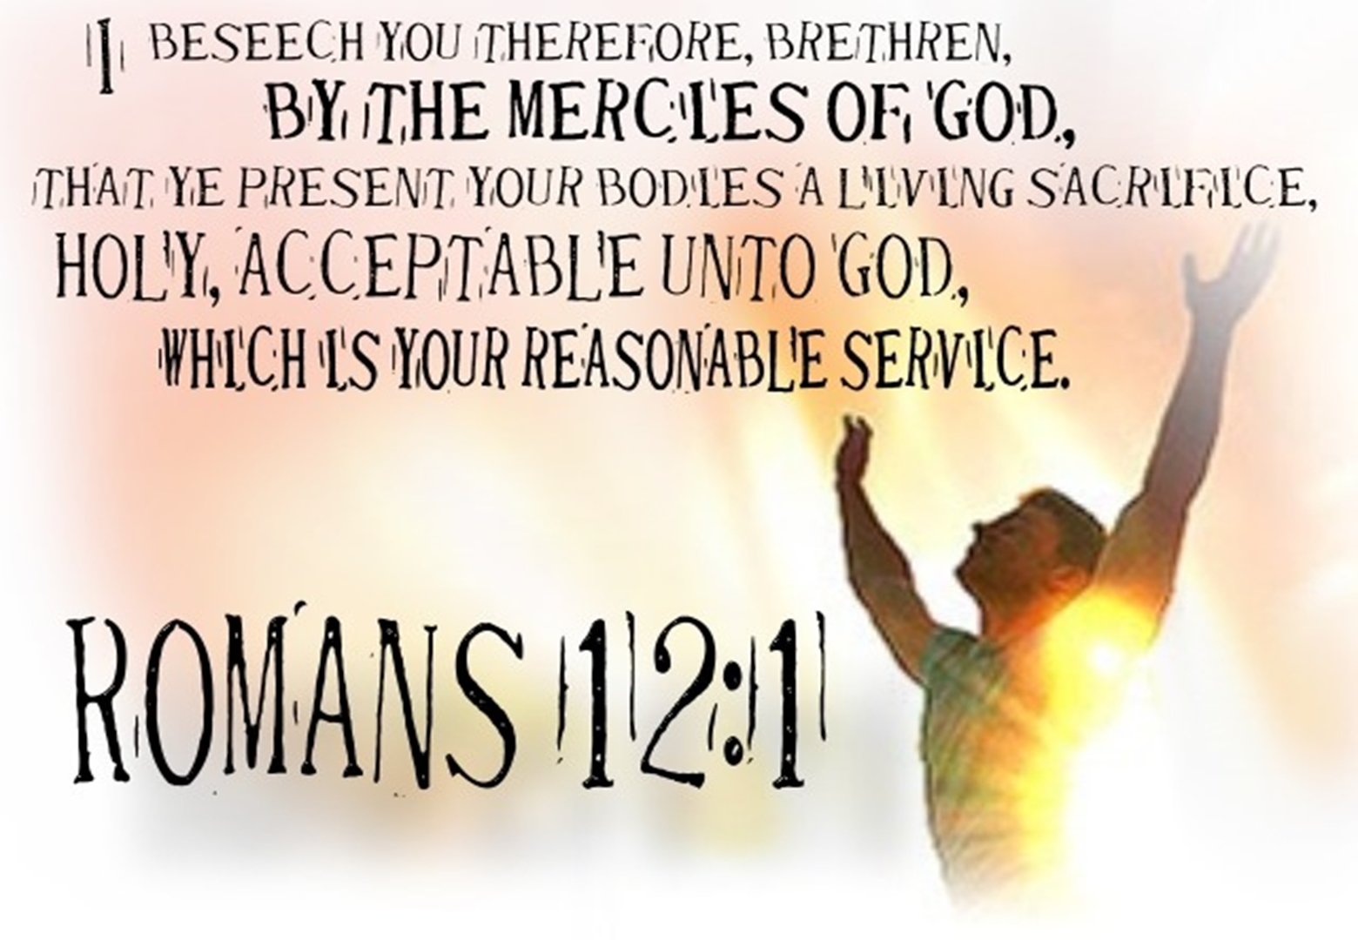
#6- Approach Each Day With Commitment
“Bind the festival sacrifice with cords
to the horns of the altar.” (27)
The word sacrifice has to do with more than just dying;
…it also has to do with living.
Romans 12:1
So here’s what I want you to do, God helping you: Take your everyday, ordinary life—your sleeping, eating, going-to-work, and walking-around life—and place it before God as an offering. Embracing what God does for you is the best thing you can do for him.

Slide 17
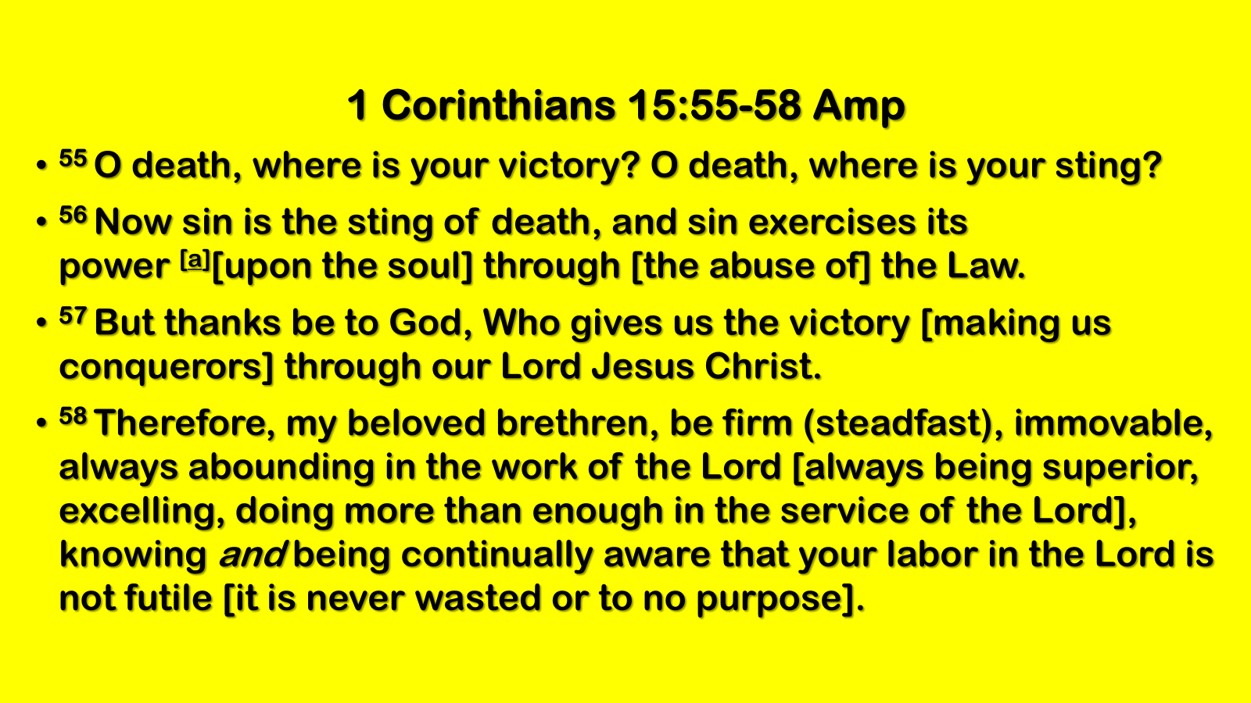
#7- Approach Each Day With Conquest
“I shall not die, but live, And tell of the works of the Lord.” (17)
The psalmist saw death, but death slain
He saw the grave, but the grave had been robbed
He saw judgment silenced, and hell defeated
What men call death, God has made the gateway to life
“Therefore, my beloved brethren, be steadfast, immovable, always abounding in the work of the Lord, knowing that your toil is not in vain in the Lord. Thanks be to God, who giveth us the victory through or Lord Jesus Christ” -1 Corinthians 15:58, NASB

Slide 18
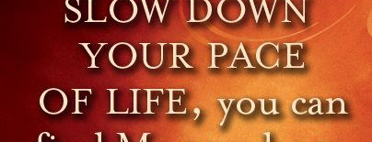
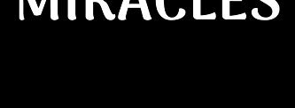
Week’s Challenge… Face These Challenges
  Begin Each Morning by Acknowledging the Day as a Gift.
  Reflect on Specific Blessings
  (health, relationships, opportunities)
  Shift Focus to Challenges Found in this Psalm
  Challenge Your Self to Accept and Practice Them

Slide 20
Boss: You got your hair cut on company time?!
Susie: It grew on company time.
Boss: Not all that hair!
Susie: I didn't get it all cut.
I know a rancher who lets his cows roam anywhere they wish. He lets the chips fall where they may.

