Slide 1
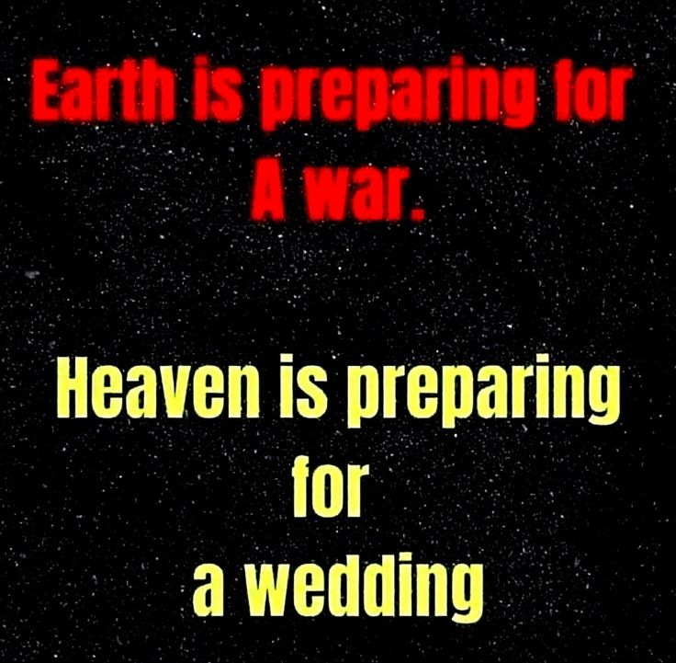

Slide 2

Spiritual Warfare
10% Satan’s Tactics
90% How We Respond
Remember… With God We Are Not
Helpless
Hopeless
We Are Powerful!!

Slide 3
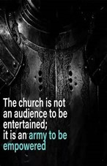
Repeat
These are the 2 Most Important Hours of My Week – Help Me to Cherish Them
I Am Here Today to Worship
Not to Be Entertained
I Am Singing to An Audience of One
Accept My Worship Oh Lord!

Slide 4

Repeat
I Lift My Offering to You
Let It Please You Oh Lord
This is My Seed
Although It Leaves My Hand
It will Never Leave My Life
You Will Multiply It!
Accept My Seed Oh Lord!

Slide 6

“Rebuilding Your Focus” pt2
Edward Christian Church
August 17, 2025
Philippians 3:13-14
10 Rebuild Points

Slide 7

Rebuild My Focus
God Uses Rebuild Mode
Draw Us Out
  Complacency
  Collapse
Draw Out of Us
  Freshness
  Further

Slide 8

Rebuilding Our Focus
Our Focus Should Start on God / His…
Word -Quick/ Powerful –not come back void
Ability -is anything too hard?
Mission -Seek and Save

Slide 9


Distraction
Any Type of…
  Activity
  Action
  Attitude
that Consumes…
      You
      Time
      Interest
…to the Point God Becomes a Blur

Slide 10


One of Satan’s Chief Tools
It is a…
Subtle Tool
  It Sneaks Up So Soft It Is Unnoticeable
Deceptive Tool
  It Makes You Feel Effective (temporarily)
Patient Tool
  Like a Trap Waiting to Be Sprung
Cooling Tool
  Cools you Down/ Keeps you Down or
  Prevents You From Getting Hot/ Effective

Slide 11

Our Focus has Unlimited Value
Satan Doesn’t Want us to Realize the…
Potential
Power
Position
...of an Undivided Focus
10 Focal Points

Slide 12
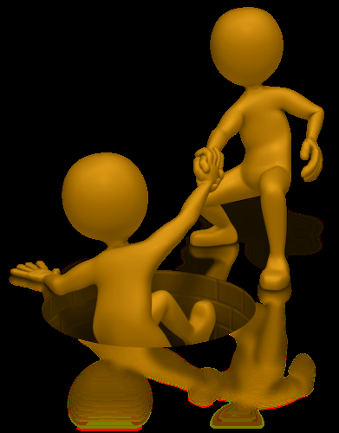
#1- He Called You…
…it Wasn’t to Get to this Place so He Can
…Drop You! (Our Position)
Philippians 1:6 (AMP)
⁶ And I am convinced and sure of this very thing, that He Who began a good work in you will continue until the day of Jesus Christ [right up to the time of His return], developing [that good work] and perfecting and bringing it to full completion in you.
#2- He Will Build His Church! (Our Power)
Matt 16:18 (AMP) ¹⁸ And I tell you, you are Peter [Greek, Petros-a large piece of rock], and on this rock [Greek, petra-a huge rock like Gibraltar] I will build My church, and the gates of Hades (the powers of the infernal region) shall not overpower it [or be strong to its detriment or hold out against it].

Slide 13
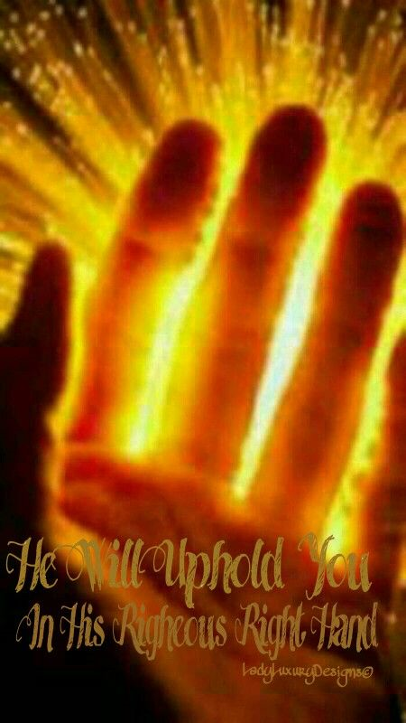
#3- He Did Not Promise to Deliver you From
the Fire, but to Walk with You Through It!
(Our Protection-His Presence)
¹ But now thus saith the LORD that created thee, O Jacob, and he that formed thee, O Israel, Fear not: for I have redeemed thee, I have called thee by thy name; thou art mine. ² When thou passest through the waters, I will be with thee; and through the rivers, they shall not overflow thee: when thou walkest through the fire, thou shalt not be burned; neither shall the flame kindle upon thee. Isaiah 43:1-2 (KJV)
#4- There is More in Store for...
...Your Life/ Ministry! (Our Potential)
Hosea 10:12- Break Up Your Fallow Ground

Slide 14

#5- When We Obey the Voice of God…
…We Are Unstoppable (Our Persevering)
So shall My word be that goes forth out of My mouth: it shall not return to Me void [without producing any effect, useless], but it shall accomplish that which I please/ purpose,/ it shall prosper in the thing for which I sent it. Isa 55:11 (AMP)

Slide 15
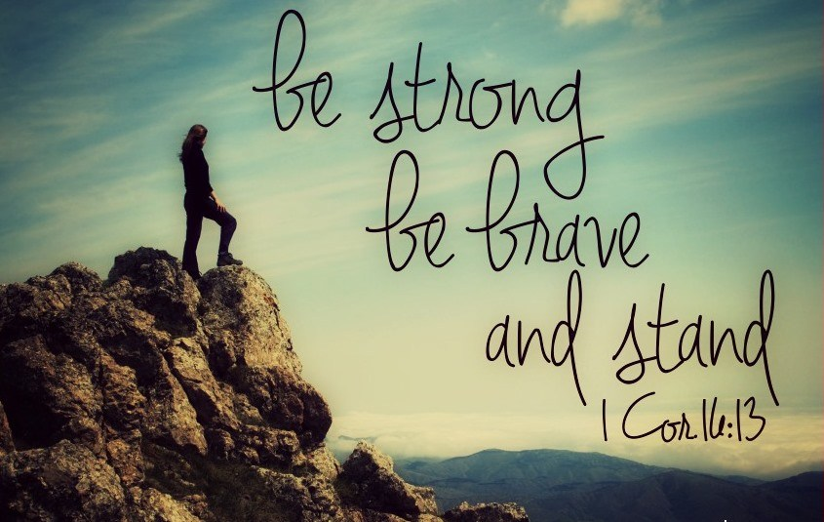
#6 –Have Courage, Be Strong, Don’t Back Down or Give In to Satan/ His Plan! (Stand)
¹³ Watch ye, stand fast in the faith, quit you like men, be strong. 1 Cor 16:13 (KJV)
  Watch ye- be on guard– Satan desires to attack
  Stand Fast in the Faith- persevere, do not deviate in trust
  Quit you like Men- to act in a mature manner –not tossed
  Be Strong- be strengthened in the Lord

Slide 16
#7 –God Didn’t Call You Because of Your Greatness but His…
He’s Still Great Even at Times…
You May Feel Like You are Not! (Understand)
2 Corinthians 4…
(1) Therefore seeing we have this ministry, as we have received mercy, we faint not;
(7) But we have this treasure in earthen vessels, that the excellency of the power may be of God, and not of us
Ask a shepherd boy as he stood over Mighty Goliath
Ask a Prisoner as he stood as Prime Minister over Egypt!

Slide 17

#8 –This Problem Will Not Destroy You! (Withstand)
2 Corinthians 4:8-9 (AMP)
⁸ We are hedged in (pressed) on every side [troubled and oppressed in every way], but not cramped or crushed; we suffer embarrassments and are perplexed and unable to find a way out, but not driven to despair;
⁹ We are pursued (persecuted and hard driven), but not deserted [to stand alone]; we are struck down to the ground, but never struck out and destroyed;

Slide 18
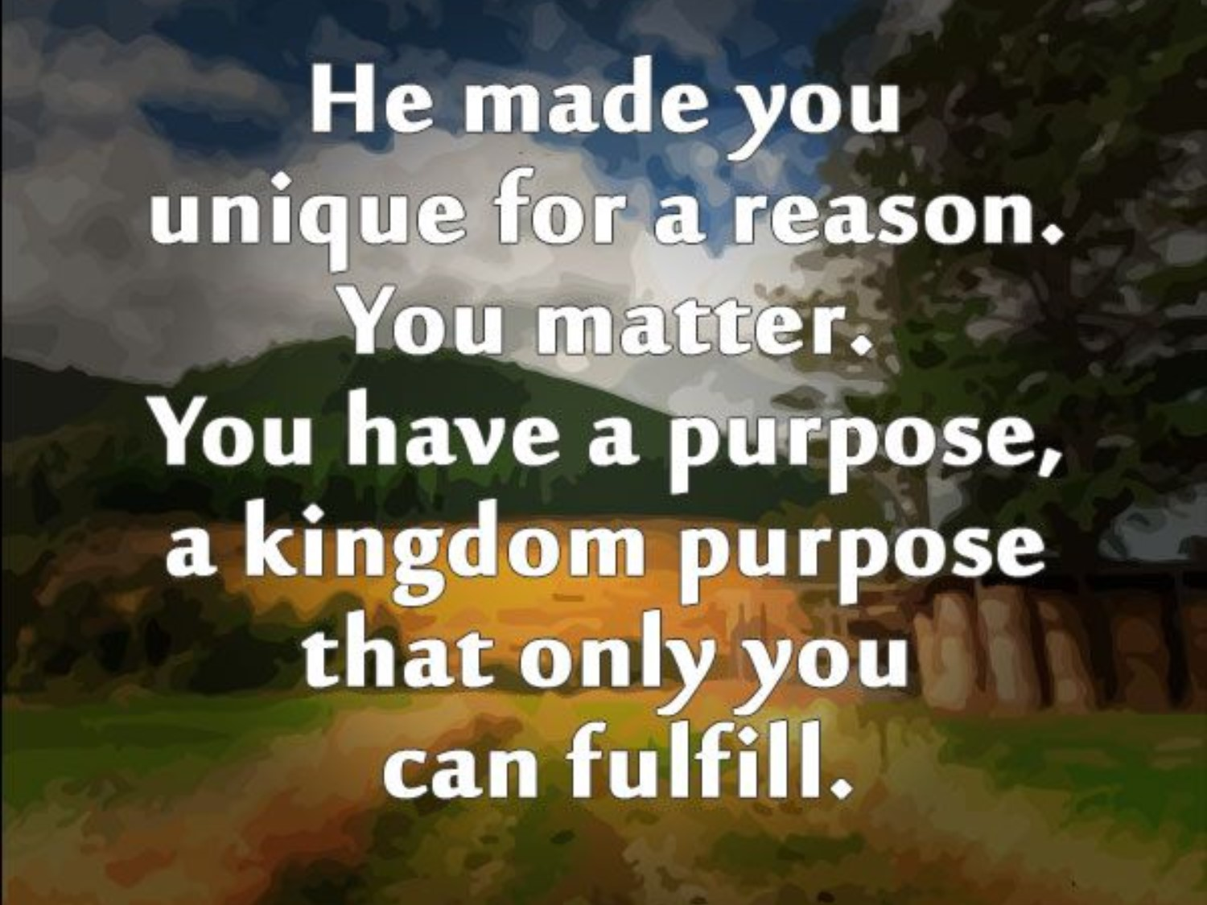
#9 –Stop Comparing Yourself to Others…
…Same God Who Called/ Empowered Them
…Did the Same for You! –
(Stand Up)
¹⁴ Thank you for making me so wonderfully complex! Your workmanship is marvelous—how well I know it. Psalm 139:14 (NLT)
⁸ For He Who motivated and fitted Peter and worked effectively through him for the mission to the circumcised, motivated and fitted me and worked through me also for [the mission to] the Gentiles. Galatians 2:8 (AMP)

Slide 19
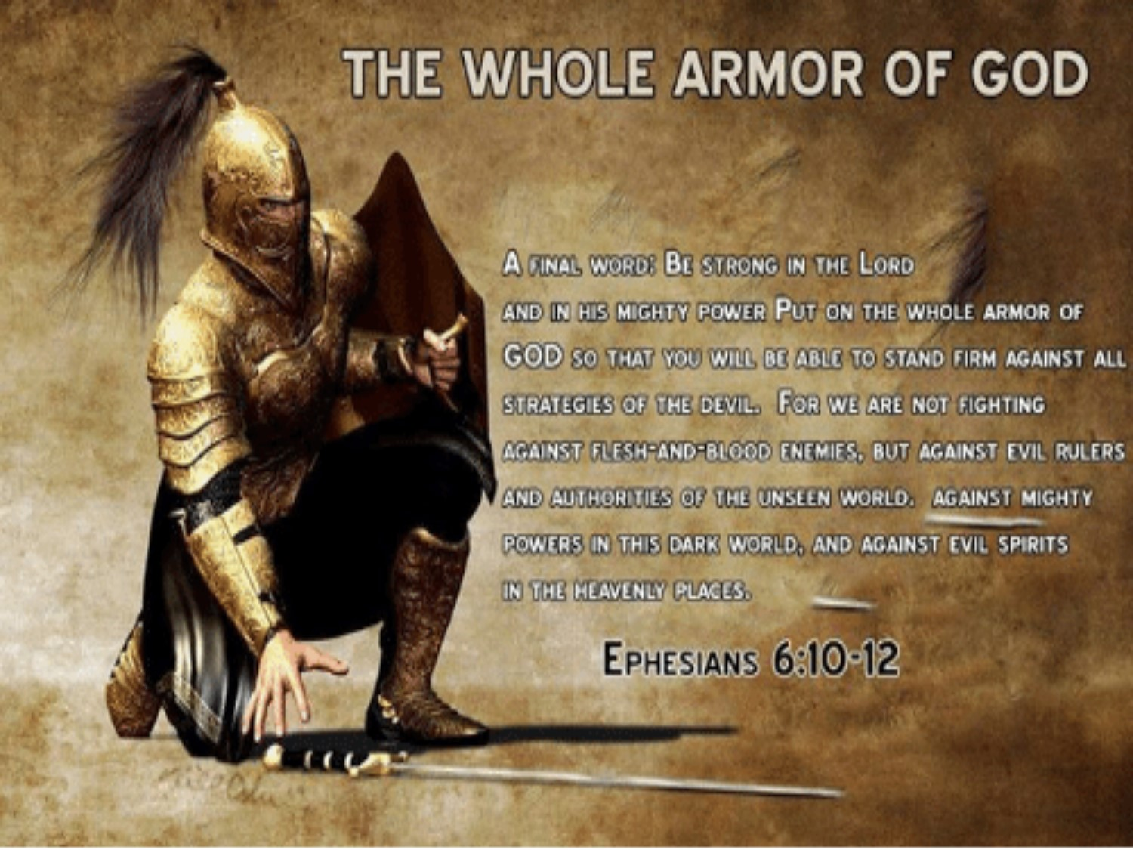
#10 –Stop Praying for…
…Protection(defense)…ONLY
…Pray For Boldness(offense)!!!
(Stand Strong)
Acts 4:29-31 (AMP)
²⁹ And now, Lord, observe their threats and grant to Your bond servants [full freedom] to declare Your message fearlessly, ³⁰ While You stretch out Your hand to cure and to perform signs and wonders through the authority and by the power of the name of Your holy Child and Servant Jesus. ³¹ And when they had prayed, the place in which they were assembled was shaken; and they were all filled w- the Holy Spirit, /they continued to speak the Word of God with freedom / boldness / courage.

Slide 20

Don’t Focus On
  Problems
  Pain
  Panic
Focus Instead
  Promise
  Power
  Peace

Slide 21

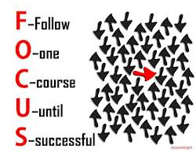
This Week’s Challenge
Make a Conscious Effort to…
Examine Your Focus
Expect Distractions
Eliminate the Unnecessary
Examine Your Focus Again
Expect God to Use You…
…As You Hone-in Your Focus
…Like Never Before

Slide 23
A young couple moves into a new neighborhood.
The next morning while they are eating breakfast, the young woman sees her neighbor hanging the wash outside. "That laundry is not very clean," she said. "She doesn't know how to wash correctly. Perhaps she needs better laundry soap." Her husband looked on, but remained silent. Every time her neighbor would hang her wash to dry, the young woman would make the same comments. About one month later, the woman was surprised to see a nice clean wash on the line and said to her husband: "Look, she has learned how to wash correctly. I wonder who taught her this?“ The husband said, "I got up early this morning and cleaned our windows."

