Slide 1
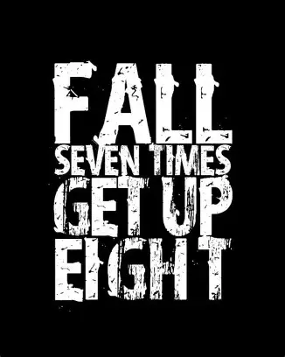

Slide 2
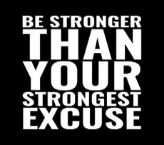
Spiritual Warfare
10% Satan’s Tactics
90% How We Respond
Remember…
With God We Are Not
Helpless
Hopeless
We Are Powerful!!

Slide 3
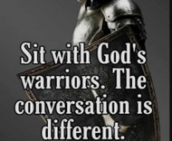
Repeat
These are the 2 Most Important Hours of My Week – Help Me to Cherish Them
I Am Here Today to Worship
Not to Be Entertained
I Am Singing to An Audience of One
Accept My Worship Oh Lord!

Slide 4
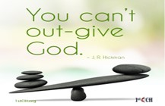
Repeat
I Lift My Offering to You
Let It Please You Oh Lord
This is My Seed
Although It Leaves My Hand
It will Never Leave My Life
You Will Multiply It!
Accept My Seed Oh Lord!

Slide 6
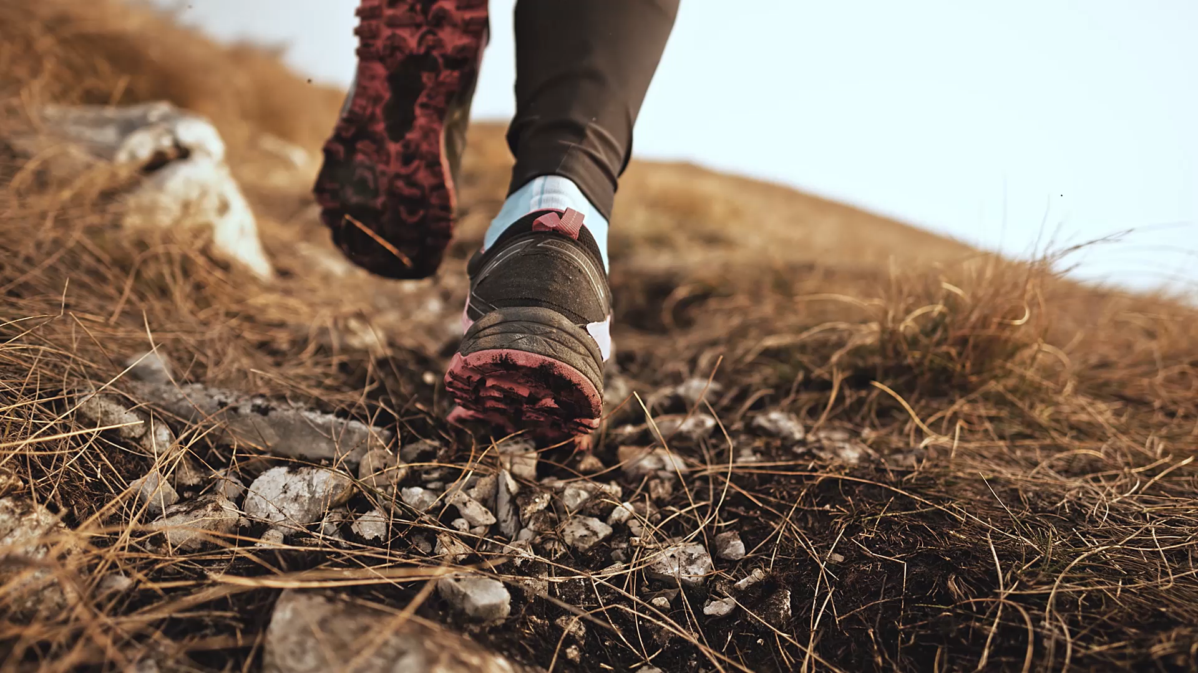
Recovery -pt1
12 Steps to Find Peace
Edward Church
August 24, 2025
Psalm 139:14

Slide 7
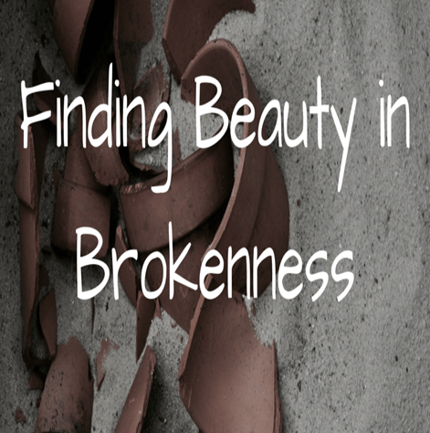
The Beauty Beneath the Brokenness
Recovery is not just about healing what’s broken...
…it’s about rediscovering what was never lost:
…your God-Given Worth

Slide 8
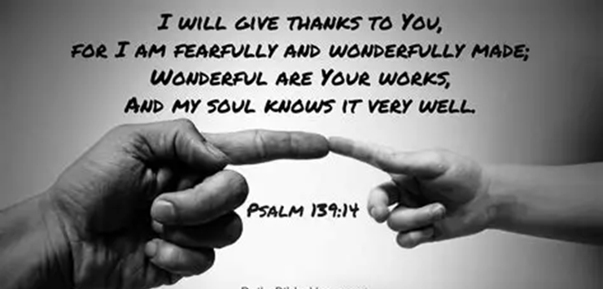
The Beauty Beneath the Brokenness
Psalm 139:14 reminds us that we are wonderfully
complex, marvelously made, and deeply known by God.
Even When We Feel Shattered…
…God Sees the Masterpiece Beneath the Mess.
This is the Heart of Recovery
Embracing God’s Design for Us Can Lead to...
Restoration, Renewal, and Hope.

Slide 9
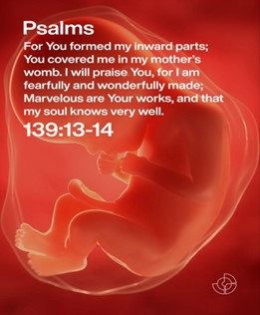
Point 1: You Are Not a Mistake — You Are Marvelous
The psalmist doesn’t say,
“I used to be marvelous.”
He says, “Your workmanship is marvelous…
…how well I know it.”
Recovery begins when we stop believing the lie
that Our Pain Defines Us.
Addiction, Trauma, Depression
these are Chapters in Your Story, Not Your Identity.

Slide 10
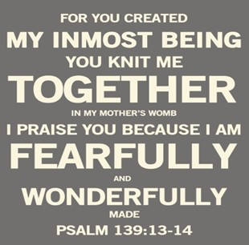
Point 1: You Are Not a Mistake — You Are Marvelous
God’s craftsmanship didn’t disappear when you fell.
  It’s still there, waiting to be reclaimed.
Declaration:
“I am not my past. I am God’s workmanship.”

Slide 11
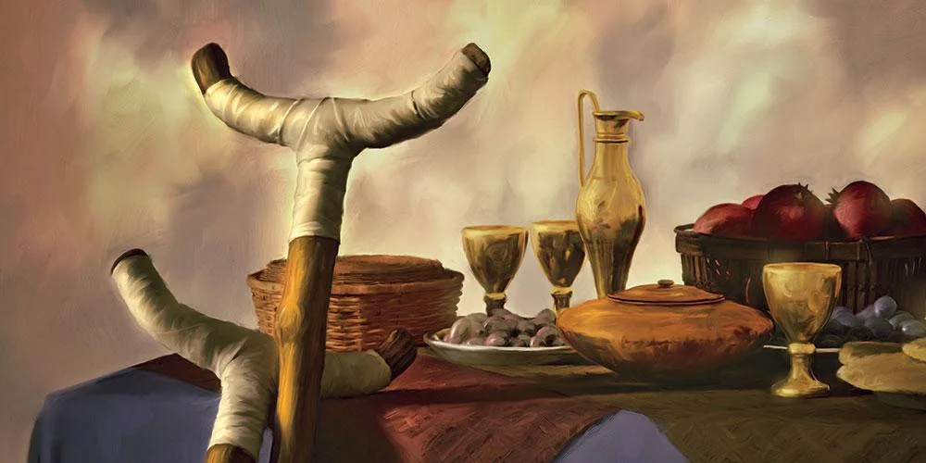
Truth from Psalm 139:14
“Your workmanship is marvelous…”
Emphasizes that God’s Design is…
…Intentional, Not Accidental
Mephibosheth (2 Samuel 9)
Crippled, Forgotten, Yet Invited to Dine at King’s Table.
“Do Not Be Afraid… You Will Always Eat At My Table.”
Recovery Principle
Your Brokenness Doesn’t Make You Less Worthy.
God Restores Dignity, Not Based On Performance, But Identity.

Slide 12
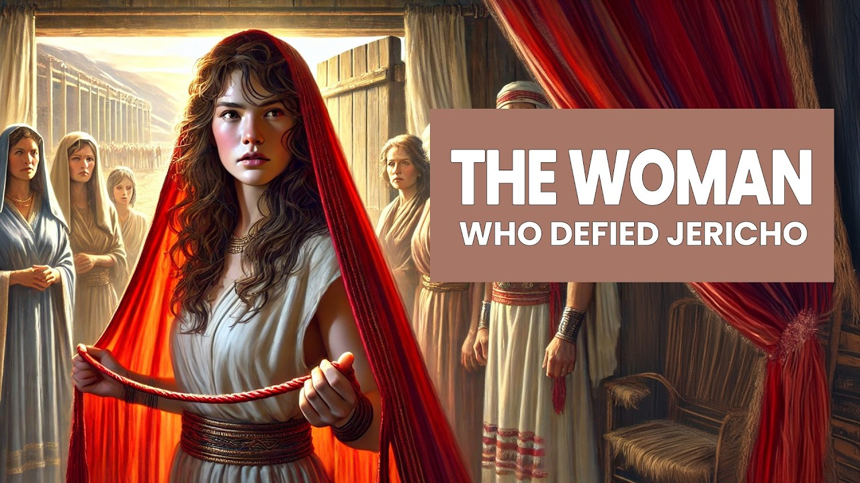
Rahab (Joshua 2; Matthew 1:5)
  A Canaanite Prostitute Who Helped Israel’s Spies
…Became Part of the Lineage Of Jesus
Recovery Principle
Your Past Doesn’t Disqualify You From God’s Plan
..You Are Part of His Marvelous Workmanship.
Joshua 6:22-23 NLT
²² Meanwhile, Joshua said to the two spies, “Keep your promise. Go to the prostitute’s house and bring her out, along with all her family.”
²³ The men who had been spies went in/ brought out Rahab, her father, mother, brothers, / all the other relatives who were with her. They moved her whole family to a safe place near the camp of Israel.

Slide 13
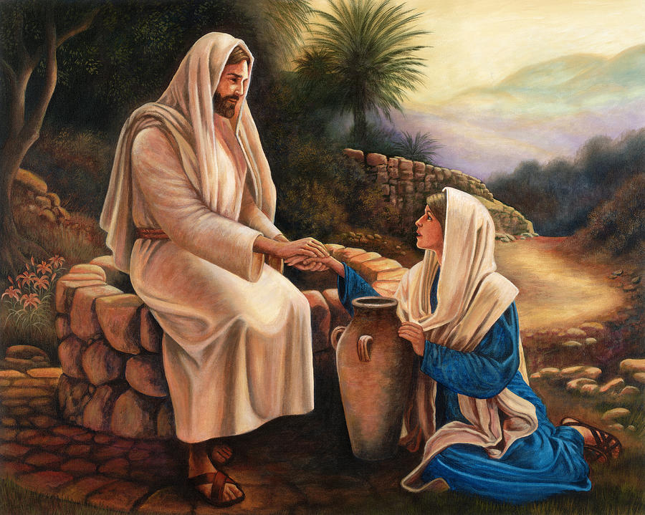
The Woman at the Well (John 4)
A Samaritan Woman with a Complicated Past Meets Jesus
…Who Sees Her Fully and Offers Living Water
Recovery Principle
  Jesus Doesn’t Flinch At Our Brokenness…
…He Meets Us There And Reveals Our True Value
John 4:28-30 NLT
²⁸ The woman left her water jar beside the well and ran back to the village, telling everyone, ²⁹ “Come and see a man who told me everything I ever did! Could he possibly be the Messiah?” ³⁰ So the people came streaming from the village to see him

Slide 14
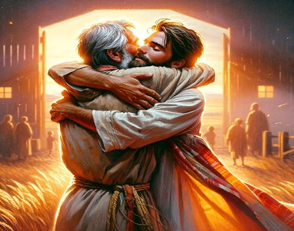
The Prodigal Son (Luke 15:11–32)
  The Son Squandered Everything,
…Yet The Father Ran To Him With Open Arms.
Recovery Principle
Even When We Feel Unworthy,
…God Sees Us as Marvelous and Welcomes Us Home.
Luke 15:17-20 Amp
¹⁷ Then when he came to himself, he said, How many hired servants of my father have enough food, and [even food] to spare, but I am perishing (dying) here of hunger! ¹⁸ I will get up and go to my father, and I will say to him, Father, I have sinned against heaven and in your sight. ¹⁹ I am no longer worthy to be called your son; [just] make me like one of your hired servants.²⁰ So he got up and came to his [own] father. But while he was still a long way off, his father saw him and was moved with pity and tenderness [for him]; and he ran and embraced him and kissed him [^{[a]}fervently].

Slide 15
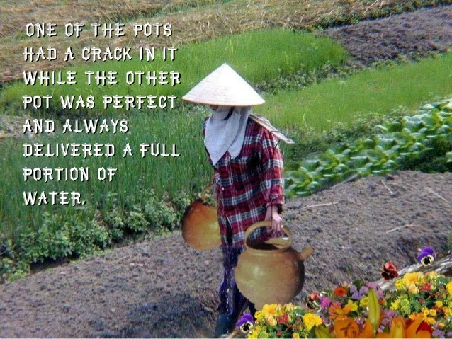
The Cracked Pot
A well-known parable from Eastern tradition: A water bearer had two pots, one perfect and one cracked. The cracked pot leaked water along the path. One day, the pot apologized for its flaws. The bearer replied, “Look at the flowers on your side of the path — I planted seeds there, and you watered them every day.”
Recovery Principle
Our Cracks Don’t Disqualify Us…
…They Allow Beauty To Grow In Unexpected Places.

Slide 17
The Baptist minister had been summoned to the bedside of a Presbyterian woman who was quite ill. As he went up the walk, he met the little daughter of the woman and said to her, "I'm very glad your mother remembered me in her illness. Is your minister out of town?"
"No," answered the child. "He's at home, but we thought it might be something contagious, and we didn't want to expose him to it."

