Slide 1
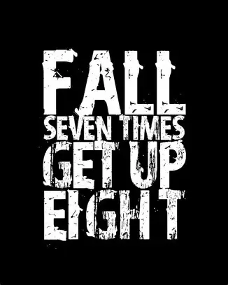

Slide 2
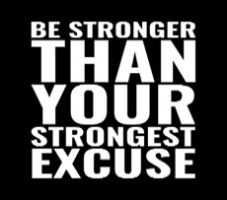
Spiritual Warfare
10% Satan’s Tactics
90% How We Respond
Remember…
With God We Are Not
Helpless
Hopeless
We Are Powerful!!

Slide 3
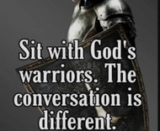
Repeat
These are the 2 Most Important Hours of My Week – Help Me to Cherish Them
I Am Here Today to Worship
Not to Be Entertained
I Am Singing to An Audience of One
Accept My Worship Oh Lord!

Slide 4

Edward Christian Church
8/31/2025

Slide 5

Repeat
I Lift My Offering to You
Let It Please You Oh Lord
This is My Seed
Although It Leaves My Hand
It will Never Leave My Life
You Will Multiply It!
Accept My Seed Oh Lord!

Slide 7

Recovery 12 Steps to Find Peace
Edward Church
August 31, 2025
Psalm 139:14 –pt2

Slide 8
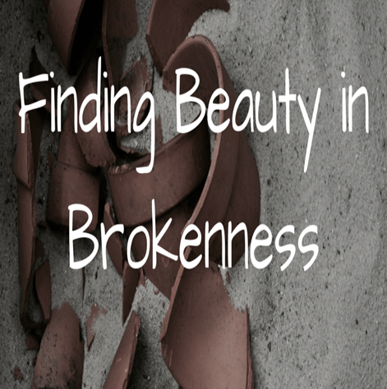
The Beauty Beneath the Brokenness
Recovery is not just about Healing What’s Broken...
…it’s About Rediscovering What Was Never Lost:
…your God-Given Worth

Slide 9
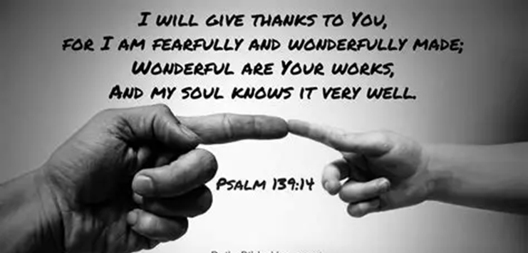
The Beauty Beneath the Brokenness
Psalm 139:14 reminds us that we are wonderfully
complex, marvelously made, and deeply known by God.
Even When We Feel Shattered…
…God Sees the Masterpiece Beneath the Mess.
This is the Heart of Recovery
Embracing God’s Design for Us Can Lead to...
Restoration, Renewal, and Hope.

Slide 10
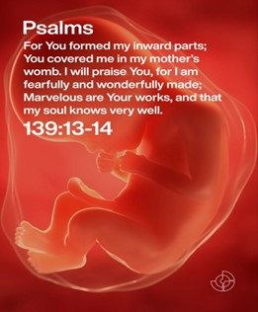
Point 1: You Are Not a Mistake — You Are Marvelous
The psalmist doesn’t say,
“I used to be marvelous.”
He says, “Your workmanship is marvelous…
…how well I know it.”
Recovery begins when we stop believing the lie
that Our Pain Defines Us.
Addiction, Trauma, Depression
these are Chapters in Your Story, Not Your Identity.

Slide 11
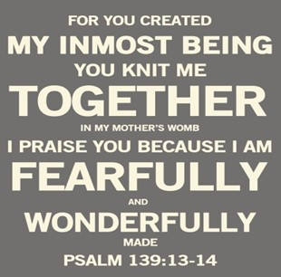
Point 1: You Are Not a Mistake — You Are Marvelous
God’s craftsmanship didn’t disappear when you fell.
It’s still there, waiting to be reclaimed.
Declaration:
“I am not my past. I am God’s workmanship.”

Slide 12
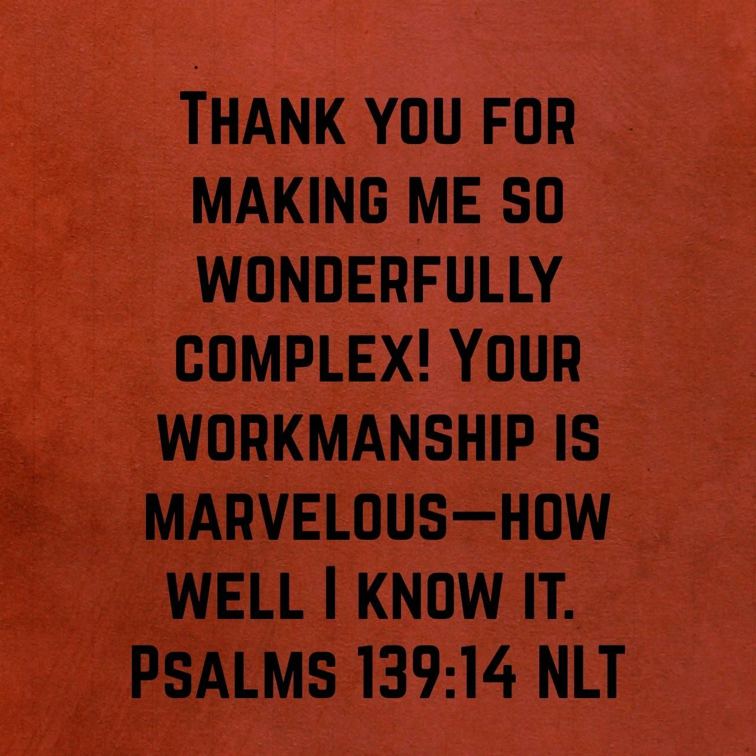
Point 2: Complexity Is Not a Curse — It’s a Calling
“Wonderfully Complex”
You are Layered, Intricate / Unique.
Recovery Often Feels Messy
Because Healing Isn’t Linear
But Complexity is Part of the Beauty

Slide 13

Point 2: Complexity Is Not a Curse — It’s a Calling
God Doesn’t Shy Away From Your…
…Tangled Emotions, Questions, Setbacks.
He Designed You With Depth
And He’s Not Intimidated By It.
Application:
Don’t Rush Your Healing.
Embrace the Process.
God Is Working In Every Layer

Slide 14
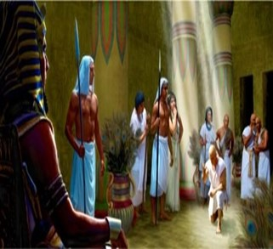
Point 2: Complexity Is Not a Curse — It’s a Calling
Joseph (Genesis 37–50)
Betrayed by his brothers, sold into slavery, falsely accused, imprisoned — yet eventually elevated to save nations.
Gen 50:20:
“You Intended To Harm Me, But God Intended It For Good…”
Message:
Joseph’s Life Was Complex and Painful
But God Used Every Twist for a Greater Purpose.

Slide 15
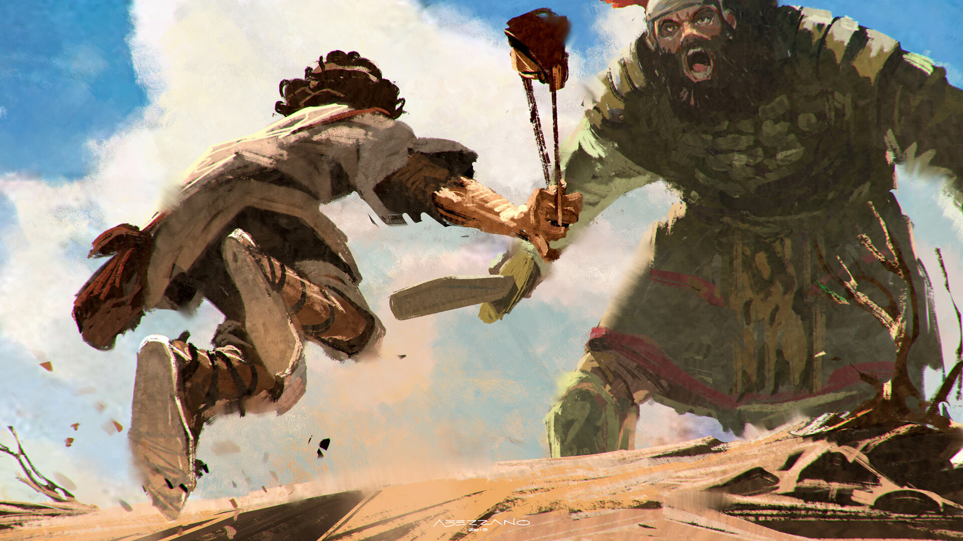
Point 2: Complexity Is Not a Curse — It’s a Calling
Joseph
Joseph’s life was Complex and Painful,
but God Used Every Twist for a Greater Purpose.
David (1 Samuel 16 – 2 Samuel 24)
A Shepherd, Warrior, Poet, King
Also, a Man Who Committed Grave Sins.
Yet He Was Called By God…
“A Man After God’s Own Heart.”
Message:
Complexity Doesn’t Cancel Calling.
God Works Through Every Layer of Your Story.

Slide 16

Point 2: Complexity Is Not a Curse — It’s a Calling
Joseph
His life was complex / painful, God used every twist David
God works through every layer of your story.
Naaman (2 Kings 5)
A Powerful Commander
Plagued With Leprosy
had to Humble Himself / Follow Strange Command Healing
Message:
Healing often comes through unexpected, humbling paths. God honors obedience in the midst of complexity.

Slide 17
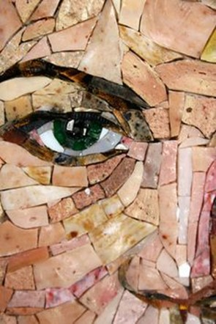
Mosaic Art
Mosaics Are Made From Broken Pieces Of Glass Or Tile
Individually, They Seem Useless
But When Arranged By An Artist
They Form Breathtaking Images
Application:
God is the Master Artist,
Your Brokenness Is Part of His Masterpiece.

Slide 18

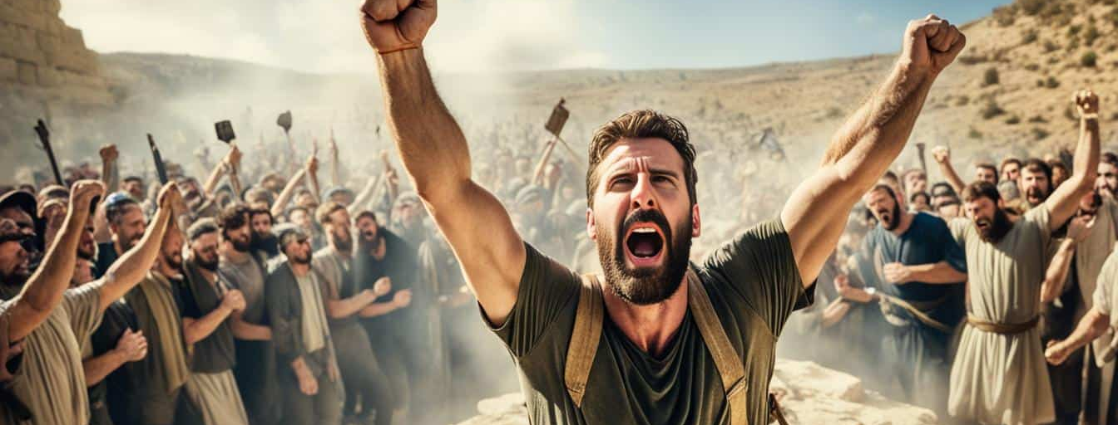

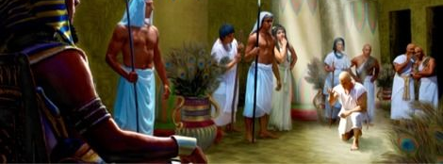
Neuroscience & Recovery
Studies Show that the Brain Can Rewire Itself —
A Process Called Neuroplasticity.
Even After Trauma Or Addiction, Healing Is Possible.
You are Wonderfully Complex
God Designed Your Mind with the Ability to…
Recover and Renew.
Isaiah 60:1 NLT
“Arise, Jerusalem! Let your light shine for all to see. For the glory of the Lord rises to shine on you.

Slide 20
When the store manager returned from lunch, he noticed his clerk's hand was bandaged, but before he could ask about the bandage, the clerk had some very good news for him.
"Guess what, sir?" the clerk said. "I finally sold that terrible, ugly suit we've had so long!"
"Do you mean that repulsive pink-and-blue double-breasted thing?!" the manager asked.
"That's the one!"
"That's great!" the manager cried, "I thought we'd never get rid of that monstrosity! That had to be the ugliest suit we've ever had! But tell me, why is your hand bandaged?"
"Oh," the clerk replied, "after I sold the guy that suit, his seeing-eye dog bit me."

