Slide 2
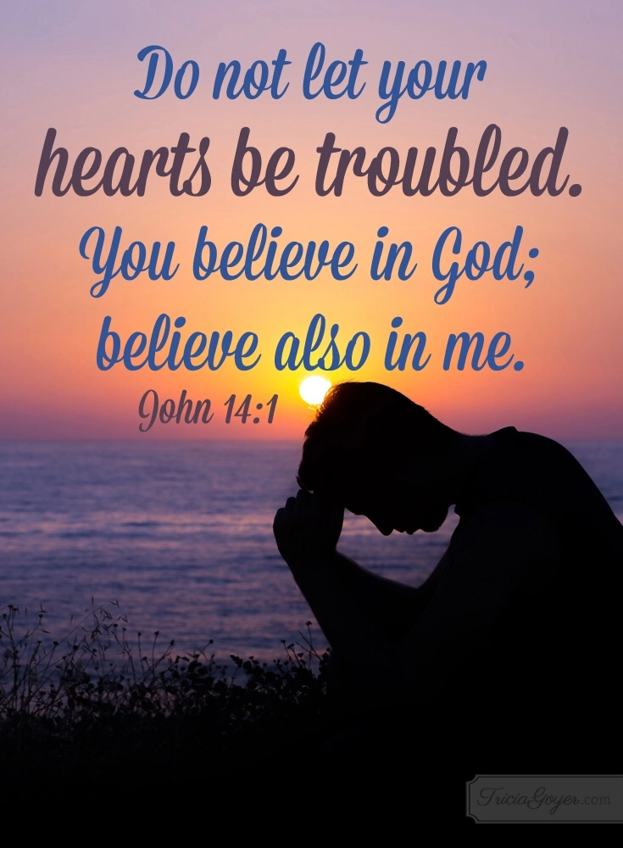

Slide 3

Edward Christian Church
9/7/2025

Slide 5
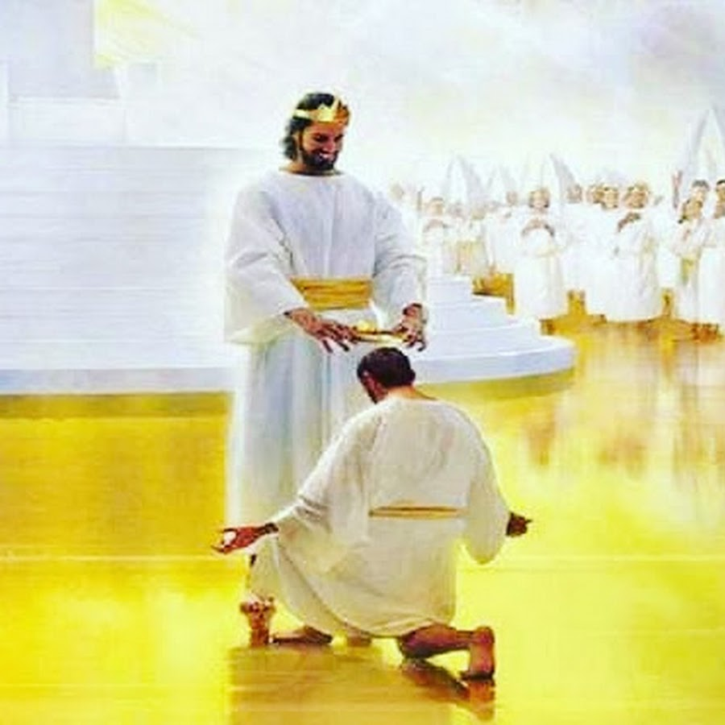
When a Servant Goes Home
1 Thes 4:13–18
Edward Church Sept 7, 2025

Slide 6

Church family
today we are gathered in a moment we never wanted to face
We’ve lost our brother, our friend, our deacon
His life was woven into the very fabric of this congregation
His passing was sudden, and shocking
Not ready to say goodbye
Feel the weight of absence
The empty seat, the missing voice
And yet, even here, we remember:
“we do not grieve as those who have no hope”

Slide 7

The Reality of Grief
Scripture: John 11:35 — Jesus wept
Grief is not a sign of weak faith — even Jesus grieved
Grief is the language of love when words fail
It’s Ok to give selves permission to feel and express sorrow
Paul’s words in 1 Thess 4 are not a command to skip grief
they are an invitation to grieve differently
We grieve with hope because we know…
…this is not the end of the story

Slide 8
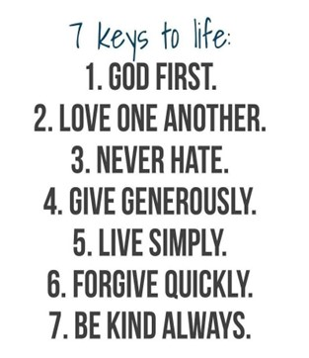
Honoring a Faithful Servant
Mark 10:43–45 Whoever wants to be great among you must be your servant
Don was not just a deacon in title — he was a deacon in heart
He served without seeking recognition
He ministered to this church and its members
He visited the sick, encouraged the weary, and welcomed the newcomer
He loved his family deeply — his children and grandchildren were his joy
His life was a sermon in action
His ministry was not about position, but about people

Slide 9

The Shock of Sudden Loss
Sudden loss leaves us with unanswered questions
Why now? Why this way?
The truth is, we don’t have all the answers —
but we do have all of God’s promises
Isaiah 55:8–9 reminds us:
‘For my thoughts are not your thoughts, neither are your ways my ways,’ declares the Lord
We may not understand the timing…
…we can trust the One who holds time in His hands

Slide 10
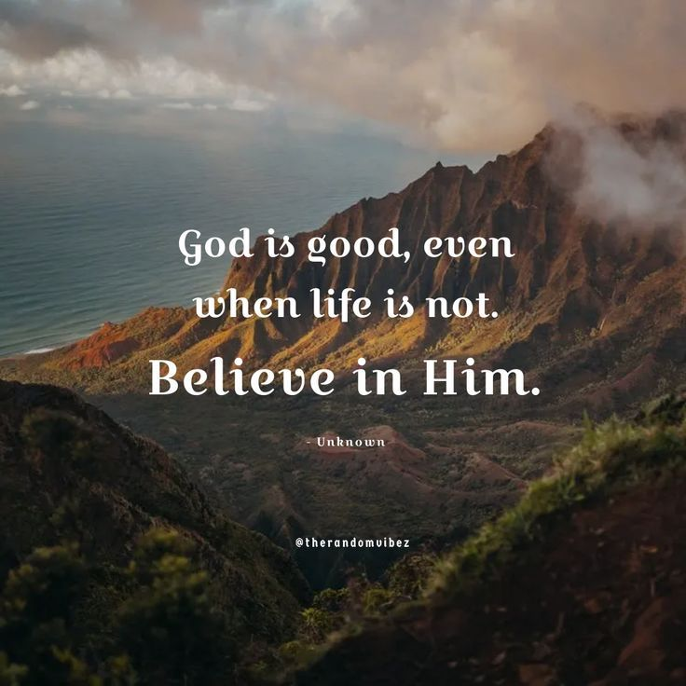
The Hope We Hold
John 14 Jesus comforts His disciples:
‘Do not let your hearts be troubled…
I go to prepare a place for you.’
That’s not a metaphor — it’s a promise.
The moment our brother closed his eyes here..
..he opened them in the presence of his Savior
Psa 116:15 ‘Precious in the sight of the Lord is the death of
His faithful servants.’
He is more alive now than he has ever been…
…free from pain, weakness, and the shadow of death

Slide 11
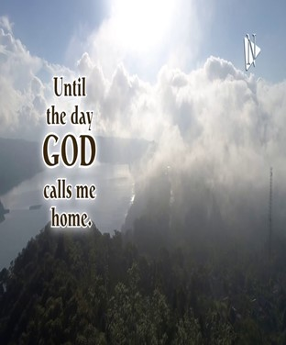
When a servant like Don is called home, it leaves a gap
We feel it in our ministries, in our fellowship, in our hearts
But his legacy is not gone —
it’s in the way he taught us to serve, to love, to be faithful
Hebrews 12:1 says, ‘Since we are surrounded by such a great cloud of witnesses… let us run with perseverance the race marked out for us.’
Our brother has finished his race…
Now it’s our turn to run ours with the same faithfulness

Slide 12

Don Left Us ..
a Legacy
of
Love
Devotion
Servant’s Heart
His Death Left a Gap
It’s Time to Fill the Gap

Slide 13



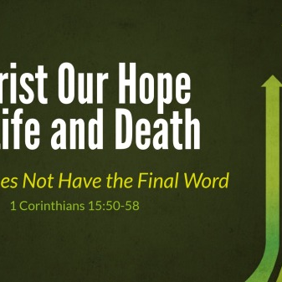
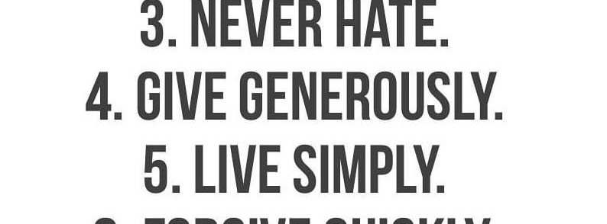
God’s Got This
It Didn’t Take Him By Surprise!
He Gave Don What He Needed
He’s Got What We Need Now!

Slide 14
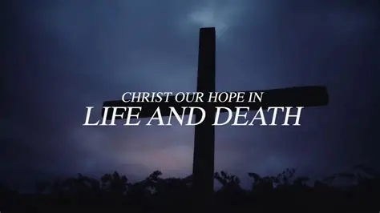

Slide 16

Repeat
These are the 2 Most Important Hours of My Week – Help Me to Cherish Them
I Am Here Today to Worship
Not to Be Entertained
I Am Singing to An Audience of One
Accept My Worship Oh Lord!

Slide 17
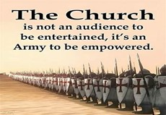
Spiritual Warfare
10% Satan’s Tactics
90% How We Respond
Remember…
With God We Are Not
Helpless
Hopeless
We Are Powerful!!

Slide 19

Repeat
I Lift My Offering to You
Let It Please You Oh Lord
This is My Seed
Although It Leaves My Hand
It will Never Leave My Life
You Will Multiply It!
Accept My Seed Oh Lord!

