Slide 2
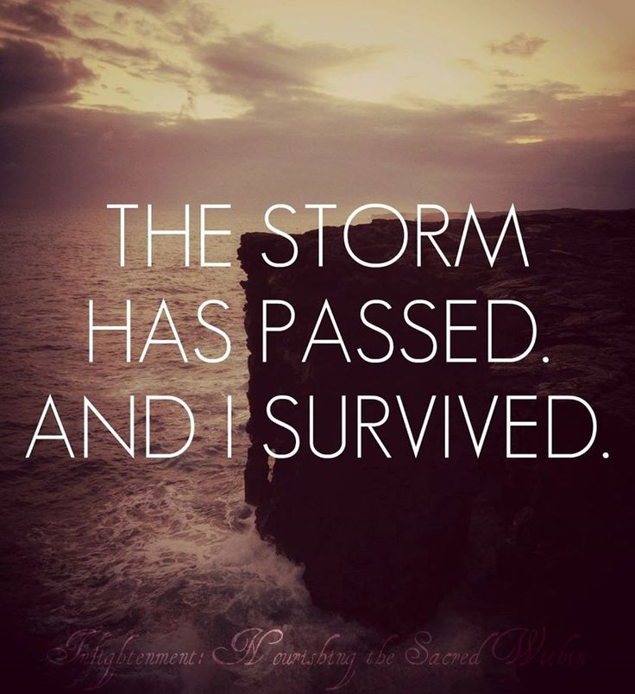
When the Storm Has Passed But the Pain Remains
Psalm 34:17-19
Edward Church
Sept. 14, 2025

Slide 3
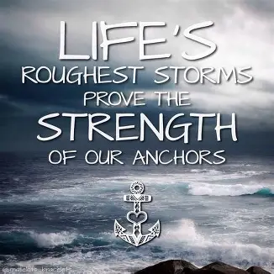
Some Storms Leave Behind More Than Broken Branches
They Leave Broken Hearts
You Survived
You Endured
But Now You’re Left With Silence
Questions
Wounds that Don’t Show

Slide 4
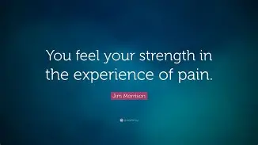
Theres A Quiet Ache That Follows The Chaos
Here’s the Truth:
You Are Still Held
By Grace
By Love
By The God
Who Never Left

Slide 5
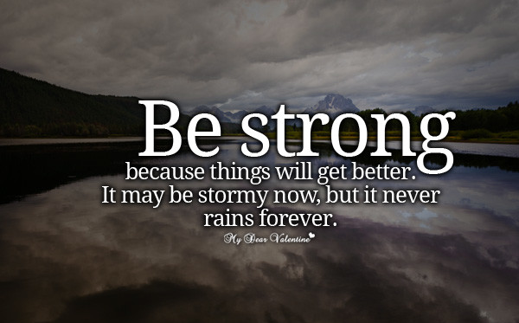
God Was There — Even When You Couldn't Feel Him
In the Middle of Your Trial…
…You May Have Felt Abandoned
But Silence Is Not Absence
God was There…
Holding, Watching, Weeping w- You

Slide 6
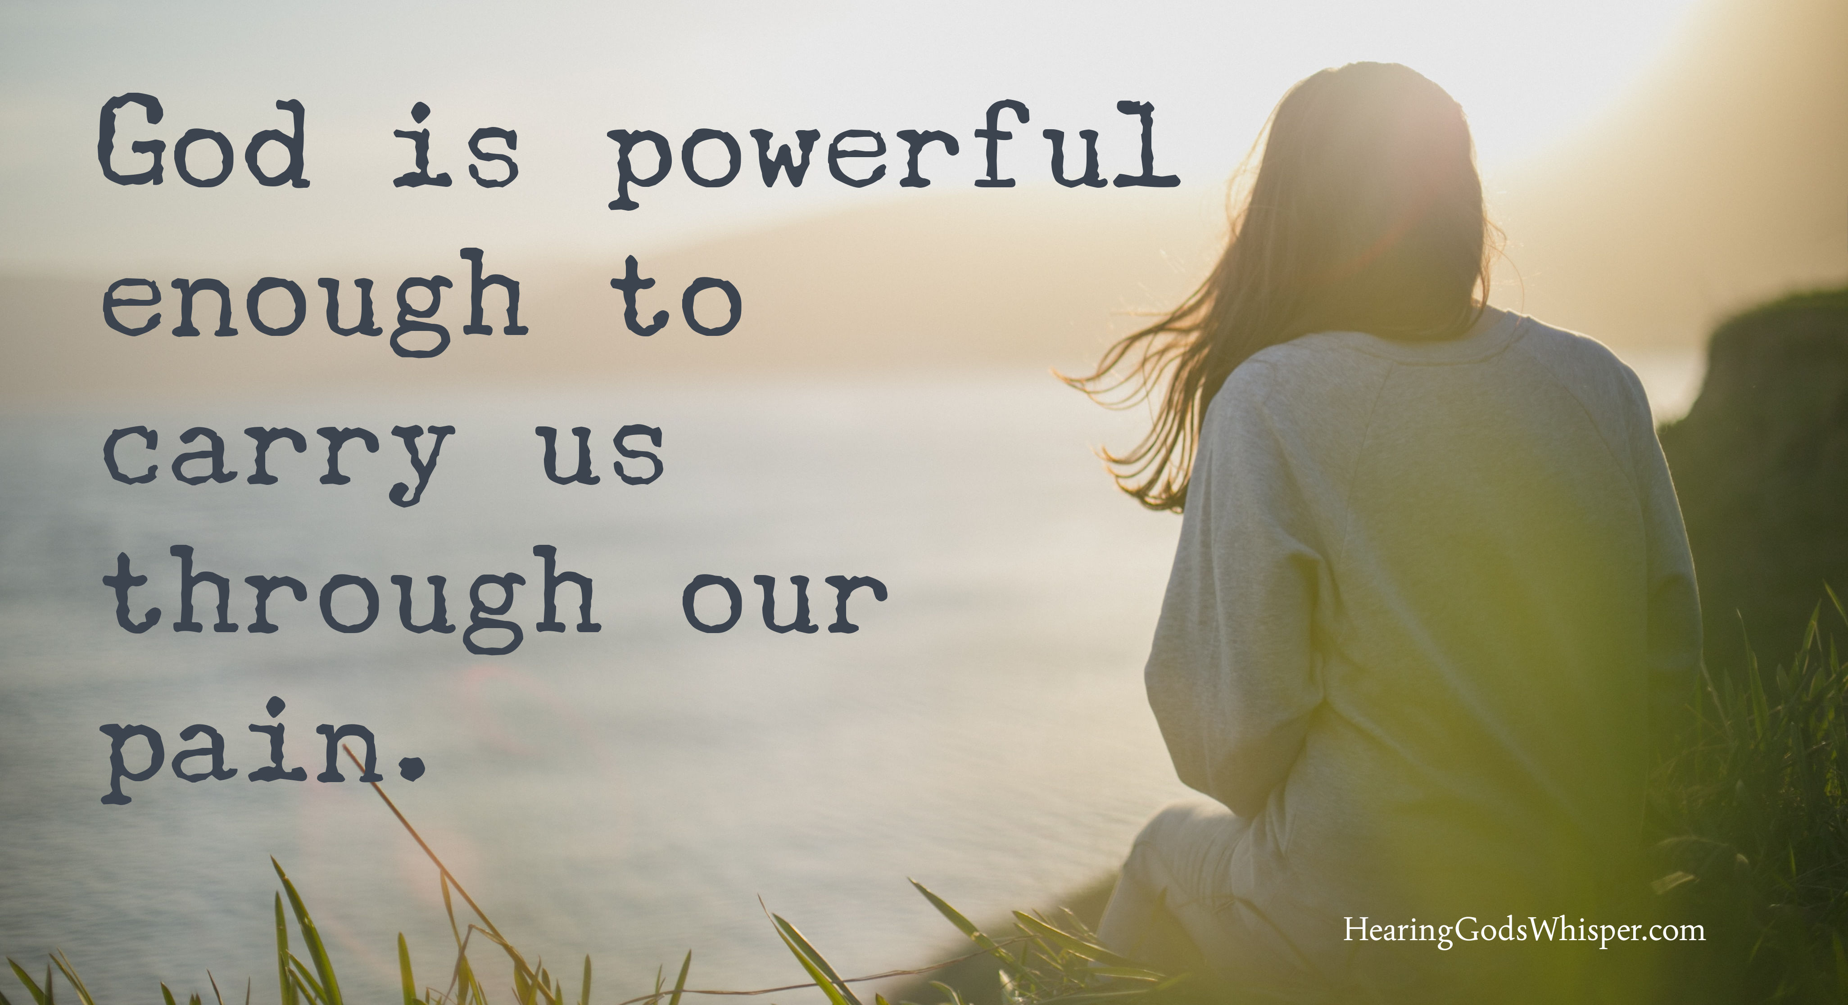
“ The Lord is close to the brokenhearted and
saves those who are crushed in spirit.” Psa 34:18
Corrie ten Boom
"There is no pit so deep…
…God’s love is not deeper still.“
Even in your lowest moment…
…you were never beyond His reach

Slide 7
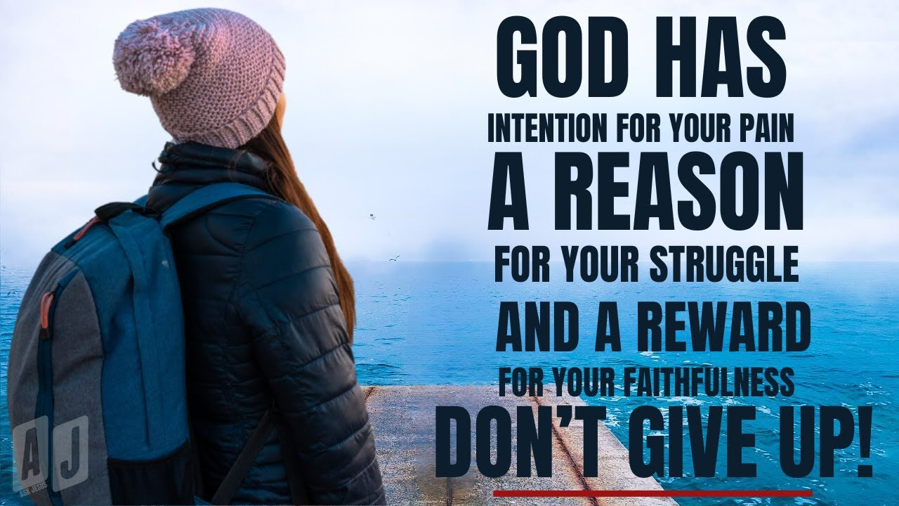
God’s Comfort Is Not Just a Feeling — It’s a Promise
God Doesn’t Offer Vague Encouragement…
…He Gives Unshakable Promises.
Isaiah 43:2, “When you pass through the waters, I will be with you… When you walk through the fire, you will not be burned.”
2 Cor 1:3-4, “The God of all comfort…
…comforts us in all our troubles.”
Charles Spurgeon
“When you cannot trace His hand, you must trust His heart."
God’s Comfort Is Not Based On Your Strength…
…It’s Anchored In His Character

Slide 8
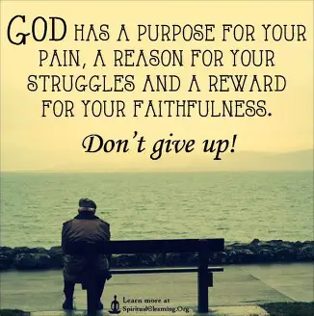
You Are Not Defined by What Broke You
The Trial May Have Left Scars,
But Scars Are Signs Of Healing — Not Defeat.
Romans 8:28 “And we know that in all things God works for the good of those who love Him…”
Elisabeth Elliot "Suffering is never for nothing."
God is Redeeming Your Story
Your Pain Has Purpose
Your Healing Has Power

Slide 9
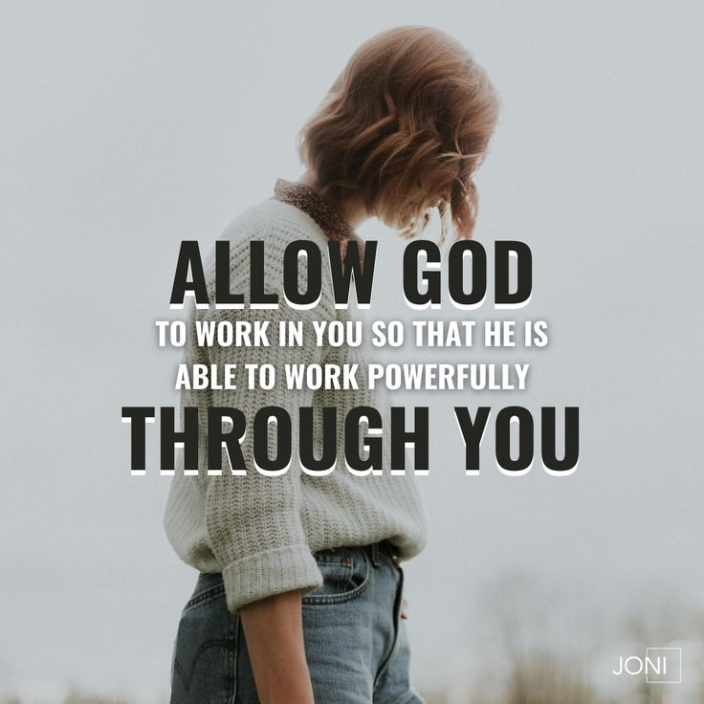
God Will Restore What Was Lost
God doesn’t just comfort — He rebuilds.
Joel 2:25, “I will restore to you the years the locusts have eaten…”
Lam 3:22–23, “Because of the Lord’s great love we are not consumed… His mercies are new every morning.”
"You’ll get through this.
It won’t be painless. It won’t be quick.
But God will use this mess for good."
The Process May Be Messy, But the Outcome Will Be Good

Slide 10
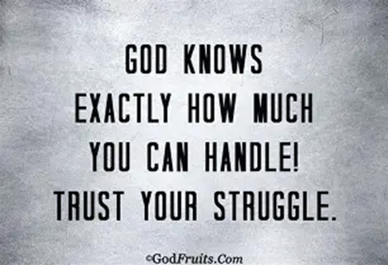

Slide 11
You Are Still Held
You May Feel Fragile.
You May Feel Tired.
But You Are Still Held —
By The Hands that Formed The Stars,
By The Heart that Broke For You,
By The Grace that Never Lets Go.
Breathe……Rest.
Let God Comfort You.
Let Him Remind You:
You Made It Through with God on Your Side

Slide 12
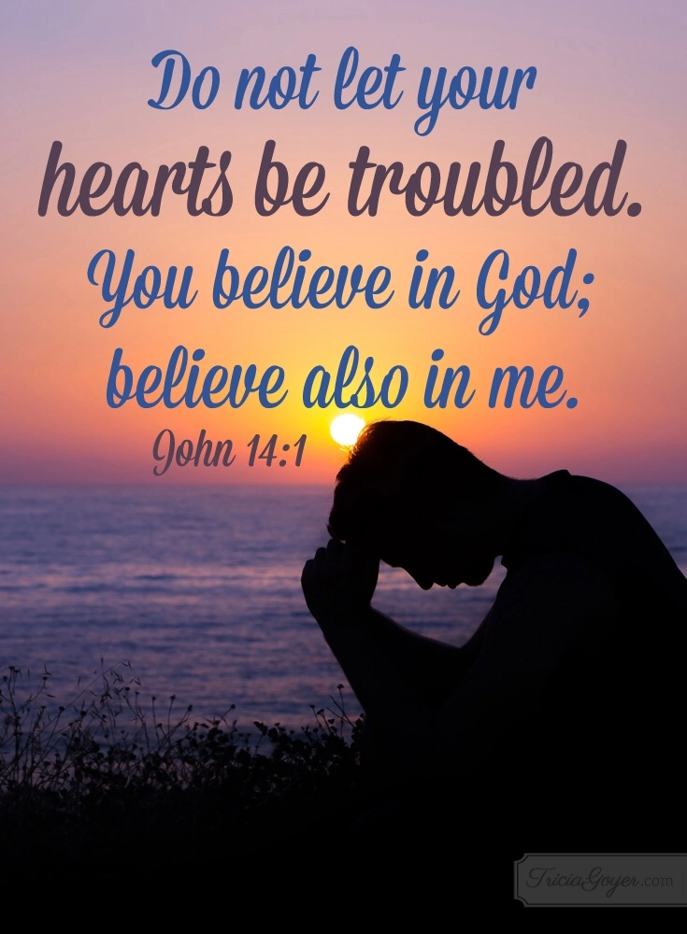

Slide 13

Spiritual Warfare
10% Satan’s Tactics
90% How We Respond
Remember…
With God We Are Not
Helpless
Hopeless
We Are Powerful!!

Slide 14
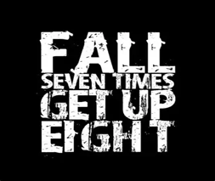
Repeat
These are the 2 Most Important Hours of My Week – Help Me to Cherish Them
I Am Here Today to Worship
Not to Be Entertained
I Am Singing to An Audience of One
Accept My Worship Oh Lord!

Slide 15

Edward Christian Church
9/14/2025

Slide 16
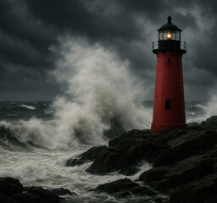
Stand in your Love

Slide 17
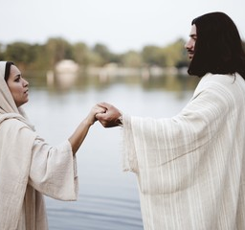
Lift your head

Slide 18

Repeat
I Lift My Offering to You
Let It Please You Oh Lord
This is My Seed
Although It Leaves My Hand
It will Never Leave My Life
You Will Multiply It!
Accept My Seed Oh Lord!

Slide 19
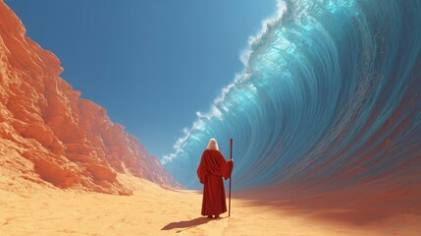
Waymaker

Slide 20

I trust in God

