Slide 1
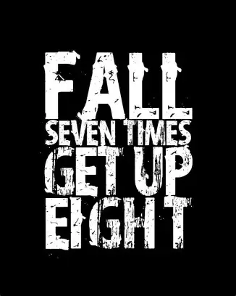

Slide 2
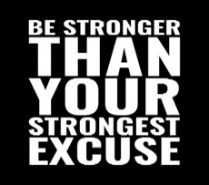
Spiritual Warfare
10% Satan’s Tactics
90% How We Respond
Remember…
With God We Are Not
Helpless
Hopeless
We Are Powerful!!

Slide 3
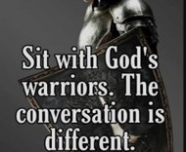
Repeat
These are the 2 Most Important Hours of My Week – Help Me to Cherish Them
I Am Here Today to Worship
Not to Be Entertained
I Am Singing to An Audience of One
Accept My Worship Oh Lord!

Slide 4
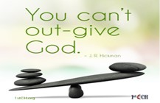
Repeat
I Lift My Offering to You
Let It Please You Oh Lord
This is My Seed
Although It Leaves My Hand
It will Never Leave My Life
You Will Multiply It!
Accept My Seed Oh Lord!

Slide 6

Recovery
12 Steps to Find Peace
Edward Church
September 21, 2025
Psalm 139:14 –pt3

Slide 7
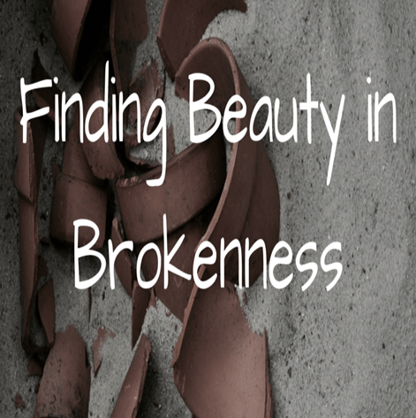
The Beauty Beneath the Brokenness
Recovery is not just about Healing What’s Broken...
…it’s About Rediscovering What Was Never Lost:
…your God-Given Worth

Slide 8
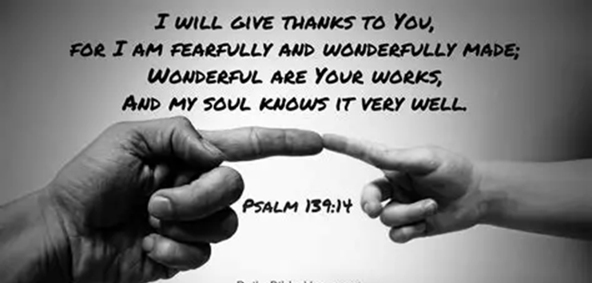
The Beauty Beneath the Brokenness
Psalm 139:14 reminds us that we are wonderfully
complex, marvelously made, and deeply known by God.
Even When We Feel Shattered…
…God Sees the Masterpiece Beneath the Mess.
This is the Heart of Recovery
Embracing God’s Design for Us Can Lead to...
Restoration, Renewal, and Hope.

Slide 9
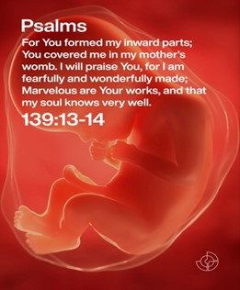
Point 1: You Are Not a Mistake — You Are Marvelous
The psalmist doesn’t say,
“I used to be marvelous.”
He says, “Your workmanship is marvelous…
…how well I know it.”
Recovery begins when we stop believing the lie
that Our Pain Defines Us.
Addiction, Trauma, Depression
these are Chapters in Your Story, Not Your Identity.

Slide 10
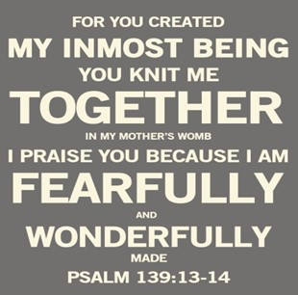
Point 1: You Are Not a Mistake — You Are Marvelous
God’s craftsmanship didn’t disappear when you fell.
  It’s still there, waiting to be reclaimed.
Declaration:
“I am not my past. I am God’s workmanship.”

Slide 11
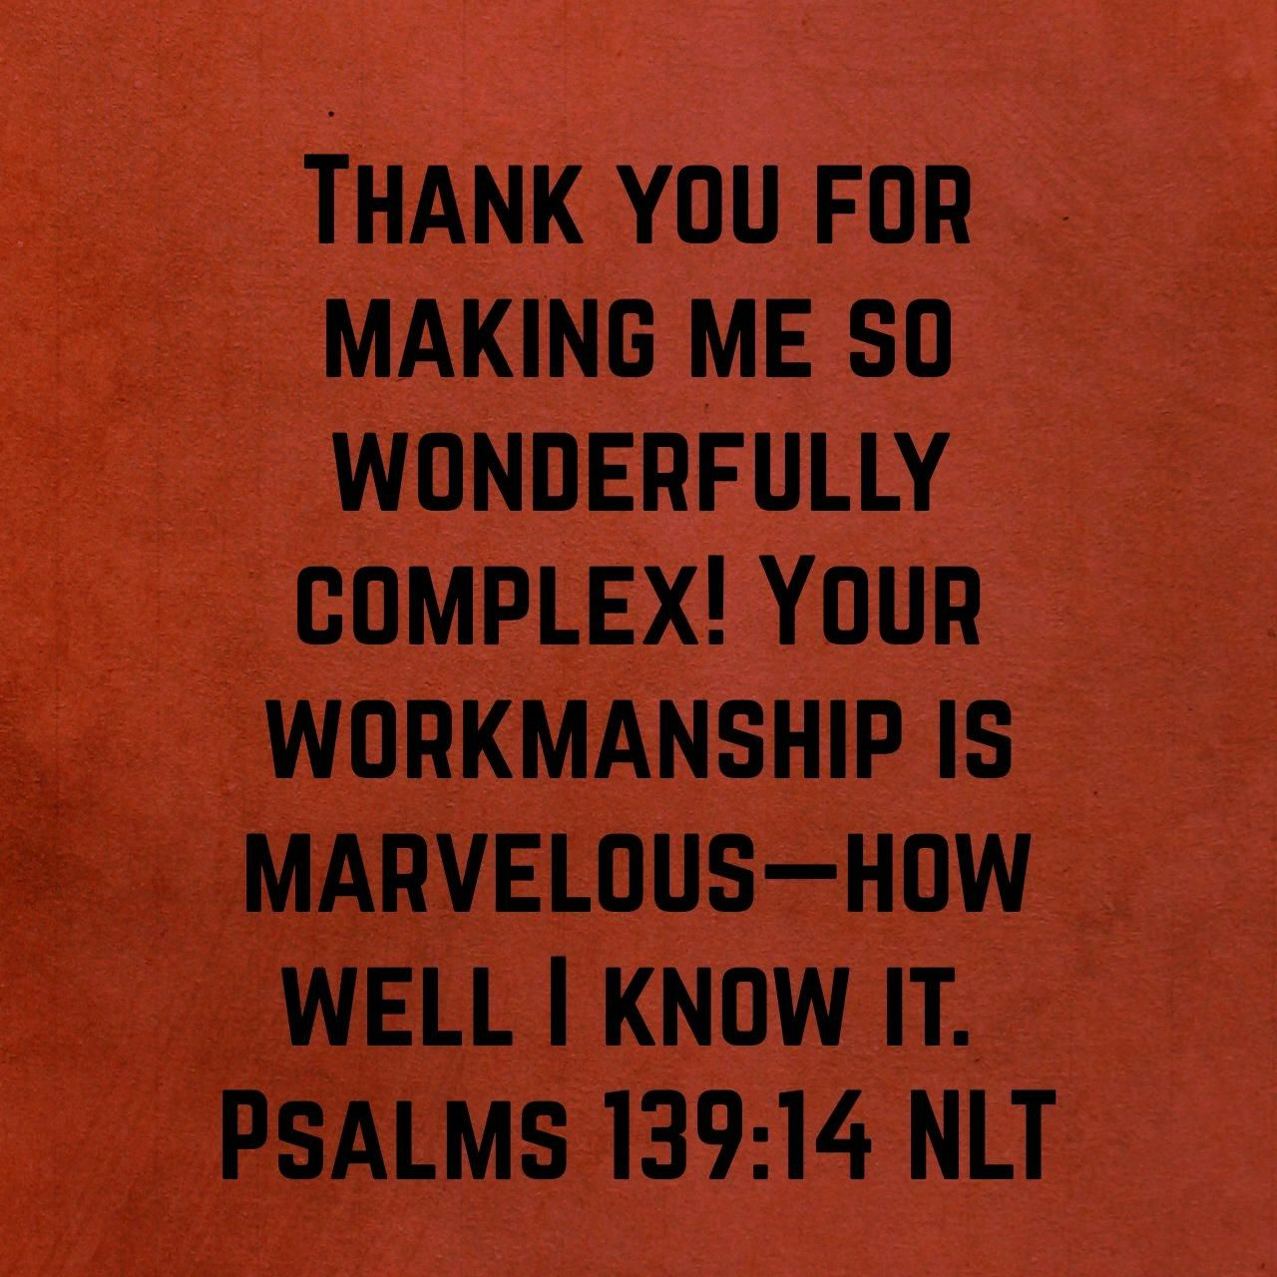
Point 2: Complexity Is Not a Curse — It’s a Calling
“Wonderfully Complex”
You are Layered, Intricate / Unique.
Recovery Often Feels Messy
Because Healing Isn’t Linear
But Complexity is Part of the Beauty

Slide 12
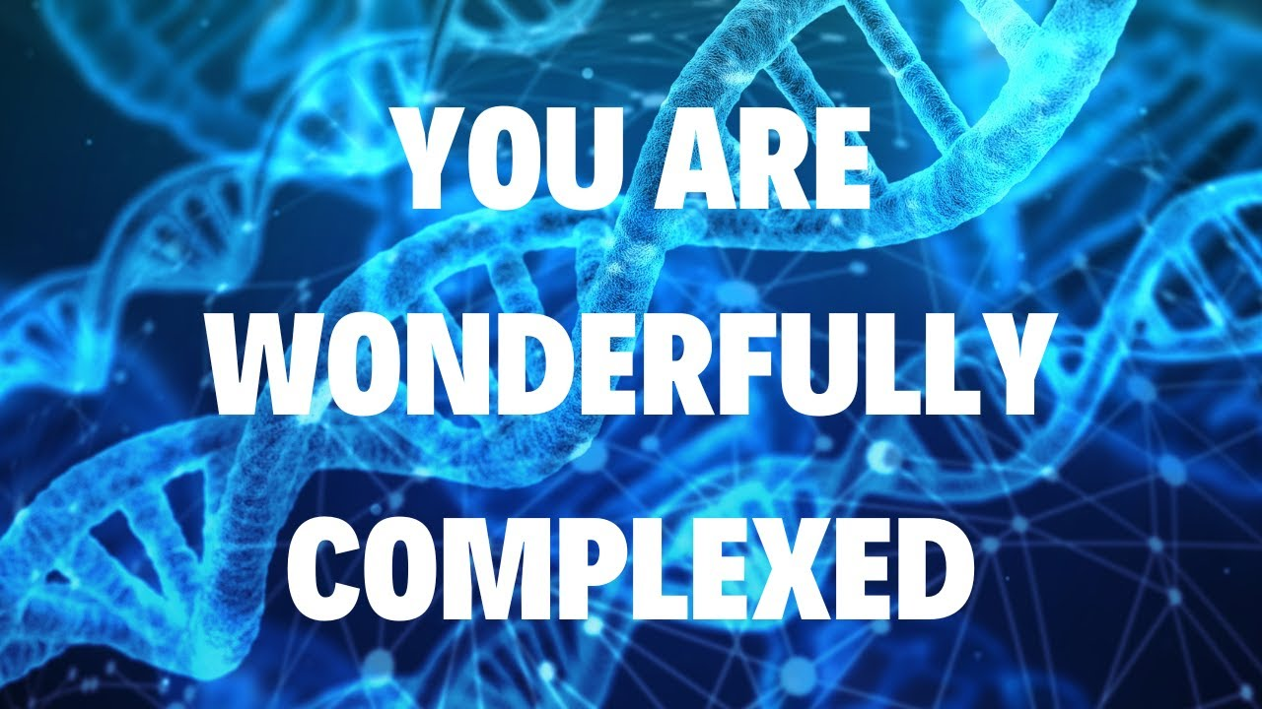
Point 2: Complexity Is Not a Curse — It’s a Calling
God Doesn’t Shy Away From Your…
…Tangled Emotions, Questions, Setbacks.
He Designed You With Depth
And He’s Not Intimidated By It.
Application:
Don’t Rush Your Healing.
Embrace the Process.
God Is Working In Every Layer

Slide 13

Point 3: Recovery Is Remembering Who You Are
The Psalmist says, “How well I know it.”
How Many Have Forgotten.
Recovery is Not Just Physical or Emotional - It’s Spiritual.
Remembering You are Loved, Chosen, and Seen.
When Shame Whispers, “You’re too far gone,”
Psalm 139 shouts, “You are marvelous!”
Encouragement:
Let God Remind You Of Your Worth Daily.
Speak Life Over Yourself.

Slide 14
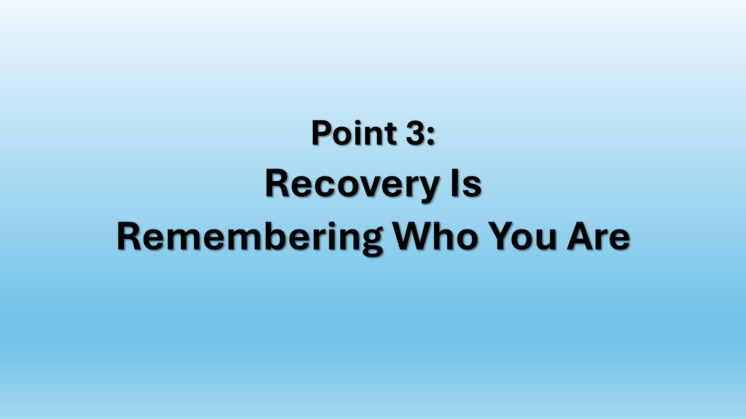
Recovery Is Rediscovering Your Identity In God
Recovery Principle
God doesn’t just Forgive —
He Restores and Reaffirms Your Calling
Peter’s Restoration (John 21)
After Denying Jesus Three Times, Peter is Lovingly Restored
by Christ and Commissioned to “feed my sheep.”
Message:
Failure Doesn’t Define You
Jesus Restores and Reaffirms Your Identity and Purpose.
Recovery is Not Just Healing —
it’s being Re-Commissioned.

Slide 15
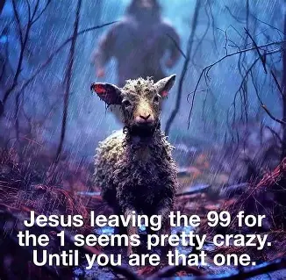
Hagar (Genesis 16 & 21)
A Servant Cast Out and Abandoned…
…God finds her in the Wilderness and Calls Her By Name
Message:
Even when you Feel Invisible, God Sees You
Recovery Begins when you Realize you are Known and Loved
The Lost Sheep (Luke 15:1–7)
Shepherd who leaves 99 sheep to find the one that’s lost
Message:
You are Worth Pursuing
Recovery is not about earning love — it’s about receiving it
“What truth about yourself do you need to reclaim today?”

Slide 16

Point 3: Recovery Is Remembering Who You Are
The Elephant and the Rope
A young elephant is tied with a rope it cannot break. As it grows, it still believes it’s trapped, even though it could easily escape.
Application:
Recovery is breaking free from lies we’ve believed for too long. You are stronger than you think.
Biblical Story: Gideon (Judges 6)
Gideon saw himself as weak
but God called him a “mighty warrior.”
Tie-in: Recovery is reclaiming your true identity — not what the world or your past says, but what God says.

Slide 17
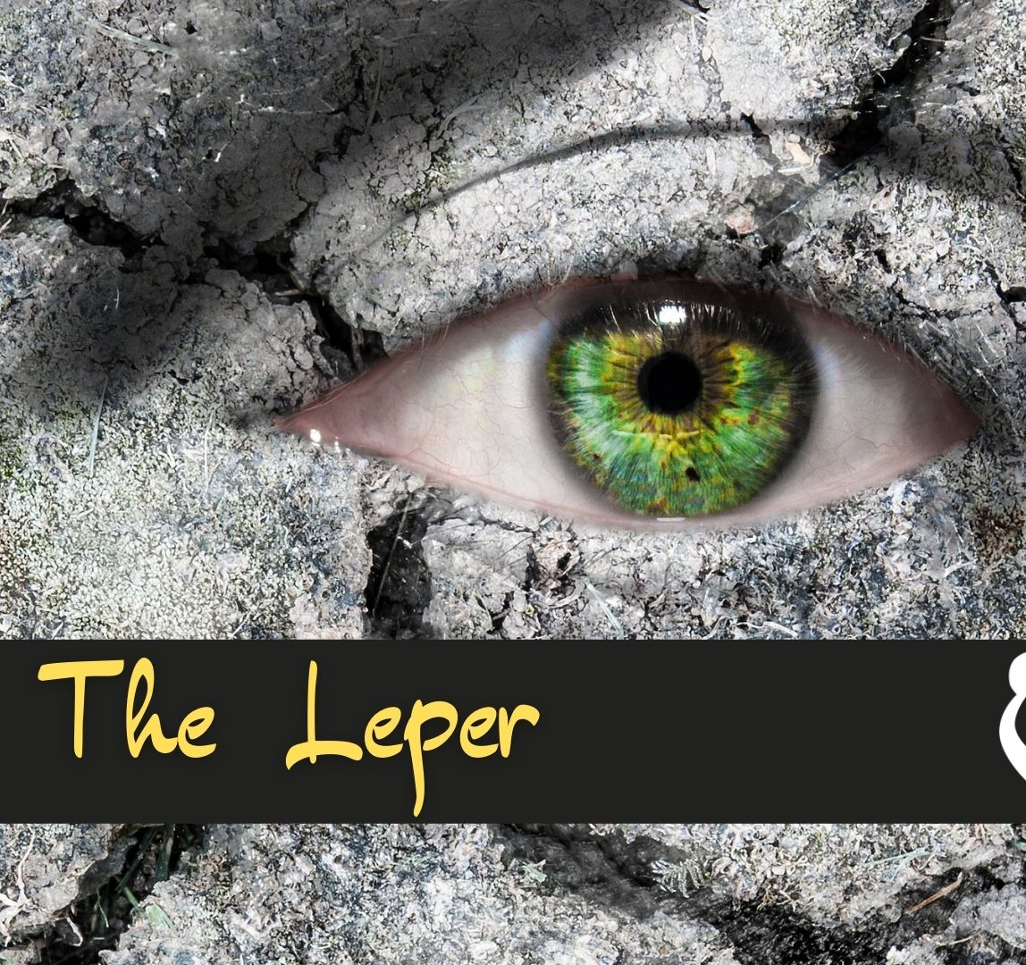
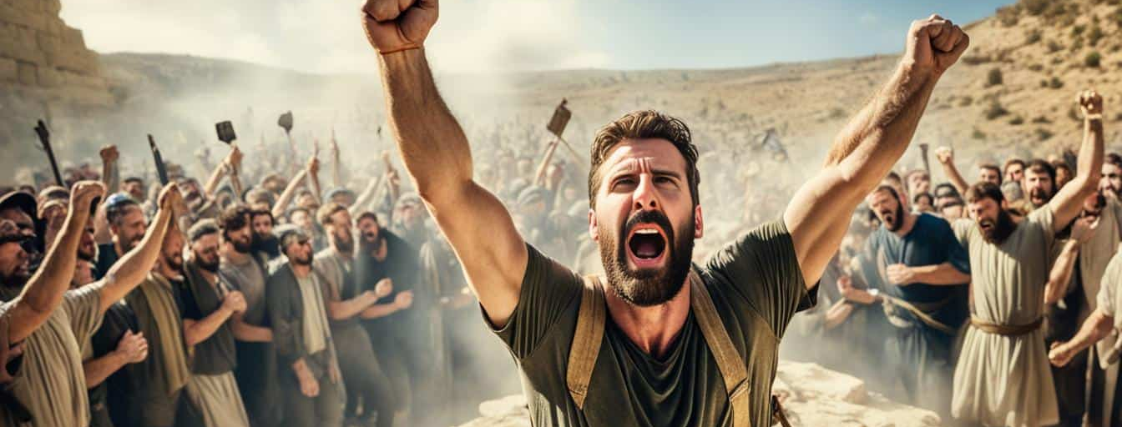
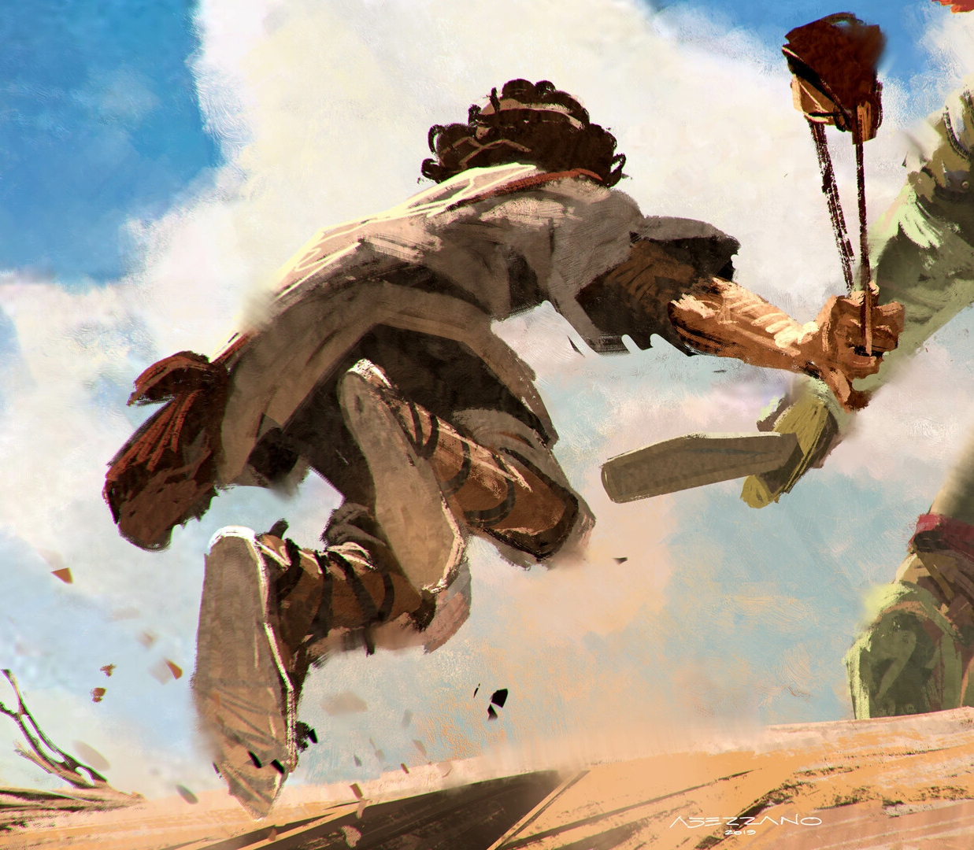
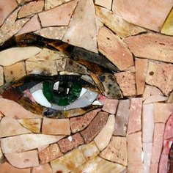
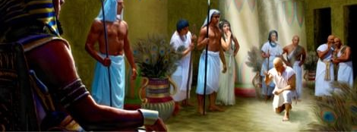
Neuroscience & Recovery
Studies Show that the Brain Can Rewire Itself —
A Process Called Neuroplasticity.
Even After Trauma Or Addiction, Healing Is Possible.
You are Wonderfully Complex
God Designed Your Mind with the Ability to…
Recover and Renew.
Isaiah 60:1 NLT
“Arise, Jerusalem! Let your light shine for all to see.
For the glory of the Lord rises to shine on you.

Slide 19
A tour guide was showing a tourist around Washington, D. C. The guide pointed out the place where George Washington supposedly threw a dollar across the Potomac River.
"That's impossible," said the tourist. "No one could throw a coin that far!"
"You have to remember," answered the guide. "A dollar went a lot farther in those days."

