Slide 1
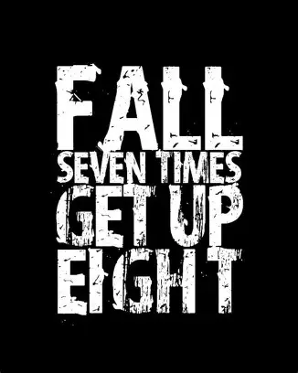

Slide 2
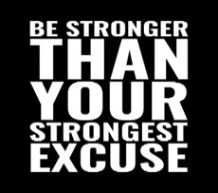
Spiritual Warfare
10% Satan’s Tactics
90% How We Respond
Remember…
With God We Are Not
Helpless
Hopeless
We Are Powerful!!

Slide 3
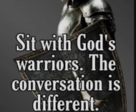
Repeat
These are the 2 Most Important Hours of My Week – Help Me to Cherish Them
I Am Here Today to Worship
Not to Be Entertained
I Am Singing to An Audience of One
Accept My Worship Oh Lord!

Slide 4

Repeat
I Lift My Offering to You
Let It Please You Oh Lord
This is My Seed
Although It Leaves My Hand
It will Never Leave My Life
You Will Multiply It!
Accept My Seed Oh Lord!

Slide 6

Recovery 12 Steps to Find Peace
Edward Church
September 28, 2025
Romans 7:15
Pt 4

Slide 7
I Can’t God Can I Will Let Him
Gimme Three Steps

Slide 8

Every Christian Is in Recovery
We All Battle Sin, Fear, Pride, Or Shame
But the Gospel Is a Recovery Story
Steps 1–3 = The Heart Of Discipleship
The Gospel In Three Steps:
I Can’t. God Can. I Will Let Him

Slide 9
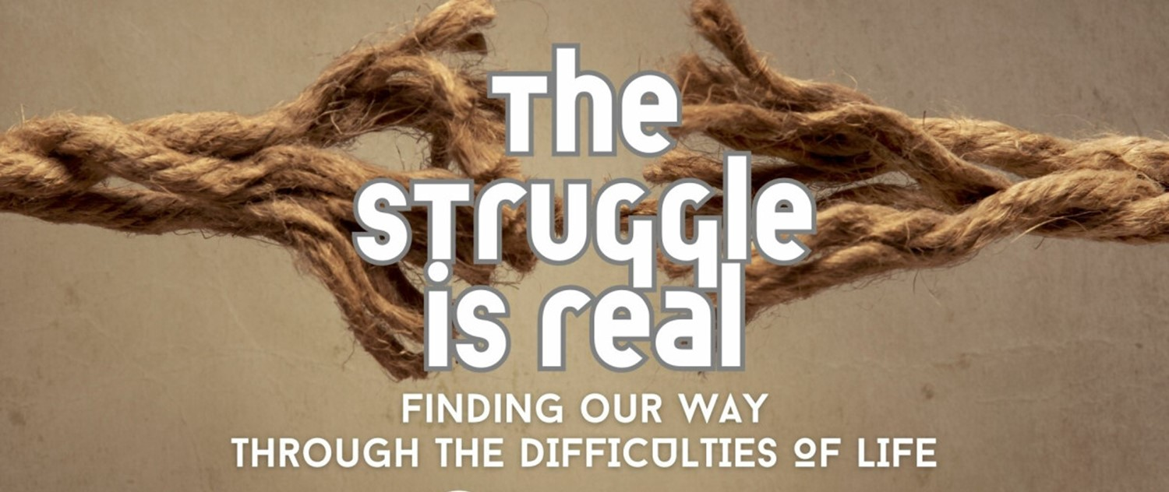
Step 1: Admit Powerlessness
Romans 7:18
“For I know that nothing good dwells in me, that is, in my flesh. For I have the desire to do what is right, but not the ability to carry it out.”
Romans 7:18 Amp
For I know that nothing good dwells within me, that is, in my flesh. I can will what is right, but I cannot perform it. [I have the intention and urge to do what is right, but no power to carry it out.]

Slide 10

Step 1: Admit Powerlessness
“We admitted we were powerless…”
Romans 7:18; John 15:5
We Cannot Fix Ourselves
Denial Keeps Us Bound; Confession Sets Us Free
Weakness Is The Doorway To Grace
Admitting Weakness Is Not Defeat-
-It’s The Beginning Of Freedom

Slide 11

The Drowning Man
“We Can’t Thrash Our Way To Safety..
…We Must Cry For Help.”
We Need To Connect To God’s Power.

Slide 12
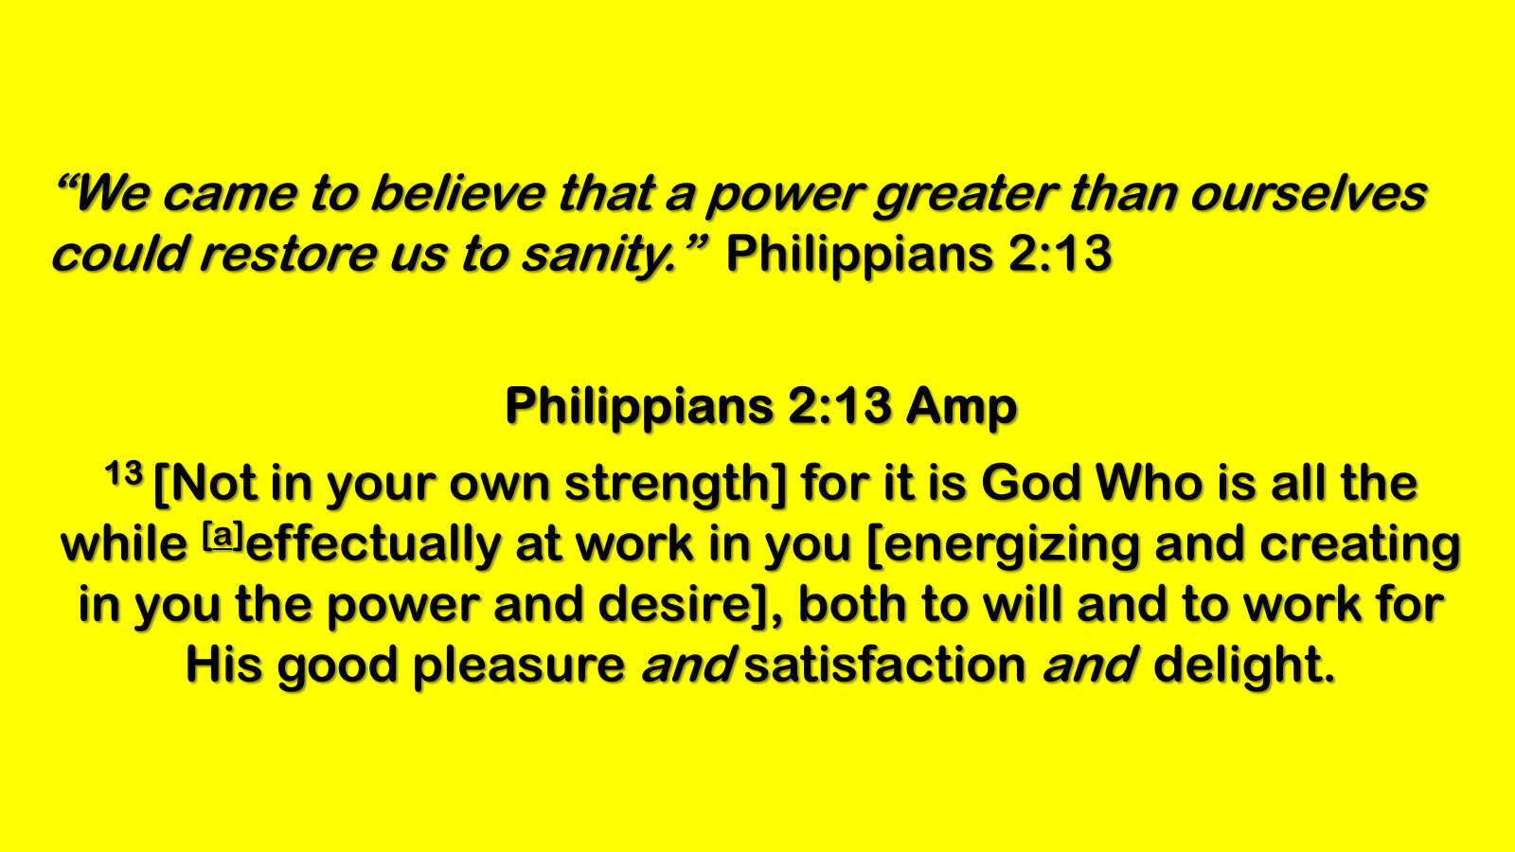
Step 2: Believe in God’s Power
“We came to believe…”
Philippians 2:13; Ephesians 3:20
God Can Do What We Cannot
His Power Restores And Renews
The Same Power That Raised Jesus Lives In Us
“Faith is plugging into the Source.”

Slide 13
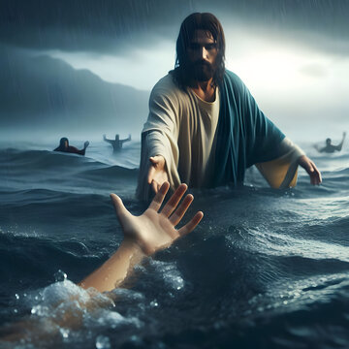
Step 3: Surrender to God’s Care
“We made a decision to turn our will / lives over…”
Romans 12:1; Proverbs 3:5–6
Belief Must Lead To Surrender
Surrender Is Not Losing…
…It’s Winning By Letting God Lead
God’s Care Is Safer Than Our Control
“A parachute only works if you jump.”

Slide 14
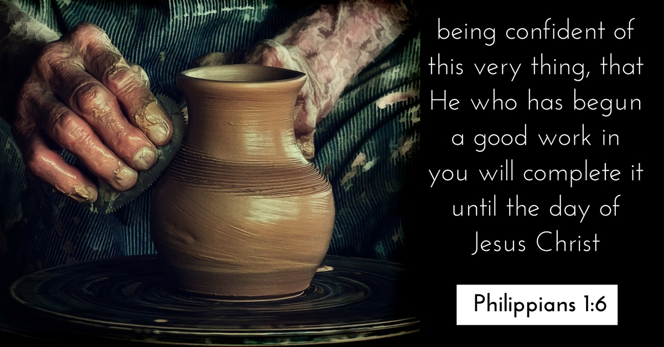
From Brokenness to Breakthrough
The Path to Freedom / Discipleship
Step 1: I Can’t
Step 2: God Can
Step 3: I Will Let Him
“This Is Not Just Recovery—it’s The Gospel.”

Slide 15

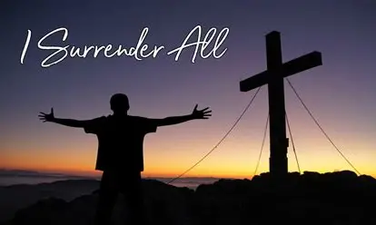

Slide 17
An 85-year-old widow went on a blind date with a 90-year-old man. When she returned to her daughter's house later that night, she seemed upset.
"What happened, Mother?" the daughter asked.
"I had to slap his face three times!"
"You mean he got fresh?"
"No," she answered, "I thought he was dead."

