Slide 1
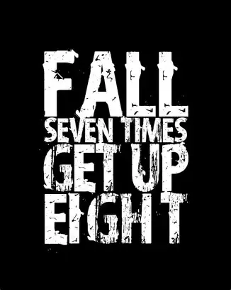

Slide 2
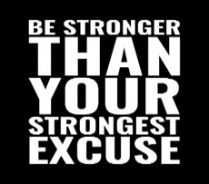
Spiritual Warfare
10% Satan’s Tactics
90% How We Respond
Remember…
With God We Are Not
Helpless
Hopeless
We Are Powerful!!

Slide 3
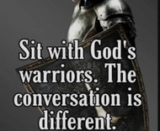
Repeat
These are the 2 Most Important Hours of My Week – Help Me to Cherish Them
I Am Here Today to Worship
Not to Be Entertained
I Am Singing to An Audience of One
Accept My Worship Oh Lord!

Slide 4

Repeat
I Lift My Offering to You
Let It Please You Oh Lord
This is My Seed
Although It Leaves My Hand
It will Never Leave My Life
You Will Multiply It!
Accept My Seed Oh Lord!

Slide 5

Recovery
12 Steps to Find Peace
Edward Church
October 5, 2025
Psalm 139:23–24

Slide 6
Cleansing & Confession (Steps 4–7)
Edward Church
October 5, 2025
Cough It Up –
Spit It Out

Slide 7

Every Christian Is in Recovery
  We All Battle Sin, Fear, Pride, Or Shame
  But the Gospel Is a Recovery Story
  Steps 1–3 = The Heart Of Discipleship
  Steps 4-7 = Cleansing & Confession
Cough It Up
Spit It Out

Slide 8
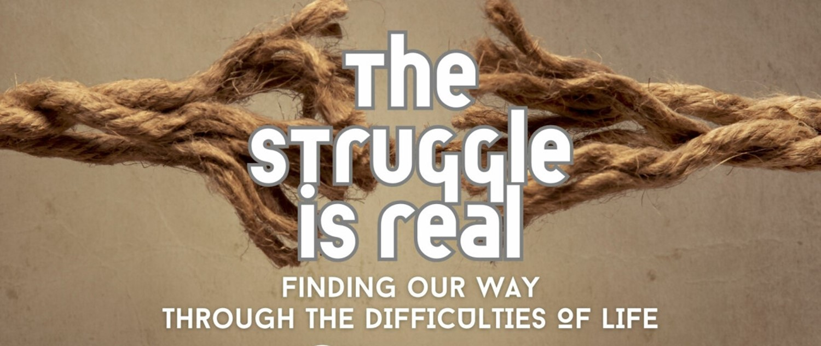
Step 1: Admit Powerlessness
Romans 7:18
“For I know that nothing good dwells in me, that is, in my flesh. For I have the desire to do what is right, but not the ability to carry it out.”
Romans 7:18 Amp
For I know that nothing good dwells within me, that is, in my flesh. I can will what is right, but I cannot perform it. [I have the intention and urge to do what is right, but no power to carry it out.]

Slide 9
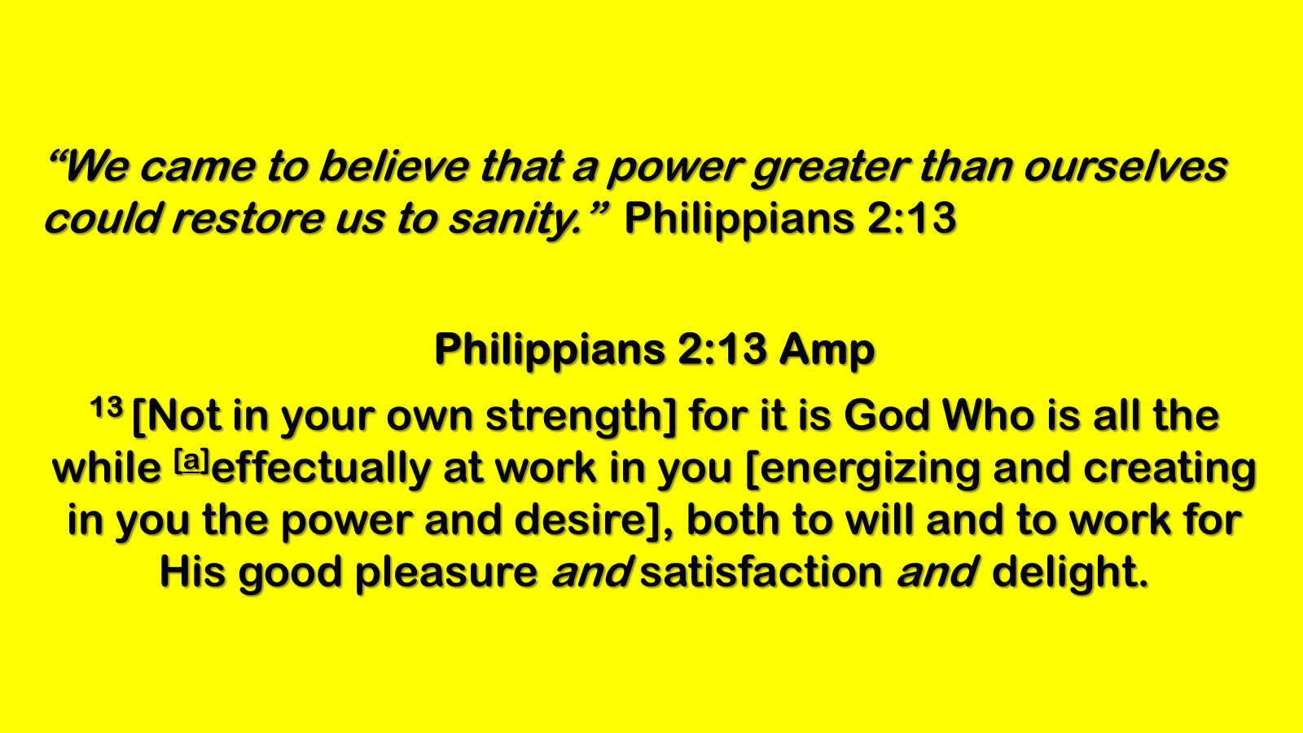
Step 2: Believe in God’s Power
“We came to believe…”
Philippians 2:13; Ephesians 3:20
  God Can Do What We Cannot
  His Power Restores And Renews
  The Same Power That Raised Jesus Lives In Us
“Faith is plugging into the Source.”

Slide 10
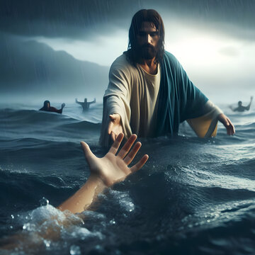
Step 3: Surrender to God’s Care
“We made a decision to turn our will / lives over…”
Romans 12:1; Proverbs 3:5–6
  Belief Must Lead To Surrender
  Surrender Is Not Losing…
  …It’s Winning By Letting God Lead
  God’s Care Is Safer Than Our Control
“A parachute only works if you jump.”

Slide 11
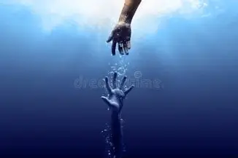
The Drowning Man
“We Can’t Thrash Our Way To Safety..
…We Must Cry For Help.”
We Need To Connect To God’s Power.

Slide 12
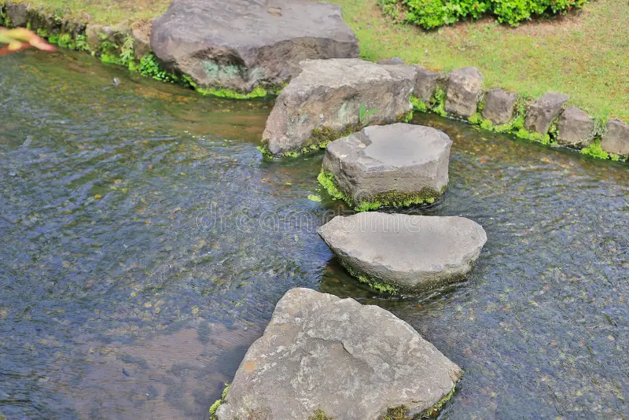
Steps Overview
Step 4: Fearless Moral Inventory
Step 5: Confession to God, Self, and Others
Step 6: Readiness For God’s Change
Step 7: Humble Request For God’s Help

Slide 13
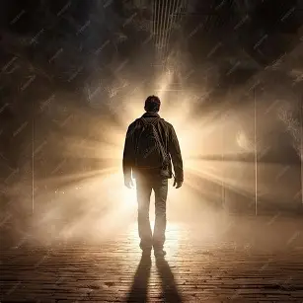
Step 4 is about “Courage” -the courage to look inside.
Psalm 139:23–24: “Search me, O God,/ know my heart; test me / know my anxious thoughts. See if there is any offensive way in me, /lead me in the way everlasting.”
This is Not About Dredging Up Shame…
Inviting God’s Light into the Dark Corners of Our Hearts
His Love Is Not Harsh; It Is Healing
Application:
Be Honest With Yourself—God Already Knows
Trust His Love To Hold You Steady As You Look Within
Remember: His Goal Is Not Exposure But Restoration

Slide 14
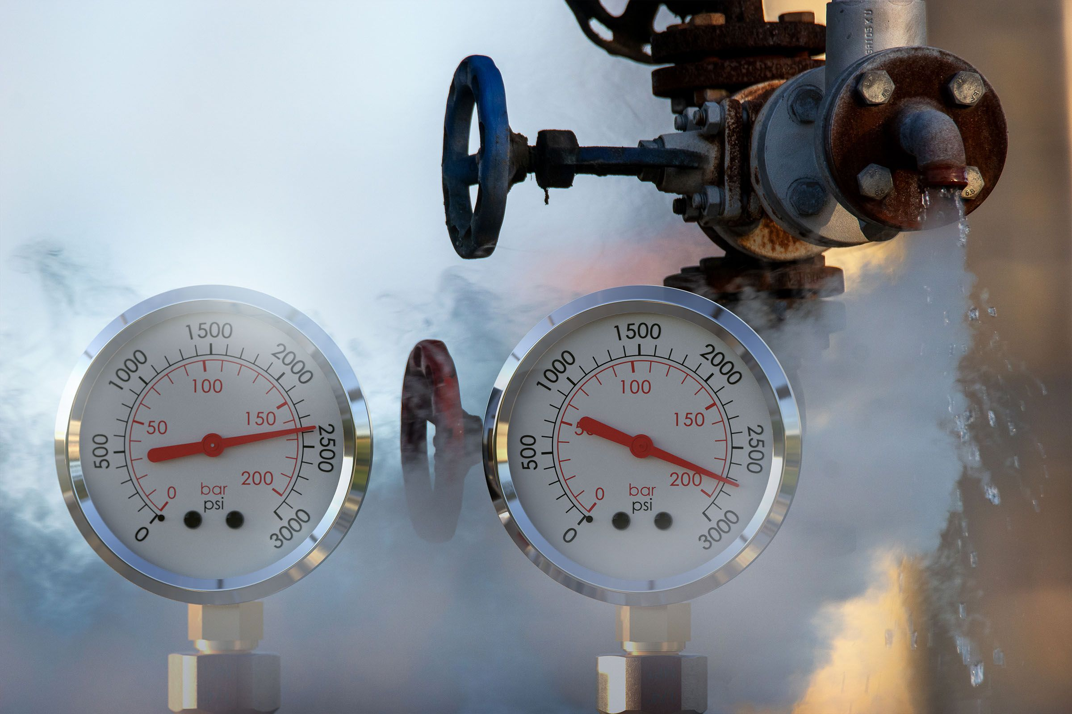
Step 5 is about “Confession” -the freedom of confession
Confess your sins to each other and pray for each other so that you may be healed.” (James 5:16)
Confession is not about shame—it’s about freedom.
Junk in the Trunk Keeps Us in Darkness
Confession Lets The Light In
Healing Comes When We Get Real
1 John 1:9,“If we confess our sins, He is faithful/ just to forgive us our sins / to cleanse us from all unrighteousness.”
Psalm 32:3–5, David said when he kept silent, his bones wasted away, but when he confessed, he found forgiveness.

Slide 15

Step 6 is about “Change” -the readiness for change.
“Being confident of this, that He who began a good work in you will carry it on to completion until the day of Christ Jesus.” (Phil 1:6)
Sp 6 is about being ready for God to remove our defects.
This is where willingness meets surrender.
We can’t change ourselves…
…but we can be ready for God to change us.
Readiness means we stop clinging to our old ways..
…open our hands to God’s new work.
Ezekiel 36:26,“I will give you a new heart/ put a new spirit in you.”
2 Cor 5:17,“If anyone is in Christ, the new creation has come: The old has gone, the new is here!”

Slide 16
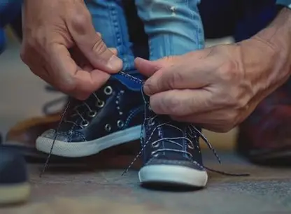
Step 7 is about “Cry” -the humility to ask
Humble yourselves, therefore, under God’s mighty hand, that He may lift you up in due time.” (1 Peter 5:6)
Sp 7 is about humbly asking God to remove our shortcomings.
Humility is not thinking less of yourself,
but thinking of yourself less.
It’s admitting: “God, I can’t fix me. But You can.”
God delights in answering the humble prayer for help.
Matthew 7:7,“Ask and it will be given to you.”
Psalm 51:10,“Create in me a clean heart, O God, and renew a right spirit within me.”

Slide 17
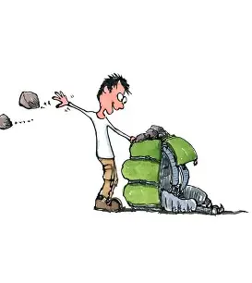
Steps 4–7 Are Not A March Through Shame…
…But A Walk w- A Gentle Shepherd
  In Step 4, He Examines Us with Compassion
  In Step 5, He Listens To Our Confession with Mercy
  In Step 6, He Shapes Us with Patience
  In Step 7, He Lifts Us with Love
The God who began this work in you will not abandon you
…His love is gentle, His grace is sufficient,
…His power is made perfect in your weakness.

Slide 18

Recovery is Not About Perfection…
….It’s About Progress.
God Doesn’t Just Forgive…
…He Transforms.

