Slide 1
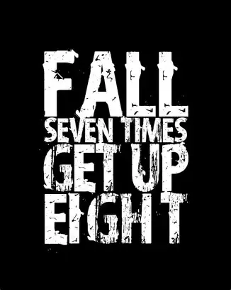

Slide 2
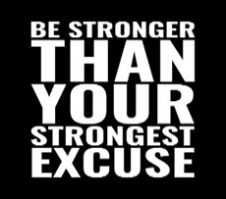
Spiritual Warfare
10% Satan’s Tactics
90% How We Respond
Remember…
With God We Are Not
Helpless
Hopeless
We Are Powerful!!

Slide 3
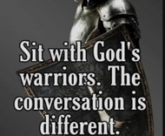
Repeat
These are the 2 Most Important Hours of My Week – Help Me to Cherish Them
I Am Here Today to Worship
Not to Be Entertained
I Am Singing to An Audience of One
Accept My Worship Oh Lord!

Slide 4
Edward Christian Church
10/12/2025

Slide 5
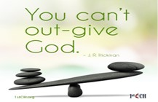
Repeat
I Lift My Offering to You
Let It Please You Oh Lord
This is My Seed
Although It Leaves My Hand
It will Never Leave My Life
You Will Multiply It!
Accept My Seed Oh Lord!

Slide 7
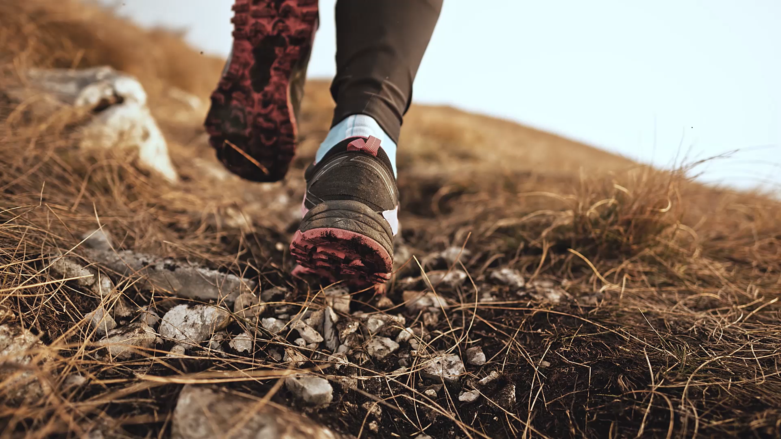
Recovery
12 Steps to Find Peace
Edward Church
October 12, 2025
Psalm 139:23–24

Slide 8
“The Courage to Make Things Right”
(Steps 8 & 9)
Edward Church
October 12, 2025
Come Together
Right Now
Over Me!

Slide 9
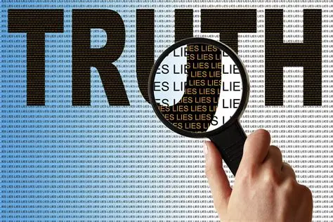
Every Christian Is in Recovery
  We All Battle Sin, Fear, Pride, Or Shame
  But the Gospel Is a Recovery Story
  Steps 1–3 = The Heart Of Discipleship
  Steps 4-7 = Cleansing & Confession
  Steps 8-9 = The Courage to Make Things Right
Come Together

Slide 10

Step 1: Admit Powerlessness
Romans 7:18
“For I know that nothing good dwells in me, that is, in my flesh. For I have the desire to do what is right, but not the ability to carry it out.”
Romans 7:18 Amp
For I know that nothing good dwells within me, that is, in my flesh. I can will what is right, but I cannot perform it. [I have the intention and urge to do what is right, but no power to carry it out.]

Slide 11
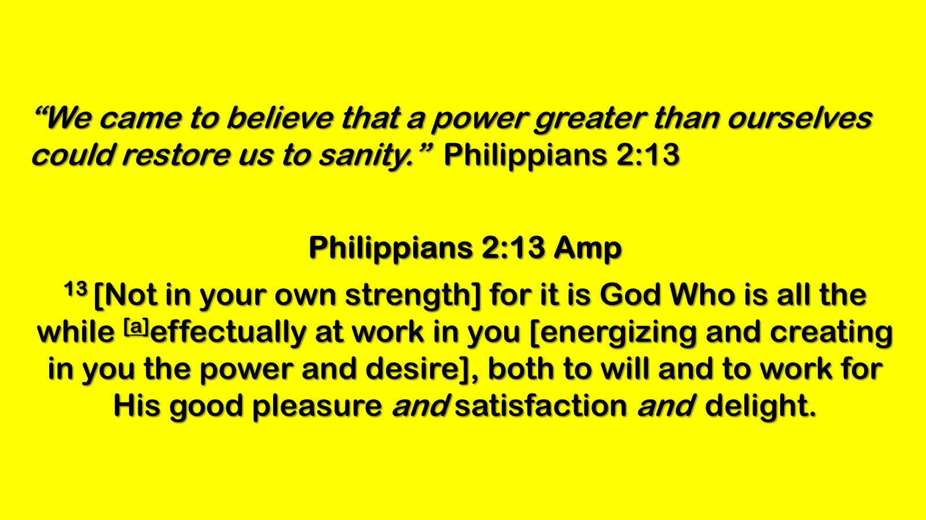
Step 2: Believe in God’s Power
“We came to believe…”
Philippians 2:13; Ephesians 3:20
Step 3: Surrender to God’s Care
“We made a decision to turn our will / lives over…”
Romans 12:1; Proverbs 3:5–6

Slide 12
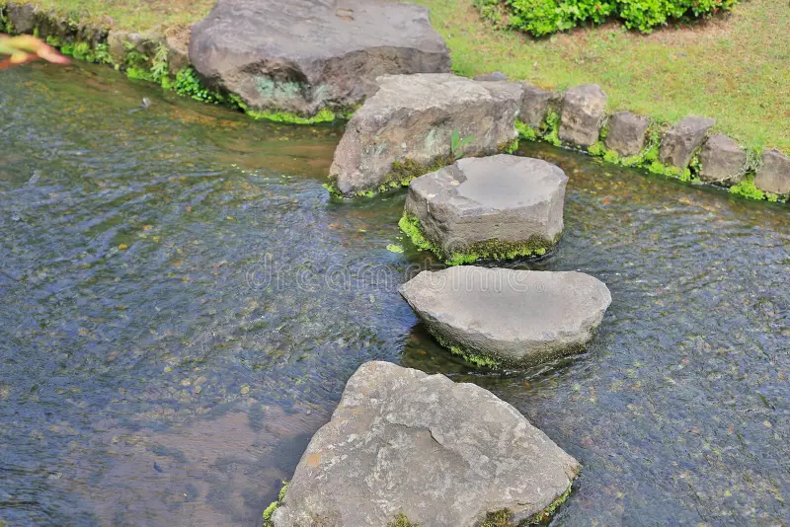
Steps Overview
Step 4: Fearless Moral Inventory
Step 5: Confession to God, Self, and Others
Step 6: Readiness For God’s Change
Step 7: Humble Request For God’s Help

Slide 13
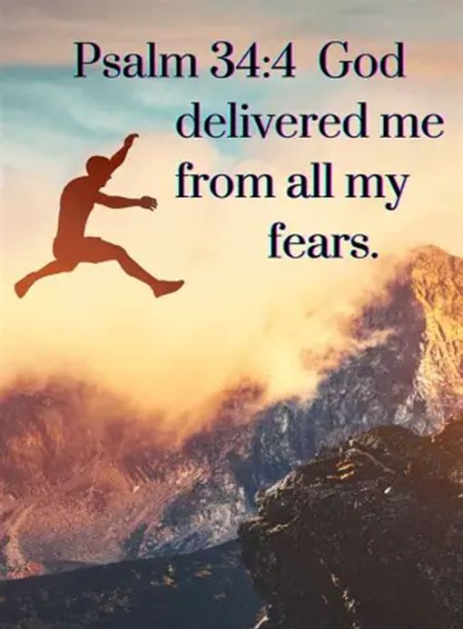
Recovery is Not About Perfection…
….It’s About Progress.
God Doesn’t Just Forgive…
…He Transforms.

Slide 14
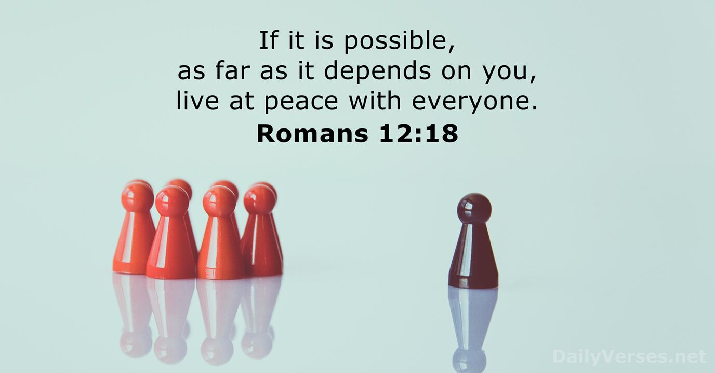
The Courage to Make Things Right
Steps 8 & 9
“If it is possible, as far as it depends on you,
live at peace with everyone”
– Romans 12:18

Slide 15
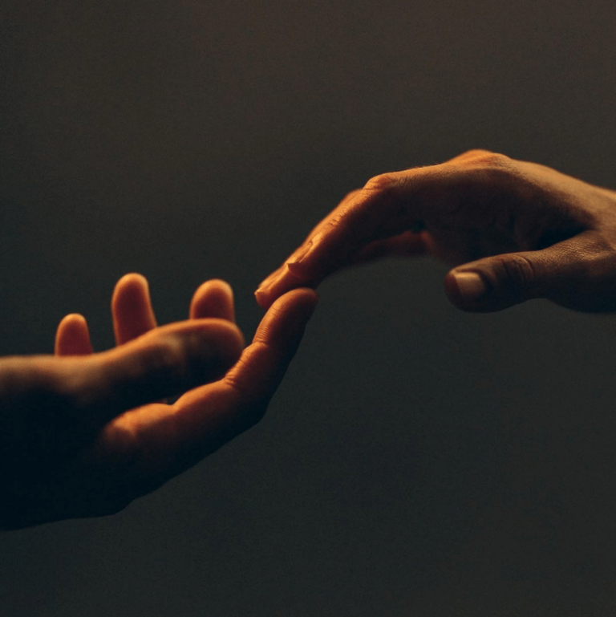
God’s Love Heals Relationships
Recovery is not just Inward
it’s Outward
God’s love flows through us into our relationships
Step 8: “Made a list of all persons we had harmed and became willing to make amends to them all.”
2 Corinthians 5:18,“God…
gave us the ministry of reconciliation.”
Recovery is not just about personal healing…
…it’s about relational restoration.
Not Just Vertical..
But Horizontal
God empowers us to make amends, rebuild trust, and walk in freedom.

Slide 16
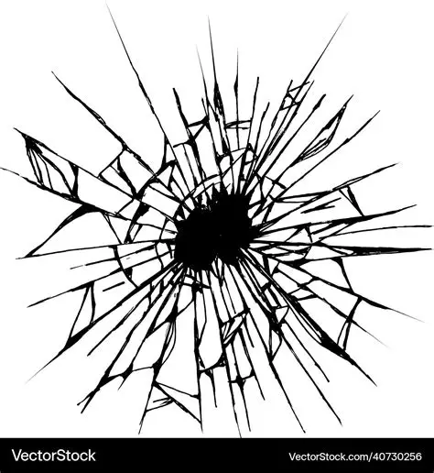
Step 8 – Willingness
Healing begins with willingness
Making a list is not about shame…
…it’s about freedom
God’s Love Gives Us Courage to Face the Past

Slide 17

Step 9 – Courage To Act
Step 9: “Made Direct Amends to Such People Wherever Possible…
…Except When to Do So Would Injure Them Or Others.”
Zacchaeus (Luke 19:8) – “If I Have Cheated Anybody…
…I Will Pay Back Four Times The Amount.”
Making Amends Is Not Groveling…
…it’s Growing

Slide 18
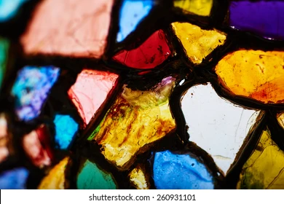
God’s Love Restores
Jesus is the ultimate reconciler (Colossians 1:20)
He took the first step toward us
Forgiveness is possible because of His love

Slide 19
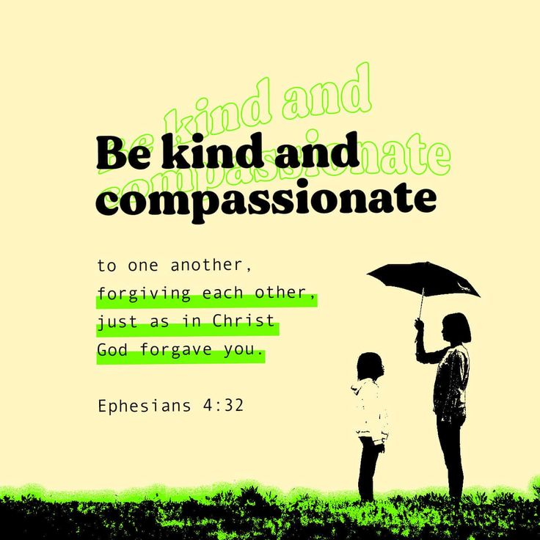
Daily Living Applications
Pray over your “list” this week
Take one step toward amends (letter, call, conversation)
Trust God with the outcome—your obedience honors Him
Ephesians 4:32 – “Be kind and compassionate… forgiving each other, just as in Christ God forgave you.”

Slide 20
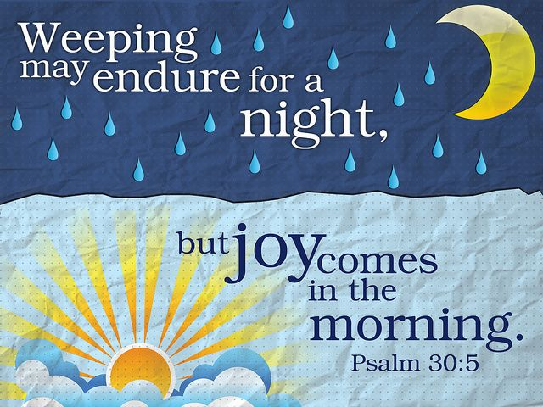
The Freedom of Love in Action
Step 8: Be Willing…
…God’s love makes you willing
Step 9: Be Courageous
…God’s love makes you brave
Both: Be like Jesus—
His love makes you new

Slide 21
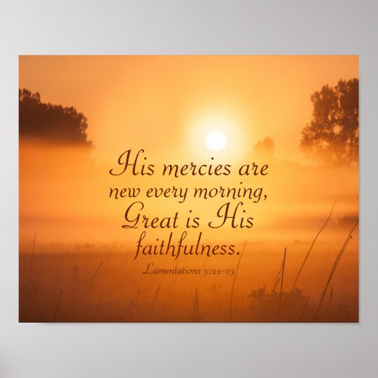
Phil 3:13–14,“Forgetting what is behind and straining toward what is ahead, I press on toward the goal…”
Be Encouraged:
You Are Not Defined By Your Mistakes…
…You Are Defined By God’s Love

Slide 23
Two old friends met one day after many years. One attended college, and now was very successful. The other had not attended college and never had much ambition.
The successful one said, "How has everything been going with you?“ "Well, one day I opened the Bible at random, and dropped my finger on a word and it was oil. So, I invested in oil, and boy, did the oil wells gush. "Then another day I dropped my finger on another word and it was gold. So, I invested in gold and those mines really produced. Now, I'm as rich as Rockefeller."
The successful friend was so impressed that he rushed to his hotel, grabbed a Gideon Bible, flipped it open, and dropped his finger on a page. He opened his eyes and his finger rested on the words, "Chapter Eleven."

