Slide 1
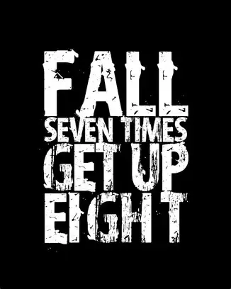

Slide 2

Spiritual Warfare
10% Satan’s Tactics
90% How We Respond
Remember…
With God We Are Not
Helpless
Hopeless
We Are Powerful!!

Slide 3
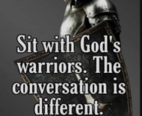
Repeat
These are the 2 Most Important Hours of My Week – Help Me to Cherish Them
I Am Here Today to Worship
Not to Be Entertained
I Am Singing to An Audience of One
Accept My Worship Oh Lord!

Slide 4

Edward Christian Church
8/17/2025

Slide 5

Repeat
I Lift My Offering to You
Let It Please You Oh Lord
This is My Seed
Although It Leaves My Hand
It will Never Leave My Life
You Will Multiply It!
Accept My Seed Oh Lord!

Slide 7

Recovery 12 Steps to Find Peace
Edward Church
October 12, 2025
Psalm 139:23–24

Slide 8
“Keeping Your List Short” (Step 10)
Edward Church
October 19, 2025
Making Sure the Check Doesn’t Bounce

Slide 9

Every Christian Is in Recovery
We All Battle Sin, Fear, Pride, Or Shame
But the Gospel Is a Recovery Story
Steps 1–3 = The Heart Of Discipleship
Steps 4-7 = Cleansing & Confession
Steps 8-9 = The Courage to Make Things Right
Come Together

Slide 10

Step 1: Admit Powerlessness
Romans 7:18
“For I know that nothing good dwells in me, that is, in my flesh. For I have the desire to do what is right, but not the ability to carry it out.”
Romans 7:18 Amp
For I know that nothing good dwells within me, that is, in my flesh. I can will what is right, but I cannot perform it. [I have the intention and urge to do what is right, but no power to carry it out.]

Slide 11
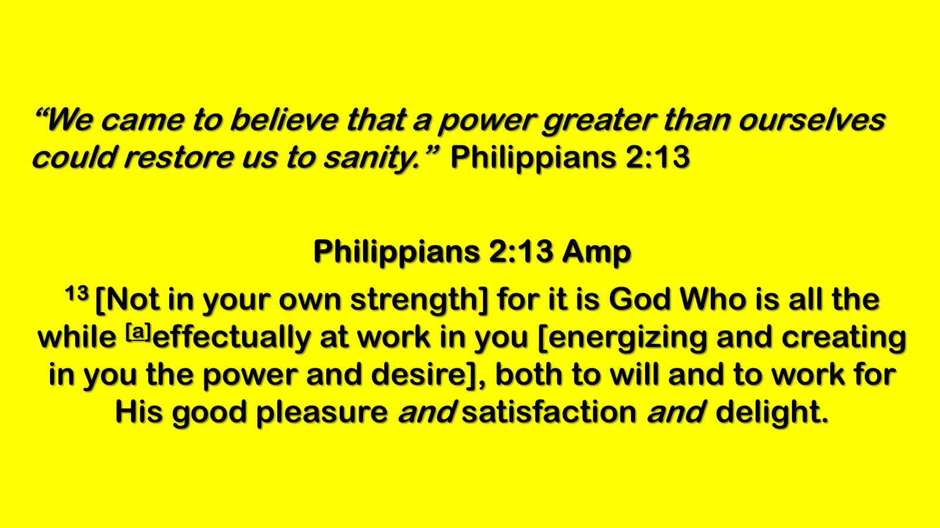
Step 2: Believe in God’s Power
“We came to believe…”
Philippians 2:13; Ephesians 3:20
Step 3: Surrender to God’s Care
“We made a decision to turn our will / lives over…”
Romans 12:1; Proverbs 3:5–6

Slide 12
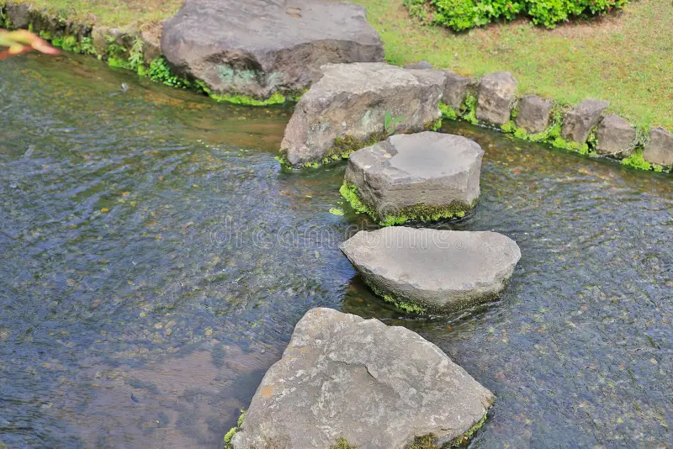
Steps Overview
Step 4: Fearless Moral Inventory
Step 5: Confession to God, Self, and Others
Step 6: Readiness For God’s Change
Step 7: Humble Request For God’s Help

Slide 13
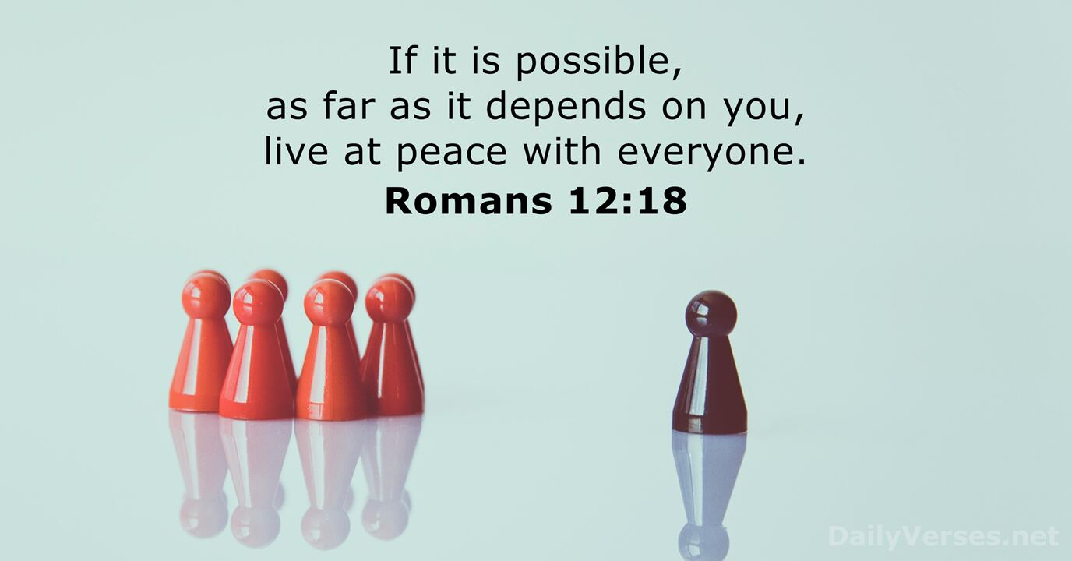
The Courage to Make Things Right
Steps 8 & 9
“If it is possible, as far as it depends on you,
live at peace with everyone”
– Romans 12:18

Slide 14

Step 10:
“We continued to take personal inventory and when we were wrong, promptly admitted it.”
Danger:
Letting Resentments, Guilt, and Sin Pile Up
Jesus: “First be reconciled…” (Matt. 5:23–24)

Slide 15
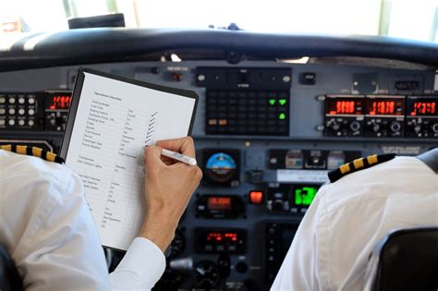
Daily Inventory
Lamentations 3:40;
Psalm 139:23–24;
Ecclesiastes 10:1
Truth:
Daily self‑examination prevents spiritual decay
Pilot’s pre‑flight checklist
Benjamin Franklin’s Moral Notebook

Slide 16
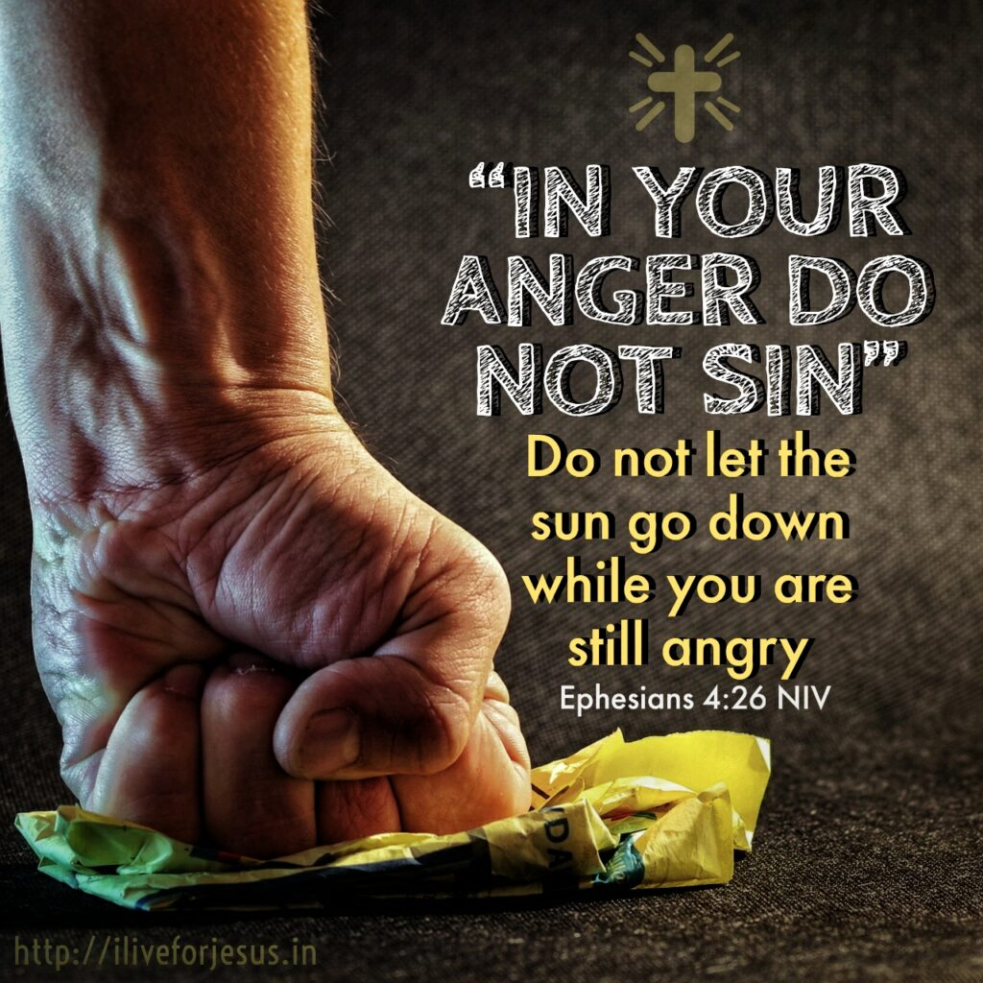
Prompt Admission
Ephesians 4:26
Proverbs 28:13
Numbers 32:23
Truth:
Admit wrongs quickly—don’t give the enemy a foothold
Roman soldiers burying waste to prevent disease
Library book fines piling up

Slide 17

Confession and Cleansing
1 John 1:9
James 5:16
Truth:
Confession is Cleansing, Not Condemnation
Taking out the trash daily
Kintsugi pottery—brokenness repaired with gold

Slide 18
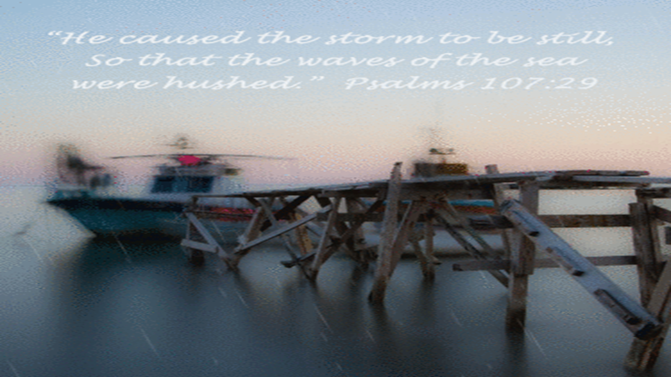
Making Amends Quickly
Matthew 5:24
Romans 12:18
Leviticus 6:4–5
Song of Solomon 2:15
Truth:
Confession + Restitution Restores Fellowship
Panama Canal tugboats make small corrections
Corrie Ten Boom Forgiving a Nazi Guard
Tugboat Guiding a Massive Ship

Slide 19
Conclusion
Keep Your List Short By:
Examining Daily
Admitting Promptly
Confessing Honestly
Reconciling Quickly
Trust God to Fill in the Gaps

Slide 20
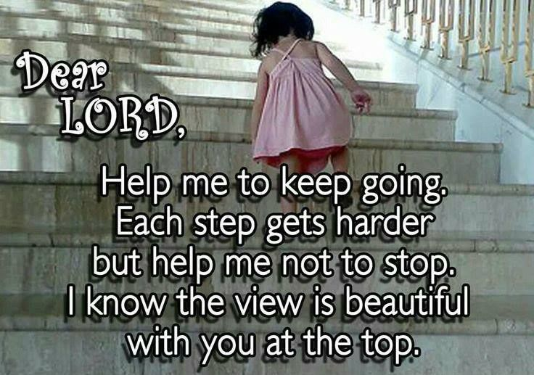
Closing Prayer
“Lord, Thank You for Step 10
Teach us to examine ourselves, admit wrongs quickly, confess boldly, and make amends promptly.
Help us to keep our list short,
so nothing stands between us and You,
or between us and others.
In Jesus’ Name, Amen.”

Slide 22
IMPORTANT NOTICE
Members are dying in the service and are failing to fall down.
This practice must stop as it becomes impossible to distinguish between death and the natural movement of the Church Members.
Any members found dead in the upright position will be dropped from the church roll.

