Slide 1

Edward Christian Church
Homecoming ‘25

Slide 2
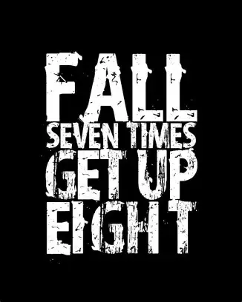

Slide 3

Spiritual Warfare
10% Satan’s Tactics
90% How We Respond
Remember…
With God We Are Not
Helpless
Hopeless
We Are Powerful!!

Slide 4

Repeat
These are the 2 Most Important Hours of My Week – Help Me to Cherish Them
I Am Here Today to Worship
Not to Be Entertained
I Am Singing to An Audience of One
Accept My Worship Oh Lord!

Slide 5

Repeat
I Lift My Offering to You
Let It Please You Oh Lord
This is My Seed
Although It Leaves My Hand
It will Never Leave My Life
You Will Multiply It!
Accept My Seed Oh Lord!

Slide 7

Don’t Give Up—Press On Gal 6:9 & Phil 3:13–14
Homecoming 2025

Slide 8

It’s a time to look back/ remember where God has brought us from, to celebrate the saints who labored before us, / to look forward with hope to what God will yet do.
As we gather today, we are reminded that the church is not built on one generation alone—it is built on the faithfulness of many who refused to give up.
Paul’s words in Galatians 6:9 speak directly to us on this Homecoming Sunday: “Let us not grow weary of doing good, for in due season we will reap, if we do not give up.”
That’s the story of this church. Through trials and triumphs, through lean years and fruitful years, God has sustained us because faithful men and women kept sowing seeds of prayer, service, and love.

Slide 9

Homecoming = Memory + Momentum
Looking Back with Gratitude
Looking Forward with Hope
Don’t Give Up—Press On

Slide 10

Galatians 6:9 NLT
“So let’s not get tired of doing what is good. At just the right time we will reap a harvest of blessing if we don’t give up”
Phil 3:13–14
“Forgetting what lies behind / straining forward to what lies ahead, I press on toward the goal for the prize of the upward call of God in Christ Jesus.”

Slide 11
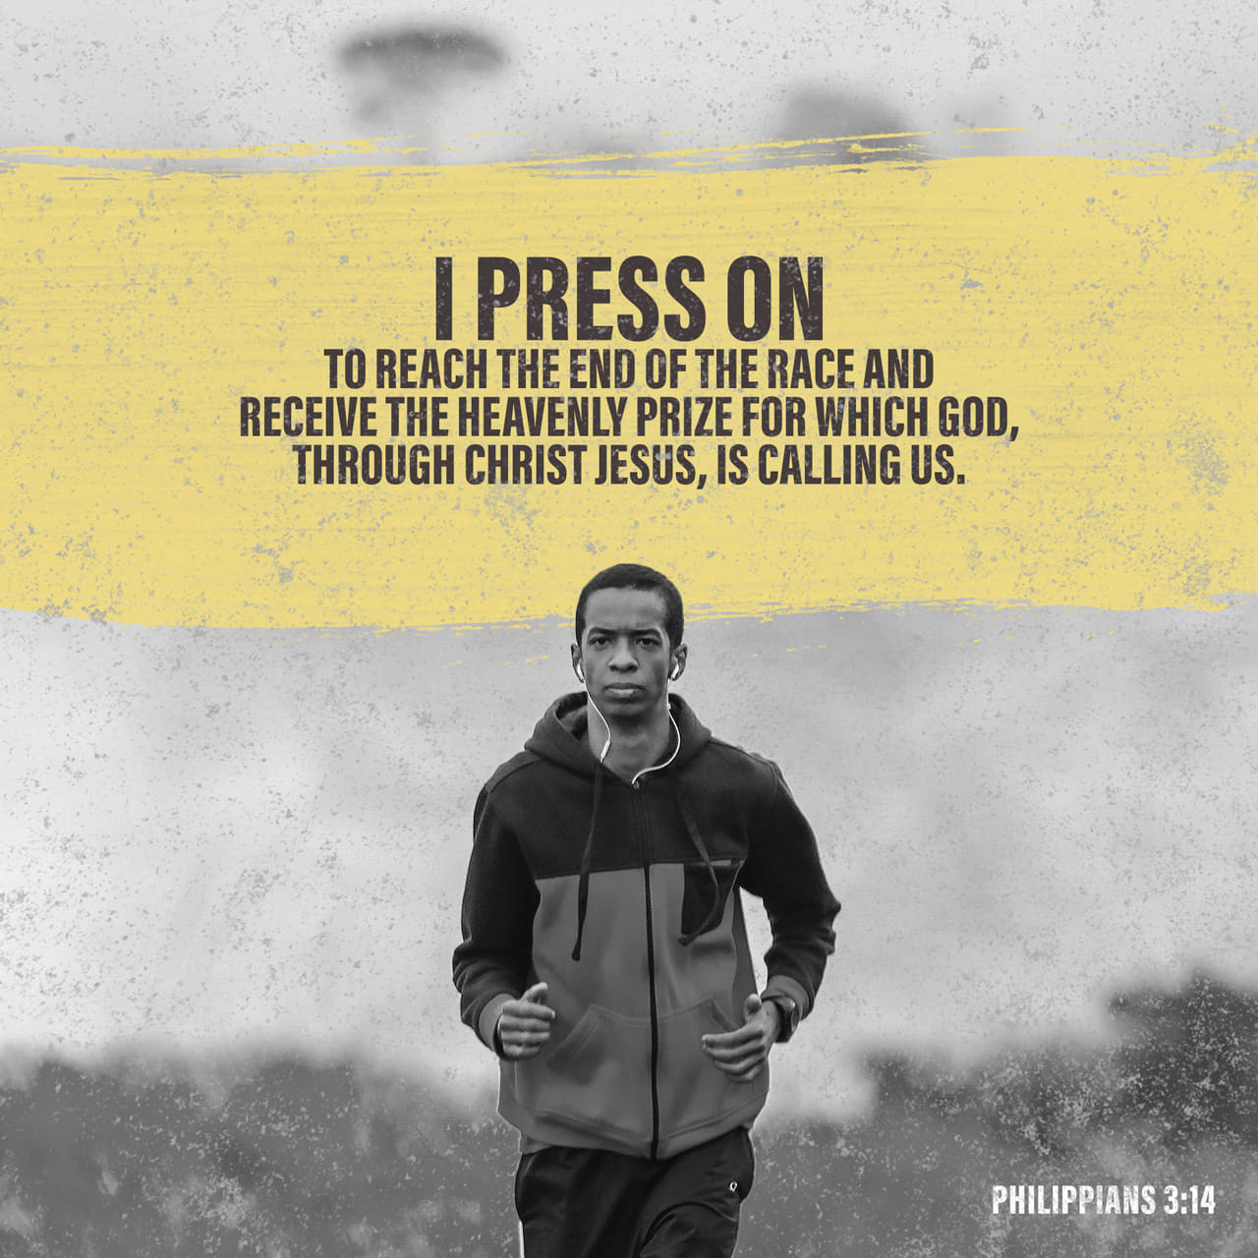
#1: The Weariness of the Past
The Caution
Doing Good Can Make Us Weary (Gal. 6:9)
Past Struggles:
…Lean Years, Hard Work, Sacrifice
Saints Before Us Pressed Through
Phil. 3:13 – Forgetting what lies behind

Slide 12
Florence Chadwick:
Gave Up Swim …
…Because Of Fog, Not Fatigue
Sometimes it’s Not the Distance
…but Discouragement that Makes Us Quit
Application:
Don’t Let the “Fog” of Discouragement…
…Blind You to God’s Shore

Slide 13
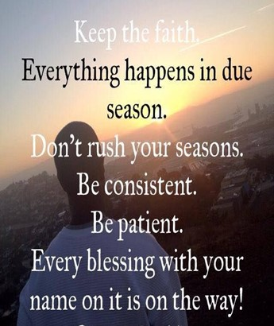
#2: The Promise of the Present
The Challenge
“In due season we will reap” -Gal. 6:9
Homecoming = Proof of Harvest
We are the Fruit of Prayers and Sacrifices of…
…Past Generations
Phil. 3:14 – Press on toward the prize

Slide 14
Bamboo: unseen growth for years,
…then sudden breakthrough
God’s Work Often Hidden Until The Right Time
Application:
Trust God’s Timing…
…your “Due Season” is Coming

Slide 15

#3: The Perseverance of the Future
The Condition:
“If we do not give up”
Perseverance Bridges Planting and Reaping
Pressing Forward = Active, Intentional Faith
Phil. 3:14 – Straining forward, pressing on

Slide 16

John Stephen Akhwari, 1968 Olympics:
…Finished Last But Refused to Quit
“My country did not send me to start the race,
…but to finish it.”
Application:
God Didn’t Bring Us This Far To Quit Now

Slide 17

Don’t Give Up in Your Walk with God
Don’t Give Up In Your Family
Don’t Give Up In Your Service to the Church
Don’t Give Up In Your Prayers for this Community
Instead: Press Forward, Strain Toward What Lies Ahead

Slide 18
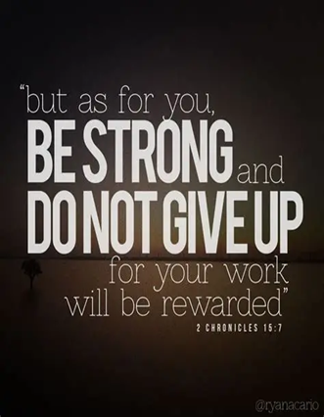
Winston Churchill:
“Never Give In…
…Never Give In.
…Never, Never, Never.”
Galatians 6:9 & Philippians 3:14
“Let us not grow weary… In due season we will reap… I
press on toward the goal for the prize of the upward call
of God in Christ Jesus.”

Slide 19

Faith Doesn’t Grow In Comfort…
…It Grows In Waiting.
When God Delays…
…He’s Developing Something Deeper In You.
Don’t Give Up Before The Harvest…
…Keep Watering The Promise
“Let us not become weary in doing good, for at the proper time we will reap a harvest if we do not give up” -Gal 6:9

Slide 21
After the fall in Garden of Eden, Adam was walking with his sons Cain and Abel.
As they passed by the ruins of the Garden of Eden, one of the boys asked,
"Father, what's that?"
Adam replied, "Boys, that's where your mother ate us out of house and home.“
We Should Plenty Today –So Eat Up

