Slide 1
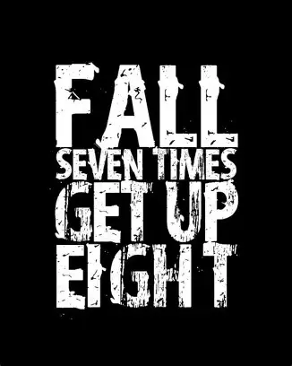

Slide 2

Spiritual Warfare
10% Satan’s Tactics
90% How We Respond
Remember…
With God We Are Not
Helpless
Hopeless
We Are Powerful!!

Slide 3
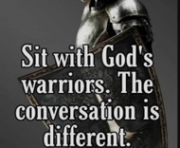
Repeat
These are the 2 Most Important Hours of My Week – Help Me to Cherish Them
I Am Here Today to Worship
Not to Be Entertained
I Am Singing to An Audience of One
Accept My Worship Oh Lord!

Slide 4
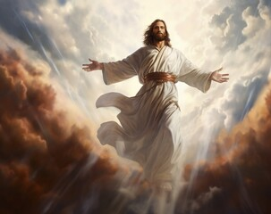
Edward Christian Church
11/2/2025

Slide 5

Repeat
I Lift My Offering to You
Let It Please You Oh Lord
This is My Seed
Although It Leaves My Hand
It will Never Leave My Life
You Will Multiply It!
Accept My Seed Oh Lord!

Slide 7

Recovery 12 Steps to Find Peace
Edward Church
October 12, 2025
Joshua 1:8

Slide 8
“Improving Our Communication Skills w- God” (Step 11) Joshua 1:8
Edward Church
November 2, 2025
Talk to Me Goose

Slide 9

Every Christian Is in Recovery
We All Battle Sin, Fear, Pride, Or Shame
But the Gospel Is a Recovery Story
Steps 1–3 = The Heart Of Discipleship
Steps 4-7 = Cleansing & Confession
Steps 8-9 = The Courage to Make Things Right
Come Together

Slide 10

Step 1: Admit Powerlessness
Romans 7:18 Amp
For I know that nothing good dwells within me, that is, in my flesh. I can will what is right, but I cannot perform it. [I have the intention and urge to do what is right, but no power to carry it out.]

Slide 11
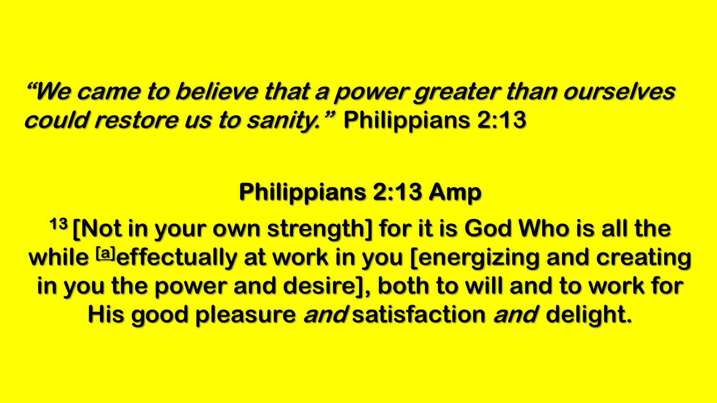
Step 2: Believe in God’s Power
“We came to believe…”
Philippians 2:13; Ephesians 3:20
Step 3: Surrender to God’s Care
“We made a decision to turn our will / lives over…”
Romans 12:1; Proverbs 3:5–6

Slide 12
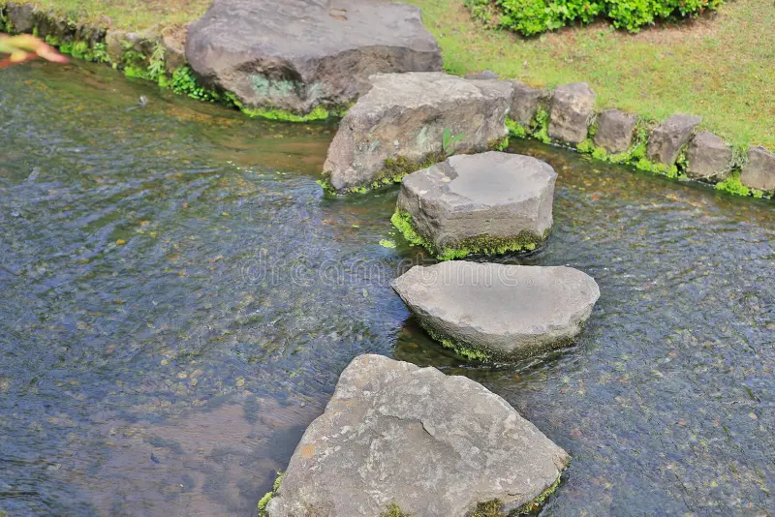
Step 4: Fearless Moral Inventory
Step 5: Confession to God, Self, and Others
Step 6: Readiness For God’s Change
Step 7: Humble Request For God’s Help

Slide 13
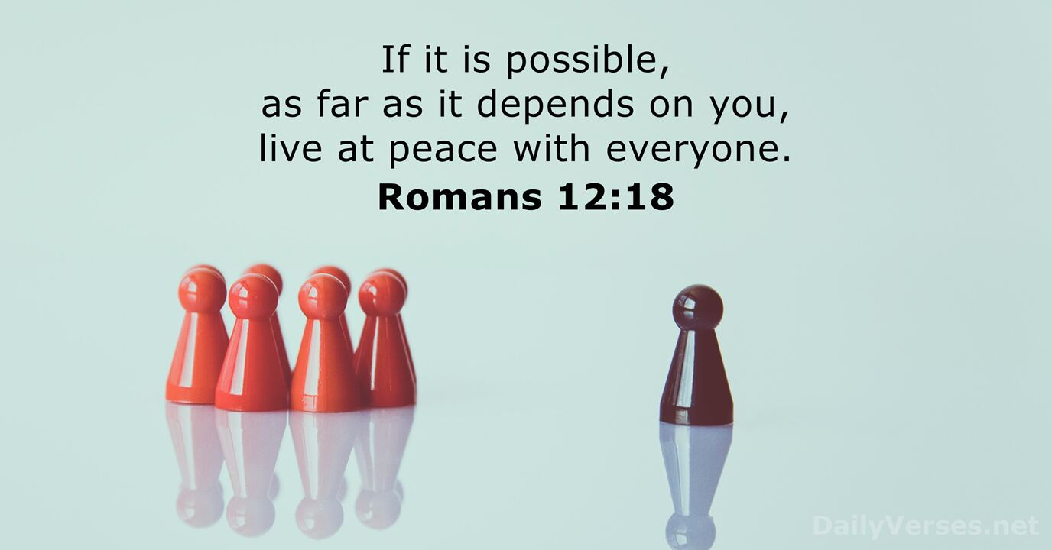
The Courage to Make Things Right
Steps 8 & 9
Step 10:
“We continued to take personal inventory and when we were wrong, promptly admitted it.”

Slide 14
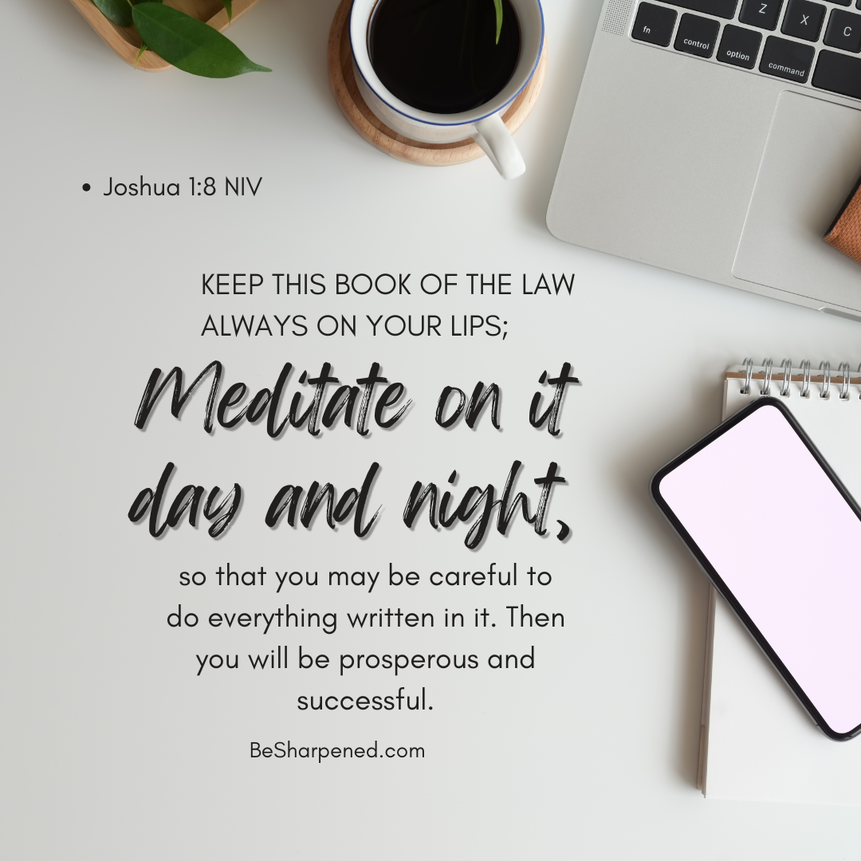
Step 11
“We sought through prayer and meditation to improve our conscious contact with God…”
“…praying only for knowledge of His will for us and the power to carry that out.”

Slide 15
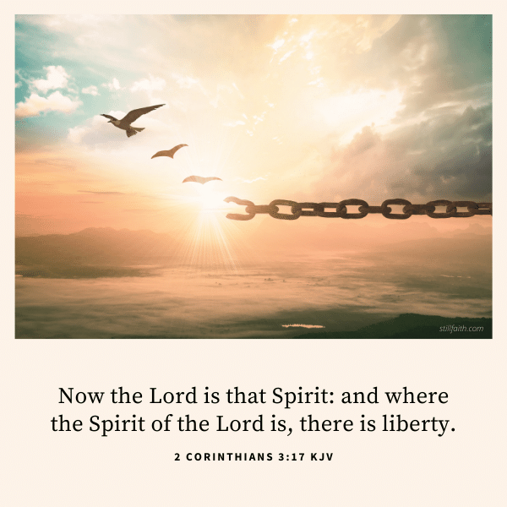
Step 11:
Conscious Contact with God
“God Not Only Commutes Your Sentence
He Wants to Communicate With You.”
That’s Not Just a Recovery Principle
It’s a Discipleship Principle

Slide 16

Recovery is Not Just Breaking Chains
It’s Building a Relationship.
God Wants More Than Parole…
….He Wants Presence.
The Heart of Step 11 is Intimacy.
God Doesn’t Just Want to Fix Us
He Wants to Walk with us.
He Wants us to Hear His Voice,
Feel His Presence,
and Live in His Love.

Slide 17
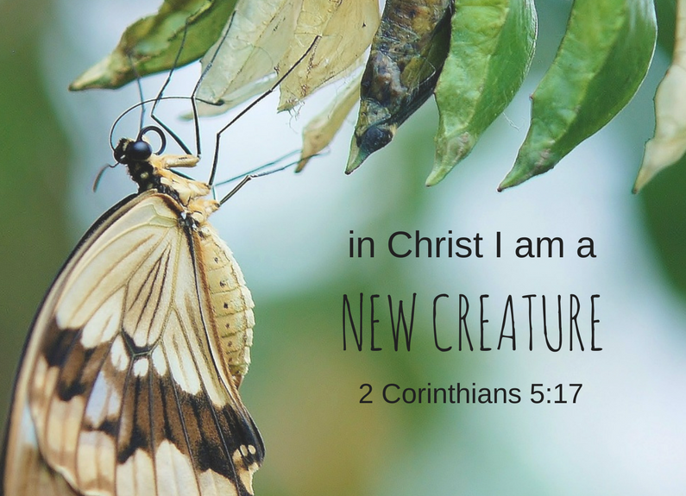
Every Believer is called to
Grow in Prayer, to
Listen for God’s voice, and to
Walk in His Will.
We all need Daily Intimacy with God.
Whether in Recovery from Addiction, Grief,
Anger, Or Simply the Weight of Life
Step 11 is an …
…Invitation to Deeper Relationship

Slide 18
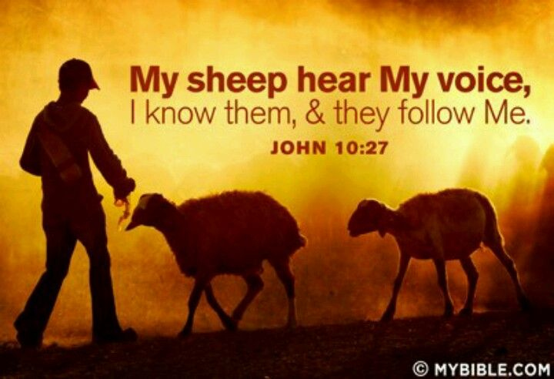
Call to Prayer and Meditation
Step 11 says we sought through prayer and
meditation to improve our conscious contact with God.
Prayer is Us Speaking to God.
Meditation is Us Listening to God.
Conscious Contact means…
…Living Aware of His Presence
…In the Everyday Moments of Life
Meditation
Psalm 46:10,‘Be still, and know that I am God.’
Conscious Contact.
1 Thes 5:17,‘Pray without ceasing.’

Slide 19
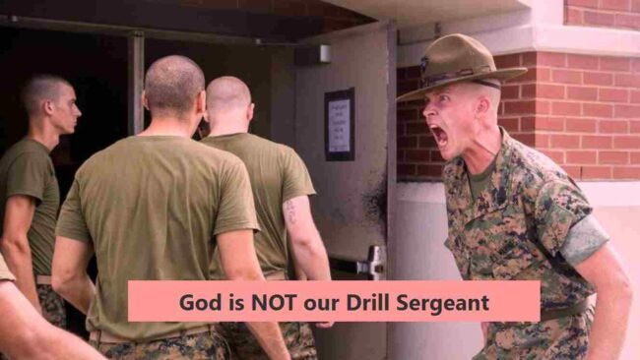
Why This Matters for the Whole Church
This is not just a Recovery Principle
it’s a Discipleship Principle
Without Prayer, We Drift
Without Meditation, We Miss God’s Whisper
Without Conscious Contact,
We Live As If God Is Distant, When He Is Near
Intimacy is Not Automatic
It Must Be Sought
It Must Be Improved
It Must Be Practiced

Slide 20
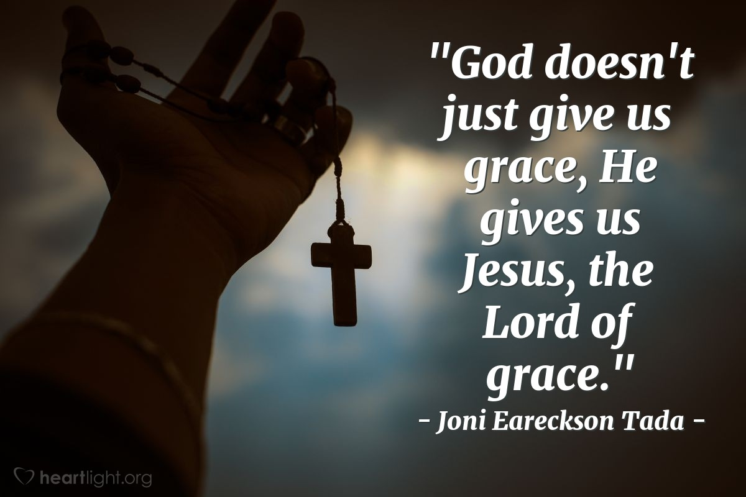
Application to Church Life
Personal: Daily prayer rhythm
Family: Model prayer at home
Ministry: Pray before planning
Worship: Space for Silence and Listening
We Open Space to Hear God’s Spirit Speak
When a Church Practices Step 11 together,
…it Becomes
Praying Church
Listening Church
Spirit‑led Church

Slide 21
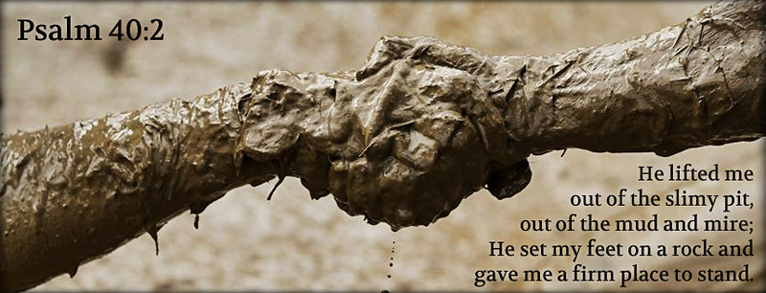
Closing Challenge
“Step 11 is not about Perfect Prayers….
…It’s about Daily Connection.
This week, I Challenge You:
Spend 10 minutes each day in Silence before God
Pray Not for Your Will, but His
Ask for the Power to Carry It Out
Like the astronaut’s tether, beekeeper…
God is inviting us to Live in
…Conscious Contact with Him, Every Day

Slide 22
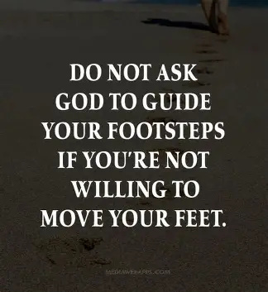
That’s Step 11 in Action
Psalm 46:10, ‘Be still, and know that I am God.’
Stillness Is Not Wasted Time — It’s Sacred Time.
It’s Where We Hear His Voice Most Clearly.”
Let’s Pray Together:
Lord, we seek You. Teach us to Pray. Teach us to Listen.
Teach us to Walk in Your Will. Fill our Cracks with Your glory
Keep Us Tethered to Your presence
and Tune Our Hearts to Your voice
In Jesus’ name, Amen

Slide 24
A customer at Gene's Gourmet Grocery marveled at the proprietor's quick wit and intelligence.
"Tell me, Gene, what makes you so smart?"
"Fish heads," says Gene. "You eat enough of them, you'll be positively brilliant.
"You sell them here?" the customer asks.
"Only $4 apiece," says Gene.
The customer buys three. A week later, he's back in the store complaining that the fish heads were disgusting and he isn't any smarter.
"You didn't eat enough, " says Gene. The customer goes home with 20 more fish heads. Two weeks later, he's back and this time he's really angry.
"Hey, Gene," he says, "You're selling me fish heads for $4 apiece when I just found out I can buy the whole fish for $2. You're ripping me off!"
"You see?" says Gene. "You're smarter already.

