Slide 1
“Living the Message” (Step 12) Eph 5:14
Edward Church
November 9, 2025
Wake Up
Walk It Out

Slide 2

Every Christian Is in Recovery
We All Battle Sin, Fear, Pride, Or Shame
But the Gospel Is a Recovery Story
Steps 1–3 = The Heart Of Discipleship
Steps 4-7 = Cleansing & Confession
Steps 8-9 = The Courage to Make Things Right
Come Together

Slide 3

Step 1: Admit Powerlessness
Romans 7:18 Amp
For I know that nothing good dwells within me, that is, in my flesh. I can will what is right, but I cannot perform it. [I have the intention and urge to do what is right, but no power to carry it out.]

Slide 4
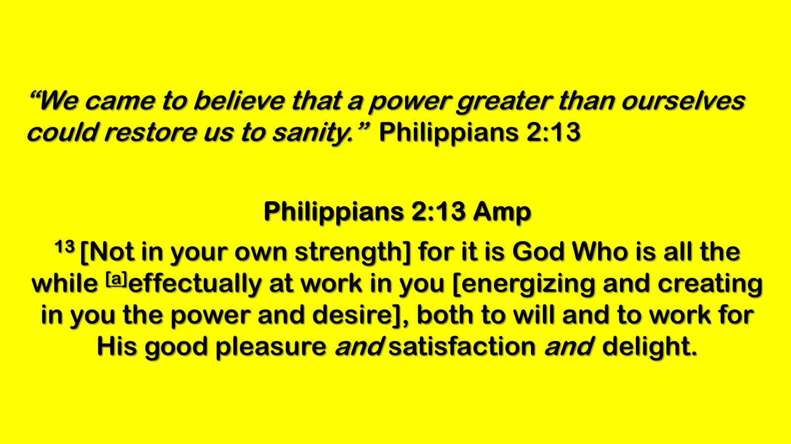
Step 2: Believe in God’s Power
“We came to believe…”
Philippians 2:13; Ephesians 3:20
Step 3: Surrender to God’s Care
“We made a decision to turn our will / lives over…”
Romans 12:1; Proverbs 3:5–6

Slide 5
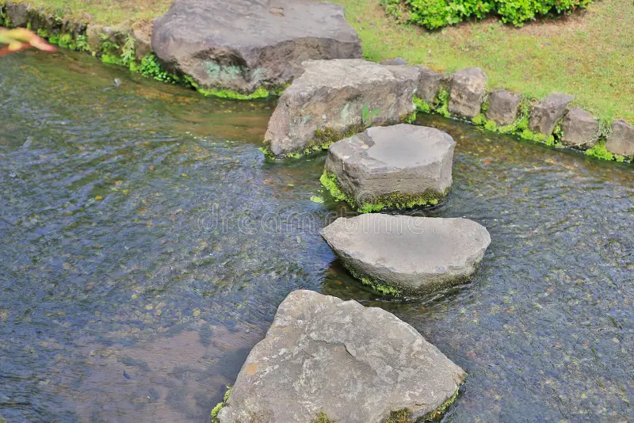
Step 4: Fearless Moral Inventory
Step 5: Confession to God, Self, and Others
Step 6: Readiness For God’s Change
Step 7: Humble Request For God’s Help

Slide 6
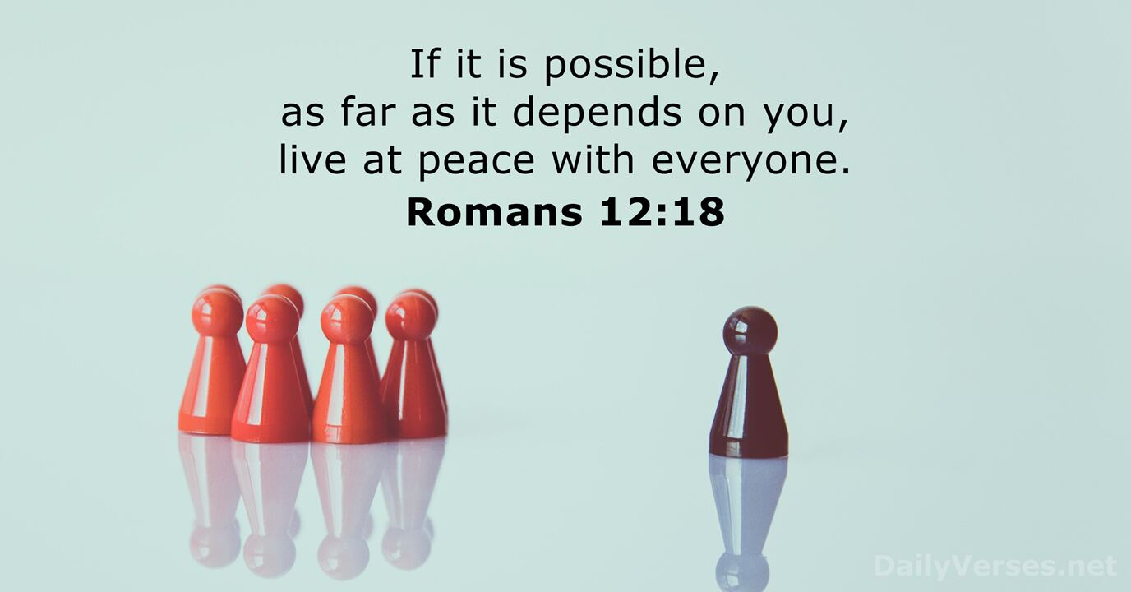
The Courage to Make Things Right
Steps 8 & 9
Step 10:
“We continued to take personal inventory and when we were wrong, promptly admitted it.”

Slide 7
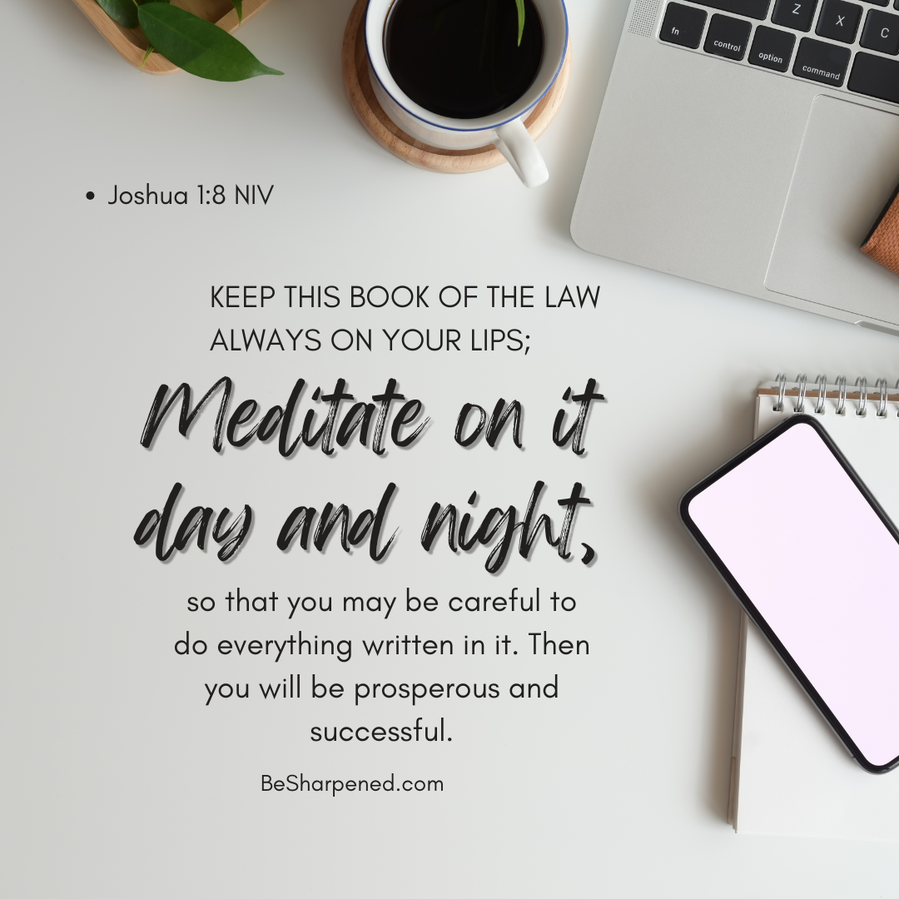
Step 11
“We sought through prayer and meditation to improve our conscious contact with God…”
“…praying only for knowledge of His will for us and the power to carry that out.”

Slide 8
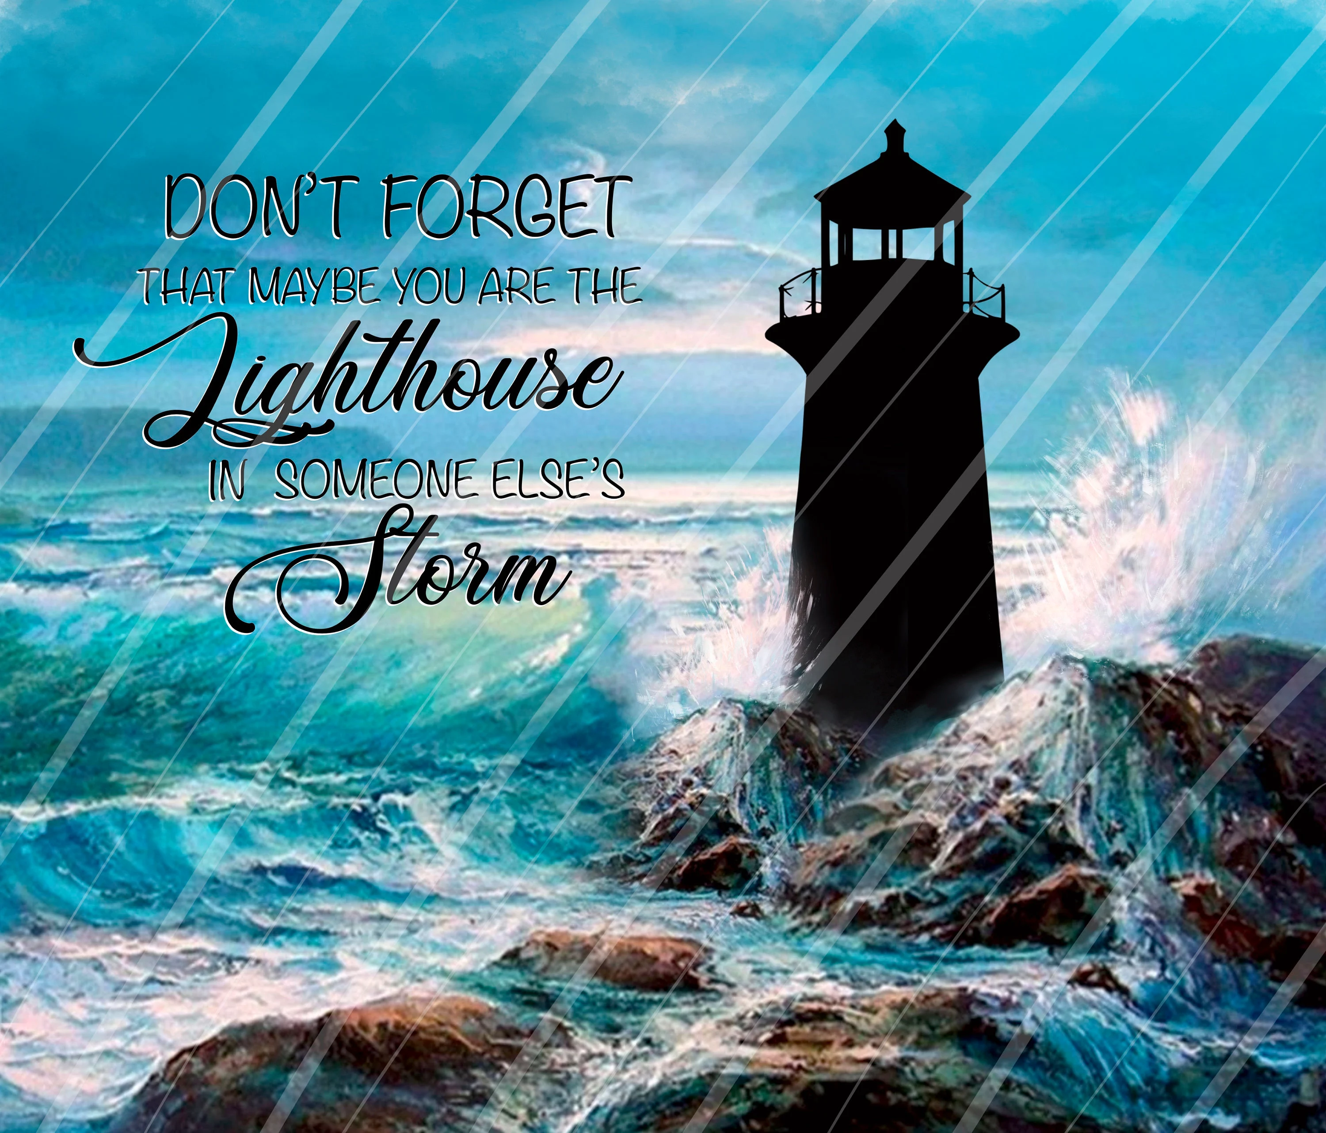
Step 12:
Living the Message, Lighting the World
2 Tim 1:7,“God has not given us a spirit of fear, but of power, love, and a sound mind.”
Wake Up –Walk It Out

Slide 9
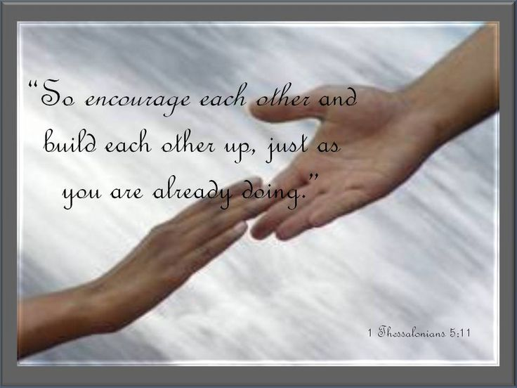
Recovery = Redemption.
Step 12 =
The Great Commission in recovery language.
Mission: Rescued → Rescuers, Healed → Healers, Loved → Lovers.

Slide 10
Step 12 says: ‘Having had a spiritual awakening as the result of these steps, we try to carry this message to others and to practice these principles in all our affairs.’
In other words: You’ve been rescued — now become a rescuer. You’ve been healed — now become a healer. You’ve been loved — now go love.”
Scripture Foundation
Matthew 5:14–16 — “You are the light of the world. A town built on a hill cannot be hidden… let your light shine before others.”
2 Corinthians 1:4 — “He comforts us in all our troubles so that we can comfort others.”

Slide 11
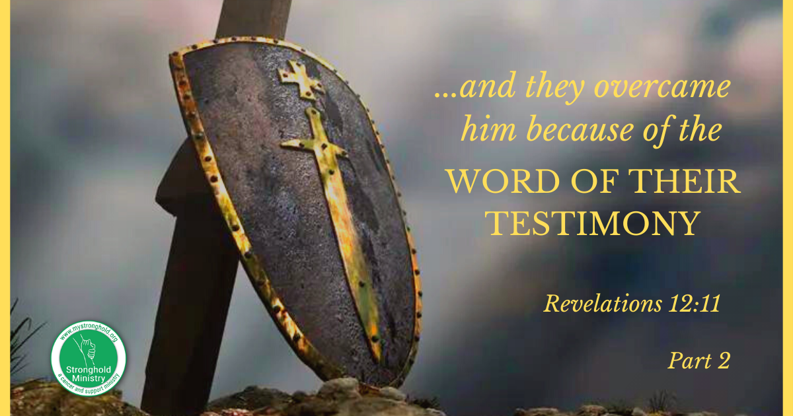
Carry the Message with Joy
(Visibility Challenge)
Matthew 5:14–16
Key Point:
Light Must Be Visible.
Story:
Woman Baking Cookies For Firefighters.
Challenge:
Share Your Story This Week.

Slide 12
Matthew 5:14–16, ‘You are the light of the world. A city set on a hill cannot be hidden.’
In Greek, ‘light’ (phōs) means revelation — the church is meant to reveal Christ. Jesus says discipleship is public, not private.
Story: A woman in recovery baked cookies every Friday and delivered them to the fire station. She said, ‘I can’t repay the world for saving me, but I can sweeten it.’
That’s Step 12 — carrying the message with joy.
Illustration: Imagine if every Christian carried joy like confetti. You walk into the grocery store, and suddenly people are smiling because you’re sprinkling hope everywhere.
Challenge: Share your story of redemption with someone outside the church this week. Don’t keep your light under a basket.”

Slide 13
“Step 12 begins with ‘having had a spiritual awakening.’ This is not just emotional relief or temporary change — it’s a transformation of the heart.
Ephesians 5:14 says, ‘Wake up, sleeper, rise from the dead, and Christ will shine on you.’
Spiritual awakening means we see differently, love differently, and live differently.
Illustration: The Caterpillar and the Butterfly — A caterpillar doesn’t just improve; it transforms. Step 12 is about living as a butterfly, not crawling like a caterpillar anymore.”
Carrying the Message
“Step 12 calls us to ‘carry this message to others.’ Recovery is not meant to be hoarded; it’s meant to be shared.
2 Corinthians 1:4 says, ‘God comforts us in all our troubles so that we can comfort those in any trouble with the comfort we ourselves receive from God.’
Your story is someone else’s survival guide.

Slide 14

Practice Principles Everywhere
(Consistency Challenge)
Scripture: James 1:22
Key Point:
Faith Must Produce Action.
Story:
Man Praying For Drivers In Traffic.
Challenge:
Live Principles At Home, Work, And In Conflict.

Slide 15
Point 2 — Practice the Principles Everywhere
“James 1:22 says: ‘Do not merely listen to the word… do what it says.’
The Greek word for ‘do’ (poiētēs) means maker, producer.
Faith is not passive; it creates action.
Story: A man said, ‘I used to lose my temper in traffic. Now I pray for the person who cut me off. Sometimes I pray they get pulled over… but I pray!’ That’s practicing principles in all affairs.
Illustration: Recovery principles are like duct tape. They hold together cars, shoes, even relationships if you’re creative.
Challenge: Ask yourself daily: ‘Am I living this at home, at work, in traffic, in conflict?’
Practice the principles everywhere, not just in safe spaces.”

Slide 16

Love with Agape
(Agape Challenge)
John 13:35
Key Point:
Love is the Evidence of Discipleship.
Story:
Pastor chasing chickens = God’s relentless love.
Challenge:
Love Someone Hard to Love This Week.

Slide 17
John 13:35 says: ‘By this everyone will know that you are my disciples, if you love one another.’
The word ‘love’ here is agapē — unconditional, sacrificial love. Jesus says love is the apologetic of the church.
Story: A pastor once kept chickens. Every time one escaped, he’d chase it down, scoop it up, and bring it back. He said, ‘That’s how God loves us — He doesn’t stop chasing.’ That’s agape love in action.
Illustration: Agape love is like a bottomless soup pot. No matter how many bowls you serve, it never runs out.
Challenge: Love someone who is hard to love this week. Show kindness where it’s undeserved. That’s agape in action.”

Slide 18
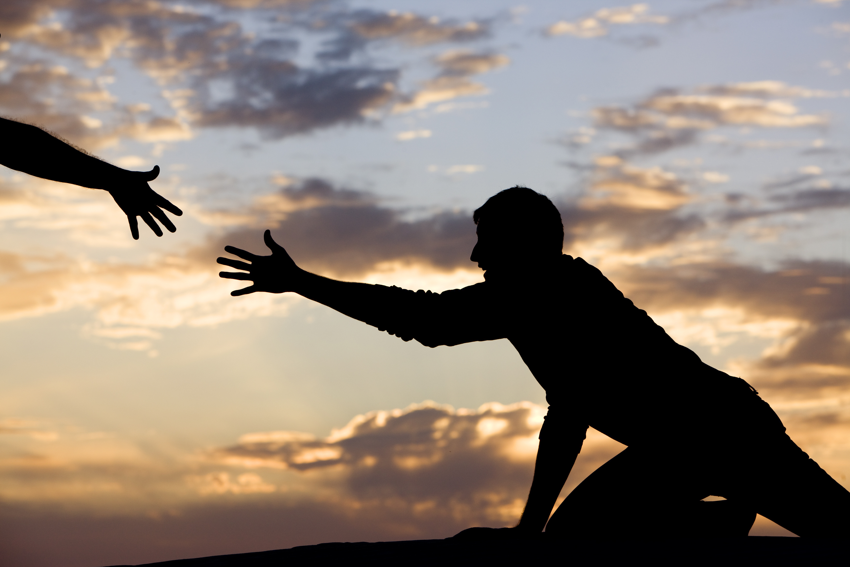
Comfort Others Creatively
(Creativity Challenge)
2 Corinthians 1:4
Key Point:
God Comforts Us So We Can Comfort Others.
Stories:
Free Lawn Mowing
Challenge:
Find An Unusual Way to Carry the Message.

Slide 19
2 Corinthians 1:4 says: ‘He comforts us in all our troubles so that we can comfort others.’
The word ‘comfort’ (parakaleō) means to come alongside, to strengthen, to encourage.
God comforts us so we can creatively comfort others.
Story: A man in recovery started a ‘Free Lawn Mowing’ ministry.
He said, ‘I can’t fix your life, but I can fix your yard.’
Story: A group of recovering friends dressed up as superheroes and visited children’s hospitals.
They said, ‘We’ve been rescued, now we rescue.’
Challenge: Find an unusual way to carry the message. Surprise someone with generosity. Comfort in creative ways.”

Slide 20
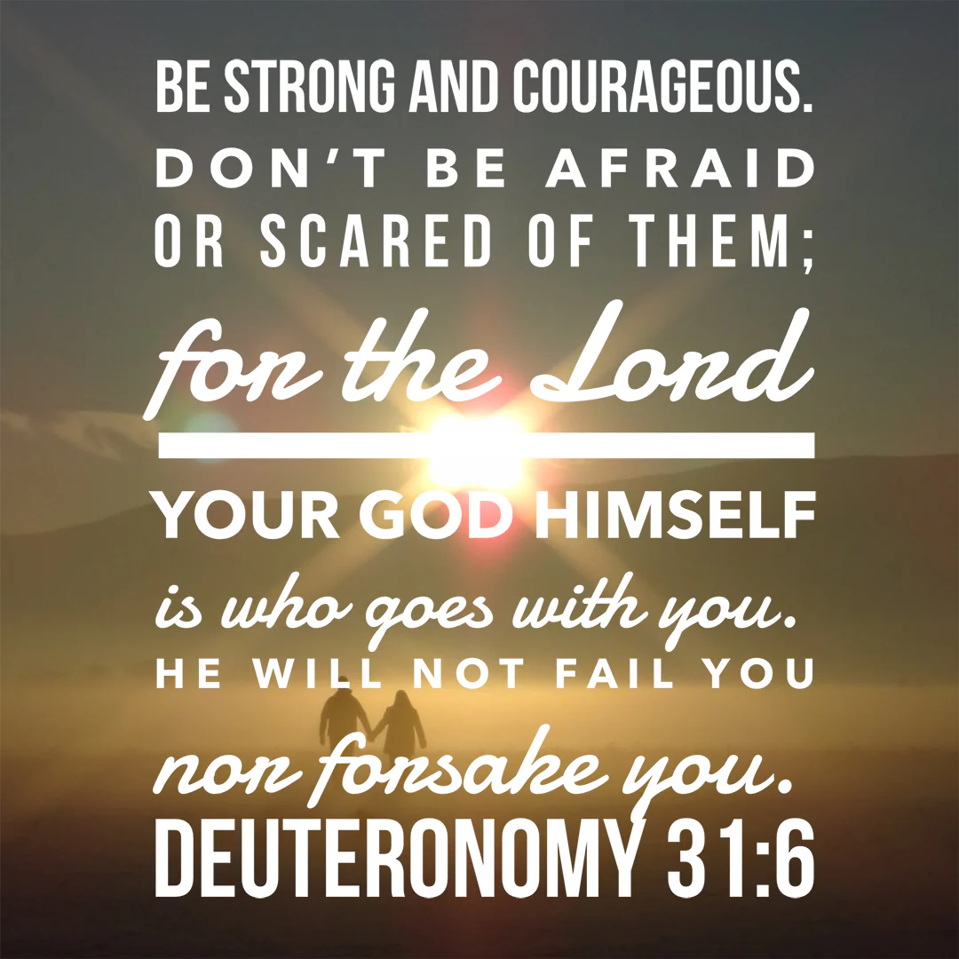
Step Into Courage
(Courage Challenge)
2 Timothy 1:7
Key Point:
God Replaces Fear With Power, Love,
And Sound Mind.
Challenge:
Step Into A Conversation Or Situation You’ve Been Avoiding.
Visual: Bold Footsteps Forward.

Slide 21
“2 Timothy 1:7 says: ‘God has not given us a spirit of fear, but of power, love, and a sound mind.’
Fear (deilia) means timidity. God replaces it with power (dynamis), love (agapē), and sound mind (sōphronismos).
Challenge: Step into a situation you’ve been avoiding.
Trust God to give you clarity under pressure.
Courage is not the absence of fear — it’s obedience in spite of fear.”

Slide 22
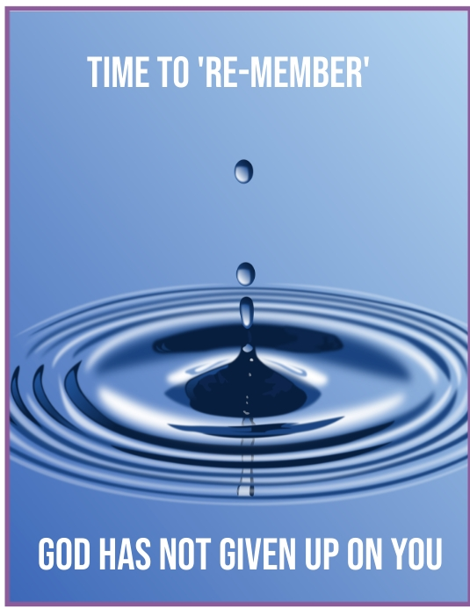
Multiply the Message
(Multiplication Challenge)
Matthew 28:19–20
Discipleship is ongoing.
Challenge:
Mentor someone. Pass on what God has given you.
Endure with Joy
(Endurance Challenge)
Hebrews 12:1–2
Joy comes from fixing eyes on Jesus.
Challenge:
Keep practicing Step 12 even when it’s hard.

Slide 23
“Matthew 28:19–20 says: ‘Go and make disciples of all nations.’
The verb ‘make disciples’ (mathēteusate) is ongoing — it’s not a one‑time act but a lifestyle.
Challenge: Mentor someone. Pass on what God has given you.
Recovery and redemption multiply when we invest in others. Who are you discipling? Who are you pouring into?”
Point 7 — Endure with Joy (Challenge of Joyful Endurance)
“Hebrews 12:1–2 says: ‘Let us run with endurance the race set before us, fixing our eyes on Jesus.’
Endurance (hypomonē) means steadfastness under trial. Joy comes from looking to Christ, not circumstances.
Challenge: Keep practicing Step 12 even when it’s hard, even when you don’t feel like it. Joy is found in the long obedience. Don’t quit shining when the storm comes.”

Slide 24
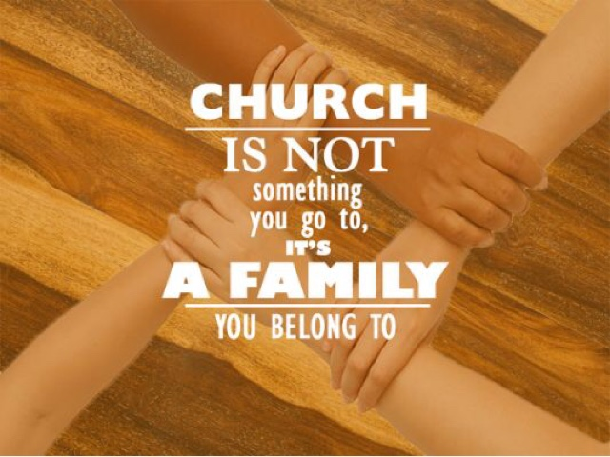
Closing Recap
Be Visible — share your story
Be Consistent — live principles everywhere
Be Agape‑filled — love the hard to love
Be Creative — comfort in unusual ways
Be Courageous — face fear with faith
Be Multiplying — disciple others
Be Enduring — keep shining with joy

Slide 25

Closing Scripture & Prayer
Matt 5:16,“Let your light shine before others…”
Prayer:
“Lord, fill us with power, love, and a sound mind.
Make this church a lighthouse of recovery,
redemption, and hope.”

Slide 27
Pregnant with my third child, I was stricken with a bout of morning sickness and lay down on the living-room couch to rest.
Just then one of the workmen who was doing repairs in my house walked by and gave me a curious look.
"Taking a little break," I explained. "I'm in my first trimester."
"Really?" he said. "What's your major?"

