Slide 1
Unusual Thanksgivings
I Thess 5:18

Slide 2
Thankful for Donkeys and Detours Num 22:21–31
Edward Church
November 16, 2025
What He Said…

Slide 3
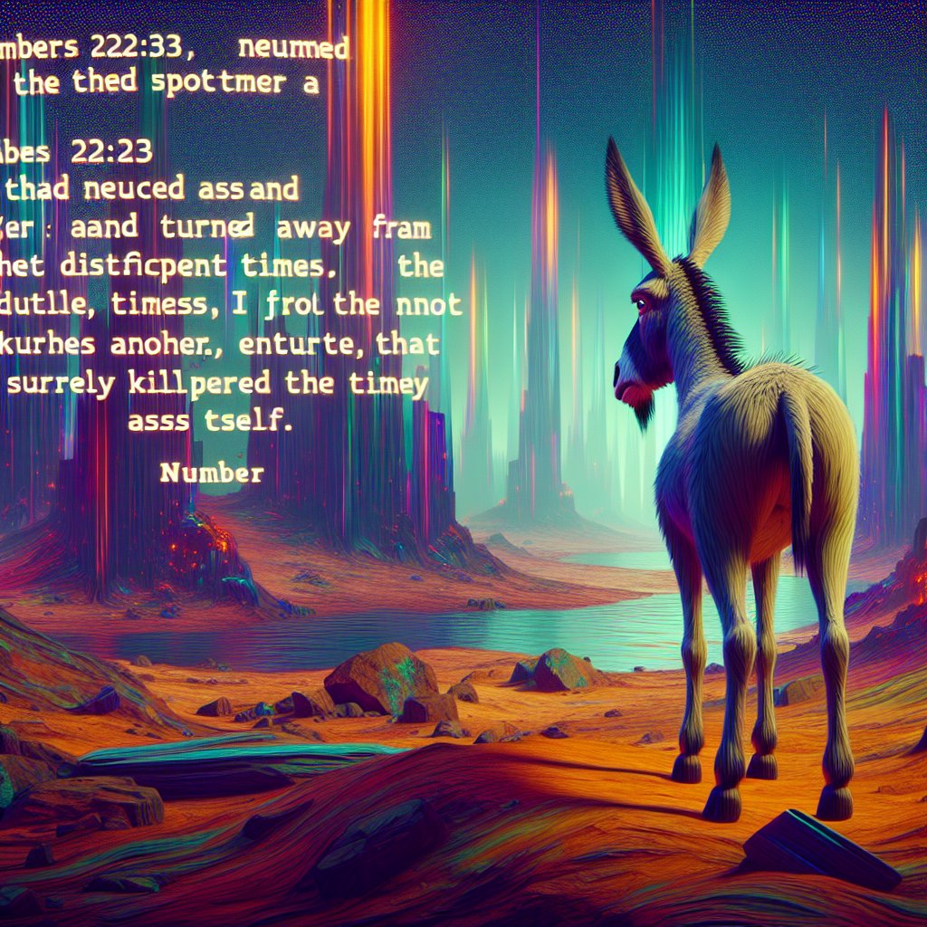
“Then the Lord opened Balaam’s eyes, and he saw the angel of the Lord standing in the road with his sword drawn.” Num. 22:31
Balaam’s Donkey Sees What Balaam Cannot
Can We See….
God Uses Detours to Protect Us
and
Sometimes Interruptions Are Blessings

Slide 4
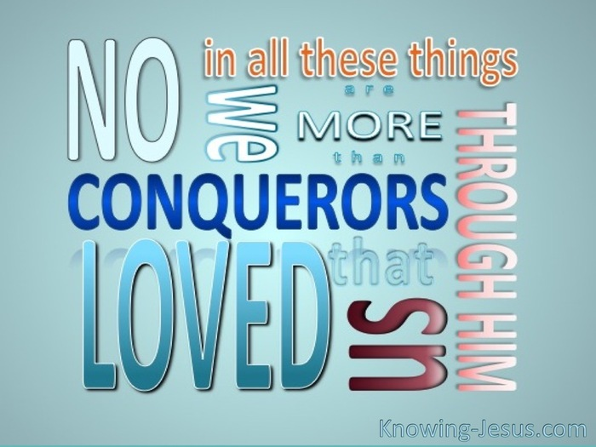
Have you ever been stopped in your tracks by something that felt like an inconvenience — a flat tire, a missed flight, a closed door —
Realized Later It Saved You ?
Balaam thought his Donkey was Stubborn…
…but she was his Salvation.
God sometimes speaks through the Most Unlikely Voices and
Saves Us Through the Most Frustrating Detours
This Thanksgiving, We’re Going to Learn to Thank Him Not Just For
The Blessings We Expect, But for the Interruptions We Resent

Slide 5
“Have you ever been stopped in your tracks by something that felt like an inconvenience — a flat tire, a missed flight, a closed door — only to realize later it saved you from something worse?
Balaam thought his donkey was stubborn, but she was his salvation.
God sometimes speaks through the most unlikely voices and saves us through the most frustrating detours.
This Thanksgiving, we’re going to learn to thank Him not just for the blessings we expect, but for the interruptions we resent.”

Slide 6
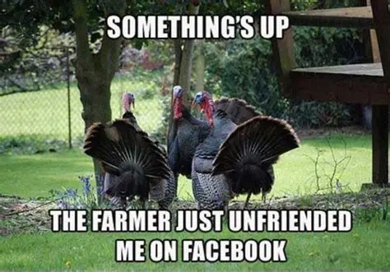
Thanksgiving is Usually About the Obvious Blessings —
Family
Food
Health
Provision
Scripture Reminds us that Sometimes the Greatest Reasons for…
…Gratitude Come from the Most Unexpected Places
It’s a Strange Story — but it’s Also a Thanksgiving story.
Because Sometimes We Need to Be Thankful for the…
…Donkeys and Detours God Sends to Save Us

Slide 7
“Thanksgiving is usually about the obvious blessings — family, food, health, provision. But Scripture reminds us that sometimes the greatest reasons for gratitude come from the most unexpected places.
In Numbers 22, Balaam is on his way to curse Israel for profit. He’s riding his donkey, blind to the danger ahead. Suddenly, the donkey sees what Balaam cannot — the angel of the Lord with a drawn sword. Three times the donkey detours, and three times Balaam beats her. Finally, God opens the donkey’s mouth, and she speaks.
It’s a strange story — but it’s also a Thanksgiving story. Because sometimes we need to be thankful for the donkeys and detours God sends to save us.”

Slide 8
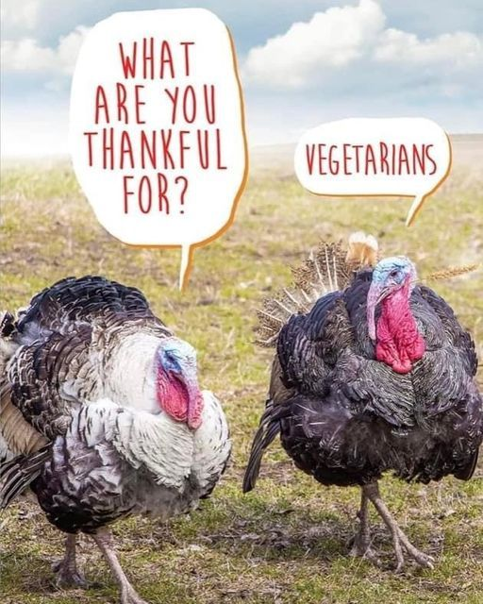
Balaam was a Man
of God
Misguided
Balaam was Blinded by His Own Ambition (21).
The Donkey Saw the Angel of the Lord (23).
Three Detours: into a Field, Against a Wall, Lying Down (23–27)
It Seems the It was Balaam was the Stubborn One
Balaam Beat the Donkey, but She was Saving Him
God Opened Her Mouth (28) and Balaam’s Eyes (31)

Slide 9
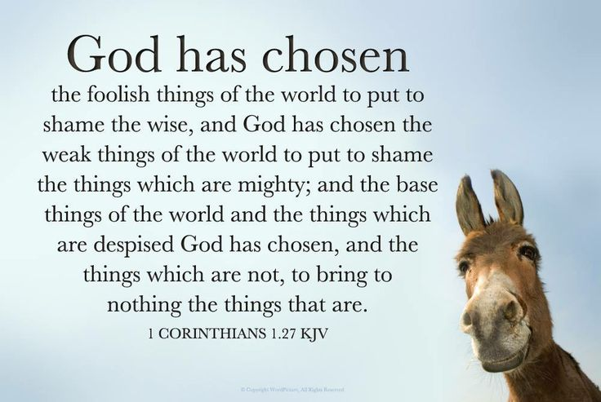
Donkeys
God Speaks Through Unlikely Voices
Balaam’s Donkey Spoke Truth…
…When Balaam Was Blind to the Truth
1 Cor 1:27 amp— But God has selected [for His purpose] the foolish things of the world to shame the wise [revealing their ignorance], and God has selected [for His purpose] the weak things of the world to shame the things which are strong [revealing their frailty].
Story
1977 New York blackout → revival in a Brooklyn church.
Edward Spencer rescued 17 from a shipwreck
Application:
Who are the “Donkeys” in Your Life?
Do You Ever Overlook Who God Uses to Speak?

Slide 10
Story -Blackout
In 1977, the New York blackout plunged the city into chaos. Looting and fires broke out. Yet in Brooklyn, one small church lit candles and opened its doors. Neighbors poured in, frightened and restless. The pastor preached by candlelight, and dozens gave their lives to Christ. Out of the “donkey” of a blackout came revival.
Story - Edward Spencer
Edward Spencer, a Northwestern student, rescued 17 people from a sinking ship in 1860. He was badly injured and never regained full health. Years later, at his funeral, it was noted that not one of the 17 ever came back to thank him.
Like Balaam’s donkey, God’s instruments often go unrecognized.

Slide 11
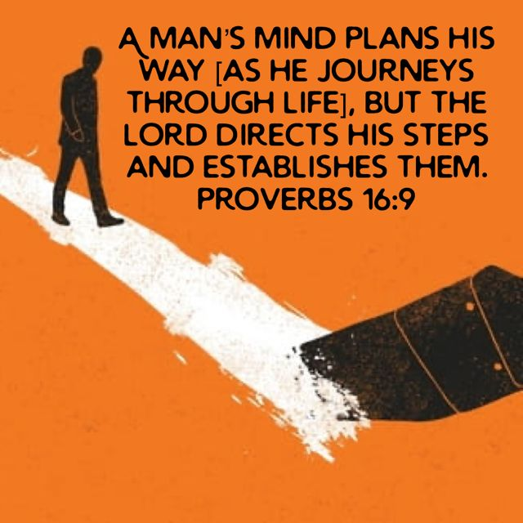
Detours
God’s (Redirections)
Story
Titanic crewman reassigned → Life spared
Corrie Ten Boom’s fleas: protection in disguise
God’s Detours Are His Protection
Proverbs 16:9 – “The Lord establishes his steps”
Isaiah 30:21 – God redirects our path
Application:
Detours may feel frustrating…
…but they are often God’s protection

Slide 12
Proverbs 16:9, “The heart of man plans his way, but the Lord establishes his steps.” Balaam had his plan, but God rerouted him.
David Blair (1874–1955) was a British merchant seaman with the White Star Line. He had been appointed as Second Officer of the RMS Titanic during her fitting out / sea trials in Belfast in early April 1912. Blair knew the ship well, having overseen her preparations / test runs. He was proud to be part of what was then the largest/ most luxurious ship in the world. But just days before Titanic’s maiden voyage, made a last‑minute reshuffle of officers. Chief Officer Henry Wilde, who had been serving on Titanic’s sister ship Olympic, was transferred over to Titanic to take a senior role. To make room, Blair was reassigned to another vessel. He was devastated — he had been preparing for months, missing the historic voyage felt like a crushing disappointment. a detour he resented — had saved his life. He lived until 1955, long enough to reflect on how a bitter disappointment became his salvation. Corrie ten Boom once thanked God for fleas in her concentration camp barracks. Because the guards refused to enter the flea‑infested room, allowing the women to hold Bible studies in peace. What looked like a curse-blessing

Slide 13
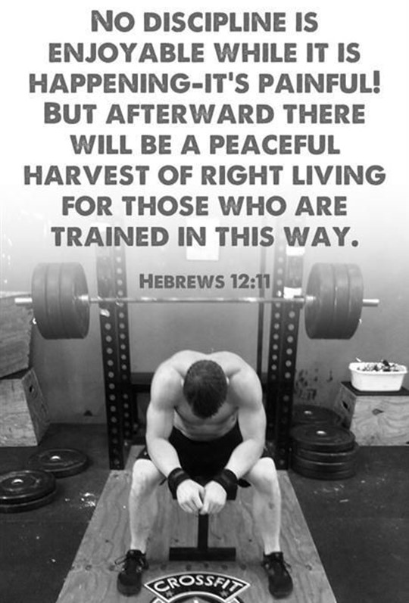
Thankful for God’s Disruptions
(Interventions)
Hebrews 12:11 — discipline feels painful, but it protects.
Story
WWII Platoon Saved By Broken Antenna
Application:
God’s Interventions May Hurt, But They Save

Slide 14
WWII Platoon and the Broken Antenna
During World War II, a platoon of Allied soldiers was advancing through enemy territory. Their radio antenna snapped unexpectedly, forcing them to stop and repair it.
While halted, scouts discovered that they were just minutes away from walking into a deadly ambush.
The broken antenna — a frustrating delay — had saved their lives. What felt like a nuisance was actually a shield.

Slide 15
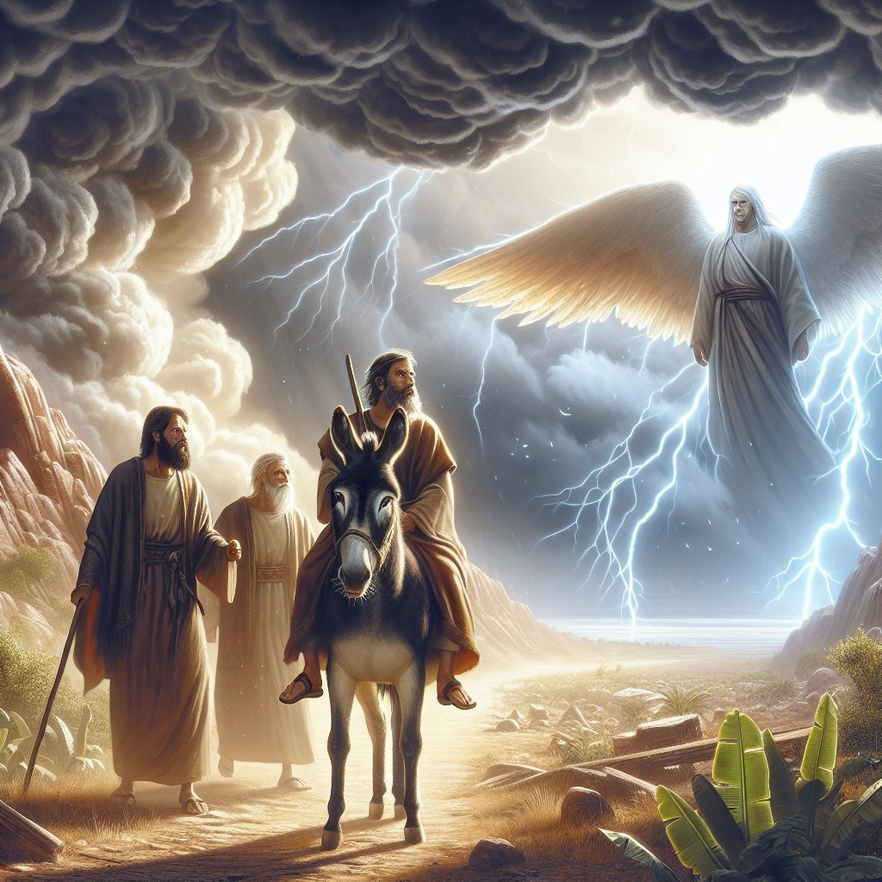
When You Sit At the Table This Thanksgiving,
Don’t Just Thank God For the Turkey and the Pie.
Thank Him For the Donkeys that Spoke…
…Even When You Wouldn’t Listen
Thank Him for the Detours that Kept You From Disaster
Thank Him for the Interventions that Hurt But Healed
Because Gratitude Grows Deepest Not in the Obvious Blessings Come
in the Unexpected Places

Slide 17
Index to 2025 services at
http://edwardnc.org/ecc/2025
Our Site:
http://ecc.edwardnc.org
See the calendar page for
updates,
links,
and more

Slide 19
One year, a family gathered around the table for their big meal. The turkey was golden brown, the mashed potatoes were piled high, and the pumpkin pie was waiting in the kitchen. Everyone sat down, bowed their heads, and the father prayed: ‘Lord, we thank You for this food, and we ask You to bless it to our bodies.’
But just as he said ‘Amen,’ the youngest child shouted, ‘Wait! We forgot to thank God for the smoke alarm!’
Everyone laughed — but here’s the backstory. Earlier that morning, the turkey had burned in the oven, and the smoke alarm went off. The family rushed in, saved the meal, and ended up with a turkey that was actually better than before.
That little child reminded them: sometimes the things we complain about — like a loud smoke alarm — are actually blessings in disguise.
And isn’t that the heart of Thanksgiving? To see God’s hand even in the interruptions, the detours, and the unexpected moments. Sometimes the things that stop us are the very things that save us.”

