Slide 1


Slide 2
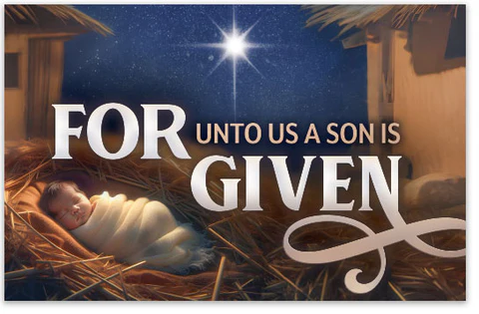
Spiritual Warfare
10% Satan’s Tactics
90% How We Respond
Remember…
With God We Are Not
Helpless
Hopeless
We Are Powerful!!

Slide 3
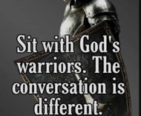
Repeat
These are the 2 Most Important Hours of My Week – Help Me to Cherish Them
I Am Here Today to Worship
Not to Be Entertained
I Am Singing to An Audience of One
Accept My Worship Oh Lord!

Slide 4
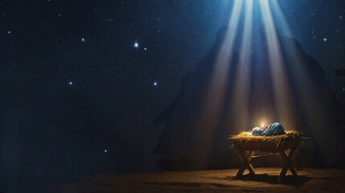
Edward Christian Church
12/7/2025

Slide 5

Repeat
I Lift My Offering to You
Let It Please You Oh Lord
This is My Seed
Although It Leaves My Hand
It will Never Leave My Life
You Will Multiply It!
Accept My Seed Oh Lord!

Slide 6
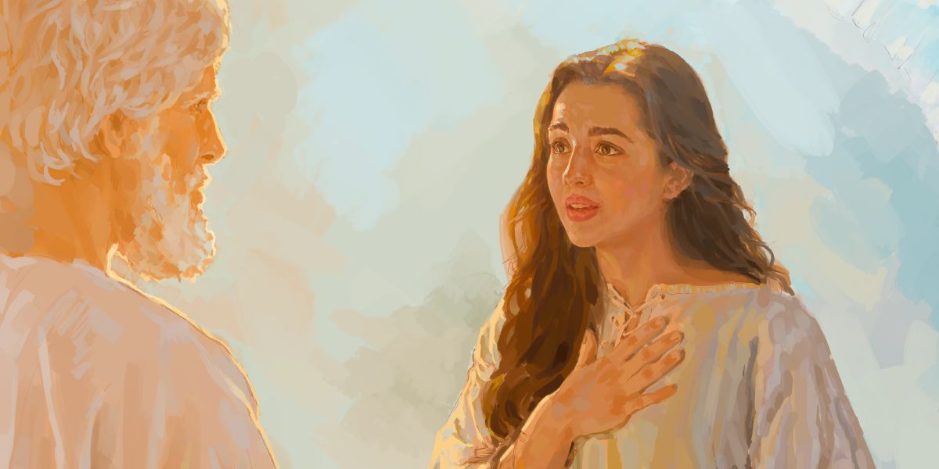
Unusual Christmas

Slide 7
Not Your Usual Christmas Sermon –pt1
Edward Church
December 7, 2025
Unusual
Announcement

Slide 8

God Had Been Silent for 400 Years
…but He was about to Break His Silence
In a Big Way-
…before now it was through His Prophets
In a Different Way-
No Longer Saged Old Men Coming fr Wilderness
In a Powerful Way-
But Through a Baby in a Manger

Slide 9
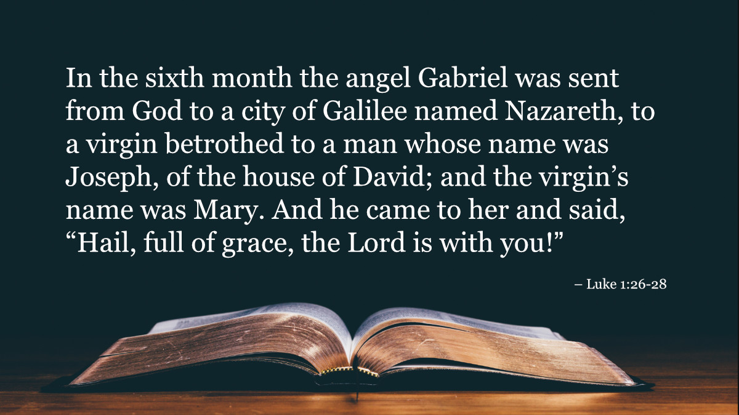
Luke 1:26–28 — Gabriel’s greeting to Mary
Greek word charitoō means ‘endowed with grace.’
Mary was Not Chosen Because Of Her Status,
But Because Of God’s Favor.

Slide 10
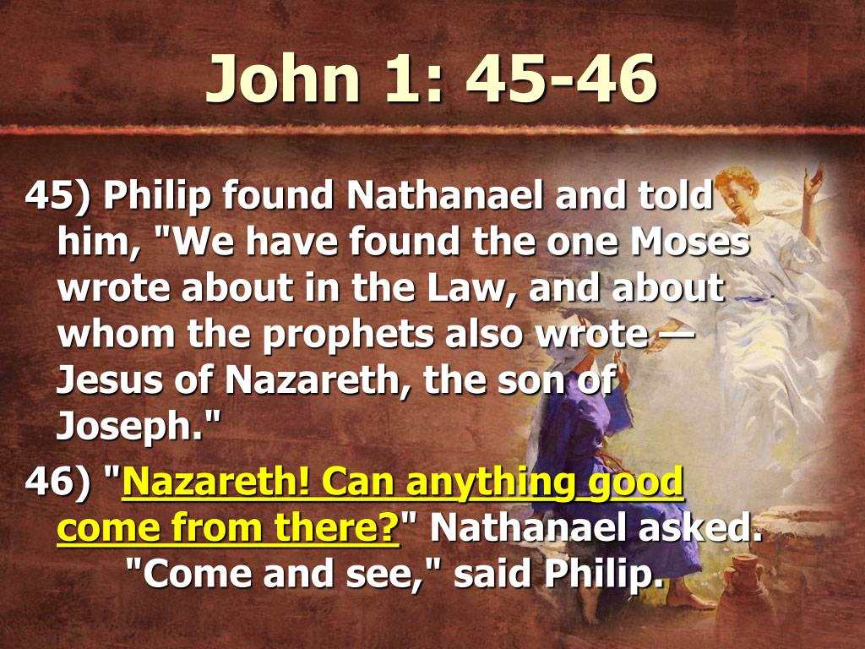
Destiny Breaks Out in Deserted Places
Nazareth Was Forgotten, Yet Chosen
Challenge:
Will you believe destiny can …
…break out in your overlooked places?
Illustration:
“Can anything good come out of Nazareth?”
→ God says Yes.

Slide 11
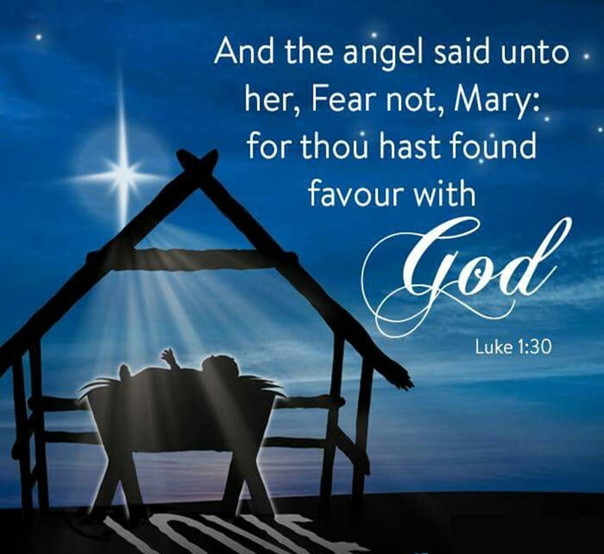
Grace is the Passport to Purpose
Mary Was Graced Before She Carried Christ
Challenge:
Will You Stop Striving / Rest In Grace That Qualifies You?
Illustration:
A Passport Grants Access — Grace Grants Destiny

Slide 12
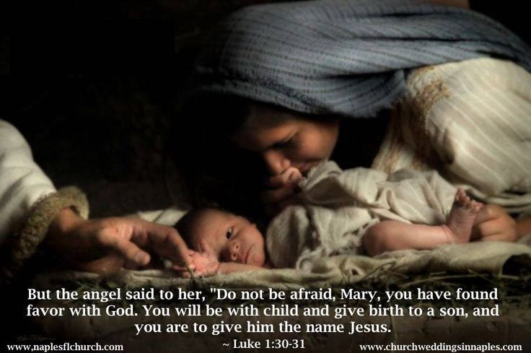
Fear Collapses Under the Weight of Favor
Gabriel:
“Do not be afraid” Luke 1:30
Divine Call Confronts Fear
God Never Reveals Destiny…
…Without Releasing Courage
Challenge:
Will You Let Favor Silence Fear?
Declaration:
“Fear Folds When Favor Walks In!”

Slide 13
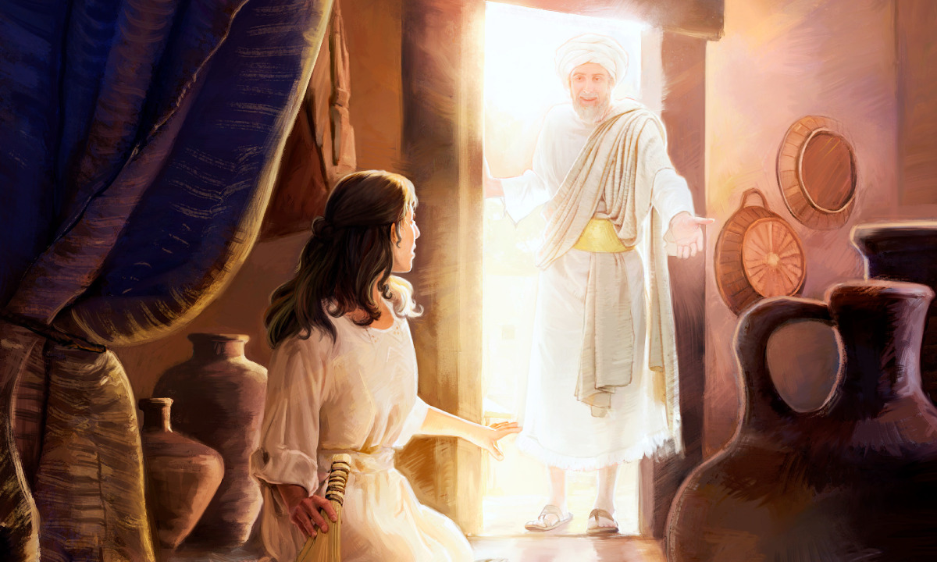
Glory Turns Bedrooms into Burning Bushes
Mary’s Room Became Holy Ground
Illustration:
Will You Treat Ordinary Spaces As Holy Ground
When God Shows Up?
Challenge:
Will You Treat Ordinary Spaces As Holy Ground?
Declaration:
“My prayer closet can blaze with His glory!”

Slide 14
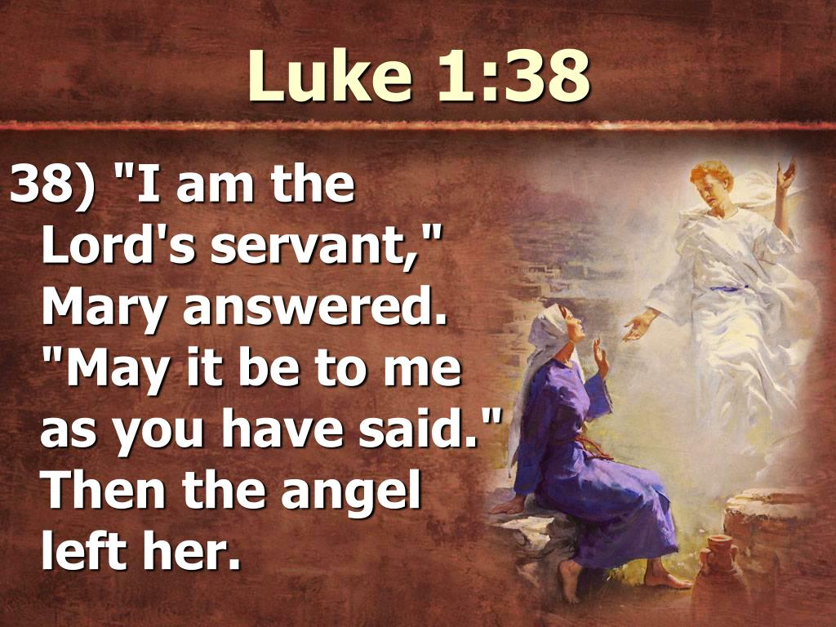
One Yes Can Detonate Destiny
Mary’s Surrender Triggered History
Overshadowing:
same verb used when the cloud of glory covered the tabernacle -Exodus 40:35
Challenge:
Will You Give God One Yes that Rewrites Your Story?
Illustration:
One Yes Can Echo for Generations

Slide 15
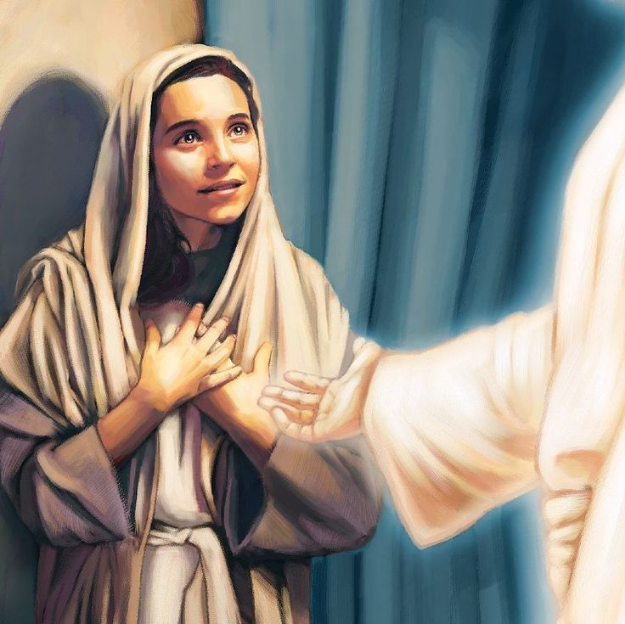
Power Declarations
“My Nazareth is Enough!”
“Grace Has Stamped My Life!”
“Fear Falls — Favor Stands Tall!”
“My Room is Holy Ground!”
“My Yes Detonates Destiny!”

Slide 16
Edward Christian Church
12/7/2025

Slide 17
My wife texted me a selfie in a new dress ands asked…
Does this make me look fat?
I texted back “Noo!”
But my phone autocorrected it to “Moo!”
Please Send Help!!!!

