Slide 1


Slide 2
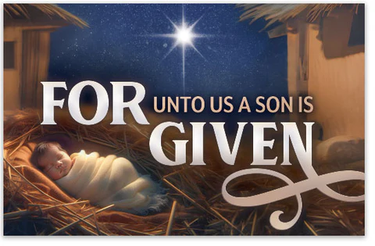
Spiritual Warfare
10% Satan’s Tactics
90% How We Respond
Remember…
With God We Are Not
Helpless
Hopeless
We Are Powerful!!

Slide 3
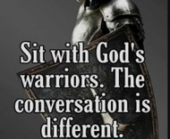
Repeat
These are the 2 Most Important Hours of My Week – Help Me to Cherish Them
I Am Here Today to Worship
Not to Be Entertained
I Am Singing to An Audience of One
Accept My Worship Oh Lord!

Slide 4

Edward Christian Church
12/14/2025

Slide 5

Repeat
I Lift My Offering to You
Let It Please You Oh Lord
This is My Seed
Although It Leaves My Hand
It will Never Leave My Life
You Will Multiply It!
Accept My Seed Oh Lord!

Slide 7
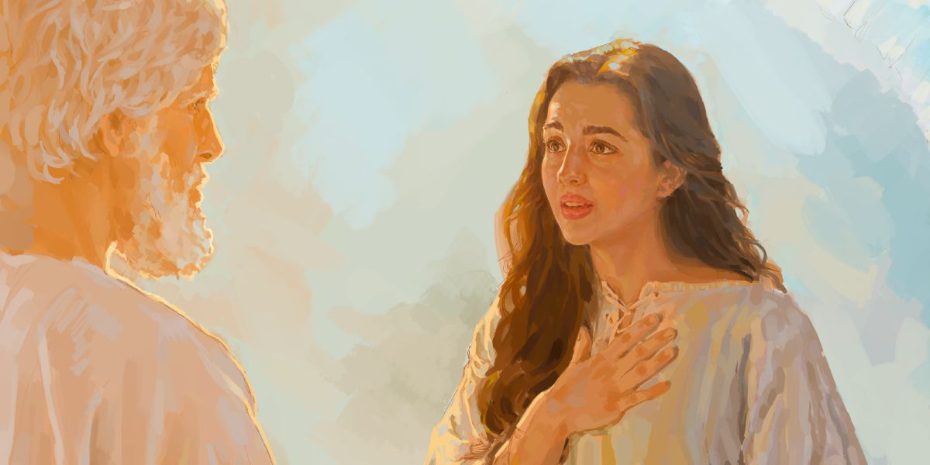
Unusual Christmas

Slide 8
Not Your
Usual
Christmas Sermon –pt2
Luke 2:6–7
Edward Church
December 14, 2025
Unusual
Birth

Slide 9
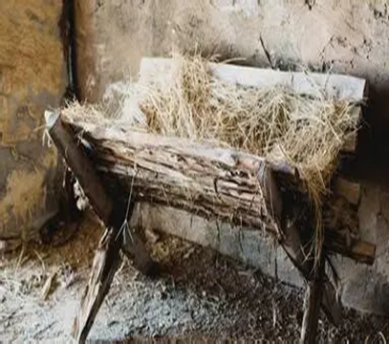
Not in a Palace, but in a Stable
Not in Silk, but in Swaddling Clothes
Know This …
The Manger was Not a Mistake…
it was a Message
God was saying, ‘I am Emmanuel =
God with you, even in the lowest of places’

Slide 10
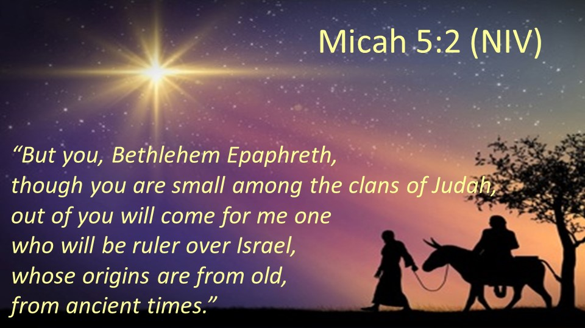
Manger = GK -feeding trough
Swaddling Clothes =
Humility
Foreshadowing of Grave Clothes
Micah 5:2 — prophecy fulfilled in Bethlehem
Isaiah 53:2 — “No beauty or majesty to attract us”

Slide 11
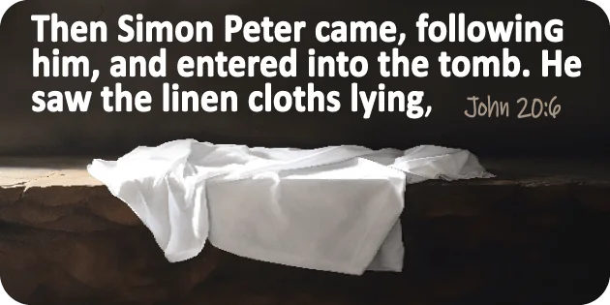
John 19:40 — Jesus wrapped in linen strips
John 20:6–7 — Grave clothes left behind, head cloth folded
Grave Clothes = Proof of Death;
Empty Tomb = Proof of Victory

Slide 12
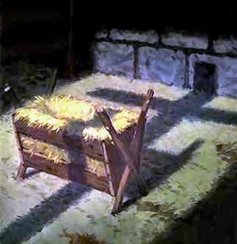
God’s Glory in Humble Wrapping?
Swaddling Clothes Looked Like Rags…
…but They Wrapped the King
Grave Clothes Looked Like Defeat…
…but They Were Left Behind in Victory

Slide 13
Challenge:
Will you Recognize God’s Presence…
…even when it looks Ordinary?
Will you Embrace His Glory even when it comes…
…in Humble Wrapping?”

Slide 14
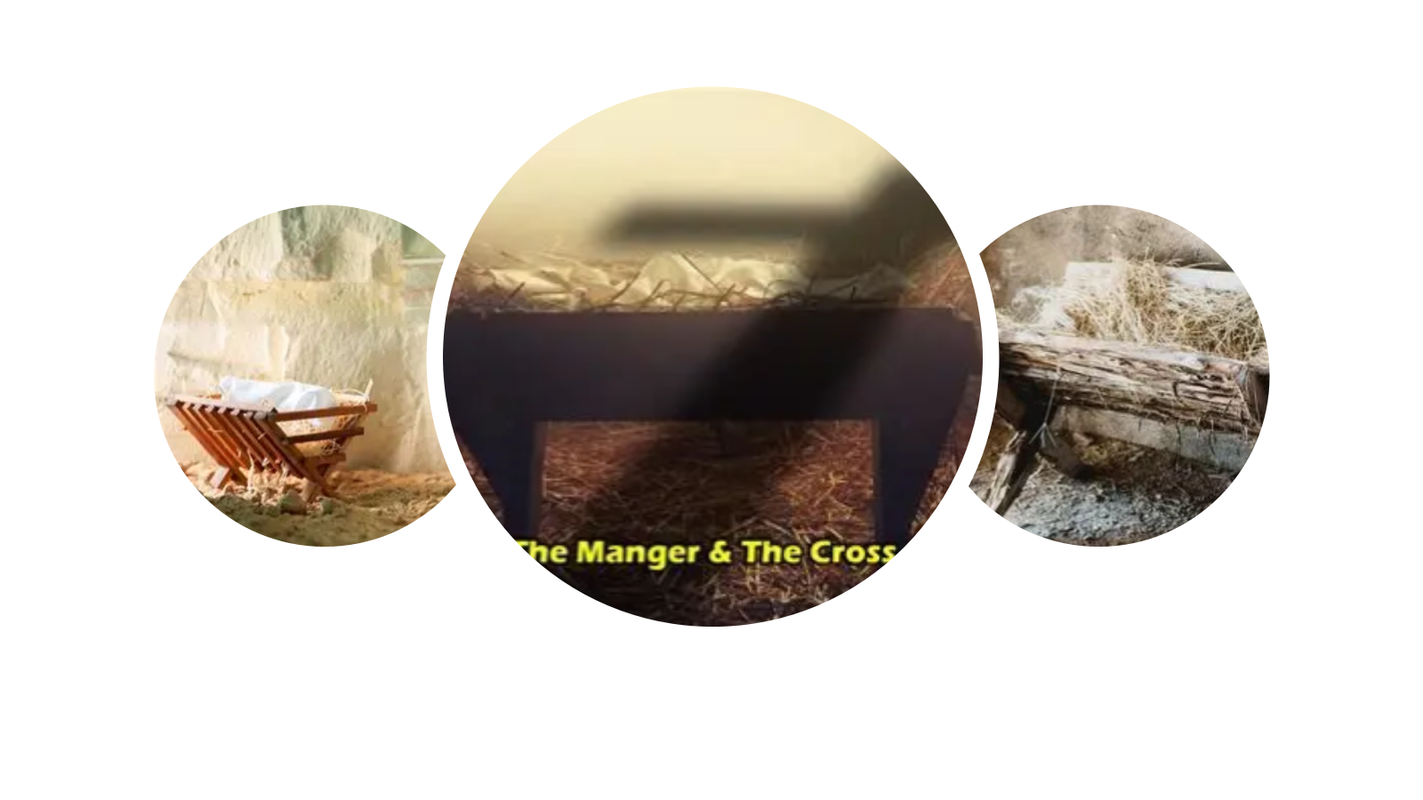
“Don’t Despise Small Beginnings!”
SayOutloud: Unusual Birth, Unusual Glory!
Manger Held Him As A Baby;
Cross Held Him As A Savior
Swaddling Clothes → Grave Clothes → Glory!

Slide 15
Challenge:
Will You Leave Behind Your Own Grave Clothes
Sin, Shame, Fear
And
Step Into Resurrection Life?

Slide 16
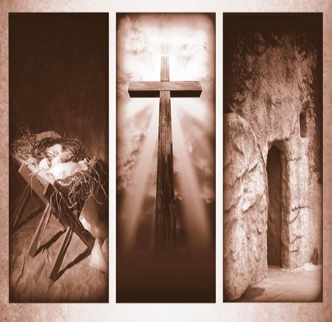
Conclusion
God is with us in Every Place —
High or Low
From Swaddling Clothes to Grave Clothes,
From Manger to Cross
Jesus embraced humility so we could inherit glory

Slide 17
Challenge:
Will you see the Cross in the Cradle?
Will you see your Salvation in His Humility?”
Challenge:
Will you open your heart to revival in unusual places
maybe even in your own home,
your workplace,
your family?”

Slide 18
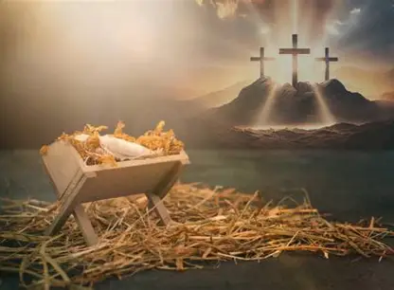
Manger
Cross
Cave (7)
Borrowed Stable
They Had No Way
God Made a Way…
…Where There Was No Way
Cave (Matt 27:57-60 )
Borrowed Tomb
They Had No Way
God Made a Way…
…Where There Was No Way

Slide 19
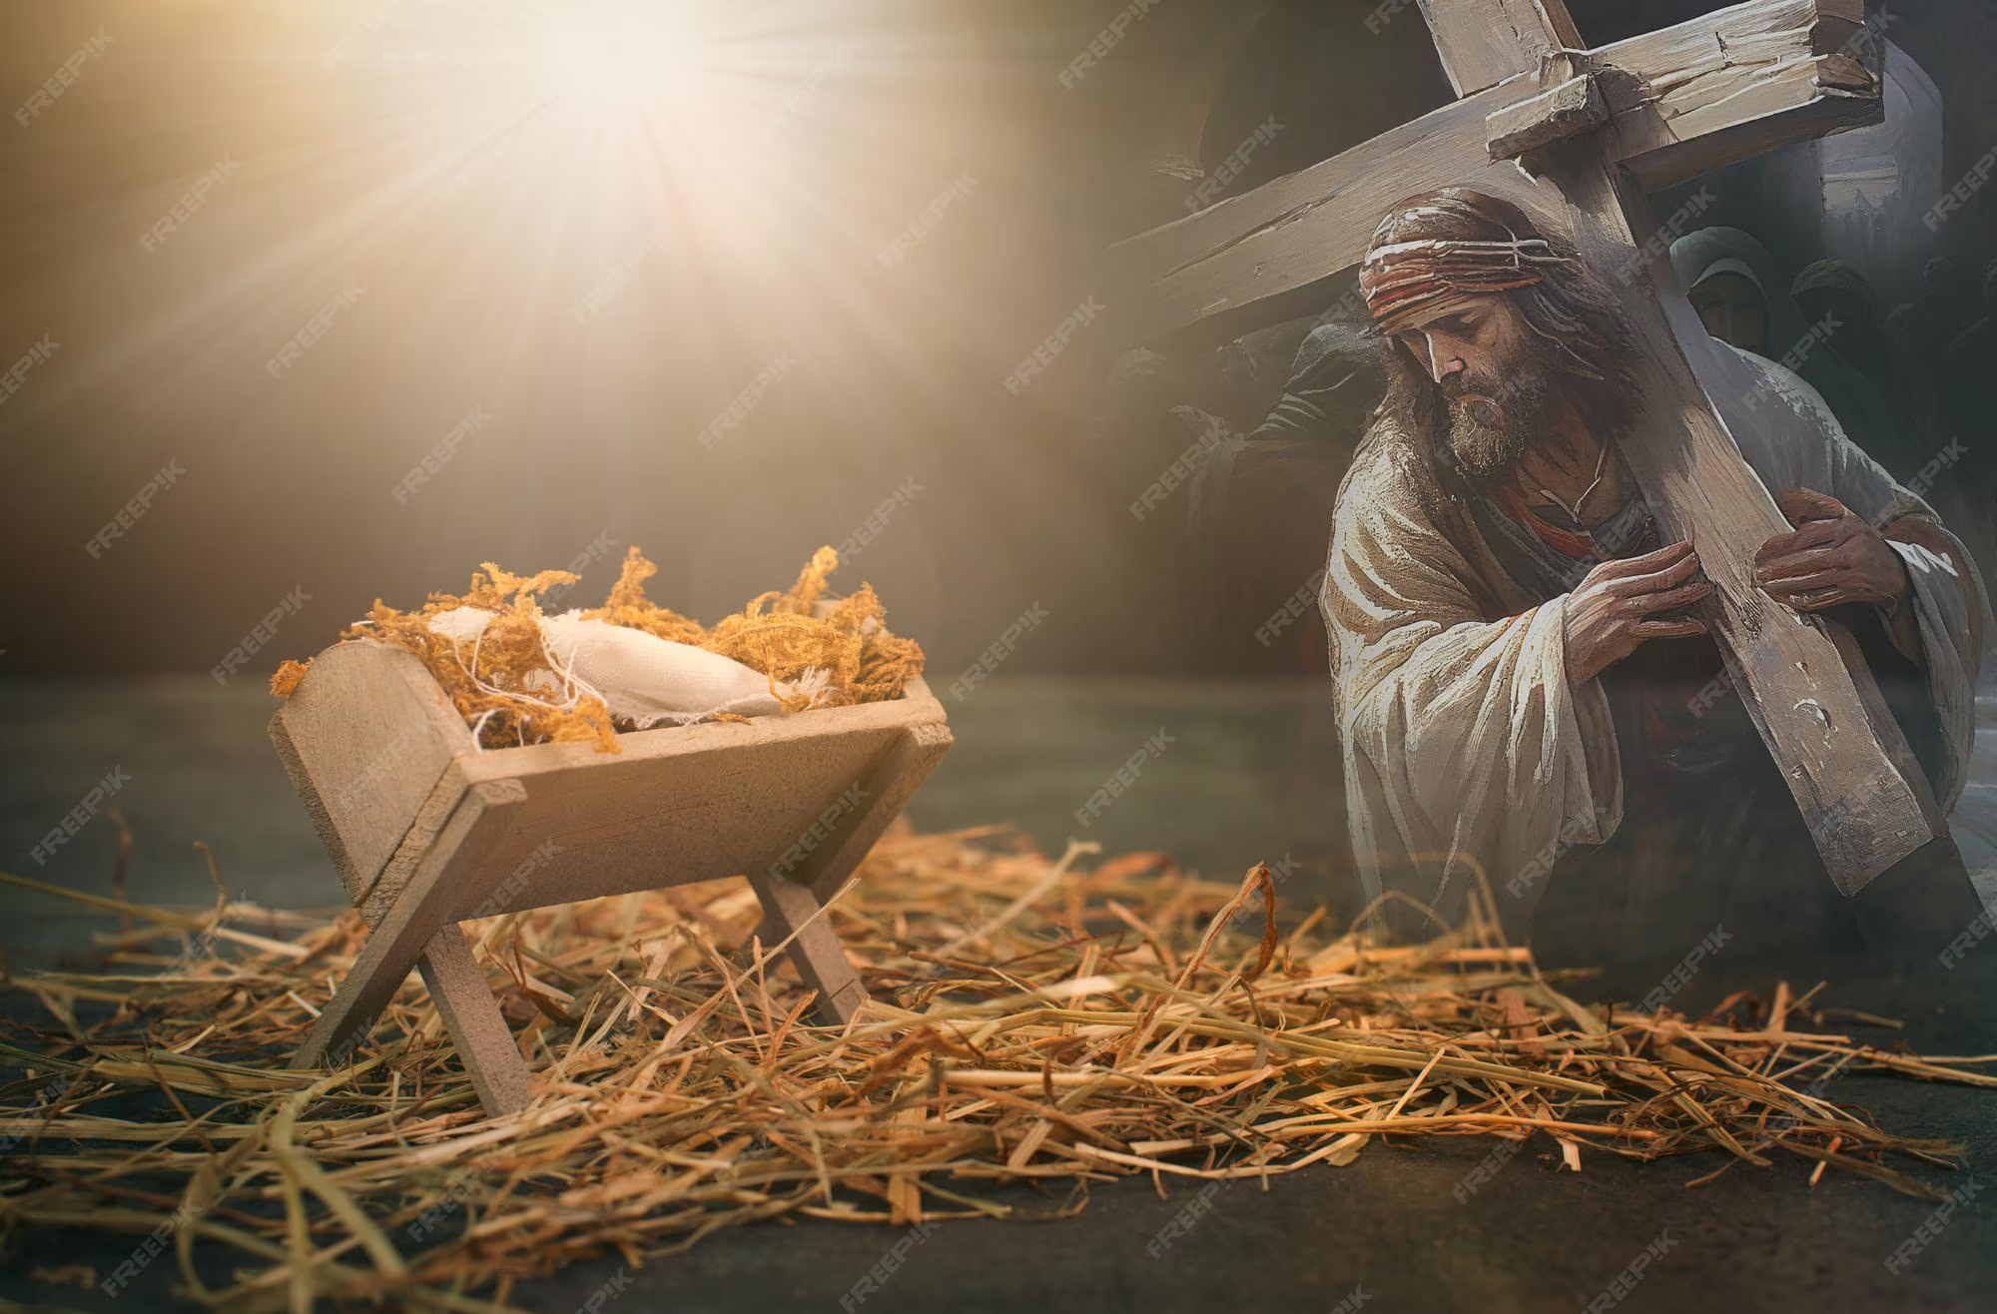
Manger
Cross
Manger (7)
Broken Wood
Carry Out Common Task
Dispense Broken Food
Helpless
In Hands of Others
Back Upon the Wood
Precious Gift
Cross (John 19:17)
Broken Wood
Carry Out Common Task
Dispense Broken Body
Helpless
In Hands of Others
Back Upon the Wood
Precious Gift

Slide 20
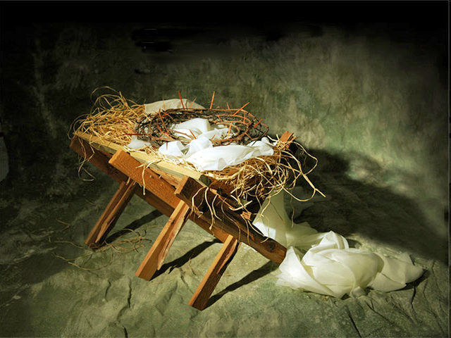
Manger
Cross
Swaddling Clothes
Linen Strips
Brought Comfort
Temporary
One-Time Use
Soon Empty
Grave Clothes
Linen Strips
Brought Comfort
Temporary
One-Time Use
Soon Empty

Slide 21
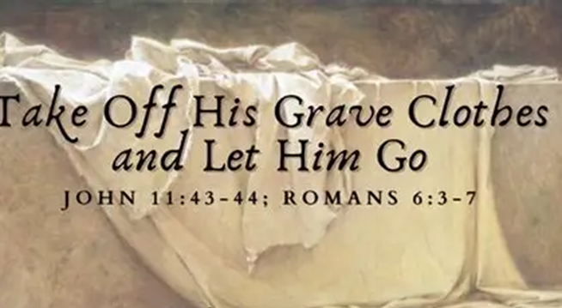
“Lord, tonight we thank You for the unusual birth that brought unusual glory.
We lay down our grave clothes — our shame, sin, our fear and step into Your light.
Wrap us now in Your righteousness, and
let Your glory shine through us.”

Slide 22
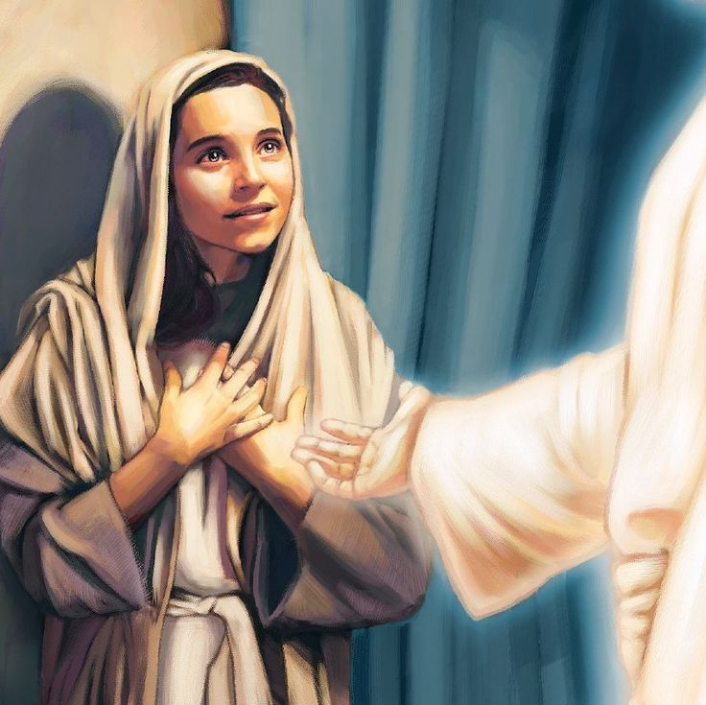
Power Declarations
“My Nazareth is Enough!”
“Grace Has Stamped My Life!”
“Fear Falls — Favor Stands Tall!”
“My Room is Holy Ground!”
“My Yes Detonates Destiny!”
The Manger and the Cross…
No Shame but Glory

Slide 24
The owner of a drug store walks in to find a guy leaning heavily against a wall.
The owner asks the clerk "What's with that guy over there by the wall?"
The clerk replies, "Well, he came in here this morning to get something for his cough. I couldn't find the cough syrup, so I gave him an entire bottle of laxative."
The owner screams, "You goober! You can't treat a cough with a bottle of laxatives!"
The clerk calmly replies, "Of course you can! Look at him; he's afraid to cough!"

