Slide 1
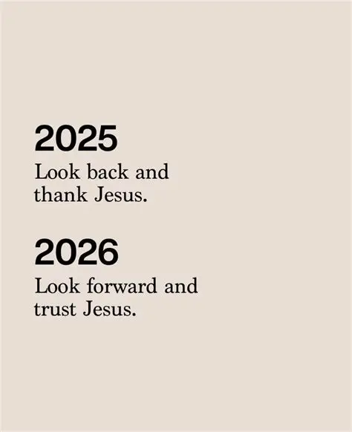

Slide 2
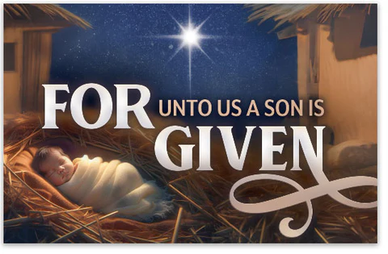
Spiritual Warfare
10% Satan’s Tactics
90% How We Respond
Remember…
With God We Are Not
Helpless
Hopeless
We Are Powerful!!

Slide 3

Repeat
These are the 2 Most Important Hours of My Week – Help Me to Cherish Them
I Am Here Today to Worship
Not to Be Entertained
I Am Singing to An Audience of One
Accept My Worship Oh Lord!

Slide 4

Repeat
I Lift My Offering to You
Let It Please You Oh Lord
This is My Seed
Although It Leaves My Hand
It will Never Leave My Life
You Will Multiply It!
Accept My Seed Oh Lord!

Slide 6


Slide 7
Preparing For The New Year Phil 3:13–14 Pt1
Edward Church
December 28, 2025
RESET,
REALIGN,
RUN!

Slide 8

“Neighbor… oh neighbor… this year will NOT catch me unprepared!”
You made it… this year, you’re gonna do more than Survive
Your Gonna THRIVE!
Today is not a lecture, not a seminar.
Today is a REVIVAL…..something in you is about to Wake Up
We’re not here to make Resolutions —but receive Revelation.
We’re not here to make Promises but Stand On Promises
We’re not here to Try Harder — we’re here to Walk In The Spirit.
If you’re ready for a New Year With New Power, shout “Let’s go!”

Slide 9
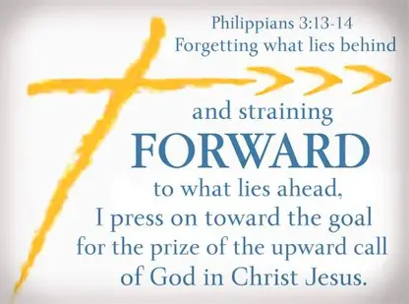
Philippians 3:13–14
Forgetting
Gk — Intentionally Ignore
Reaching
Gk — Stretch Beyond Limits
Pressing
Gk — Chase with Force
Say: “This is not a Wishlist — this is a War Plan!”

Slide 10
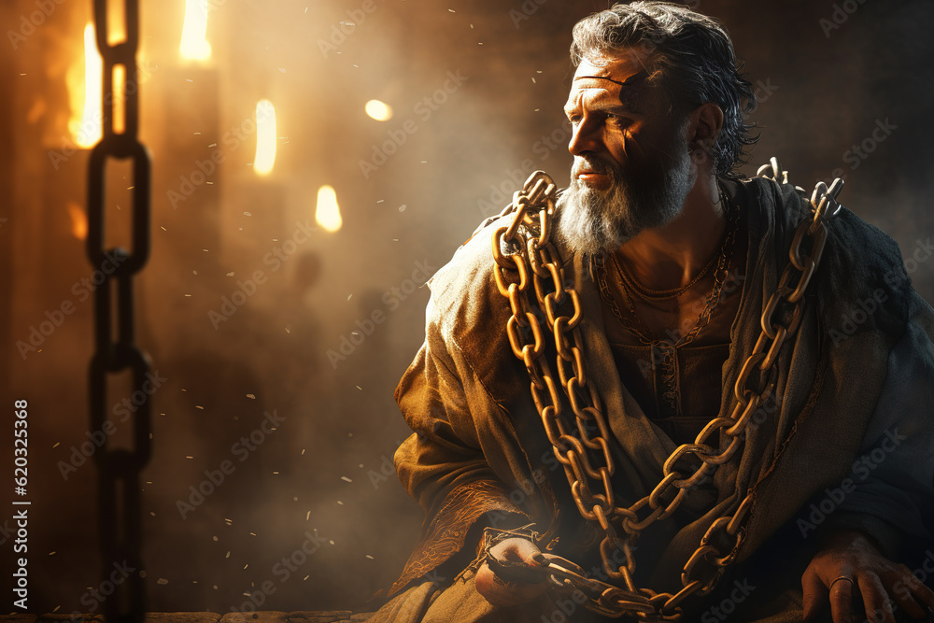
Paul’s Situation
📌 Roman Imprisonment
📌 Harsh Conditions
📌 Uncertain Future
📌 Yet Writes W-
Joy, Focus, and Forward Momentum
Your Environment…
…Doesn’t Determine Your Destiny
…Your Alignment Does

Slide 11
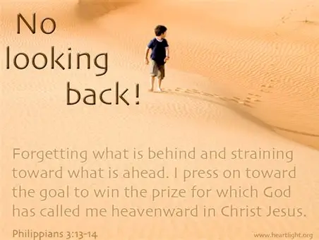
LET GO OF WHAT’S BEHIND YOU
“Forgetting those things which are behind…”
Let’s dig into this.
The Greek word for “forgetting” is a Compound Word:
epi =
intensifier (“completely, thoroughly”)
lanthanomai =
“to be hidden, to escape notice, to be overlooked”

Slide 12
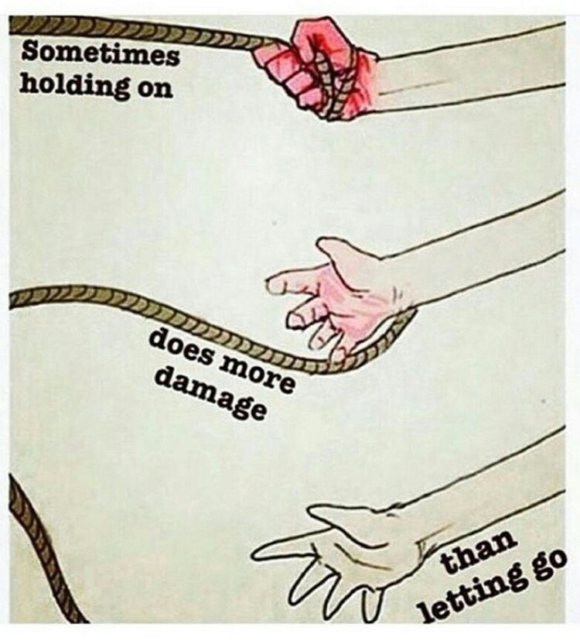
LET GO
“Forgetting those things which are behind…”
Greek:
To Overlook
To Starve of Attention
To Deny Influence
Say: “Some things deserve to be ignored!”
Challenge:
“If God forgave it, why are you still feeding it?”

Slide 13
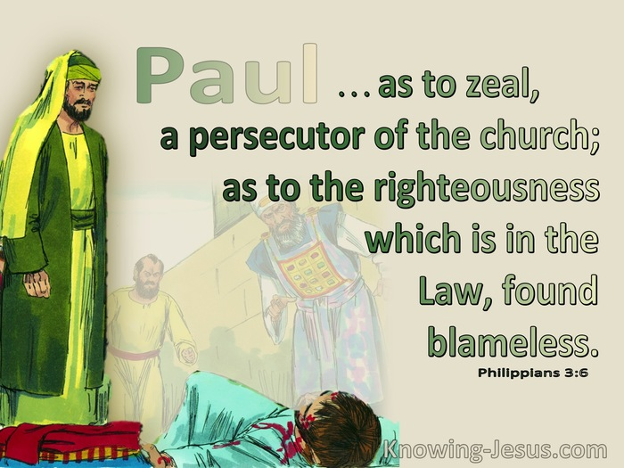
Let Go…
…Past Failures
Paul had Failures:
Persecuted the Church
Imprisoned Believers
Approved Stephen’s Death
Terrorized Christians
Yet he says, “I forget it.”
Why?
Because Grace Rewrites Our Identity

Slide 14

LET GO OF WHAT’S BEHIND YOU
“Forgetting those things which are behind…”
Together it Means:
“I Choose to Overlook It”
“I Choose to Treat It as Irrelevant”
“I Choose to Deny It Influence”
“I Choose to Starve It of Attention”
Paul Is Not Saying, “I Don’t Remember My Past”
He’s Saying, “I Refuse To Let My Past Remember Me”
Say: “Some Things Deserve To Be Ignored!”

Slide 15
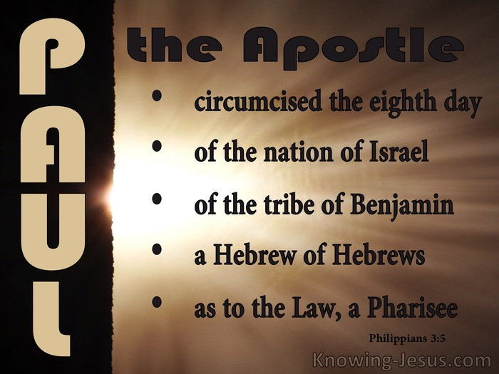
Let Go of..
…Past Successes
Paul had Spiritual Achievements:
Circumcised on the Eighth Day
Hebrew of Hebrews
Pharisee
Zealous
Blameless in the Law
But He Calls Them -Gk “garbage, refuse, dung”
”My past victories are not my present identity.”

Slide 16

What You Must Release
❌ Past Failures
❌ Past Disappointments
❌ Past Mistakes
❌ Past Identities
❌ Past Victories that Keep You Stuck
Say: “Some Things Deserve to Be Ignored!”
Challenge:
“Don’t Build a Shrine Around What God Used to Do.”

Slide 17

REACH FORWARD
“…reaching forth…”
Greek:
Stretch
Strain
Lean Forward
Say: “I’m reaching for more!”
Challenge:
“This year, no microwave devotion —
go deeper.”

Slide 18

Reach for
…Spiritual Growth
🔥 Deeper Prayer
🔥 Stronger Devotion
🔥 Higher Worship
🔥 Greater Obedience

Slide 19
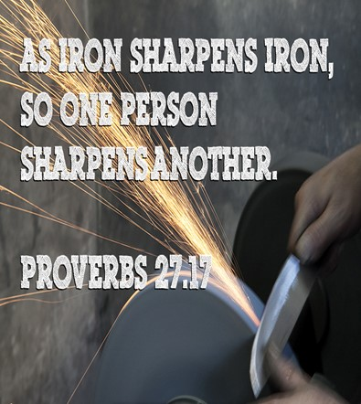
Reach for…
…Healthy Relationships
✔ People Who Sharpen You
✔ People Who Challenge You
✔ People Who Pray With You
✔ People Who Push You

Slide 20
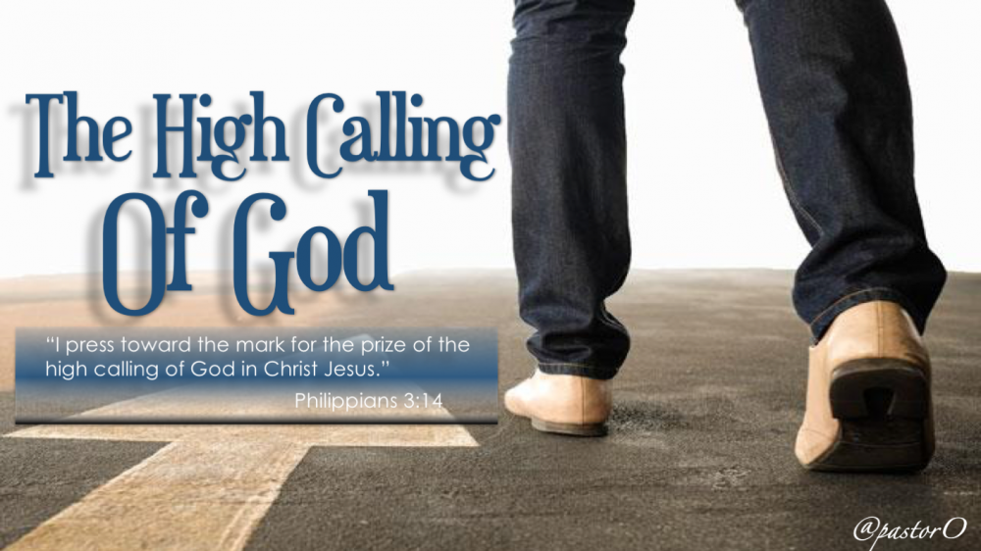
Reach for Kingdom Purpose
“I press toward the mark for the prize of the High Calling…”
Gk - “calling” klesis —
a divine summons, a heavenly invitation.

Slide 21

God Has Called You
To Live Beyond Ordinary
Live Beyond Our
Past
Problems
Pains
To Step Up
Go Beyond the Mile

Slide 22

Everybody Stand
If you’re ready to let go of what’s behind you…
If you’re ready to reach for what’s ahead…
If you’re ready to press toward the mark…
Raise Both Hands Saying…

Slide 23

Raise Both Hands and Say…
“Lord, Reset me- Realign me- Refocus me- Renew me.
Prepare me for the new year
Now lift your hands and declare:
This year,
I will run with purpose, walk with power, and live with passion
And the God who brought you through last year is about to launch you into this one w- FIRE, w- FOCUS /w- HOLY GHOST POWER.

Slide 25
Mrs Claus was trying to get Santa to relax a little after his big night –so she sent him to play a relaxing game of golf… But.. Santa had a bit of an accident while playing golf today. His ball hit a bird on the second hole.
It was a partridge on a par 3

