Slide 1
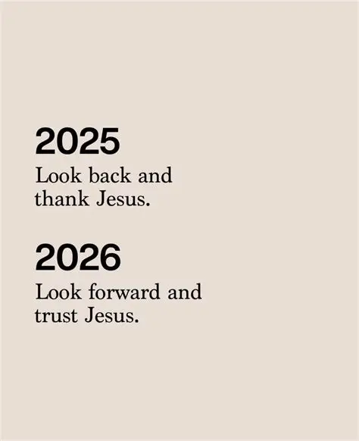

Slide 2
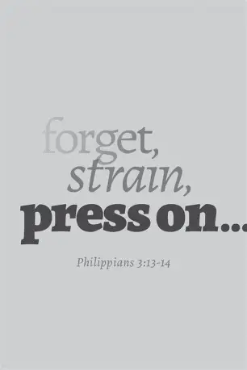
Spiritual Warfare
10% Satan’s Tactics
90% How We Respond
Remember…
With God We Are Not
Helpless
Hopeless
We Are Powerful!!

Slide 3

Repeat
These are the 2 Most Important Hours of My Week – Help Me to Cherish Them
I Am Here Today to Worship
Not to Be Entertained
I Am Singing to An Audience of One
Accept My Worship Oh Lord!

Slide 4
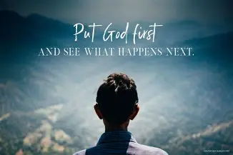
Repeat
I Lift My Offering to You
Let It Please You Oh Lord
This is My Seed
Although It Leaves My Hand
It will Never Leave My Life
You Will Multiply It!
Accept My Seed Oh Lord!

Slide 6


Slide 7
Preparing for the New Year Phil 3:13–14 Pt 2
Edward Church
January 4, 2026
RESET,
REALIGN,
RUN!

Slide 8

“Neighbor… oh neighbor… this year will NOT catch me unprepared!”
You made it… this year, you’re gonna do more than Survive
Your Gonna THRIVE!
Today is not a lecture, not a seminar.
Today is a REVIVAL…..something in you is about to Wake Up
We’re not here to make Resolutions —but receive Revelation.
We’re not here to make Promises but Stand On Promises
We’re not here to Try Harder — we’re here to Walk In The Spirit.
If you’re ready for a New Year With New Power, shout “Let’s go!”

Slide 9
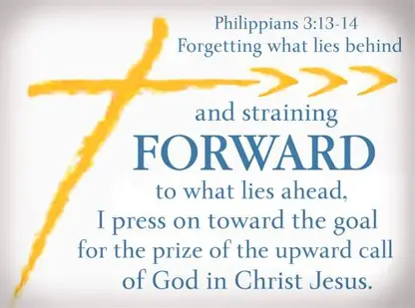
Philippians 3:13–14
Forgetting
Gk — Intentionally Ignore
Reaching
Gk — Stretch Beyond Limits
Pressing
Gk — Chase with Force
Say: “This is not a Wishlist — this is a War Plan!”

Slide 10
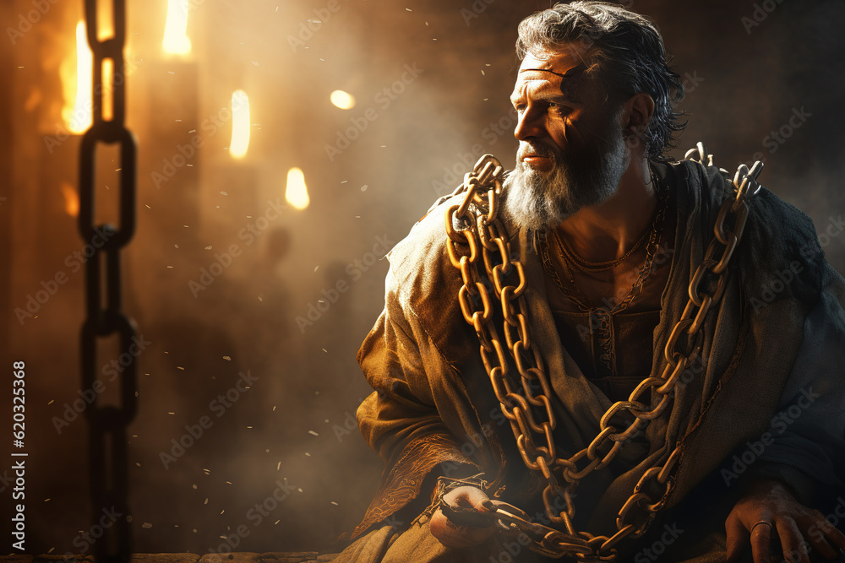
Paul’s Situation
📌 Roman Imprisonment
📌 Harsh Conditions
📌 Uncertain Future
📌 Yet Writes W-
Joy, Focus, and Forward Momentum
Your Environment…
…Doesn’t Determine Your Destiny
…Your Alignment Does

Slide 11
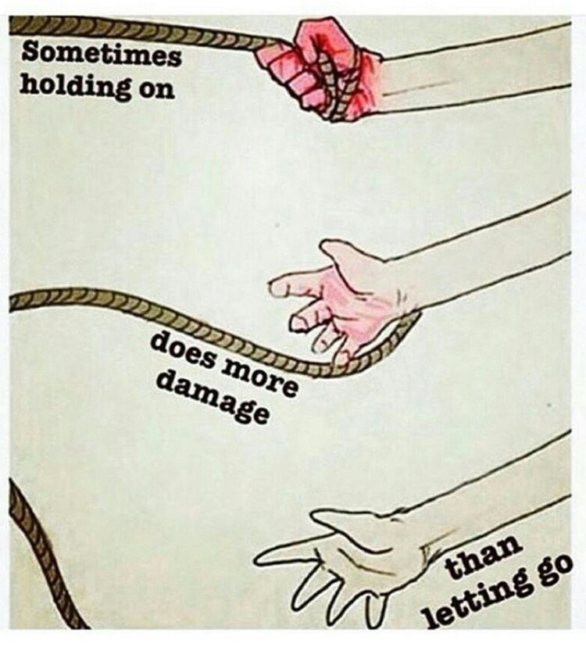
LET GO
“Forgetting those things which are behind…”
Greek:
To Overlook
To Starve of Attention
To Deny Influence
Say: “Some things deserve to be ignored!”
Challenge:
“If God forgave it, why are you still feeding it?”

Slide 12
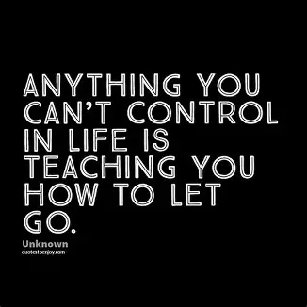
LET GO OF WHAT’S BEHIND YOU
“Forgetting those things which are behind…”
Together It Means:
“I Refuse to Revisit It”
“I Refuse to Rehearse It”
“I Refuse to Relive It”
“I Refuse to Let It Define Me”
Paul Is Not Saying, “I Don’t Remember My Past”
He’s Saying, “I Refuse To Let My Past Remember Me”
Say: “Some Things Deserve To Be Ignored!”

Slide 13
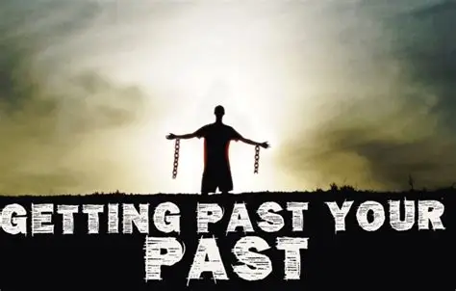
What You Must Release
❌ Past Failures
❌ Past Disappointments
❌ Past Mistakes
❌ Past Identities
❌ Past Victories that Keep You Stuck
Say: “Some Things Deserve to Be Ignored!”
Challenge:
“Don’t Build a Shrine Around What God Used to Do.”

Slide 14

REACH FORWARD
“…reaching forth…”
Greek:
Stretch
Strain
Lean Forward
Say: “I’m reaching for more!”
Challenge:
“This year, No Microwave Devotion — Go Deeper”

Slide 15
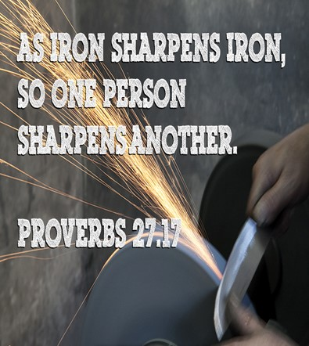
Reach for…
…Healthy Relationships
✔ People Who Sharpen You
✔ People Who Challenge You
✔ People Who Pray With You
✔ People Who Push You

Slide 16
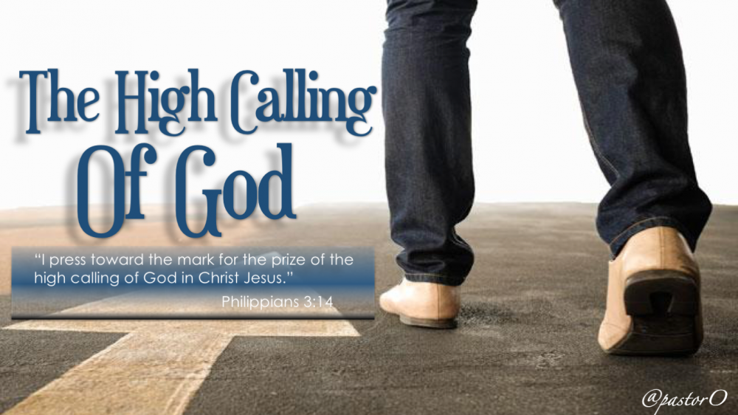
Reach for Kingdom Purpose
“I press toward the mark for the prize of the High Calling…”
Gk - “calling” klesis —
a divine summons, a heavenly invitation.

Slide 17
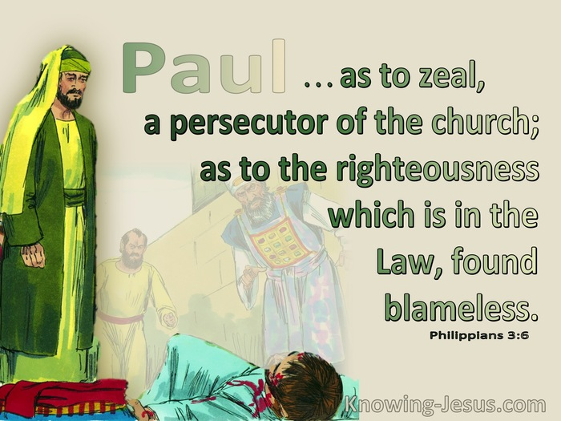
PRESS TOWARD THE MARK
“I press toward the mark…”
Greek
to chase, pursue, hunt down, run after with force
Same Word Used For Persecution
Meaning
Paul Now…
Chases God with the Same Intensity …
… He Once Used to Chase Christians
Say it: “I’m Pressing!”

Slide 18
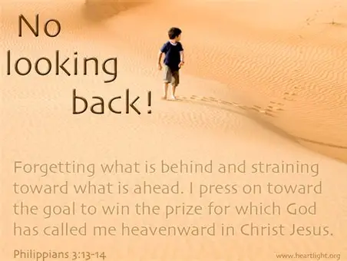
Press Through Distractions
Paul Says:
“This one thing I do…”
The Greek Phrase Means:
“I focus exclusively”
“I eliminate competing priorities”
“I refuse divided attention”

Slide 19
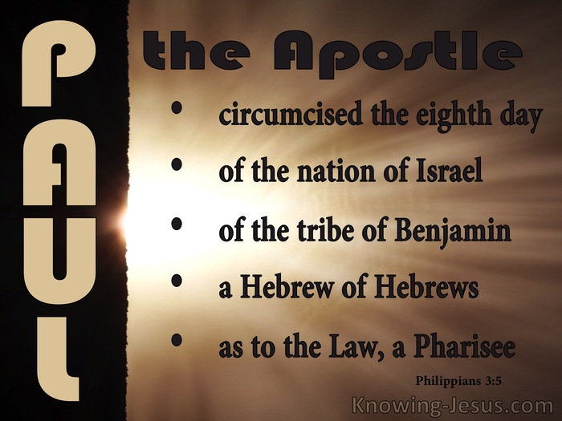
Press Through Discouragement
Paul says:
“I have not yet attained…”
He acknowledges:
“I’m not perfect.”
“I’m not finished.”
“I’m not there yet.”
But He Refuses to Quit.

Slide 20

Press With the Power of the HG
Paul says:
“I press toward the mark…”
Gk= “mark” is skopos —
the target
the goal
the finish line
You Can’t Reach the Mark
Without the Spirit’s Power

Slide 21
Practical Steps To Prepare For The New Year
Set a Spiritual Focus
Choose to Grow and Ask Yourself
Where Do I Need God To Stretch Me?
What Discipline Have I Neglected?
What Area Is God Highlighting In My Spirit?
Clean Your Spiritual House
Forgive…
Release...
Let Go…
Don’t Bring Old Poison Into a New Season
You can’t control what happened …
…you can control what you carry

Slide 22
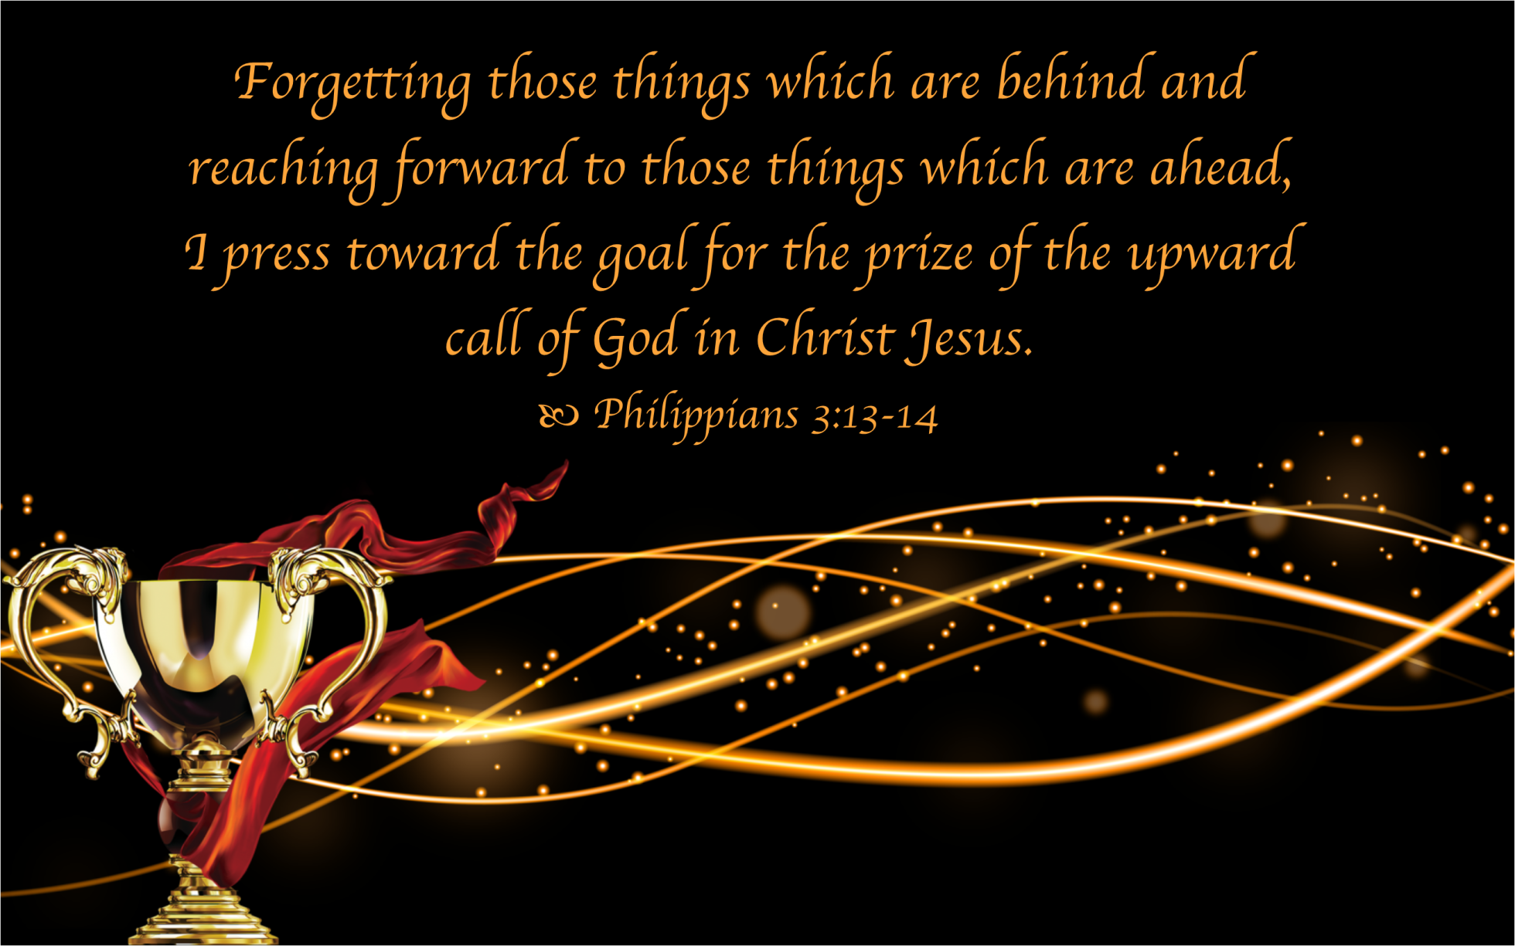
Practical Steps To Prepare For The New Year
Write the Vision
“Write the vision and make it plain.” -It Brings…
Clarity
Accountability
Direction
Focus
Start the Year in Worship
How you start determines how you finish
Worship sets the tone, atmosphere, your heart in alignment with heaven.
Expect the Supernatural
Don’t walk into the New Year with Natural Expectations

Slide 23

God Has Called You
To Live Beyond Ordinary
Live Beyond Our
Past
Problems
Pains
To Step Up
Go Beyond the Mile

Slide 24
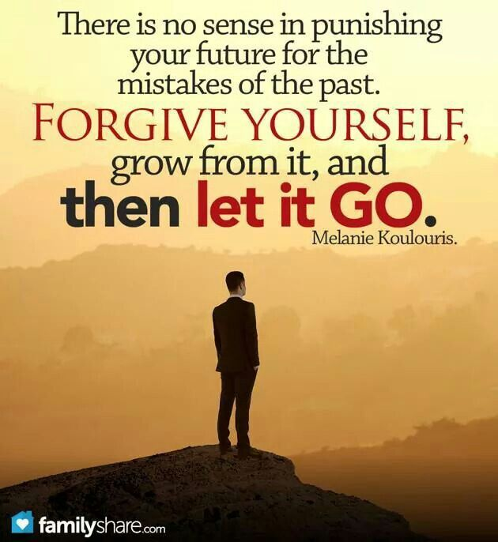
Everybody Stand
If you’re ready to let go of what’s behind you…
If you’re ready to reach for what’s ahead…
If you’re ready to press toward the mark…
Raise Both Hands Saying…

Slide 25

Raise Both Hands and Say…
“Lord, Reset Me- Realign Me- Refocus Me- Renew Me!
Prepare me for the new year
Now lift your hands and declare:
This year,
I will run with purpose, walk with power, and live with passion
And the God who brought you through last year is about to launch you into this one w- FIRE, w- FOCUS /w- HG POWER!

Slide 27
A pastor attended a men's breakfast in the middle of a rural farming area of the country.
The group had asked an older farmer, decked out in bib overalls, to say grace for the morning breakfast:
"Lord, I hate buttermilk," the farmer began.The visiting pastor opened one eye to glance at the farmer and wonder where this was going.
The farmer loudly proclaimed, "Lord, I hate lard."Now the pastor was growing concerned.
Without missing a beat, the farmer continued, "And Lord, you know I don't much care for raw white flour."The pastor once again opened an eye to glance around the room and saw that he wasn't the only one to feel uncomfortable.
Then the farmer added, "But Lord, when you mix them all together and bake them, I do love warm fresh biscuits. So Lord, when things come up that we don't like, when life gets hard, when we don't understand what you're saying to us, help us to just relax and wait until you are done mixing. It will probably be even better than biscuits. Amen.“

