Slide 1
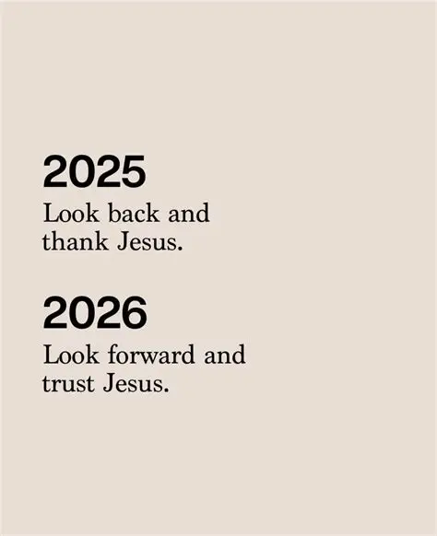

Slide 2
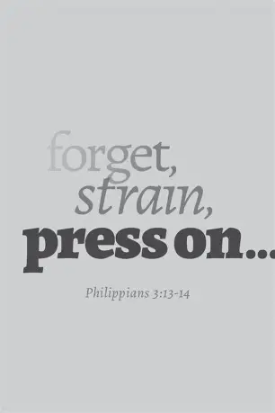
Spiritual Warfare
10% Satan’s Tactics
90% How We Respond
Remember…
With God We Are Not
Helpless
Hopeless
We Are Powerful!!

Slide 3

Repeat
These are the 2 Most Important Hours of My Week – Help Me to Cherish Them
I Am Here Today to Worship
Not to Be Entertained
I Am Singing to An Audience of One
Accept My Worship Oh Lord!

Slide 4
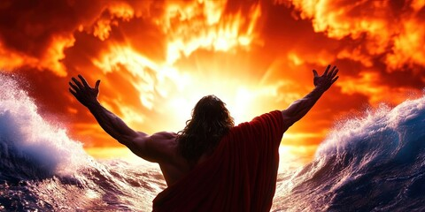
Edward Christian Church
1/4/2025

Slide 5
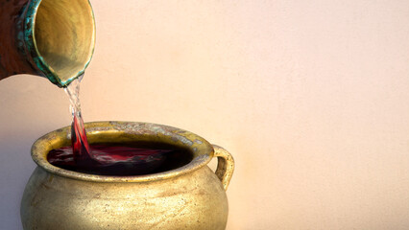
Oh Taste & See

Slide 6
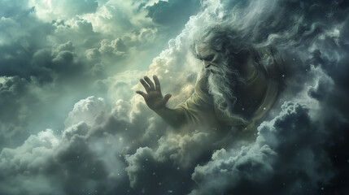
Good God Almighty

Slide 7
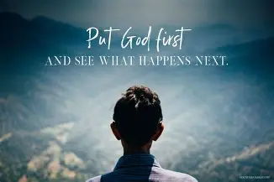
Repeat
I Lift My Offering to You
Let It Please You Oh Lord
This is My Seed
Although It Leaves My Hand
It will Never Leave My Life
You Will Multiply It!
Accept My Seed Oh Lord!

Slide 8
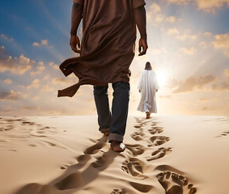
Trust In God

Slide 9
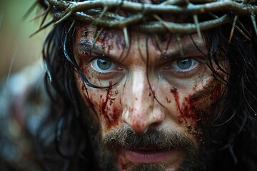
Great Are You Lord

Slide 11


Slide 12
Second Mile
Servanthood
John 13
Pt1
Edward Church
January 11, 2026
THE TOWEL THAT
TURNS THE WORLD
UPSIDE DOWN

Slide 13
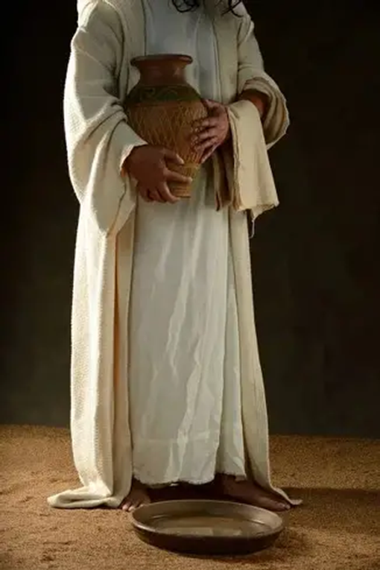
There are Many Symbols in Scripture:
The Cross — Salvation
The Tomb — Resurrection
The Crown — Authority
John 13:
Jesus Picks Up a Symbol Rarely Celebrated:
a Towel

Slide 14
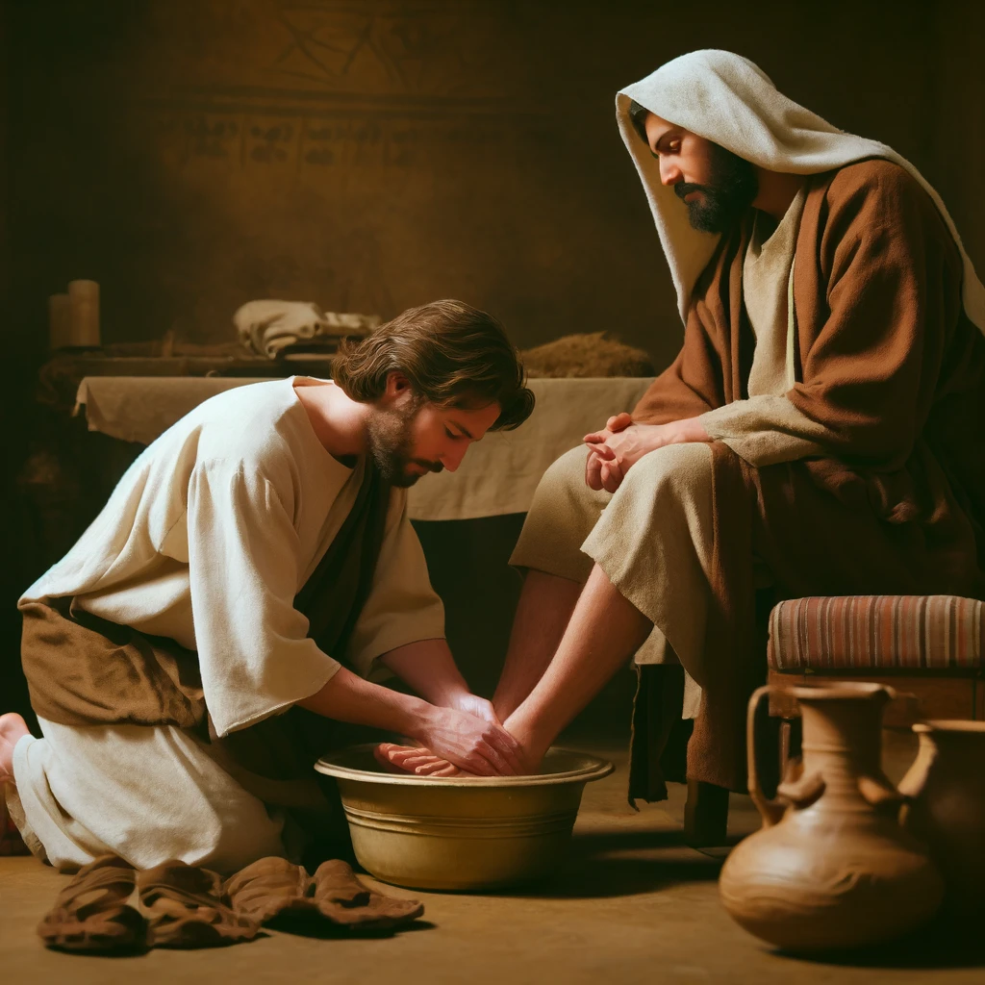
In the Kingdom,
the Towel Is the True Sign of Greatness.
Jesus Didn’t Just Teach Servanthood
— He Demonstrated It.
In this Passage,
He Calls Us Not Just to Serve…
But to Serve at the Second‑Mile Level.
Say:
“The Second Mile Is Where Servants Are Made”

Slide 15
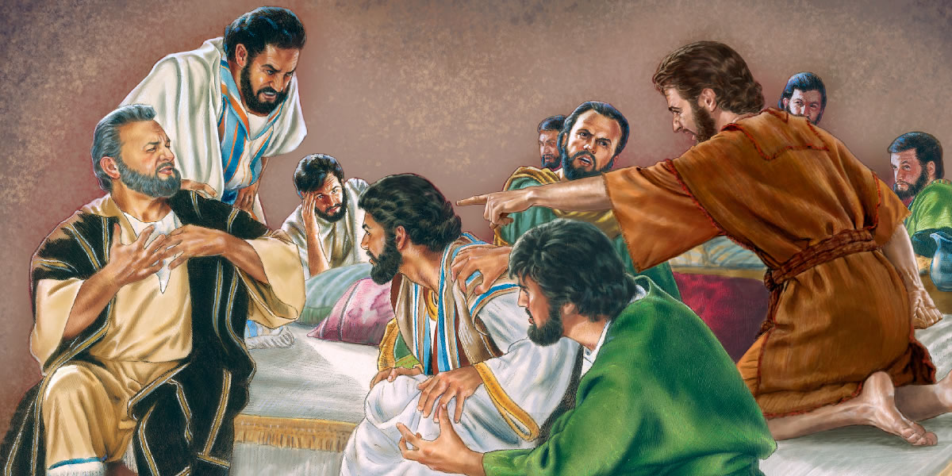
Context Of John 13
The Room Before The Towel
Feel The Tension In The Room:
It Is The Final Night Before The Cross
Judas Has Already Sold Jesus Out
Peter Is Hours Away From Denying Him
Disciples Are Arguing About Who Is The Greatest -Luke 22:24
The Weight Of Betrayal And Abandonment Is Thick In The Air

Slide 16
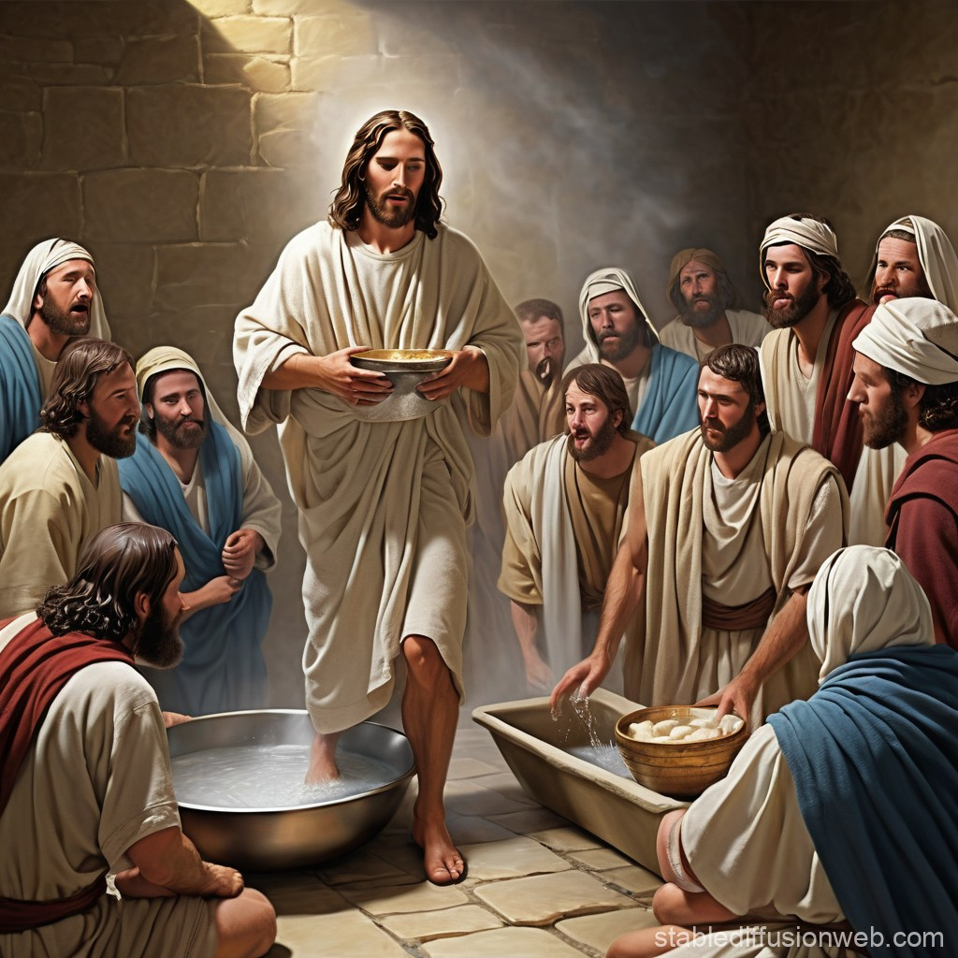
CONTEXT OF JOHN 13
Jesus Responds…
not with a Throne,
not with a Sword,
not with a Rebuke…
But with a Towel
SECOND‑MILE PRINCIPLE #1:
Second‑Mile Servants Respond to Chaos
With Calm, and to Pride With Humility

Slide 17
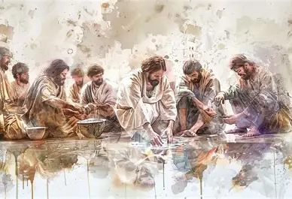
JOHN 13:12 — “WHEN HE HAD WASHED THEIR FEET”
Greek = “Washed”
Aorist tense: a Complete, Intentional, Decisive Act
Not Symbolic
Not Partial
Not Rushed
Jesus Washed Every Foot
Including The Feet Of Judas.

Slide 18
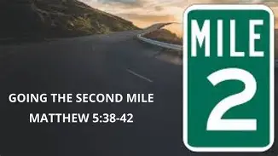
SERVANT INSIGHT
Servanthood Is Not Selective
You Don’t Get To Choose…
…Whose Feet Deserve Washing
Jesus Washed the Feet of Those Who:
Would Betray Him
Would Deny Him
Would Abandon Him

Slide 19
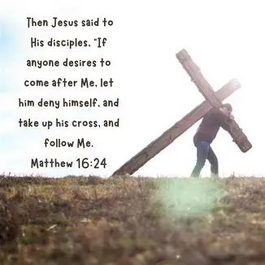
SERVANT INSIGHT
LIFE APPLICATION CHALLENGE :
Serve someone who Doesn’t Deserve It
This week:
Bless someone who HURT YOU
Help someone who CANNOT REPAY YOU
Show kindness to someone who IRRITATES YOU
Because the Second Mile Begins…
….where your COMFORT ZONE ENDS

Slide 20
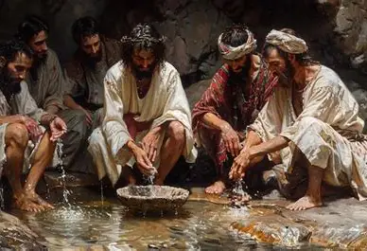
“I have set you an example…”
The Greek means:
                Blueprint
                Model
                Pattern
Jesus is saying:
“This is not a moment — this is a model”
“No servant is greater than his master”
If Jesus served, we cannot excuse ourselves from serving

Slide 21
The Second-Mile Pattern
The first mile is what’s expected.
The second mile is what’s anointed.
The first mile is what people see.
The second mile is what God rewards.
The first mile is where religion stops.
The second mile is where revival begins.

Slide 22

The Second-Mile Pattern
The first mile is obligation.
The second mile is revelation.
The first mile is law.
The second mile is love.
Jesus Didn’t Just Wash Feet
He Went The Second Mile.

Slide 23
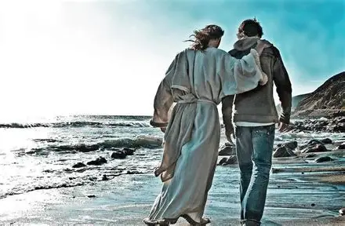
Everyone Who Accepts Challenge
Form a Line
Let Me Anoint You
Give You a Reminder
Commission You

Slide 24

“In the Name of Jesus,
I commission you to walk the high road,
serve in the second mile,
lead with humility,
influence with integrity,
and love with the heart of Christ.
May your life reveal the towel,
your leadership reflect the cross,
and your steps follow the path of Jesus.”

Slide 25
End pt 1

Slide 26
There was a gentleman in the hospital bed next to me.
He was covered with bandages from head to toe.
I said to him, "What do you do for a living?"
He said, "I'm a former window washer."
I asked, "When did you give it up?"
He said, "Halfway down."

