Slide 1
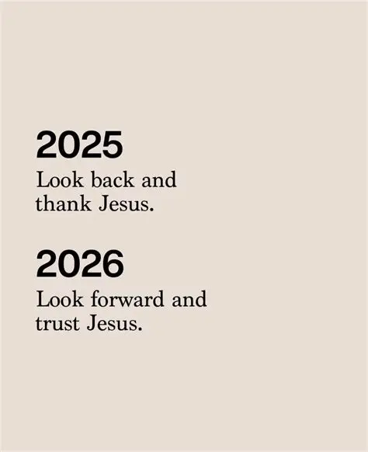

Slide 2

Spiritual Warfare
10% Satan’s Tactics
90% How We Respond
Remember…
With God We Are Not
Helpless
Hopeless
We Are Powerful!!

Slide 3

Repeat
These are the 2 Most Important Hours of My Week – Help Me to Cherish Them
I Am Here Today to Worship
Not to Be Entertained
I Am Singing to An Audience of One
Accept My Worship Oh Lord!

Slide 4
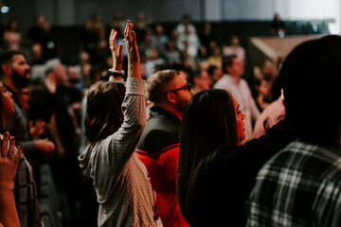
Edward Christian Church
1/18/2026

Slide 5
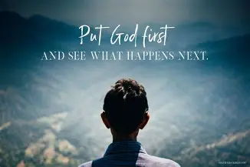
Repeat
I Lift My Offering to You
Let It Please You Oh Lord
This is My Seed
Although It Leaves My Hand
It will Never Leave My Life
You Will Multiply It!
Accept My Seed Oh Lord!

Slide 7


Slide 8
Second Mile
Servanthood
John 13
Pt2
Edward Church
January 18, 2026
THE TOWEL THAT
TURNS THE WORLD
UPSIDE DOWN

Slide 9
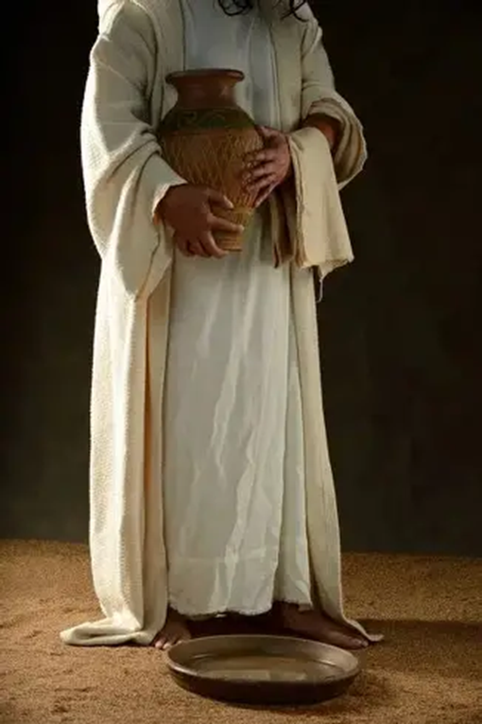
There are Many Symbols in Scripture:
The Cross — Salvation
The Tomb — Resurrection
The Crown — Authority
John 13:
Jesus Picks Up a Symbol Rarely Celebrated:
a Towel

Slide 10
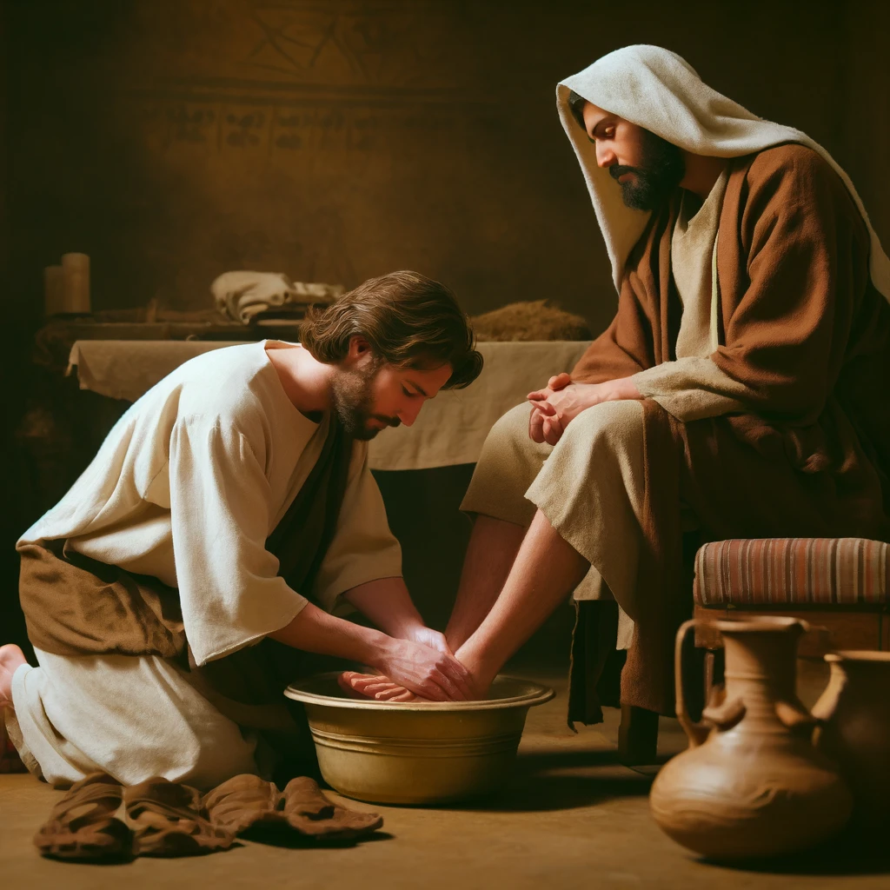
In the Kingdom,
the Towel Is the True Sign of Greatness.
Jesus Didn’t Just Teach Servanthood
— He Demonstrated It.
In this Passage,
He Calls Us Not Just to Serve…
But to Serve at the Second‑Mile Level.
Say:
“The Second Mile Is Where Servants Are Made.

Slide 11
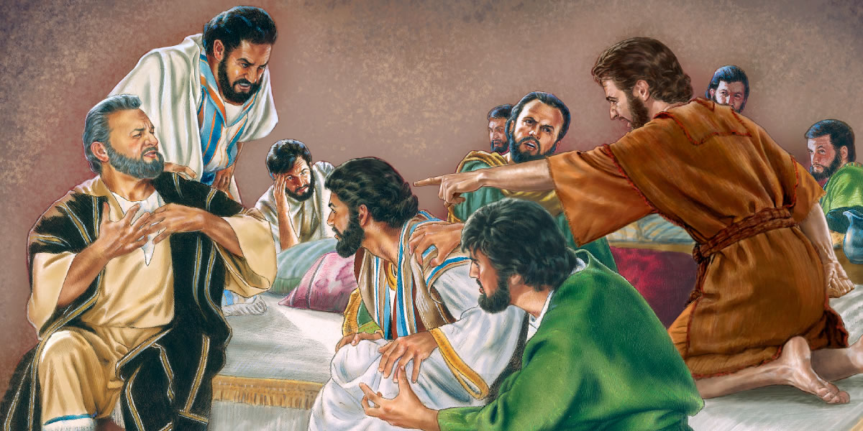
Context Of John 13
The Room Before The Towel
Feel The Tension In The Room:
It Is The Final Night Before The Cross
Judas Has Already Sold Jesus Out
Peter Is Hours Away From Denying Him
Disciples Are Arguing About Who Is The Greatest -Luke 22:24
The Weight Of Betrayal And Abandonment Is Thick In The Air

Slide 12
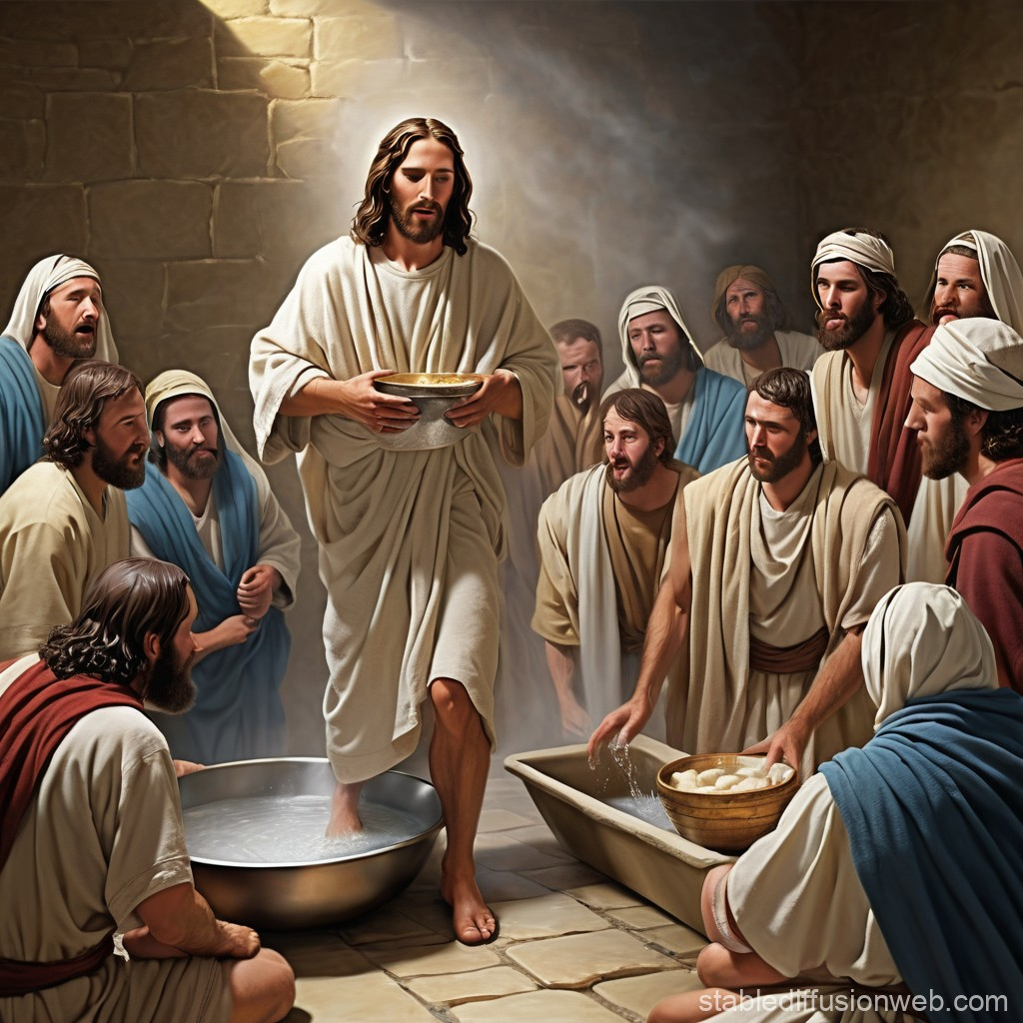
CONTEXT OF JOHN 13
Jesus Responds…
not with a Throne,
not with a Sword,
not with a Rebuke…
But with a Towel
SECOND‑MILE PRINCIPLE #1:
Second‑Mile Servants Respond to Chaos
With Calm, and to Pride With Humility

Slide 13
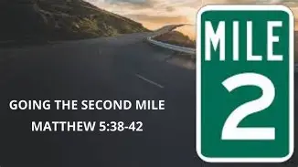
SERVANT INSIGHT
Servanthood Is Not Selective
You Don’t Get To Choose…
…Whose Feet Deserve Washing
Jesus Washed the Feet of Those Who:
Would Betray Him
Would Deny Him
Would Abandon Him

Slide 14
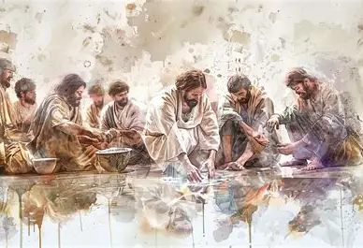
JOHN 13:13–14 — “YOU CALL ME TEACHER AND LORD…YOU ARE RIGHT”
Jesus doesn’t deny His authority.
He doesn’t pretend to be less than He is.
Then He flips the kingdom upside down:
“If I, your Lord and Teacher, have washed your feet, you also ought to wash one another’s feet.”
Greek
“Ought” =
A moral obligation
A sacred duty
A kingdom requirement

Slide 15
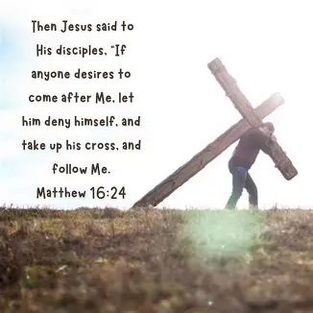
Insight
Jesus is Not Lowering Himself…
…He is Raising the Standard for Us
SECOND‑MILE PRINCIPLE #2:
The First Mile Is Duty
The Second Mile Is Destiny

Slide 16
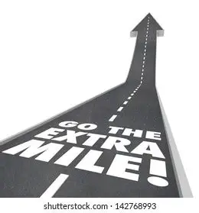
CHALLENGE:
Take the Lowest Place On Purpose
This Week:
Choose the job nobody wants
Let someone else go first
Do something anonymously
Serve without being seen
Why?
Humility is the Uniform of the Second‑mile Servant

Slide 17
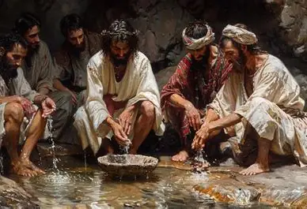
JOHN 13:15 — “I HAVE GIVEN YOU AN EXAMPLE”
Jesus didn’t just give a Command —
He Gave a Pattern
Greek
“Example”
A Model
A Blueprint
A Pattern to Trace
Jesus is saying: “Trace Your Life Over Mine”

Slide 18
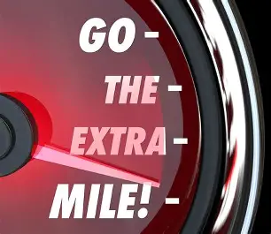
Insight
The World Climbs Ladders…
…But Jesus Carried a Towel
SECOND‑MILE PRINCIPLE #3:
The second mile is where you stop asking, “What do I have to do?” and start asking, “What more can I do?”
CHALLENGE
Follow the Pattern, Not the Culture
This Week:
Replace complaining with serving
Replace entitlement with gratitude
Replace “That’s not my job” with “How can I help?”

Slide 19
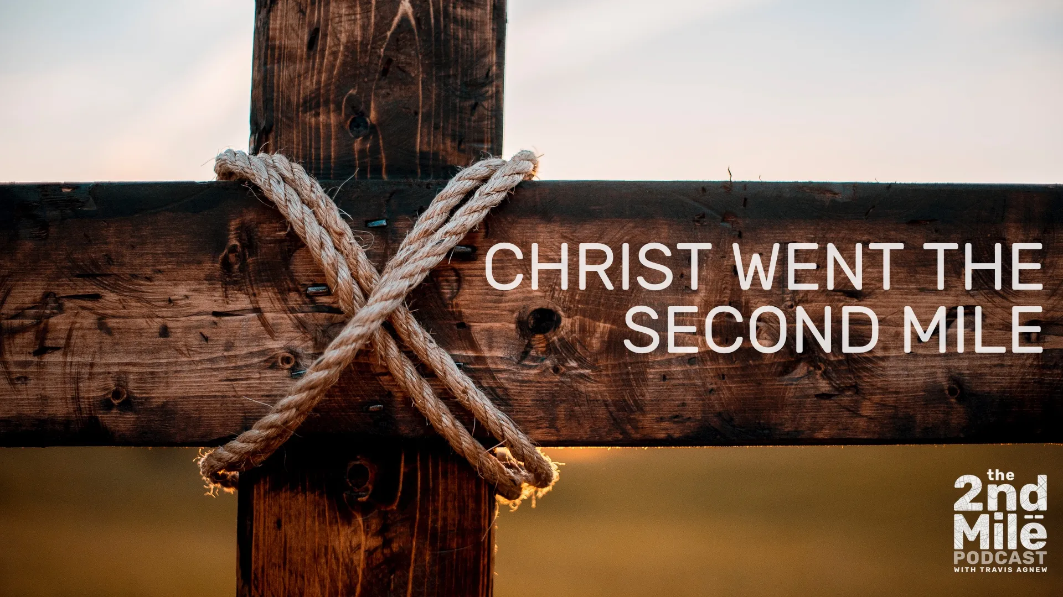
JOHN 13:16, “Servant is not greater than his master”
If the Master served… the servants must serve
If the King knelt… the kingdom must kneel
Matthew 5:41
“If someone forces you to go one mile, go with him two”
First Mile is Obligation
Second Mile is Revelation
Mark 10:45
“the Son of Man did not come to be served, but to serve…”

Slide 20
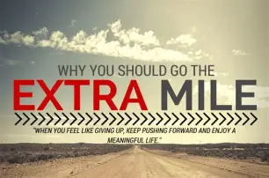
SECOND‑MILE PRINCIPLE #4:
The second mile is where Jesus Walks
If you want to find Him — Go There!
CHALLENGE:
Go the Second Mile
This Week:
Do more than Required
Stay longer than Expected
Give more than Asked
Love deeper than Comfortable

Slide 21
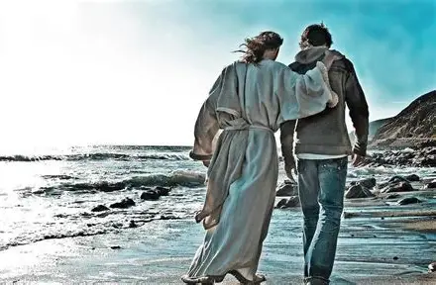
JOHN 13:17, “BLESSED ARE YOU IF YOU DO THEM”
Jesus Ends with a Promise:
Blessing is Not in Knowing…
…Blessing is in Doing
Greek= Blessed
Deep Joy
Inner Satisfaction
Divine Favor

Slide 22

Insight
You don’t get blessed for understanding servanthood…
…You get blessed for practicing it
SECOND‑MILE PRINCIPLE #5:
The Second Mile Is Where Blessing Lives
Challenge:
Turn Knowing into Doing
Within the next 24 hours:
Turn one Sermon Point into one Action
Turn one Conviction into one Commitment
Turn one Opportunity into one Blessing

Slide 23
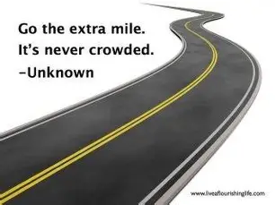
“LORD, MAKE ME A SECOND‑MILE SERVANT”
If you’ve been tired… If you’ve been selective in your serving… …stuck in the first mile… ..been avoiding the towel… If you’ve been waiting for others to go first…
Come to the Altar Saying:
“Lord, make me a Second‑Mile Servant.”
CLOSING DECLARATION
I choose the towel. I choose the second mile. I choose the posture of Jesus. I choose the path of servanthood. I choose the joy of obedience. I choose the blessing of the basin. I choose to follow the Example of my Master.

Slide 24
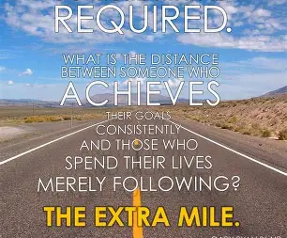


Slide 26
A pastor attended a men's breakfast in the middle of a rural farming area of the country.
The group had asked an older farmer, decked out in bib overalls, to say grace for the morning breakfast:
"Lord, I hate buttermilk," the farmer began.The visiting pastor opened one eye to glance at the farmer and wonder where this was going.
The farmer loudly proclaimed, "Lord, I hate lard."Now the pastor was growing concerned.
Without missing a beat, the farmer continued, "And Lord, you know I don't much care for raw white flour."The pastor once again opened an eye to glance around the room and saw that he wasn't the only one to feel uncomfortable.
Then the farmer added, "But Lord, when you mix them all together and bake them, I do love warm fresh biscuits. So Lord, when things come up that we don't like, when life gets hard, when we don't understand what you're saying to us, help us to just relax and wait until you are done mixing. It will probably be even better than biscuits. Amen.“

