Slide 1
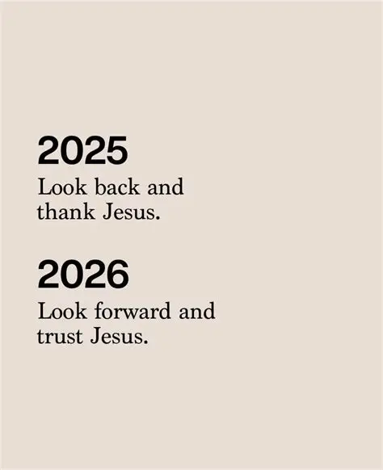

Slide 2

Spiritual Warfare
10% Satan’s Tactics
90% How We Respond
Remember…
With God We Are Not
Helpless
Hopeless
We Are Powerful!!

Slide 3

Repeat
These are the 2 Most Important Hours of My Week – Help Me to Cherish Them
I Am Here Today to Worship
Not to Be Entertained
I Am Singing to An Audience of One
Accept My Worship Oh Lord!

Slide 4
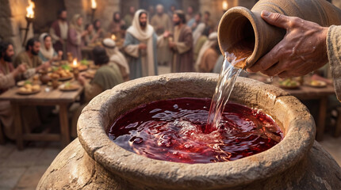
Edward Christian Church
2/1/2026

Slide 6
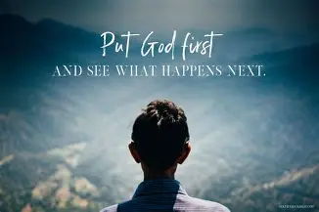
Repeat
I Lift My Offering to You
Let It Please You Oh Lord
This is My Seed
Although It Leaves My Hand
It will Never Leave My Life
You Will Multiply It!
Accept My Seed Oh Lord!

Slide 8


Slide 9
Pardon Me For the Interruption… …God
Edward Church
February 8, 2026
Peace
In Spite of
the Storm

Slide 10
INTRO Church, I want to talk to you today about a peace that doesn’t depend on the weather, the news cycle, or the condition of your bank account.
A peace that doesn’t evaporate when the storm clouds roll in.
A peace that doesn’t shake when the wind starts blowing.
A peace that doesn’t run when the waves get high.
I’m talking about the peace of Jesus Christ —
the peace that stands up in the middle of a storm and says, “Peace, be still.”
Let’s go to the text.

Slide 11
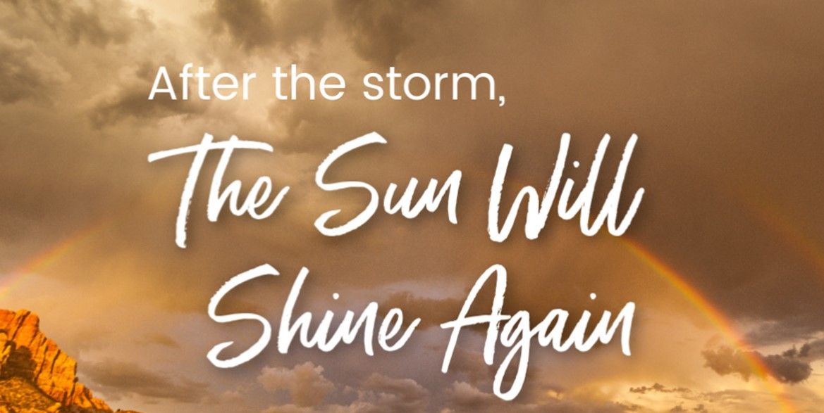
The storm may have interrupted our rhythm
…but it did NOT interrupt God’s Plan
The weather may have shut down God’s House
…but it did NOT shut down God
…Or His Purpose
I Came to Declare this with Assurance

Slide 12
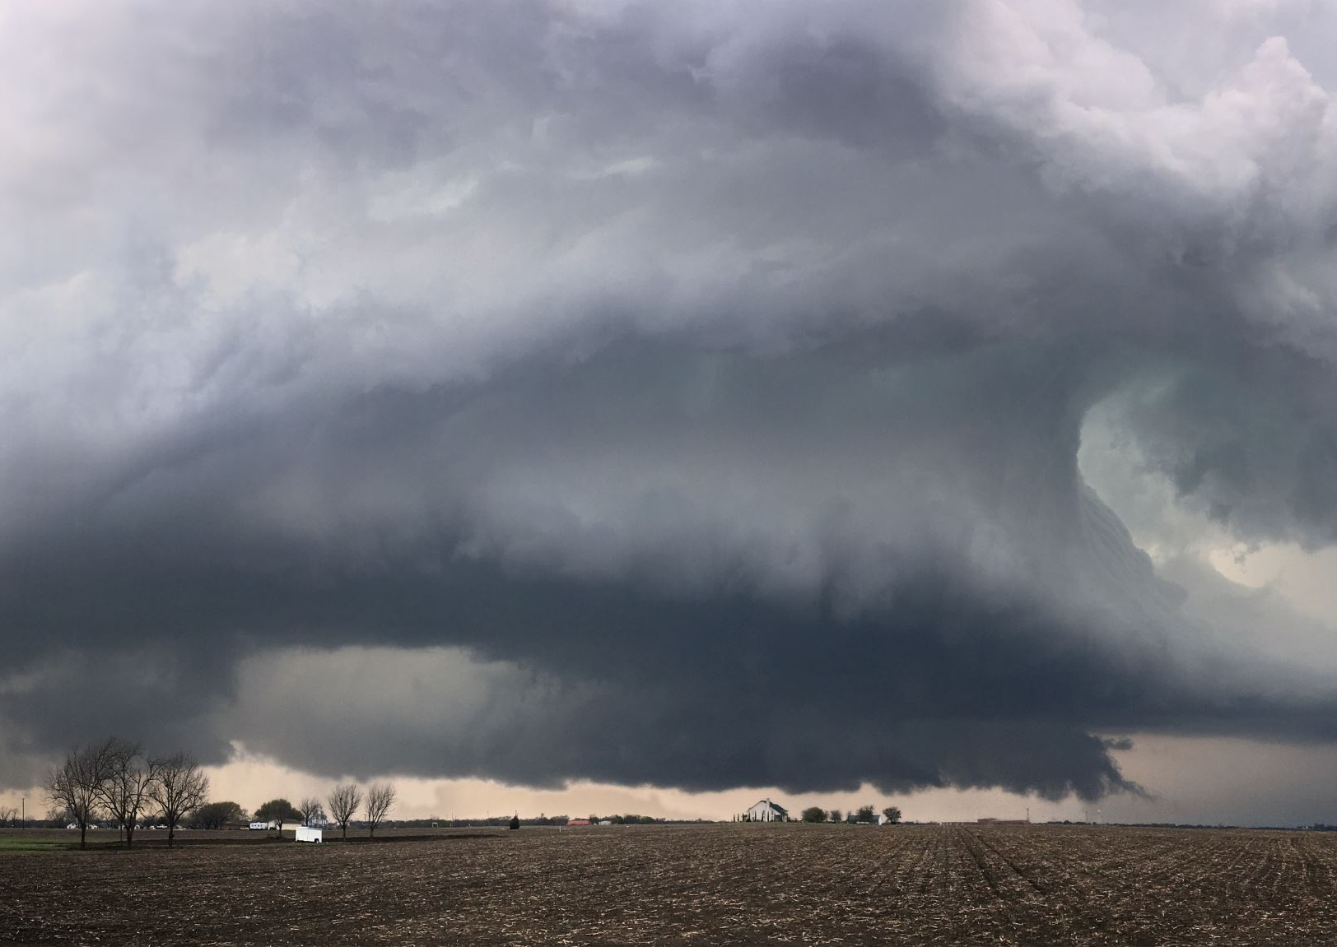
Talking to Somebody Who’s Been in a Storm
Not a Drizzle
Not a Cloudy Day
But a Storm
A Storm in Your
Mind
Family
Finances
Emotions
And the Enemy has Whispered,
“You’re not going to make it through this one!”

Slide 13
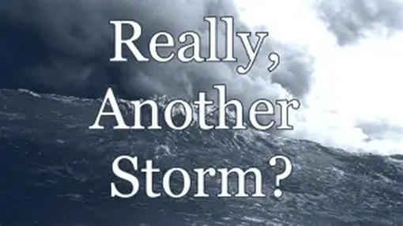
Storm Facts:
Storms Don’t Send Invitations
Don’t Knock Politely
Don’t Wait For A Convenient Moment
Storms Show Up Unannounced
Uninvited
Unrelenting

Slide 14
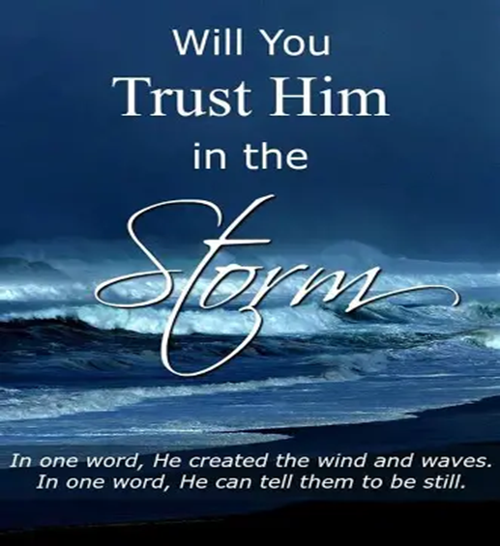
Good News
Storms Don’t Scare Jesus.
Wind May Roar,
Waves May Rise,
Boat May Shake,
The Snow May SHUT our County Down
But Jesus is Still the Master of the Storm
“Three Thoughts to Get You Through Your Storm”

Slide 15
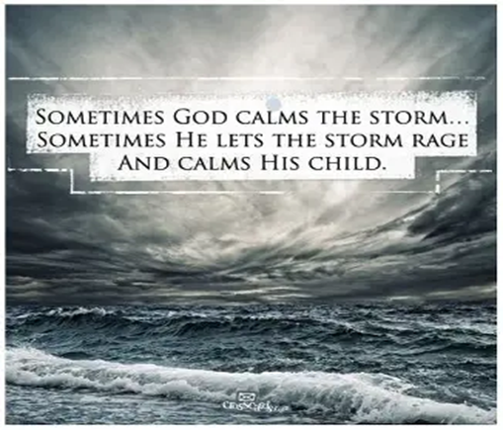
“The Storm Is Real, But So Is The Savior”
Storms Are
Sudden
Violent
Unpredictable
But Jesus Is
Present
Powerful
Unshaken
The Storm Doesn’t Define You…
…His Presence Does

Slide 16
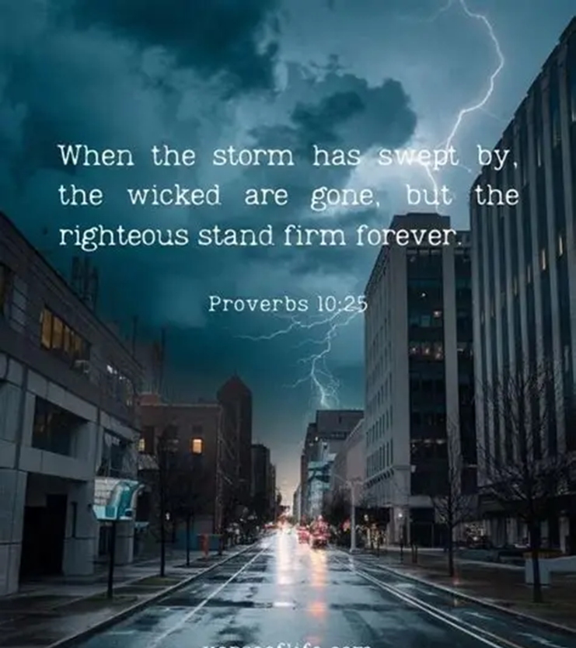
“The Storm Is Real, But So Is The Savior”
Verse 37, “A great storm arose.”
Greek= violent, unexpected whirlwind.
This storm came out of nowhere.
…Just like some of the storms in your life.
Disciples were Panicking

Slide 17

“The Storm Is Real, But So Is The Savior”
Jesus is Asleep
Not pacing, panicking, wringing His hands
Why?
Because the Storm Didn’t Threaten Him
The Storm Didn’t Intimidate Him
The Storm Didn’t Have Authority Over Him
CHALLENGE #1
Where Have You Allowed the Storm to Become…
…More Real to You Than the Savior?

Slide 18

“Fear Questions God; Faith Awakens His Word”
Fear says,
“Don’t You Care?”
Faith Remembers,
“Let Us Go to the Other Side”
Application
God’s Promise is Stronger Than Your Panic

Slide 19
Fear Always Attacks God’s Character
Fear Forgets /says: “God doesn’t care.”
“God forgot me.” “God left me.” “God isn’t listening.”
But Faith Remembers the First Thing Jesus Said:
“Let us go to the other side”
If Jesus said THAT…
…You’re Not Dying In The Middle
Challenge #2
What promise did God give you that you stopped believing when the storm hit?

Slide 20

“Jesus Doesn’t Just Calm Storms- He Confronts Them”
“Peace, be still” =
“Be muzzled”
Jesus speaks to what’s speaking to you
Peace is Spiritual Authority..
…Not Emotional Comfort

Slide 21
Jesus Stands Up and Rebukes the Wind
He doesn’t Negotiate with it
He doesn’t Tolerate it
He Confronts it
Jesus Speaks to What’s Speaking to You
If fear is speaking — He Speaks Louder
If anxiety is speaking — He Speaks Stronger
If the storm is speaking — He Speaks With Authority
CHALLENGE #3
What voice has been louder than Jesus in your life?

Slide 22
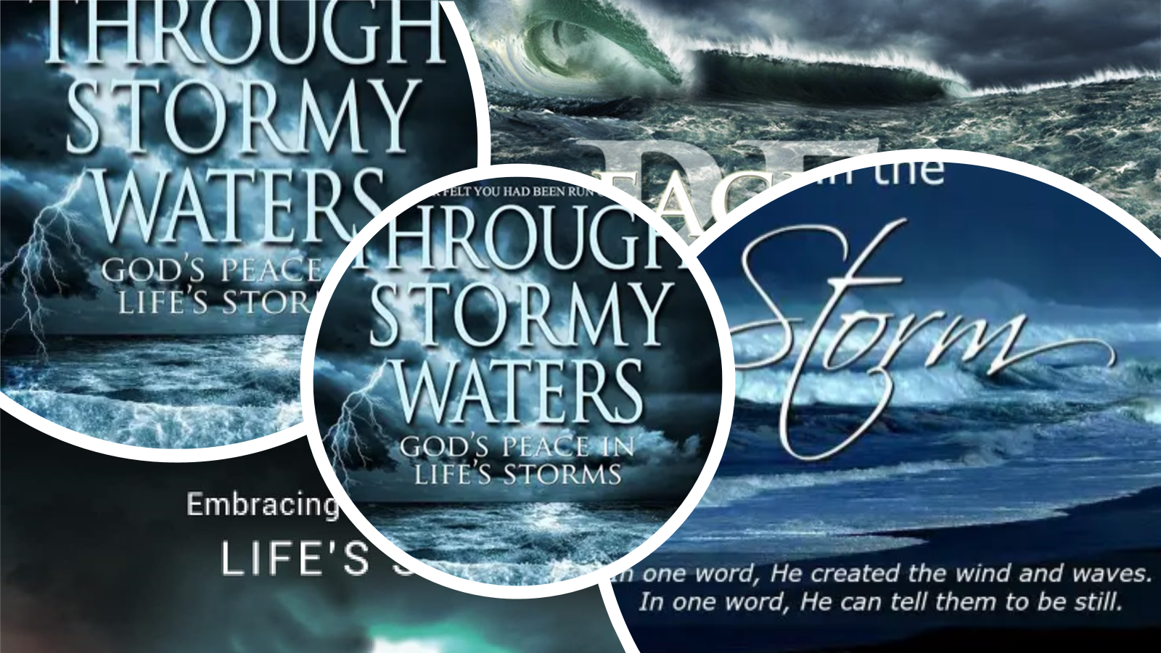
BRING IT HOME
Stop Interpreting God’s Silence as Absence
Hold Onto the Last Word Jesus Gave You
Invite Jesus Into the Boat, Not Just the Storm
Peace Is Not the Absence of Trouble —
It’s the Presence of Jesus

Slide 23
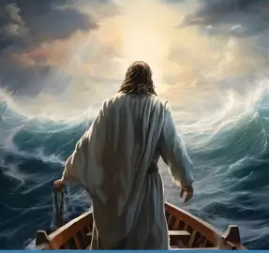


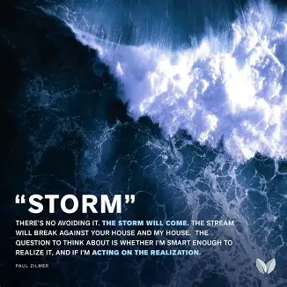
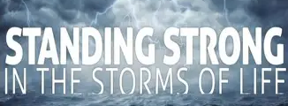
ALTAR CALL — “LORD, SPEAK PEACE TO MY STORM”
If You’re In a Storm… If You’re In a Battle…
If You’re In a Season Where The Waves Are High
If You’re Tired of Rowing…
If You’re Tired of Panicking…
If You’re Tired of Pretending You’re Okay…
Lift Your Hands!

Slide 24
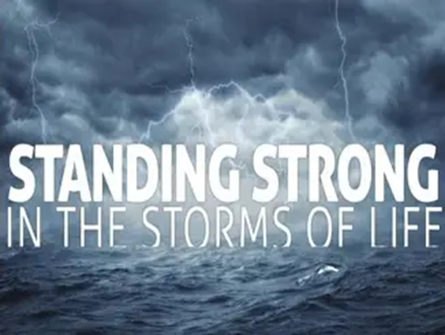
“THE POWER OF PEACE DECLARATION”
I confess that the peace of God is my portion. I have peace in the storm — because Jesus is in my boat.
I have peace in my mind — because my thoughts are stayed on Him.
I have peace in my relationships — because I choose forgiveness and boundaries.
I have peace in my spirit — because God’s peace guards my heart and mind.
I refuse to be ruled by fear. I refuse to be swayed by anxiety. I refuse to be controlled by conflict.
I refuse to be divided in my mind

Slide 26
An archaeologist was digging in the Negev Desert in Israel
and came upon a tomb containing a mummy.
After examining it, he called the curator of a prestigious
natural-history museum.
"I've just discovered the 3,000 year-old mummy of
a man who died of heart failure!"
the excited scientist exclaimed.
The curator replied, "Bring him in. We'll check it out."
A week later, the amazed curator called the archaeologist.
"You were right about the mummy's age and cause of death.
How in the world did you know?"
"Easy. There was a piece of paper in his hand that
said, '10,000 Shekels on Goliath'."

