Slide 2


Slide 3
THE LOVE THAT MAKES NO SENSE 1 John 4:7–12
Edward Church
February 15, 2026
True
Second Mile
Love

Slide 4
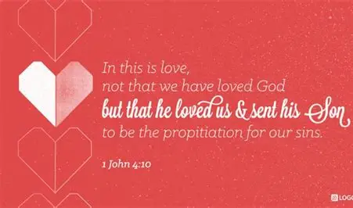
CHALLENGE:
Open Your Heart Today …
… to a Different Kind of Love

Slide 5
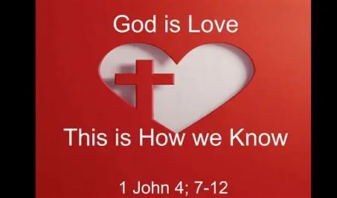
This Love Is Different:
Not Hallmark Love
Not Emotional Love
Not Chemistry Or Compatibility
Not Temporary Affection
This Is Holy Love
ACTIVE CHALLENGE: Let God Redefine Love for You Today

Slide 6

Valentine’s Day
A Day Filled With:
Roses
Chocolates
Cards
Romance
Feelings
But the Bible Doesn’t Talk Much About…
…Romantic Love.

Slide 7
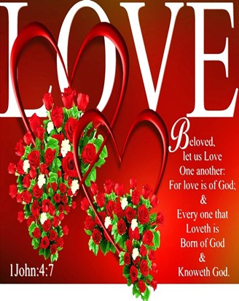
It Talks About a Love that Is …
…Bigger, Deeper, Wilder / More Costly
A Love that Doesn’t …
…Make Sense
…Depend On Chemistry
…Require Compatibility
…Wait For You to Deserve It
A Love that Comes from God Alone
Look At Someone And Say:
“This Love Is Different”

Slide 8
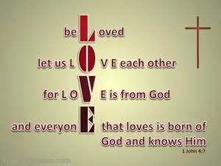
GOD’S LOVE IS NOT A FEELING; IT’S A SOURCE
“…for love is from God.” (7)
John Does NOT say:
Love is from ROMANCE
Love is from ATTRACTION
Love is from COMPATIBILITY
Love is from EMOTIONS
John Says:
Love Is from GOD

Slide 9

Exegesis
“From” = ek — out of, originating from, flowing out of
Love doesn’t START in you
It flows THROUGH you from Him
You can’t POUR what you don’t have
You CAN’T GIVE what you haven’t RECEIVED
CHALLENGE:
Stop trying to love people out of your own strength
Ask God to Fill You First

Slide 10
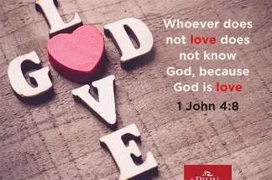
GOD’S LOVE IS NOT DESERVED; IT’S GIVEN
“Not that we loved God, but that He loved us…” (10)
God Loved You FIRST
God Loved You Before You CHANGED
God Loved You When You Were UNLOVABLE

Slide 11

Exegesis
“Loved” = agapaō — to choose, to act, to sacrifice
This is Not Emotional Love
This is Intentional Love
This is the Most Powerful Love
CHALLENGE:
Stop Trying to Earn God’s Love
Receive It
Rest In It
Believe It

Slide 12
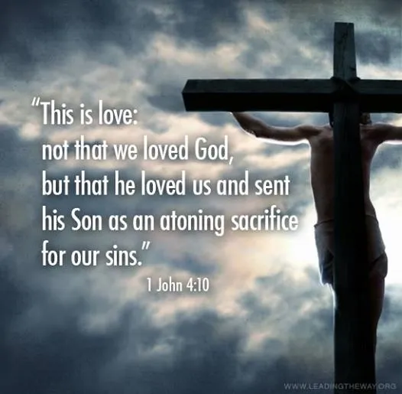
GOD’S LOVE IS NOT SAFE; IT’S SACRIFICIAL
“…He sent His Son to be the propitiation for our sins.” (10)
This is the Most Unusual Part of God’s Love:
He Didn’t Send:
a card
a poem
an angel
a message
…He sent His Son

Slide 13
“Propitiation” = the sacrifice that satisfies justice
Love Didn’t Just Feel Something…
…Love Paid Something
“The Firefighter Father”
A firefighter ran into a burning house to save his daughter. He didn’t send someone else. He went himself.
Love Doesn’t Stay at a Distance… …Love Enters The Fire
CHALLENGE:
If Your Love Never Costs You Anything…
…It’s Not Christ‑like Love

Slide 14
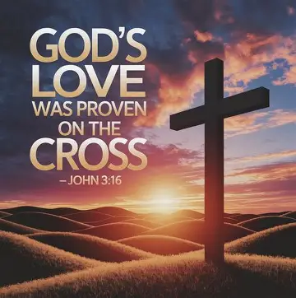
GOD’S LOVE IS NOT PRIVATE; IT’S PROVEN
“The love of God was made manifest…” (9)
Love is not invisible
Love is not silent
Love is not theoretical
Love shows up

Slide 15
“Manifest” = to make visible, reveal, to display publicly.
God Didn’t Whisper Love… …He Demonstrated It
Love is Proven by Presence.
CHALLENGE:
Stop Saying You Love People…
…Start Showing It.

Slide 16
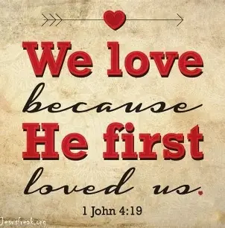
GOD’S LOVE IS NOT OPTIONAL; IT’S OUR MANDATE
“If God so loved us, we also ought to love one another” (11)
John doesn’t say:
“Try to love…”
“Consider loving…”
“Think about loving…”
He Says: “You ought to.”
“Ought” = GK -to owe, to be obligated, to be indebted
We Owe Love Because We Received Love
CHALLENGE:
Love someone this week who cannot repay you

Slide 17
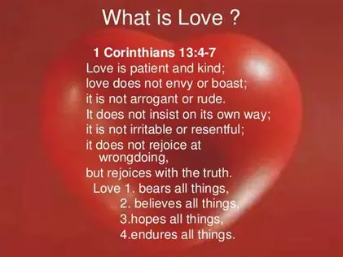
GOD’S LOVE IS NOT SEEN IN FEELINGS; IT’S SEEN IN US
“No one has ever seen God but if we love one another, God lives in us.” (12)
People don’t see God by:
clouds
visions
angels
miracles
They see God through your love.
You are the evidence of God’s love on earth.
Your love is someone’s first sermon.
CHALLENGE:
Be the proof of God’s love to someone who doubts He exists

Slide 18
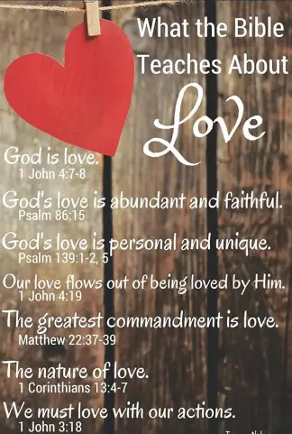
“LET GOD LOVE YOU FIRST”
Tell the room:
You cannot love others until you let God love you.
You cannot pour until you are filled.
You cannot give what you have not received.
Come to the altar saying: “Lord, fill me with Your love.”

Slide 19
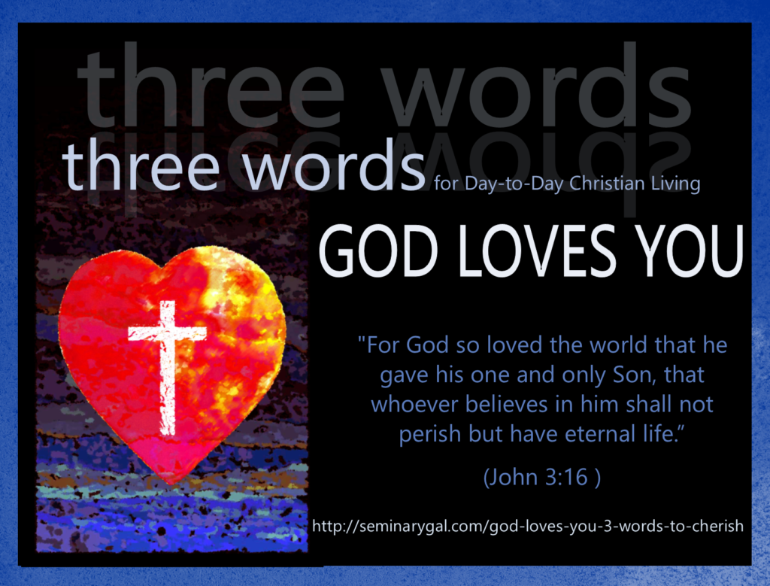
CLOSING DECLARATION
I am Loved by God
I am Chosen by God
I am Pursued by God
I am Filled by God
I will Love like God
I will Show His Love to the World

Slide 21
An archaeologist was digging in the Negev Desert in Israel
and came upon a tomb containing a mummy.
After examining it, he called the curator of a prestigious
natural-history museum.
"I've just discovered the 3,000 year-old mummy of
a man who died of heart failure!"
the excited scientist exclaimed.
The curator replied, "Bring him in. We'll check it out."
A week later, the amazed curator called the archaeologist.
"You were right about the mummy's age and cause of death.
How in the world did you know?"
"Easy. There was a piece of paper in his hand that
said, '10,000 Shekels on Goliath'."

