Slide 1



Slide 2

Spiritual Warfare
10% Satan’s Tactics
90% How We Respond
Remember…
With God We Are Not
Helpless
Hopeless
We Are Powerful!!

Slide 3

Repeat
These are the 2 Most Important Hours of My Week – Help Me to Cherish Them
I Am Here Today to Worship
Not to Be Entertained
I Am Singing to An Audience of One
Accept My Worship Oh Lord!

Slide 4
Repeat
These are the 2 Most Important Hours of My Week – Help Me to Cherish Them
I Am Here Today to Worship
Not to Be Entertained
I Am Singing to An Audience of One
Accept My Worship Oh Lord!

Slide 5
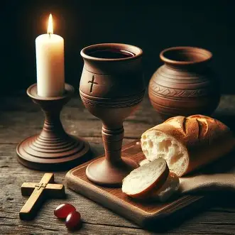

Slide 7

DEACONS: PEOPLE WHO LIFT WHAT MATTERS
Acts 6:1–7

Slide 8

The Ministry of Lifting
Every growing community reaches a point where the work exceeds the hands
Acts 6: a practical solution to a real problem
Deacons chosen not for status, but for service
Today: recognizing calling, character, and capacity

Slide 9

EXEGESIS OF “DEACON”
What “Deacon” Really Means
diakonos =**
Servant
Helper
One who runs toward a need
One who “kicks up dust” because they move quickly to help
Not A Title — A Posture
Not Authority — Availability

Slide 10
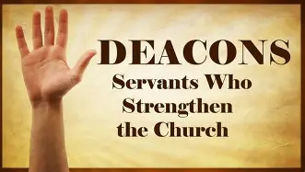
ACTS 6 CONTEXT
The Early Church Problem
Growth created gaps
Some widows overlooked
Leaders stretched thin
Mission at risk
Solution: Choose Servants Who Lift

Slide 11
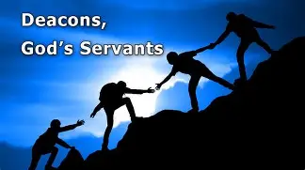
DEACONS SEE WHAT OTHERS MISS
Acts 6:1
They notice overlooked people
They pay attention to quiet needs
They protect the vulnerable
Challenge to Deacons: See the invisible Notice the unnoticed
Challenge to Congregation: Let them know when you need help

Slide 12
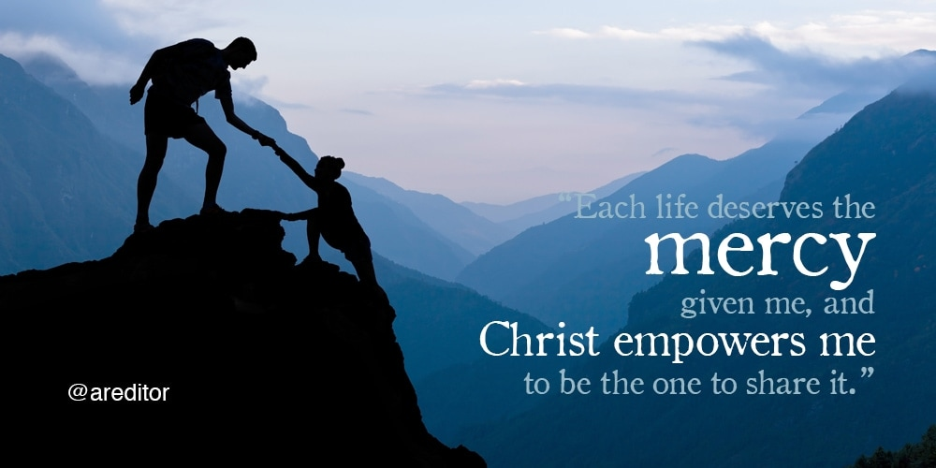
DEACONS SERVE WITHOUT SPOTLIGHT -Acts 6:2
“Wait on tables” =
Feeding
Managing
Caring
Reconciling
Protecting unity
A deacon moves toward the mess, not away from it
Challenge to Deacons: Serve where no one sees
Challenge to Congregation: Honor their service

Slide 13

DEACONS LIFT THE MISSION - Acts 6:7
When deacons serve, the church grows
When burdens are lifted, leaders lead
When unity is protected, mission advances
Challenge to Deacons: Your service strengthens the whole church.
Challenge to Congregation: Serve somewhere. Lift something.

Slide 14
CLOSING THOUGHT
Deacons Are Not Just Titles — They Are Towels
Jesus didn’t hand out Titles
Jesus picked up a Towel
Today we honor those Who Lift Like Jesus

Slide 15

Deacon Installation
Candidate Commitments:
Serve with humility
See the overlooked
Protect unity
Support the mission
Congregation Commitments:
Pray for them
Support them
Follow their example

Slide 16
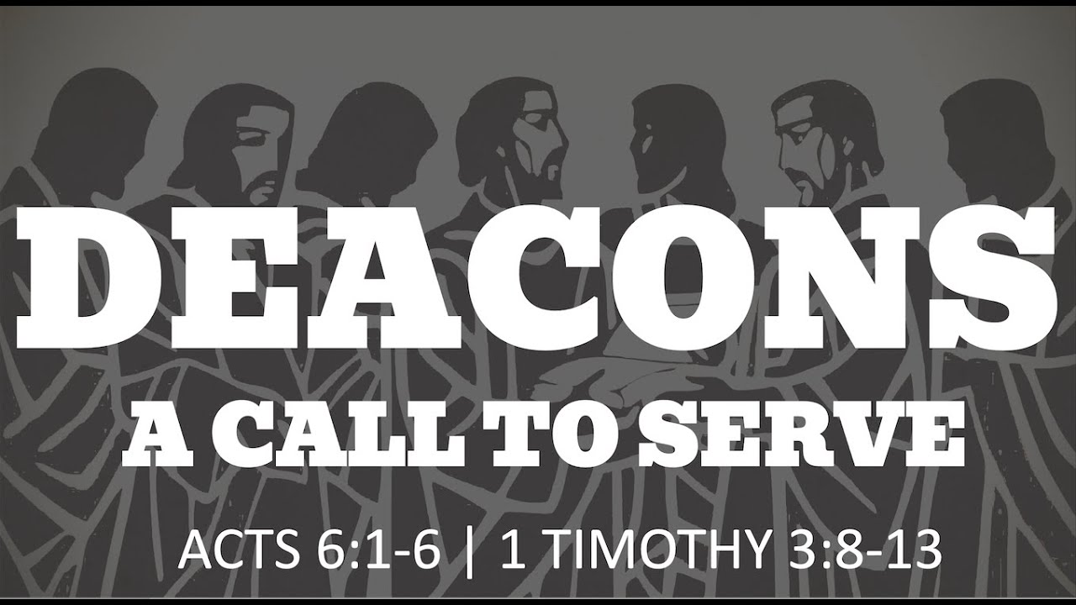
Prayer of Commissioning
“Strengthen their hands.
Steady their hearts.
Fill them with wisdom, compassion, and courage.”

Slide 17

BENEDICTION
May God give you eyes to see needs,
hands to lift burdens,
and a heart that reflects Christ
Go in unity and strength

Slide 18


Slide 20
One morning a deacon was asked to go to the airport and meet the preacher who was coming to his church to conduct a revival. He went but was not sure as to what the preacher looked like. He carefully examined the passengers as they exited the plane. He was anxious to pick up the man he was to entertain but whom he had never met.
Selecting a likely fellow, he asked, “Pardon me, sir, but are you a minister?”
“No, sir!” came the reply. “My indigestion makes me look like this.”

