Slide 1


Slide 2

Spiritual Warfare
10% Satan’s Tactics
90% How We Respond
Remember…
With God We Are Not
Helpless
Hopeless
We Are Powerful!!

Slide 3

Repeat
These are the 2 Most Important Hours of My Week – Help Me to Cherish Them
I Am Here Today to Worship
Not to Be Entertained
I Am Singing to An Audience of One
Accept My Worship Oh Lord!

Slide 4
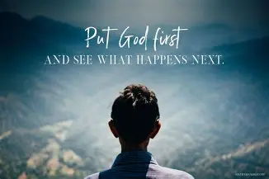
Repeat
I Lift My Offering to You
Let It Please You Oh Lord
This is My Seed
Although It Leaves My Hand
It will Never Leave My Life
You Will Multiply It!
Accept My Seed Oh Lord!

Slide 6

Held By Hope
Edward Church
Romans 15:13

Slide 7
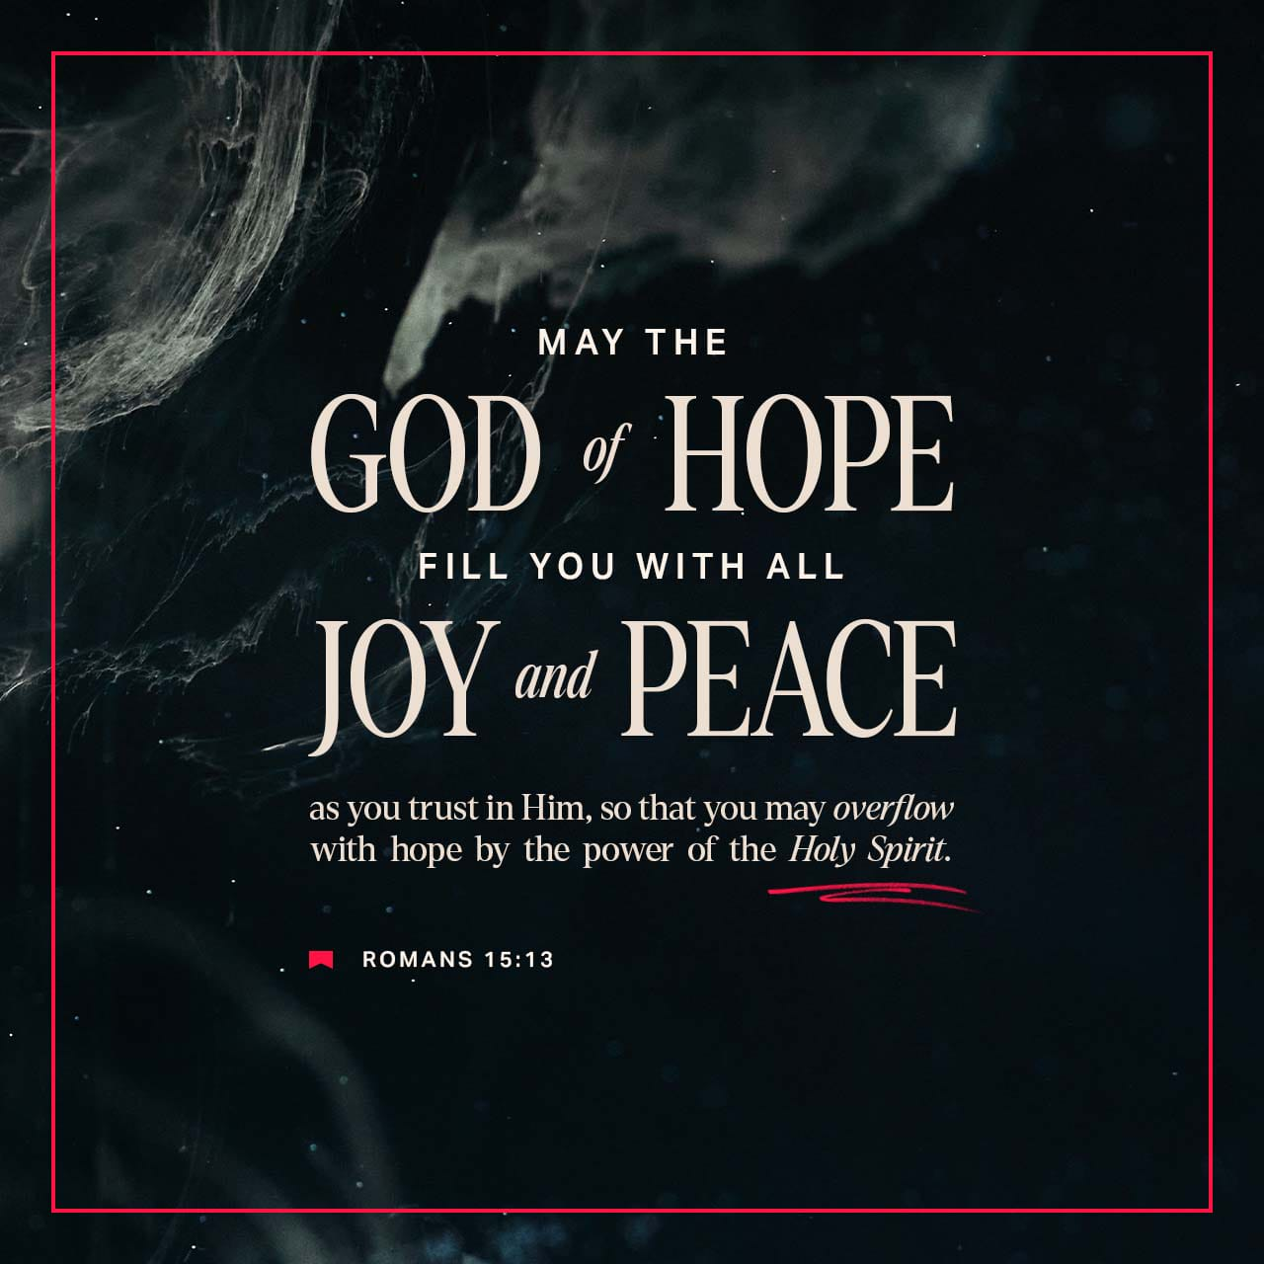
The God of Hope is in this Room.
Romans 15:13 declares:
“Now may the God of hope fill you with all joy and peace in believing, that you may abound in hope by the power of the Holy Spirit.”
Tonight, God doesn’t want to give you a little hope.
He doesn’t want to give you temporary hope.
He doesn’t want to give you Sunday‑only hope.
He wants to Fill You…
Overflow You…
Saturate You…
In HOPE

Slide 8
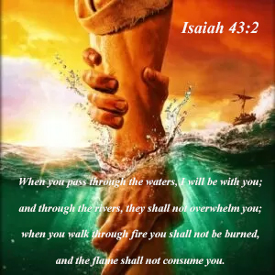
THE DEEP SEA DIVER
A deep‑sea diver once said,
“I don’t die because the water is deep
I die if the oxygen line gets cut.”
Church, some of you aren’t drowning because life is deep
you’re drowning because you’ve been cut off from your source of hope.
But tonight, God is reconnecting the line
Tonight, God is restoring your oxygen
Tonight, God is breathing hope back into you

Slide 9

“THE GOD OF HOPE” (HOPE HAS A SOURCE)
Paul doesn’t say God gives Hope
He says God IS Hope
Hope is not a product — it’s a Person
Hope is not an emotion — it’s an attribute of God
Hope is not a feeling — it’s a force that flows from His nature
When you lose hope, you haven’t lost a feeling
you’ve lost sight of Him.
POWER POINT:
Hope is not found in circumstances changing — hope is found in Christ remaining.

Slide 10
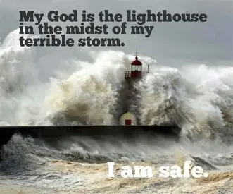
THE LIGHTHOUSE
A sailor once said
“In the darkest storm, I don’t look at the waves …
… I look for the lighthouse
The waves move. The wind moves. The clouds move.
But the lighthouse never moves.”
Church, God is your lighthouse.
Everything around you may be shifting
but He does not move
CHALLENGE:
What has your attention — the storm or the Savior?
What are you magnifying — the mountain or the Maker?

Slide 11

“FILL YOU WITH ALL JOY AND PEACE” (HOPE HAS FRUIT)
Hope produces something.
When God fills you with hope, He fills you with:
Joy — strength for your spirit
Peace — stability for your mind
Joy is the shout of hope
Peace is the stillness of hope
POWER POINT:
Hope doesn’t just lift your heart — it stabilizes your mind.

Slide 12
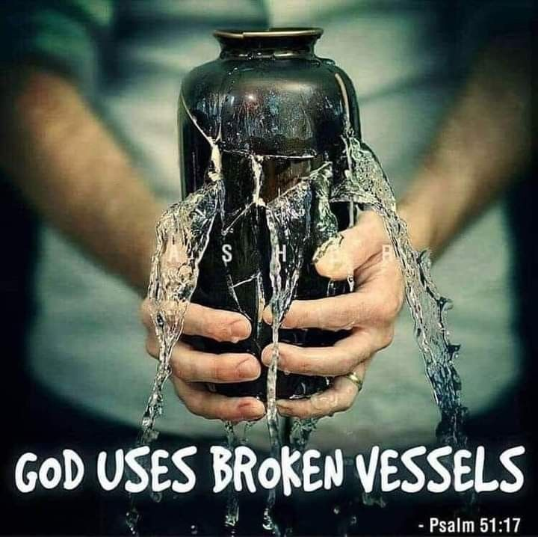
THE CRACKED CUP
A pastor once visited a woman who said,
“I feel empty. I feel cracked. I feel like God can’t fill me.”
He picked up a cracked cup, placed it under a running faucet, and said,
“It may leak… but it will still fill.”
Church, you may feel cracked… but God can still fill you
You may feel broken… but God can still pour into you.
CHALLENGE:
Are you letting God fill you, or letting life drain you?

Slide 13

“IN BELIEVING” (HOPE HAS A CONDITION)
Hope flows through believing.
Not believing in yourself (unhealthily)
Not believing in luck
Not believing in the odds
Believing in the God who cannot lie.
POWER POINT:
Hope grows where faith is planted.

Slide 14

“THAT YOU MAY ABOUND IN HOPE” (HOPE OVERFLOWS)
“Abound” means:
Overflow
Run over
Spill out
More than enough
God Idea is Not barely enough hope to survive
He wants you to have so much hope that it spills onto everyone around you.
POWER POINT:
God doesn’t give survival hope — He gives revival hope.

Slide 15

“BY THE POWER OF THE HOLY SPIRIT” (HOPE HAS POWER)
Hope is not positive thinking
Hope is not optimism
Hope is not self‑help
Hope is Holy Ghost Power
The Spirit of God breathes hope into dry bones
The Spirit of God ignites hope in dark valleys.
The Spirit of God resurrects hope where hope has died.
POWER POINT:
Hope is Not Human — Hope Is Holy Spirit Power

Slide 16

THE DEAD TREE THAT GREW AGAIN
A man once cut down a dead tree stump in his yard.
He thought it was gone forever.
But months later, a green shoot pushed through the stump.
He said,
“I didn’t bring it back.
Life was still in the roots.”
Church, you may feel cut down…
but there is still life in your roots.
The Holy Spirit is about to make something grow again
CHALLENGE:
Are you trying to manufacture hope…
or are you letting the Holy Spirit fill you?

Slide 17
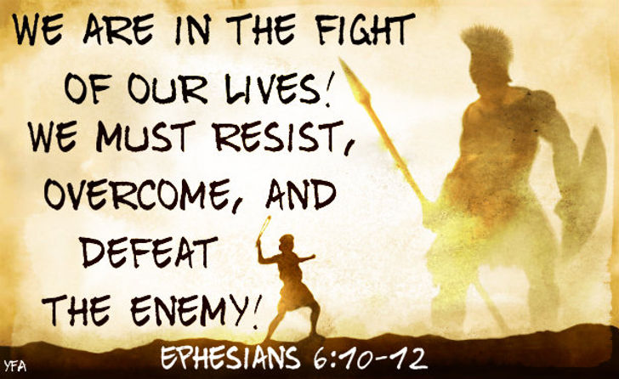
A WORD FOR THE WOUNDED
Some of you have been living on empty
Your hope tank is dry
Your spirit is tired
Your faith is thin
Your heart is heavy
But the God of Hope brought you here to fill you again.
Not halfway
Not partially
Not barely.
To Fill You With ALL Joy.
To Fill You With ALL Peace.
To Make You ABOUND In Hope.
By The POWER Of The Holy Spirit.

Slide 18
If you Need Hope…
Strength…
Peace…
Joy…
If You Need God to Breathe on You Again…
RUN to this Altar
RUN to His Presence
RUN to the God of Hope
Lift Your Hands
…Heart
…Expectation
Because the God of Hope is about to Fill You

Slide 19
DECLARATION of Hope (Say it with authority)
My hope is not in what I see
My hope is in who He is
My hope is not fragile
My hope is supernatural
My hope is overflowing
My hope is alive
My hope is rising Now!

Slide 21
After 9 year old Daniel did something really dumb, DC called him a "moron.“ And said there was no hope for him.
He looked at DC and said, "DC, do you know anything?"
Daniel told DC that he looked 'moron' up in the dictionary and the definition of it is 'a person who has the intelligence of a 12 year old.'
Thanks DC, you just gave me a compliment!“
And Now I know there is Hope for Me!

