Slide 1
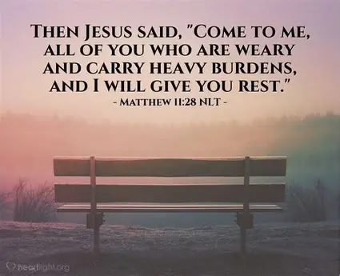

Slide 2

Spiritual Warfare
10% Satan’s Tactics
90% How We Respond
Remember…
With God We Are Not
Helpless
Hopeless
We Are Powerful!!

Slide 3

Repeat
These are the 2 Most Important Hours of My Week – Help Me to Cherish Them
I Am Here Today to Worship
Not to Be Entertained
I Am Singing to An Audience of One
Accept My Worship Oh Lord!

Slide 4
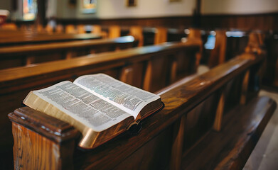
Edward Christian Church
3/22/2026

Slide 5
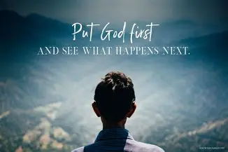
Repeat
I Lift My Offering to You
Let It Please You Oh Lord
This is My Seed
Although It Leaves My Hand
It will Never Leave My Life
You Will Multiply It!
Accept My Seed Oh Lord!

Slide 7
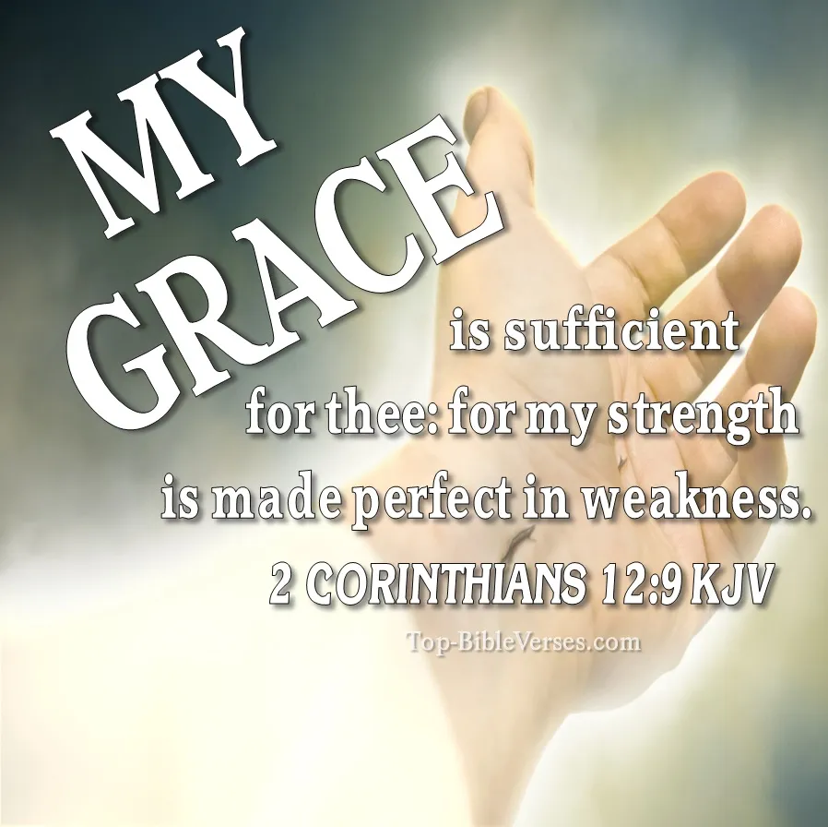
WHEN YOU’RE TIRED OF BEING STRONG
Edward Church
2 Cor 12:9

Slide 8
Paul is Writing from a Place of DEEP STRUGGLE
He is WOUNDED
He is TIRED
He is OVERWHELMED
He is CARRYING more than any Human Should
And he Prays for God to Remove the Burden
But God Answers:
“My Grace is Sufficient for You,
for My Power is Made Perfect in Weakness.”

Slide 9
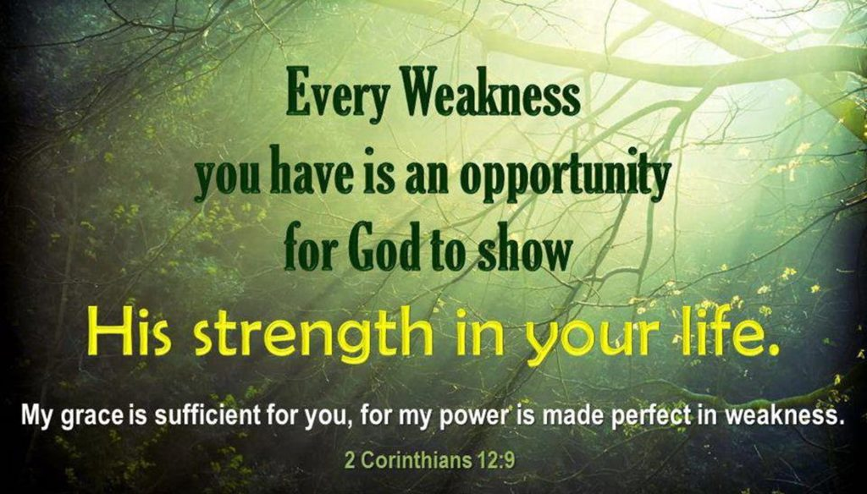
God heals the wounds created by
chronic strength, emotional exhaustion,
and the pressure to hold everything together.
-we were not created to carry Chronic Strain
News Flash
You Were Never Designed To Carry Everything
God’s Strength Begins Where Yours Ends

Slide 10
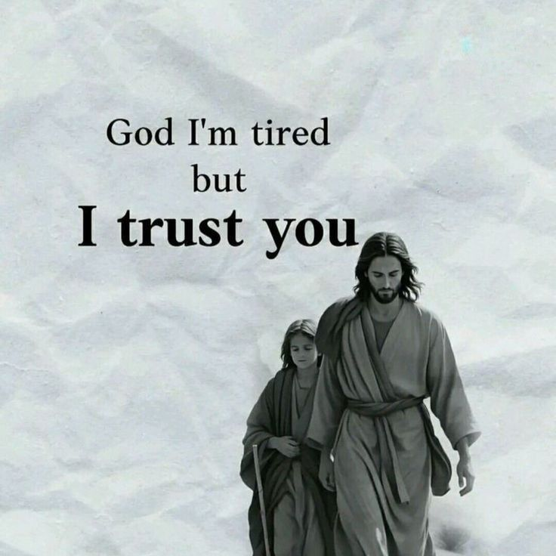
GOD IS NOT ASKING YOU TO BE STRONG
“My grace is sufficient…”
EXEGESIS
Grace — charis
Divine Strength, Help, Empowerment, Enablement
Sufficient — GK
• Holds you up
• Fully adequate
• More than enough

Slide 11
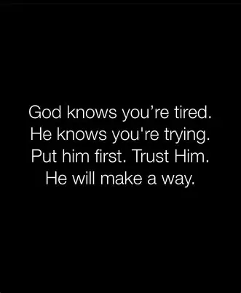
INSIGHT
God never asked you to be self‑sufficient
He asked you to be God‑dependent
CHALLENGE
Where have you been trying to be strong
instead of letting God be strong for you?
Application Prayer:
“Lord, I receive Your strength”

Slide 12
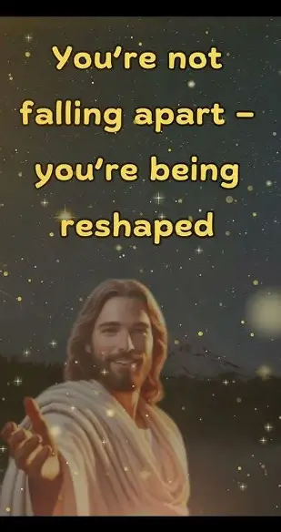
GOD’S POWER FLOWS BEST THROUGH WEAK PLACES
“My power is made perfect in weakness”
EXEGESIS
Power — dynamis
• explosive strength, supernatural ability, divine force.
Made Perfect — GK
• completed, fully expressed, brought to its highest effectiveness.
Weakness — GK
• frailty, limitation, exhaustion, inability

Slide 13
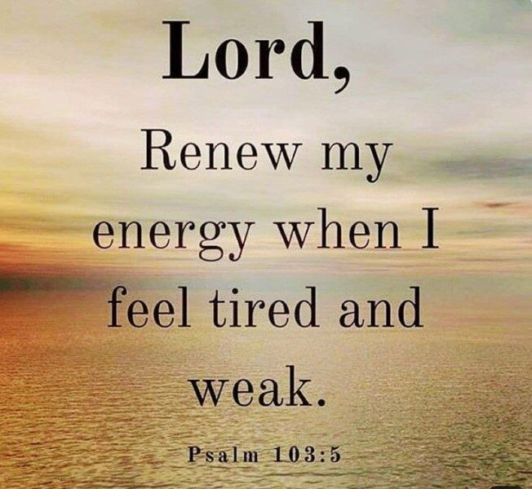
INSIGHT
Your Weakness is not a LIABILITY
it is an ENTRY POINT for GOD’S POWER
CHALLENGE
Where have you been Hiding your Weakness
instead of Letting God Use It?
APPLICATION Prayer
“Lord, use my weakness for Your glory”

Slide 14
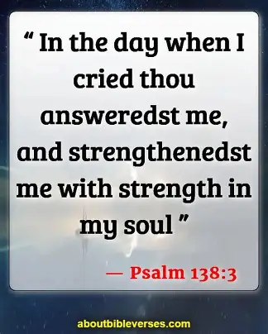
YOU DON’T HAVE TO HOLD EVERYTHING
“When I am weak, then I am strong”
EXEGESIS
Weak =
unable, insufficient, overwhelmed.
Strong =
empowered, enabled, strengthened by God
APPLICATION
Paul is not saying weakness becomes strength
“When I stop pretending to be strong
God becomes my strength”

Slide 15
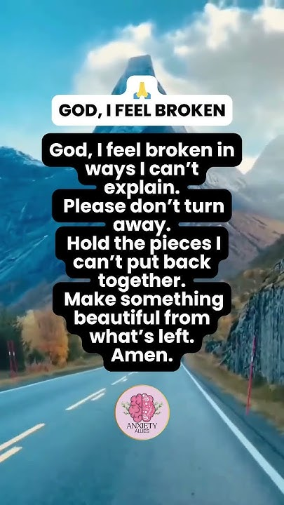
INSIGHT
You are NOT THE GLUE…
…Holding Your World Together
“GOD IS”
CHALLENGE
What weight have you been carrying
that God never assigned to you?
APPLICATION Prayer
“Lord, I release what is not mine to carry”

Slide 16
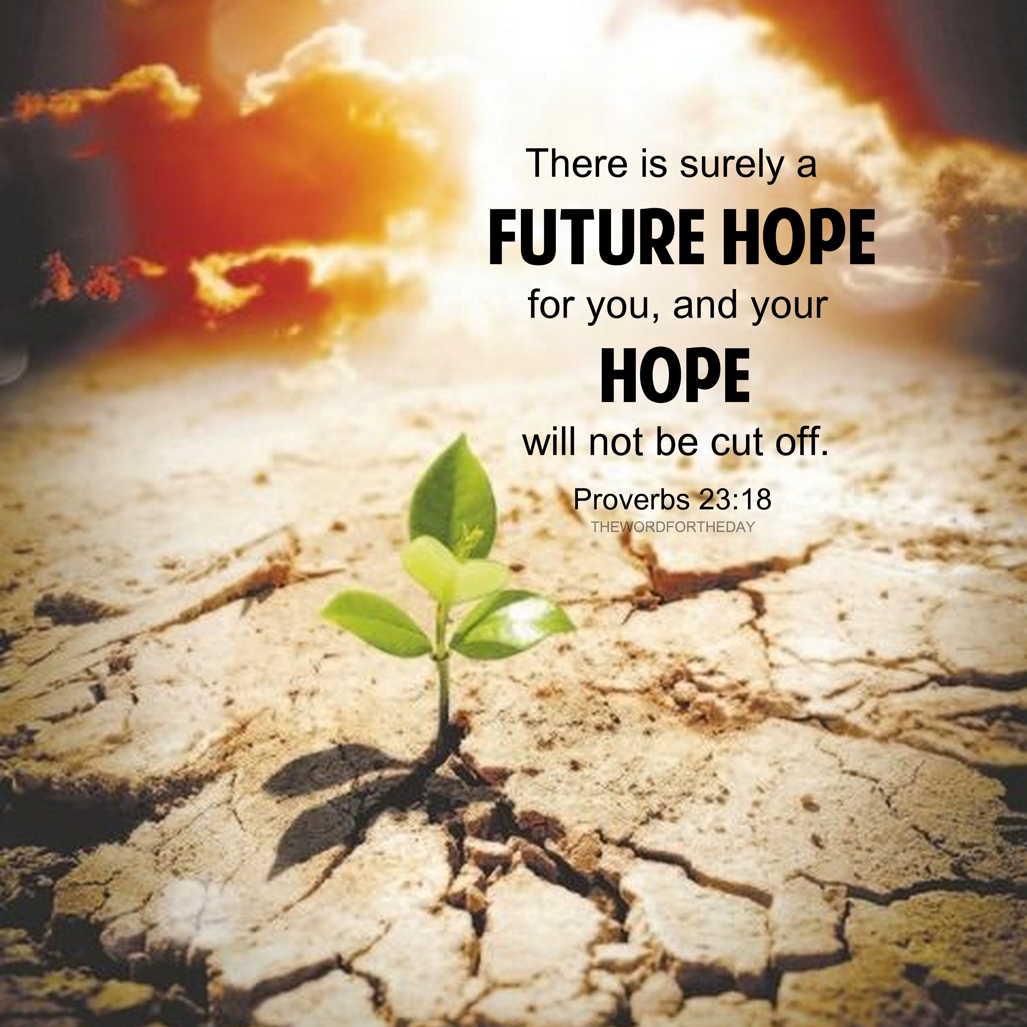
GOD HEALS THE WOUNDS OF CONSTANT RESPONSIBILITY
“Cast your burden on the Lord…”- Psa 55:22
EXEGESIS
Cast — GK
to throw off, to hurl away, to release violently
Burden — GK
the load assigned to you, the weight you carry daily
CHALLENGE
God is not asking you to manage your burden…
He is asking you to throw it on Him

Slide 17
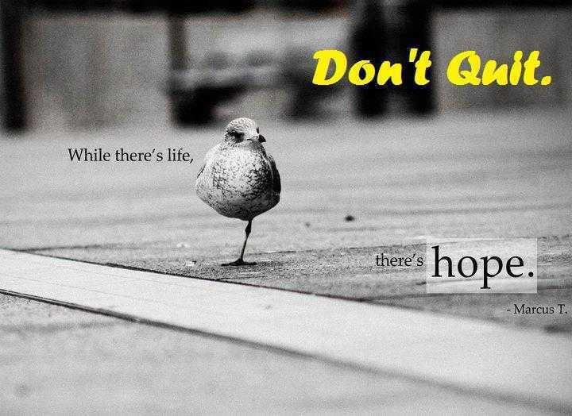
INSIGHT
Healing begins when you STOP carrying
what God asked you to CAST
CHALLENGE
What burden have you NORMALIZED
that God wants to REMOVE?
LIFE Prayer:
“Lord, I cast this burden on You”

Slide 18
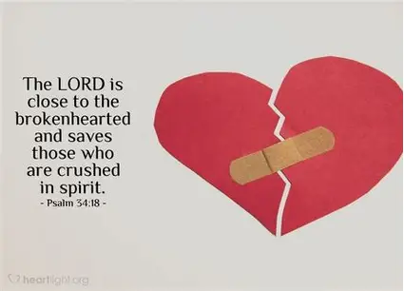
GOD IS MOVED BY YOUR SURRENDER,
NOT YOUR STRENGTH
“The Lord is close to the brokenhearted.”-Psa 34:18
“Close”=
near enough to touch, near enough to hold.
INSIGHT
Your tears do not repel God —they attract Him
CHALLENGE
Where have you been performing strength
because you’re afraid to be vulnerable?
LIFE Prayer
“Lord, I surrender my strength.”

Slide 19
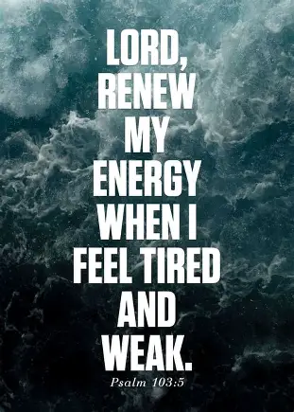
WHEN YOU’RE TIRED OF BEING STRONG
God says:
My Grace Is Enough.
My Strength Is Enough.
My Power Is Enough.
ALTAR PRAYER
Lord, I’m tired Of Being Strong
Be My Strength
Be My Rest
Be My Help

Slide 21
I had a job selling security alarms door to door and I was really good at it. If no one was home I would just leave a brochure on the kitchen table.
Ever feel like life is a car wash and you're on a bicycle?

