Slide 1


Slide 2

Spiritual Warfare
10% Satan’s Tactics
90% How We Respond
Remember…
With God We Are Not
Helpless
Hopeless
We Are Powerful!!

Slide 3

Repeat
These are the 2 Most Important Hours of My Week – Help Me to Cherish Them
I Am Here Today to Worship
Not to Be Entertained
I Am Singing to An Audience of One
Accept My Worship Oh Lord!

Slide 4

Edward Christian Church
3/29/2026

Slide 5

Repeat
I Lift My Offering to You
Let It Please You Oh Lord
This is My Seed
Although It Leaves My Hand
It will Never Leave My Life
You Will Multiply It!
Accept My Seed Oh Lord!

Slide 7
PALM SUNDAY THE KING WHO DID NOT COME AS EXPECTED When God Arrives in Ways We Didn’t See Coming
Matthew 21:1–11
Edward Church

Slide 8

Palm Sunday is the Moment Jesus
Publicly Reveals Himself As King
But Not As Expected
Politically
Militarily
Culturally
Religiously

Slide 9

He Comes God’s Way, Not Their Way
And The Same Is True For Us Today
God Often Moves Powerfully,
But Rarely Predictably

Slide 10

EXEGESIS
“Go into the village…”
…Jesus orchestrates every detail
The Donkey
…Peace, not war (Zech. 9:9)
Cloaks & Branches
…Celebration without surrender
“Hosanna!”
…They wanted rescue, not redemption
“Who is this?”
…Jesus disrupts everything

Slide 11

JESUS DOESN’T SHOW UP AS EXPECTED
They expected: warrior, liberator, champion
He came: humble, peaceful, cross‑bound
Challenge:
Where has God not moved as expected?
Application:
Don’t miss God because He came differently

Slide 12

PRAISE WITHOUT SURRENDER =
POWER WITHOUT IMPACT
They praised loudly… but surrendered little
When Jesus didn’t ACT AS EXPECTED…
…their PRAISE COLLAPSED
Challenge:
Are you praising WHO HE IS or
who you EXPECT HIM TO BE?
Application:
Power comes WHEN PRAISE and SURRENDER MEET

Slide 13

JESUS BRINGS PEACE, BUT NOT AS EXPECTED
They wanted PEACE FROM ROME
Jesus brought PEACE WITH GOD
Challenge:
Will you ACCEPT GOD’S PEACE or
DEMAND YOUR VERSION?
Application:
Let Him bring peace to what you’re trying to control

Slide 14

THE KINGDOM ADVANCES, BUT NOT AS EXPECTED
They EXPECTED A THRONE
Jesus CHOSE A CROSS
Challenge:
Can you TRUST God’s victory when …
…it DOESN’T LOOK like victory?
APPLICATION:
God’s greatest work may not look successful at first

Slide 15
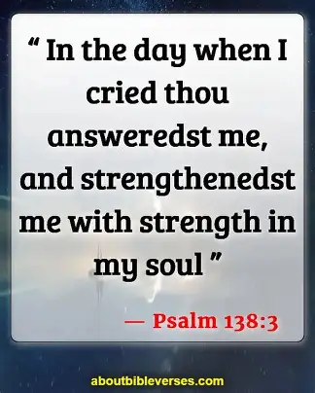
GOD STILL MOVES — BUT NOT AS EXPECTED
He Moves:
In Unexpected Ways
Through Unexpected People
At Unexpected Times
With Unexpected Methods
Challenge:
Release expectations to receive revelation
Application:
Expect God to move — but not your way

Slide 16
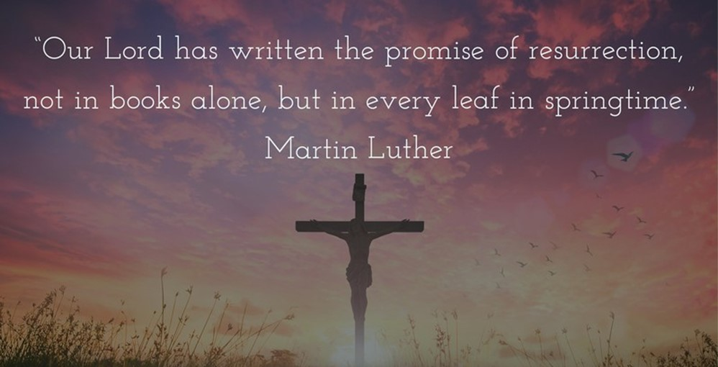
CHALLENGE
LET JESUS BE KING — NOT AS EXPECTED
Surrender:
Expectations
Disappointments
Assumptions
Timelines
Your whole life

Slide 17

ALTAR Prayer
“Jesus, be the KING I NEED, not the KING I IMAGINED I Surrender my Expectations Move YOUR WAY, in YOUR TIMING, for YOUR GLORY”

Slide 20
"Can people predict the future with cards?" Brandan asked BJ.
“Yes mother can," BJ replied.
"Really? Said Brandan
"Yes," BJ told Brandan, "she takes one look at our report card and can tell us exactly what will happen when our Dad gets home."

