Slide 1
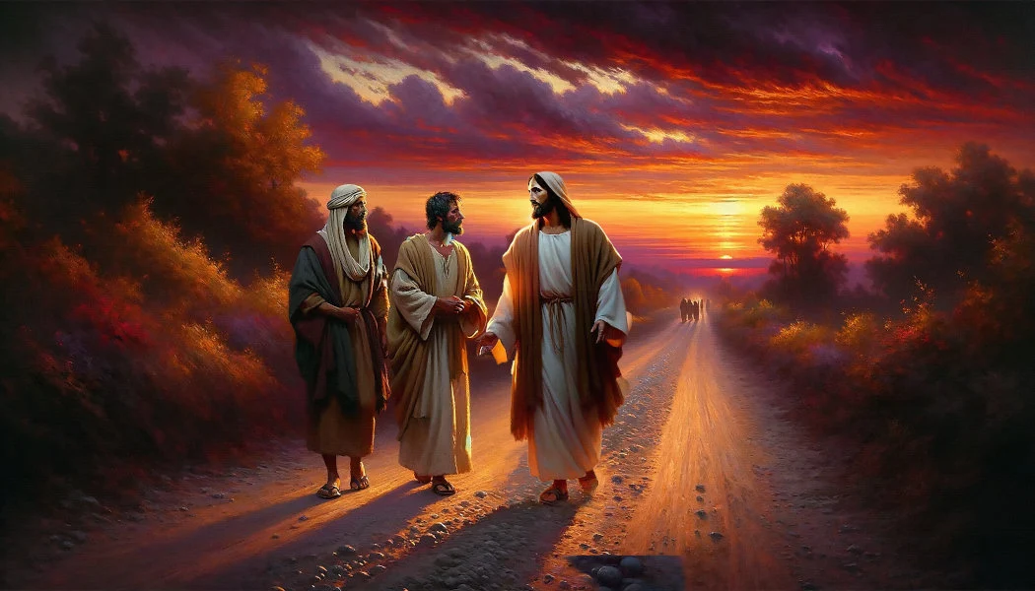

Slide 2

Spiritual Warfare
10% Satan’s Tactics
90% How We Respond
Remember…
With God We Are Not
Helpless
Hopeless
We Are Powerful!!

Slide 3

Repeat
These are the 2 Most Important Hours of My Week – Help Me to Cherish Them
I Am Here Today to Worship
Not to Be Entertained
I Am Singing to An Audience of One
Accept My Worship Oh Lord!

Slide 4

Edward Christian Church
4/12/2026

Slide 5

Repeat
I Lift My Offering to You
Let It Please You Oh Lord
This is My Seed
Although It Leaves My Hand
It will Never Leave My Life
You Will Multiply It!
Accept My Seed Oh Lord!

Slide 7

Emmaus –the Broken Road WHEN JESUS WALKS INTO YOUR DISAPPOINTMENT part 1 Luke 24:13–24
Edward Church

Slide 8
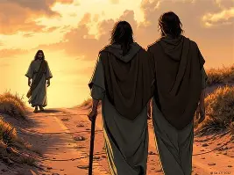
THE WALK NOBODY WANTED TO TAKE
One of the most honest and heartbreaking
moments in the Resurrection Story.
Two disciples… walking down a Dusty Road…
Not toward Jerusalem…
…. the Upper Room…
…. Revival…
…. BUT AWAY
Away From…
Hope
Expectation
Everything they Believed God was Doing

Slide 9
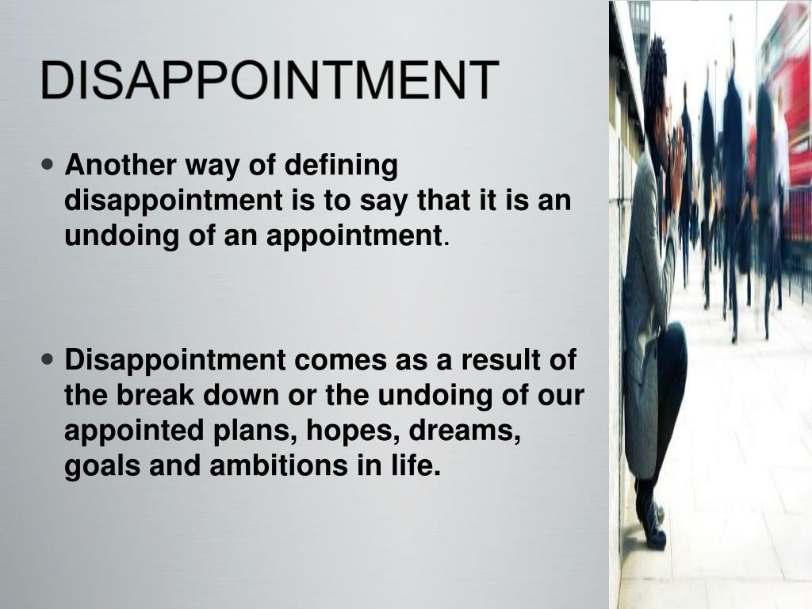
They are walking toward a village “Emmaus”
Emmaus is not just a Place…
EMMAUS IS A DIRECTION
Application:
Disappointment can Redirect your Feet
Challenge:
What Direction has Disappointment Pushed You

Slide 10
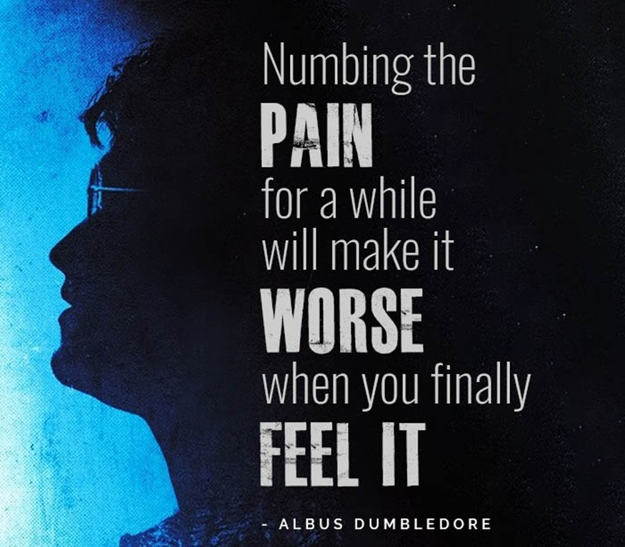
WHAT EMMAUS REALLY MEANS
EMMAUS = “hot springs”
A place of comfort, soothing, escape
A place you go to numb pain, not heal it
APPLICATION:
Everyone has an Emmaus —
a place you run to when life breaks you
CHALLENGE:
What “hot spring” have you been escaping to
To NUMB YOUR PAIN

Slide 11

THE DISTANCE OF DISAPPOINTMENT
EMMAUS = SEVEN MILES FROM JERUSALEM
SEVEN =
completion, fullness, Divine perfection
They walked the FULL MEASURE of their Disappointment
They walked the COMPLETE CYCLE of their Grief
APPLICATION:
You Cannot Walk Far Enough in Disappointment for Jesus
…Not to Meet You
CHALLENGE:
How Far Have You Walked?
…EMOTIONALLY, SPIRITUALLY, MENTALLY

Slide 12
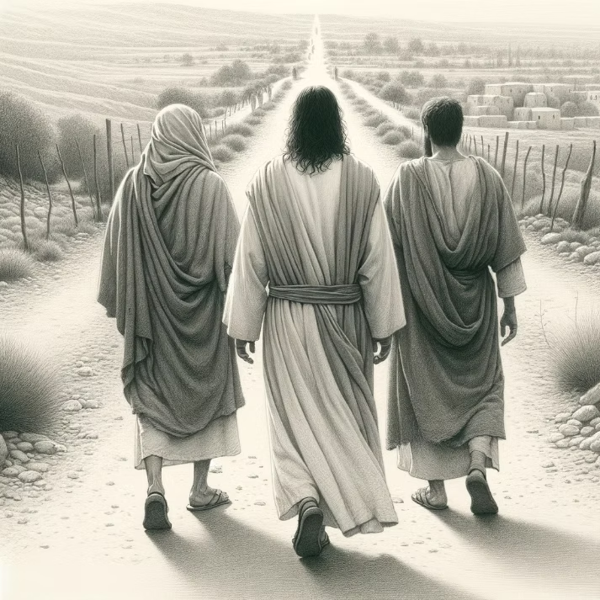
The Bible says:
‘Jesus Himself Drew Near and Walked with Them’
He Didn’t Wait for them to GET IT TOGETHER
…. RETURN TO JERUSALEM
…. PRAY THE RIGHT PRAYER
HE WALKED INTO THEIR DISAPPOINTMENT

Slide 13

JESUS WALKS WITH YOU EVEN WHEN YOU CAN’T SEE HIM
‘Their eyes were kept from recognizing Him.’ (16)
This is Divine Passive —
meaning God Allowed their EYES TO BE CLOSED
They were Walking with Jesus…
…Talking to Jesus…
…Pouring out their Pain to Jesus…
…they Didn’t even KNOW IT WAS HIM.
Let Me Preach This Into Your Spirit:
YOUR INABILITY TO FEEL GOD…
…DOES NOT EQUAL HIS ABSENCE

Slide 14

APPLICATION:
When You Can’t Feel God
“Even when you can’t FEEL HIM”
He is STILL WALKING
He is STILL LISTENING
He is STILL NEAR
CHALLENGE: Where Have You Assumed …
…God Abandoned You?

Slide 15

JESUS INVITES YOU TO TELL THE TRUTH ABOUT YOUR PAIN
‘What are you discussing as you walk along?’
He already knows.
But He wants them to say it.
They respond with one of the saddest phrases in Scripture:
‘We had hoped…’
Greek word for hope =to expect with confidence

Slide 16

THEIR CONFIDENCE DIED
‘We had hoped He would redeem Israel.’
‘We had hoped things would turn out differently.’
‘We had hoped God would come through.’
‘We had hoped the story would end another way.’

Slide 17

What is Your “I had hoped…”?
I had hoped the Marriage Would Survive
… Diagnosis would Change
… Addiction would Break
… Depression would Lift
… God would Answer Sooner
JESUS IS NOT INTIMIDATED BY YOUR DISAPPOINTMENT …HE INVITES IT
Deeper Challenge: What dream have you buried without Hope?”

Slide 18
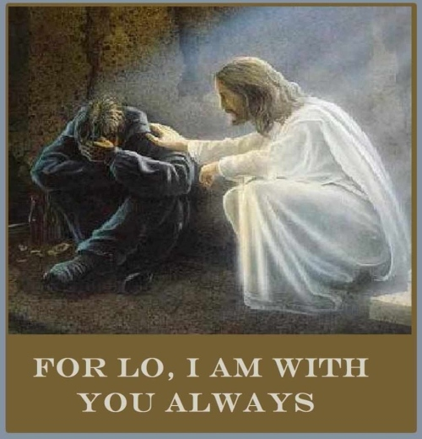
JESUS LISTENS BEFORE HE CORRECTS
Notice this:
Jesus doesn’t interrupt them
He doesn’t rebuke them
He doesn’t shame them
HE LISTENS
He lets them Pour Out their…
Confusion, Grief, Shattered Expectations
Jesus is a BETTER LISTENER than we are TALKERS.”

Slide 19

JESUS WALKS INTO THE PLACES YOU WALK AWAY FROM
“They walked away from Jerusalem the place of prophecy, promise, and resurrection
But Jesus walked toward them
Disappointment Will Always Take You Farther…
…Than You Meant To Go.
Jesus meets you on the road you never wanted to walk
He meets you in the disappointment you didn’t choose
He meets you in the heartbreak you didn’t expect.”

Slide 20
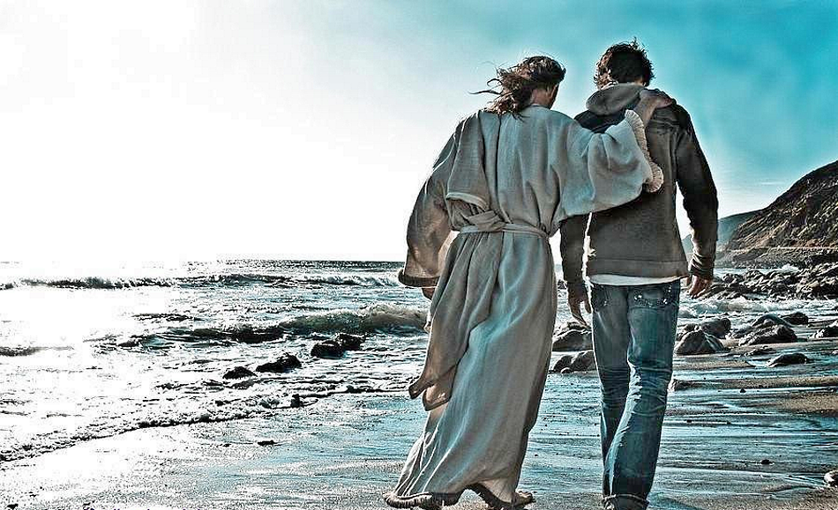
Application:
How To Walk With Jesus In Disappointment
Here’s What This Story Teaches Us:
Bring Him your disappointment
Tell Him Your Truth
Stop Pretending you’re Okay
Let Him Walk with you in the Dark
Let Him hear your ‘I HAD HOPED’
Deeper Challenge: What would healing require you to confront?”

Slide 21

ALTAR CALL —
“JESUS, WALK WITH ME IN MY DISAPPOINTMENT”
“If you’re Tired…
If you’re Confused…
If you’re Disappointed…
IF YOU’VE BEEN WALKING AWAY FROM HOPE…
This Altar is for you.
Come with your ‘I had hoped.’
Come with your Confusion.
Come with your Disappointment.
Jesus is walking Toward you.”

Slide 22
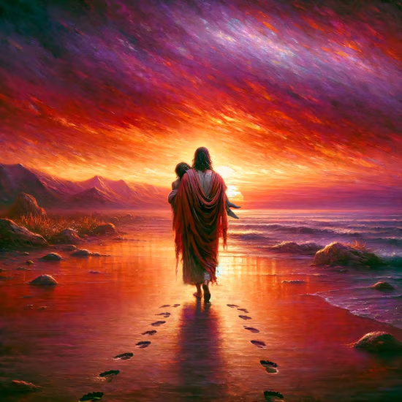
APPLICATION:
HOW TO WALK WITH JESUS IN DISAPPOINTMENT
Bring Him your DISAPPOINTMENT
Tell Him your Truth
Stop pretending you’re Okay
Let Him walk with you in the Dark
Let Him hear your “I HAD HOPED”
Challenge:
Which of these steps is hardest for you right now?
Deeper Challenge:
What would healing require you to confront?

Slide 23

Altar Call
“Lord, Raise What I Cannot Raise
Heal What I Cannot Heal
Restore What I Cannot Restore
Because You Live, I Can Live.”

Slide 25
Two elderly women were eating breakfast in a restaurant one morning.
Ethel noticed something funny about Mabel's ear and she said, "Mabel, did you know you've got a suppository in your left ear?"
Mabel answered, "I have? A suppository?" She pulled it out & stared at it.
Then she said, "Ethel, I'm glad you saw this thing. Now I think I know where my hearing aid is."

