Slide 1
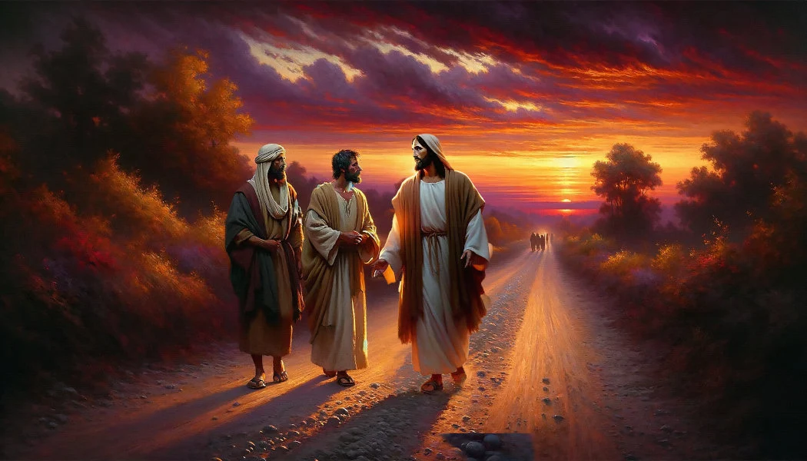

Slide 3

Edward Church

Slide 4
Emmaus –the Broken Road part 2 WHEN JESUS OPENS YOUR EYES AGAIN Revelation changes everything. Luke 24:13–24
Edward Church

Slide 5
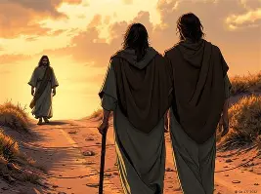

Slide 6
THE WALK NOBODY WANTED TO TAKE
One of the most honest and heartbreaking
moments in the Resurrection Story.
Two disciples… walking down a Dusty Road…
Not toward Jerusalem…
…. the Upper Room…
…. Revival…
…. BUT AWAY
Away From…
Hope
Expectation
Everything they Believed God was Doing

Slide 7
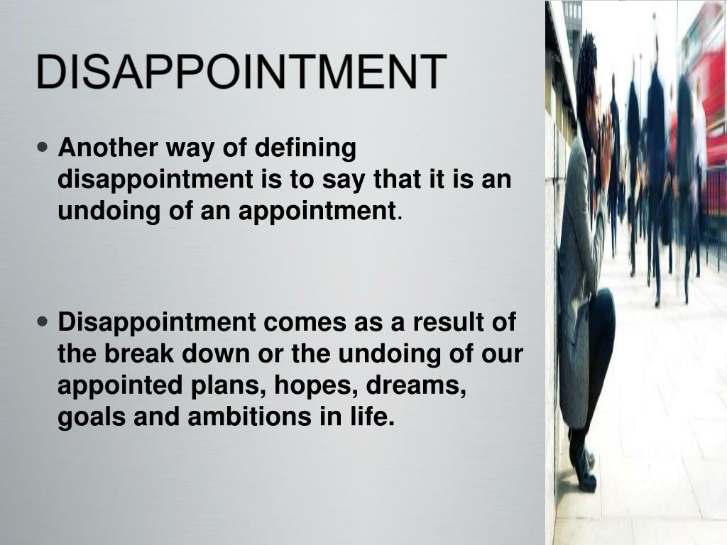

Slide 8
They are walking toward a village “Emmaus”
Emmaus is not just a Place…
EMMAUS IS A DIRECTION
Application:
Disappointment can Redirect your Feet
Challenge:
What Direction has Disappointment Pushed You

Slide 9
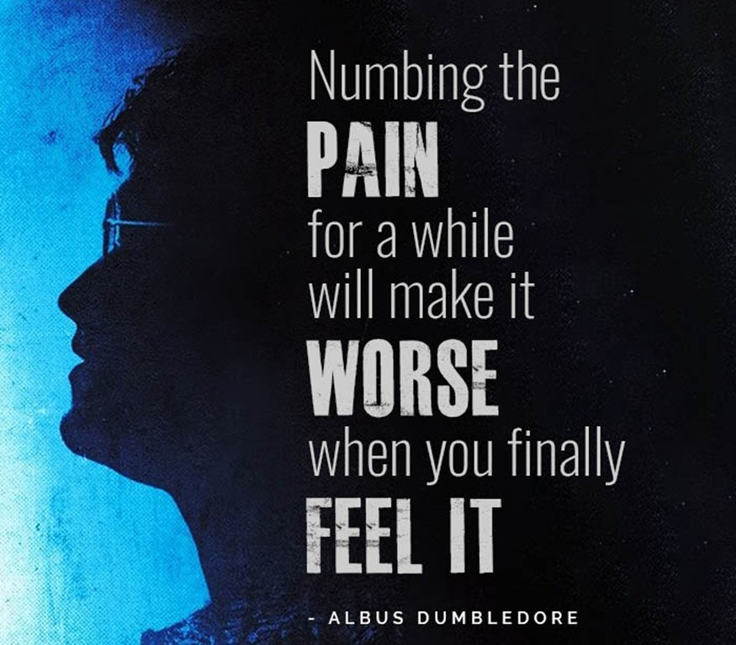

Slide 10
THE STORY DOESN’T END WITH DISAPPOINTMENT
Jesus walked with them in Pain
Now He reveals Himself in Power
Disappointment becomes Revelation
KEY THOUGHT: Jesus doesn’t just walk with you —
He OPENS YOUR EYES
CHALLENGE:
Where have you SETTLED for walking with Jesus…
…but stopped expecting REVELATION?

Slide 11


Slide 12
JESUS REFRAMES YOUR STORY WITH SCRIPTURE
“Beginning With Moses…”
He Gives Them A Biblical Lens
He Shows Purpose In Pain
INSIGHT: Scripture Heals The Mind Before It Heals The Moment
CHALLENGE: Are you letting Scripture INTERPRET YOUR PAIN,
or is your PAIN INTERPRETING SCRIPTURE?

Slide 13
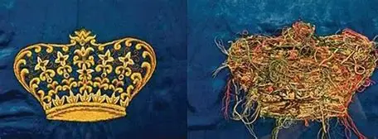

Slide 14
THE BACK OF THE TAPESTRY
The Back Looks Chaotic
The Front Reveals the Design
INSIGHT: Scripture Flips Your Story Over
CHALLENGE: What Part Of Your Story Looks Chaotic From The Wrong Side?

Slide 15


Slide 16
LET SCRIPTURE REWRITE YOUR NARRATIVE
The Cross Wasn’t Failure
The Silence Wasn’t Abandonment
The Tomb Wasn’t The End
CHALLENGE: What Lie is Scripture trying to Correct in You?
DEEPER CHALLENGE: What TRUTH HAVE YOU BEEN RESISTING Because Pain Told You a DIFFERENT STORY?

Slide 17


Slide 18
JESUS STAYS WHERE HE’S WANTED
He Acts Like He’s Going Farther
They Urge Him: “Stay With Us”
Hunger Invites Habitation
INSIGHT: Jesus Walks With Everyone…
..But He Stays W- The Hungry
CHALLENGE: Is your hunger strong enough to make Him stay?

Slide 19
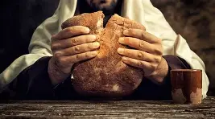

Slide 20
JESUS REVEALS HIMSELF IN THE BREAKING
Bread Blessed, Broken, Given
Eyes Opened
Revelation Through Brokenness
INSIGHT: Some Revelations Only Come THROUGH BREAKING
CHALLENGE: What Breaking Have You Been TRYING TO AVOID …
…That God Is TRYING TO USE?

Slide 21
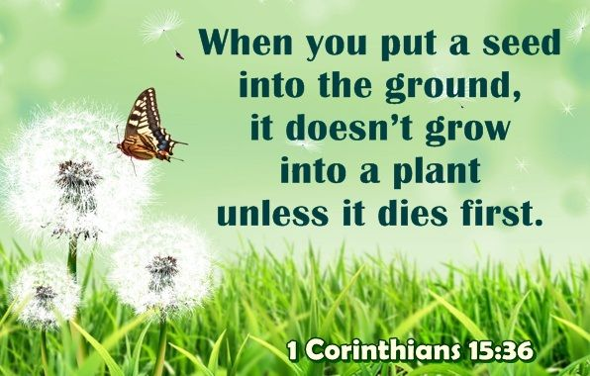

Slide 22
THE SEED THAT MUST BREAK
A Seed Must BREAK OPEN
Before Life Can COME OUT
INSIGHT: Breaking is not Destruction…
…it is TRANSFORMATION.
CHALLENGE: What new life is trapped inside a shell …
…God is trying to break?

Slide 23
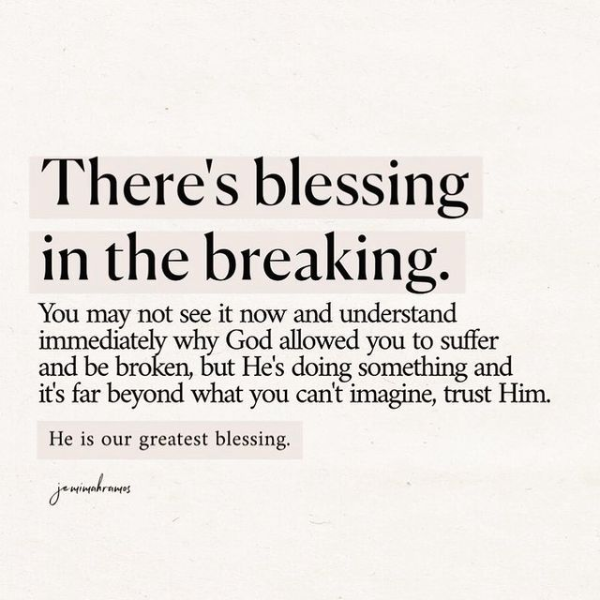

Slide 24
THE BREAKING IS NOT THE END…
RELEASES
REVEALS
TRANSFORMS
CHALLENGE: What is God breaking to open your eyes?
DEEPER CHALLENGE: What if the breaking you FEAR is…
…the BREAKTHROUGH you prayed for?

Slide 25
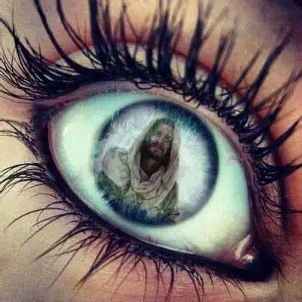

Slide 26
WHEN JESUS OPENS YOUR EYES….
….YOUR FEET CHANGE DIRECTION
They return to Jerusalem
Same road, NEW FIRE
Same path, NEW PURPOSE
INSIGHT: Revelation produces MOVEMENT
CHALLENGE: What direction needs to CHANGE now…
…that you see DIFFERENTLY?

Slide 27


Slide 28
CHANGE YOUR DIRECTION
Go back to the PLACE HOPE DIED
Go back with fire
Go back with testimony
CHALLENGE: Where is God calling you to RETURN WITH RENEWED VISION?
DEEPER CHALLENGE: What unfinished assignment is waiting…
…for the “NEW YOU” TO RETURN?

Slide 29
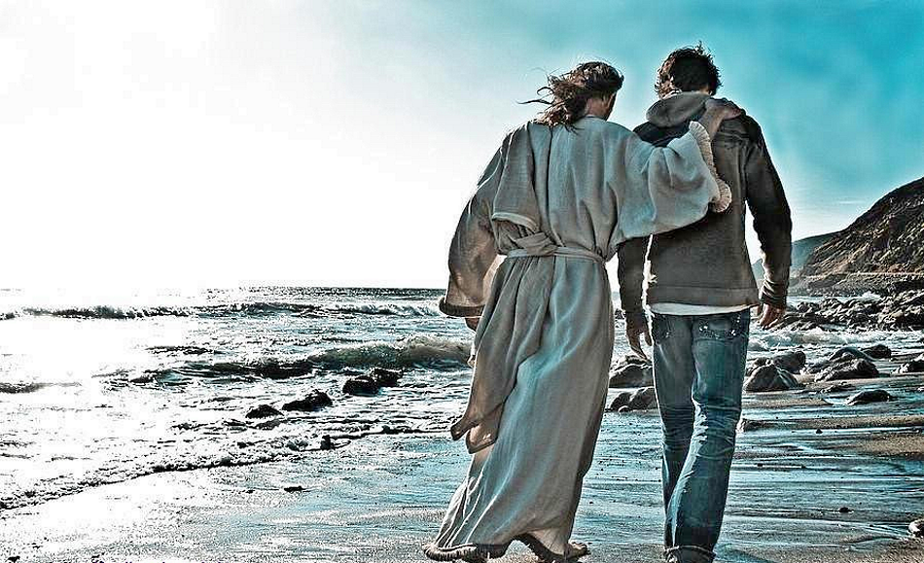

Slide 30
HOW TO WALK WITH JESUS AFTER REVELATION
Let Scripture RESHAPE Your PERSPECTIVE
Invite Him to Stay
Embrace the Breaking
Let Him Open Your Eyes
Return to Purpose with Fire
CHALLENGE: Revelation without movement becomes religion…
…where do you NEED TO MOVE?

Slide 31


Slide 32
ALTAR CALL
“JESUS, OPEN MY EYES AGAIN.”
For those who need:
Clarity
Direction
Fire
Revelation
Renewal
INVITATION:
Come Hungry - Come Ready
DEEPER CHALLENGE: Jesus is passing by, will you ask Him to stay?

Slide 33
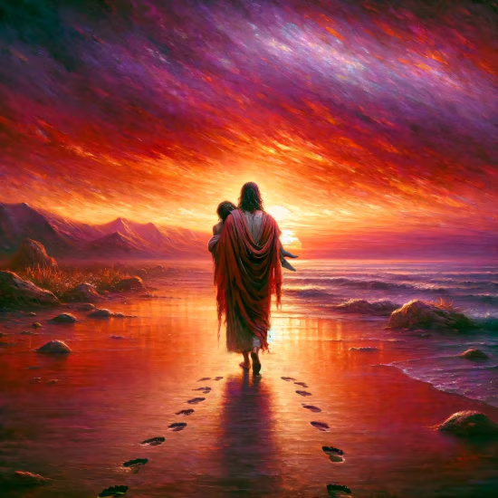

Slide 34
ALTAR CALL PRAYER
Jesus, STAY With Me
BREAK What Needs BREAKING
OPEN My Eyes.
Set My HEART On Fire.
Send Me BACK With PURPOSE
CHALLENGE: What Will You Do Differently ONCE YOUR EYES OPEN?

Slide 35


Slide 36
Altar Call
Lord, Raise What I Cannot Raise
Heal What I Cannot Heal
Restore What I Cannot Restore
Because You Live, I Can Live.”

Slide 38

Spiritual Warfare
10% Satan’s Tactics
90% How We Respond
Remember…
With God We Are Not
Helpless
Hopeless
We Are Powerful!!

Slide 39

Repeat
These are the 2 Most Important Hours of My Week – Help Me to Cherish Them
I Am Here Today to Worship
Not to Be Entertained
I Am Singing to An Audience of One
Accept My Worship Oh Lord!

Slide 40
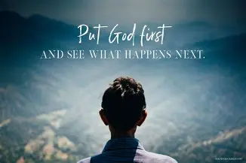
Repeat
I Lift My Offering to You
Let It Please You Oh Lord
This is My Seed
Although It Leaves My Hand
It will Never Leave My Life
You Will Multiply It!
Accept My Seed Oh Lord!

Slide 42
Lawyer: "Well Barney, so you want me to defend you? Have you got any money?"
Barney: "No sir. I ain't got no money, but I do got a 1928 Ford Car!"
Lawyer: "Well you can raise money on that. Now let's see, just what do they accuse you of stealing?"
Barney: "A 1928 Ford Car."
>>>Today's Thot
I talk to myself, because sometimes I need expert advice.

