Slide 1


Slide 2

Edward Christian Church
5/10/2026

Slide 3
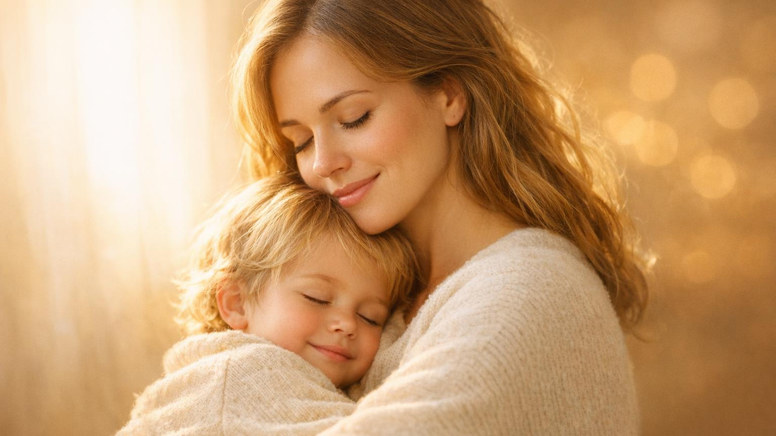
MAMA SAID IT FIRST
Everything She Told You Was Already in the Bible
Proverbs 1:8
Happy Mother's Day

Slide 4
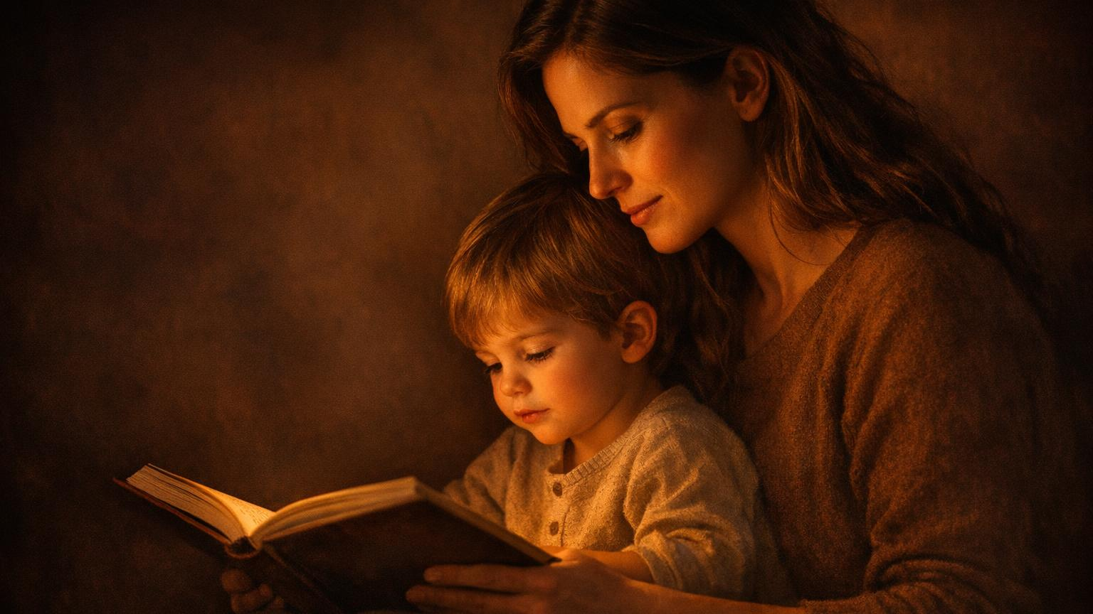
"Forsake not the TORAH of thy mother."
— Proverbs 1:8
Instruction. Law.
Divine direction.
Discipline. Correction.
Curriculum.
Mama was downloading DIVINE INSTRUCTION
and you rolled your eyes!

Slide 5
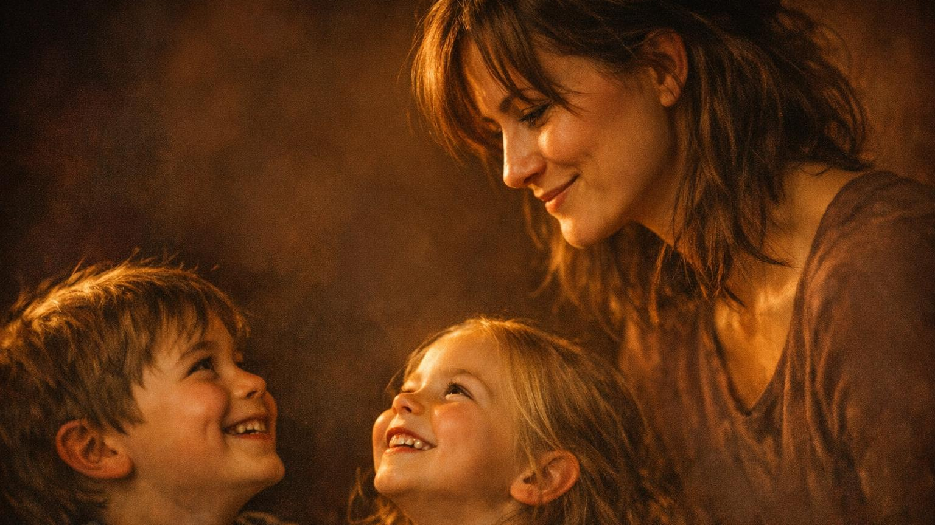
FIVE THINGS MAMA SAID
1. "Because I said so!"
2. "Go sit down somewhere!"
3. "I've got eyes in the back of my head!"
4. "Fix your face!"
5. "I don't care what everybody else is doing!"
"Her children arise and call her blessed." — Proverbs 31:28

Slide 6
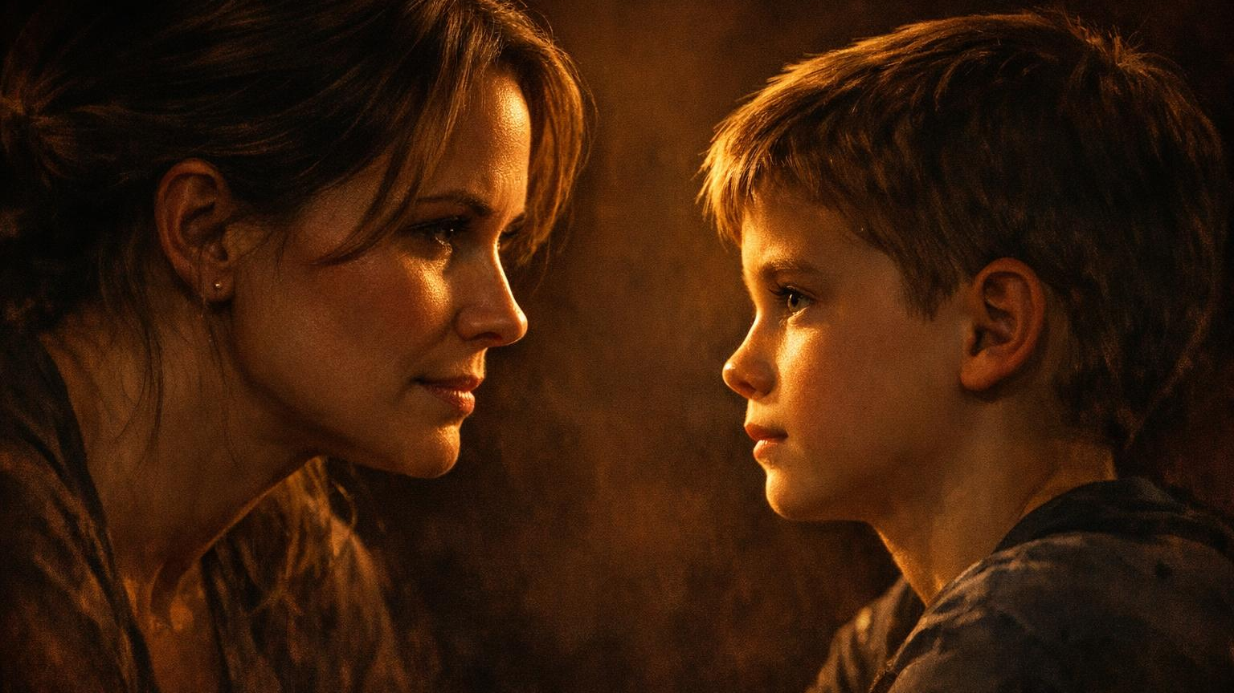
"BECAUSE I SAID SO!"
"Forsake not the law of thy mother."
— Proverbs 1:8
MUSAR= Every "no" was a lesson.
Every "I said what I said" was curriculum.
When mama talked, she was downloading DIVINE INSTRUCTION — and you rolled your eyes!

Slide 7
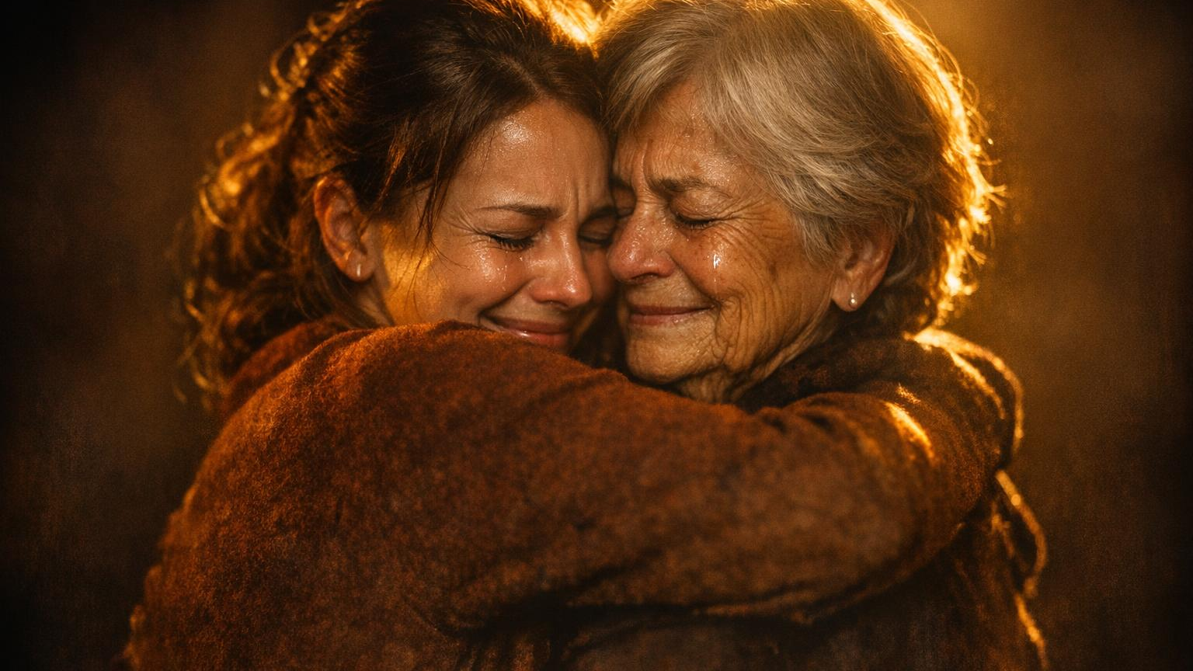
The Apology Tour
Call mama and apologize for every time you said "But WHY?"
Tell her: "Because I said so" was Proverbs 1:8 the whole time.
If she's next to you — apologize NOW.
We'll wait.
"Listen to your father... do not despise your mother when she is old." — Proverbs 23:22

Slide 8
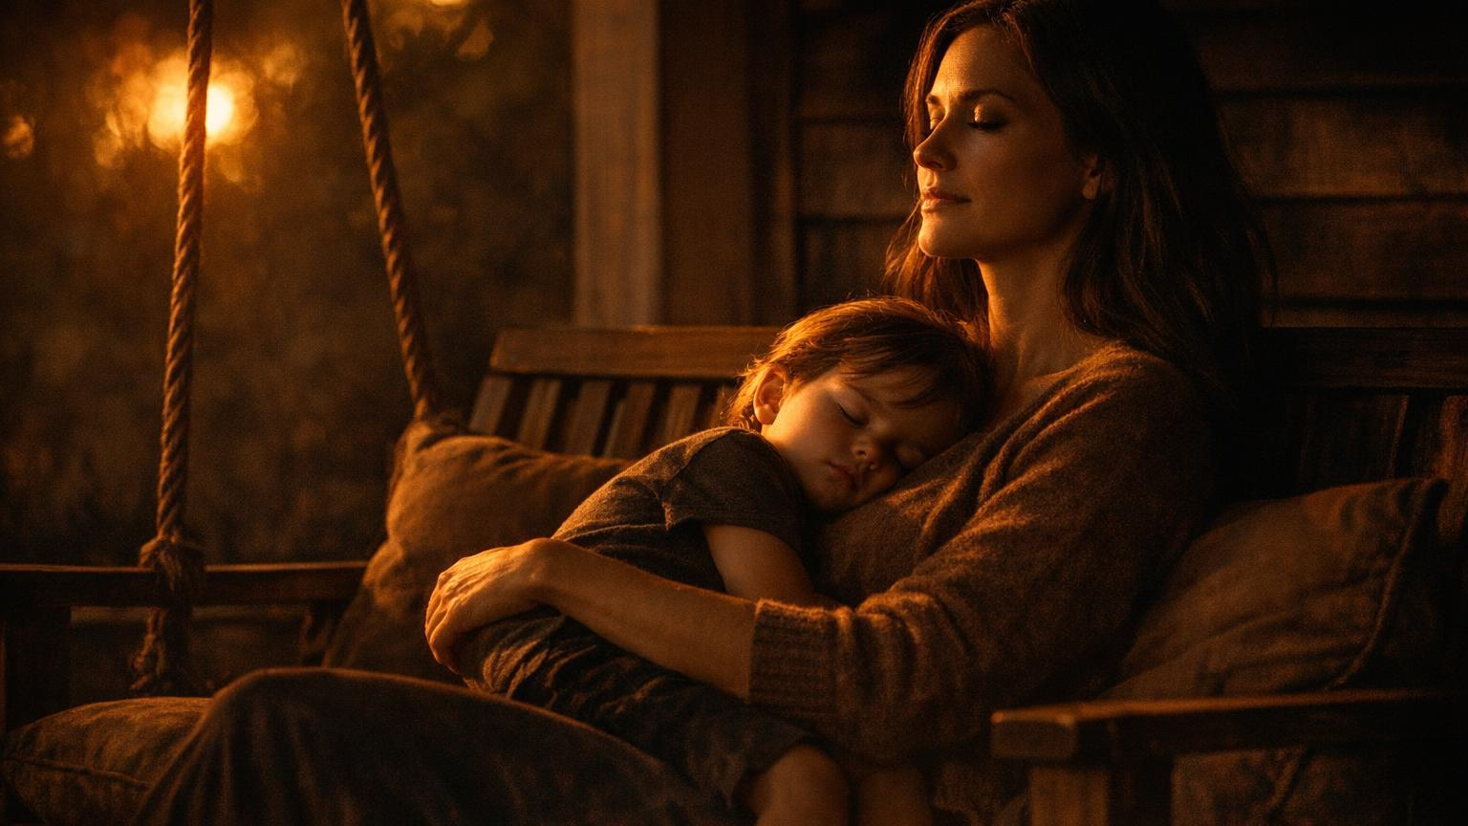
"GO SIT DOWN SOMEWHERE!"
"Be still, and know that I am God." — Psalm 46:10
RAPHAH = Stop. Let go. Cease striving.
Mama gave you Psalm 46 in street clothes.

Slide 9
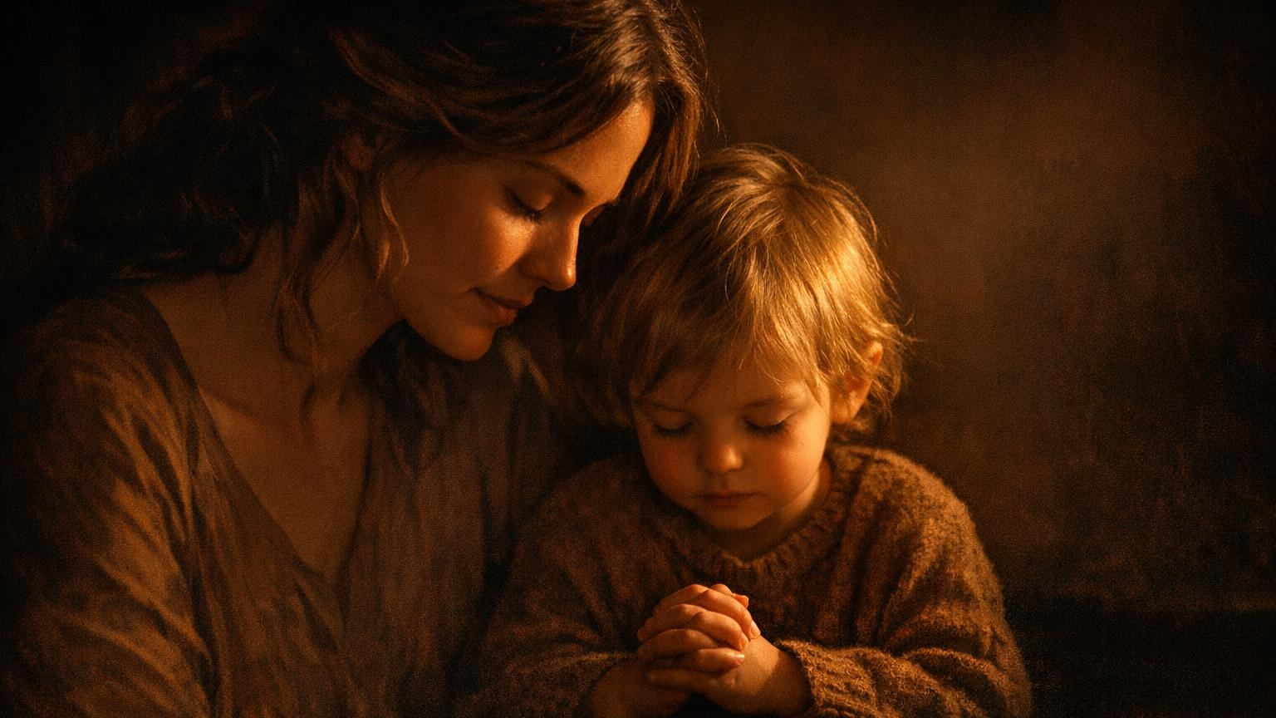
The Sit Down Challenge
When stressed this week — hear mama:
GO SIT DOWN SOMEWHERE.
Then DO it. 5 minutes.
Say: "Mama said sit down. God said be still. I'm listening."
Text mama: "I finally sat down."
She'll probably faint.
"As a mother comforts her child, so will I comfort you." — Isaiah 66:13

Slide 10
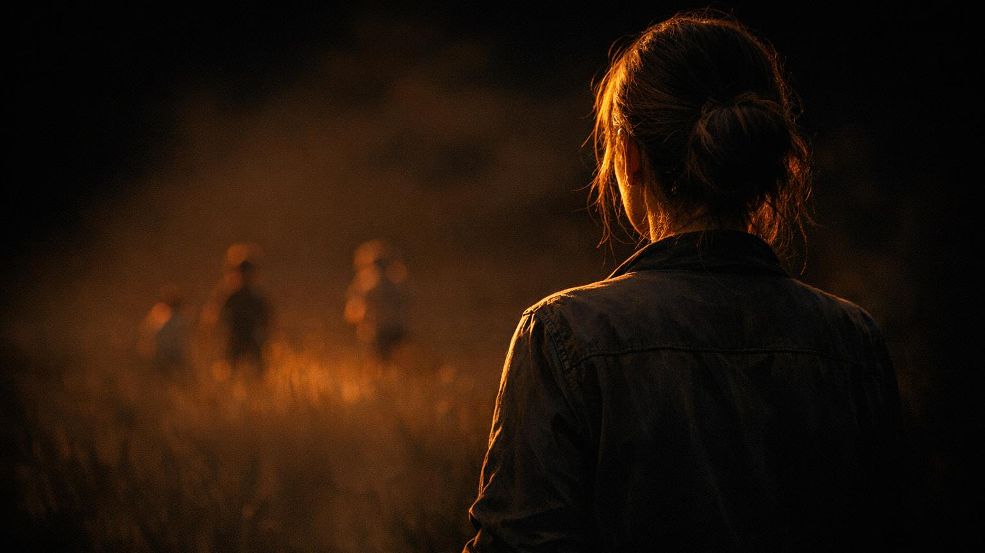
"I'VE GOT EYES IN THE BACK OF MY HEAD!"
"The eyes of the LORD are in every place."
— Proverbs 15:3
Eyes of Yahweh =God sees everything
He shares the feed with mothers

Slide 11
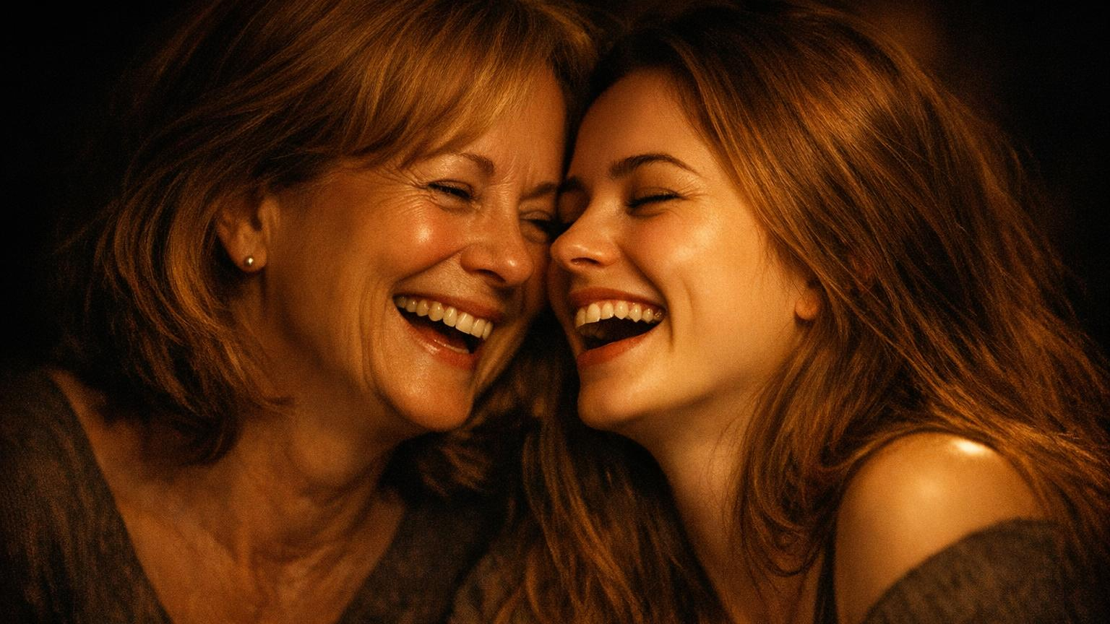
Mama's Surveillance System
Confess ONE childhood secret to mama. She already knows.
She'll say "I KNEW IT!" and then laugh.
That's mama-flavored grace.
⚠️ WARNING:
Some confessions should go to the GRAVE.
"Train up a child in the way he should go; even when he is old he will not depart from it." — Proverbs 22:6

Slide 12
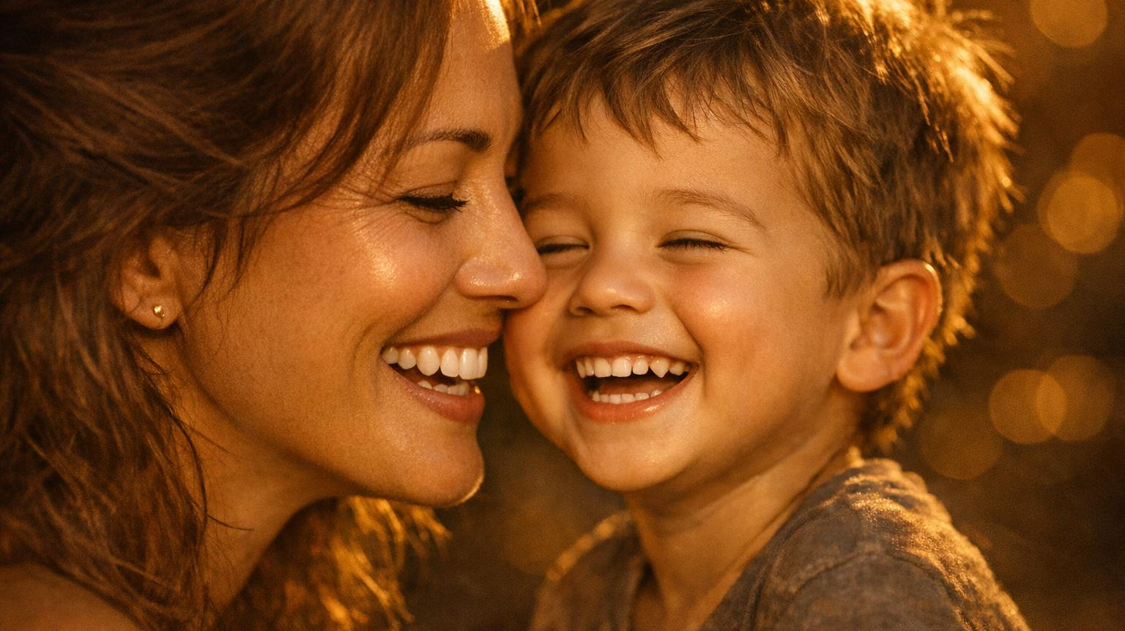
"FIX YOUR FACE!"
"A merry heart maketh a cheerful countenance."
— Proverbs 15:13
Cheerful=Chosen joy. Count=Face.
Joy is a decision, not a reaction.

Slide 13
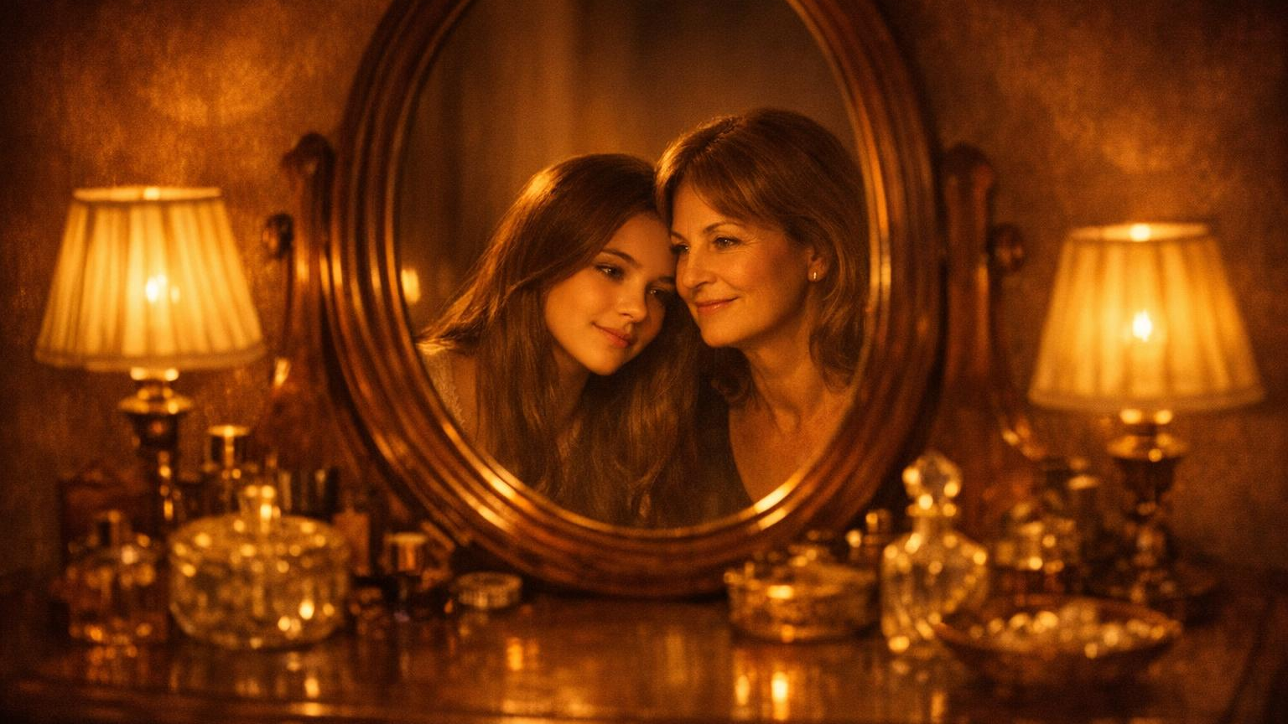
Fix Your Face Week
Every morning, mirror declaration: "I choose joy.
I choose hope. I'm fixing my face."
FAMILY GAME:
When someone is grumpy, say "FIX YOUR FACE!"
First to smile gets dessert.
"She is clothed with strength and dignity; she can laugh at the days to come." — Proverbs 31:25

Slide 14
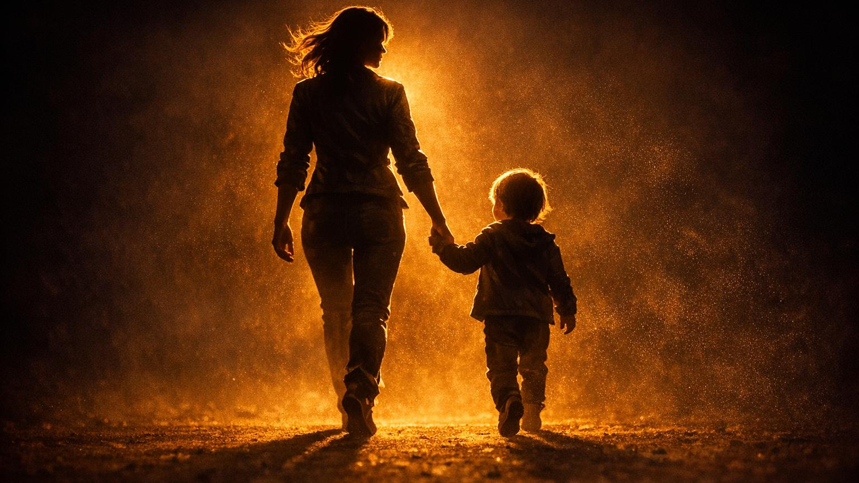
"I DON'T CARE WHAT EVERYBODY ELSE IS DOING!"
"Be not conformed to this world: but be ye transformed."
— Romans 12:2
METAMORPHOUSTHE =
Be completely TRANSFORMED.
Mama was your first pastor of counter-cultural living.

Slide 15
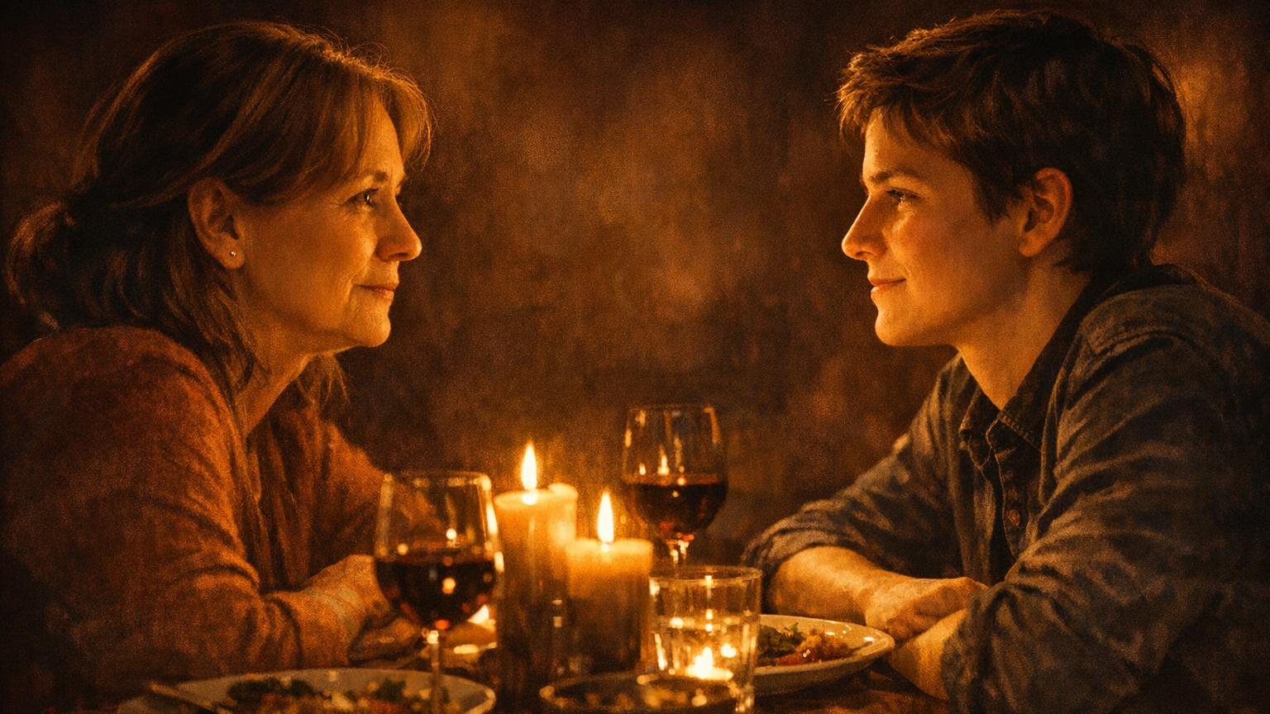
The Bridge Question
Ask mama: "Did anybody ACTUALLY jump off that bridge?"
Then thank her for making you different. It made you STRONGER.
Family: "In THIS house, we follow GOD." Mama will be SO proud.
"Honor your father and your mother, that your days may be long." — Exodus 20:12

Slide 16
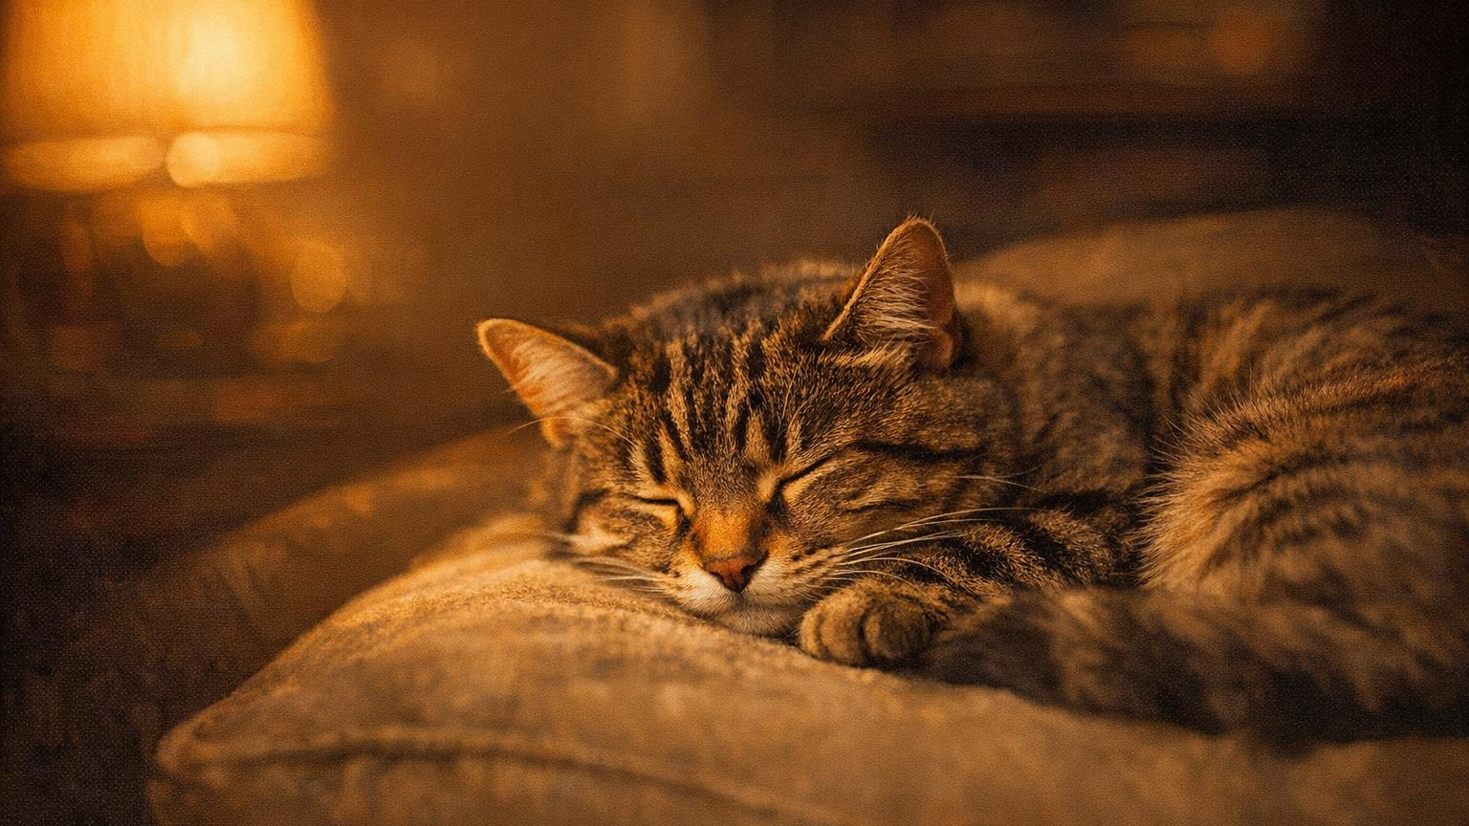

MAMA'S GREATEST HITS QUIZ
I say the Mama Saying — YOU shout the Scripture!
1
"Because I said so!"
Proverbs 1:8
2
"Go sit down!"
Psalm 46:10
3
"Eyes in the back of my head!"
Proverbs 15:3
4
"Fix your face!"
Proverbs 15:13
5
"I don't care what they're doing!"
Romans 12:2
Click anywhere to reveal each answer ▸

Slide 17
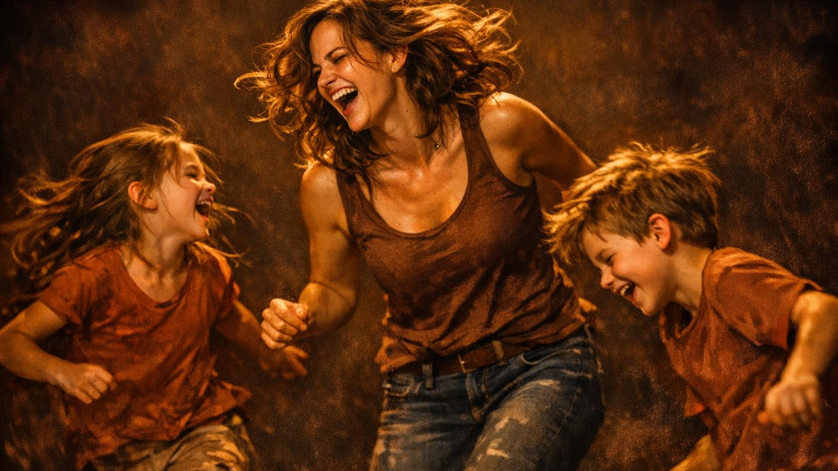
🔥 BONUS ROUND!
"McDonald's money?"
Can't serve God and mammon! (Matt 6:24)
→
"Count to three!"
God's patience has limits! (Gen 6:3)
→
The day of the Lord cometh! (1 Thes 5:2)
"Wait till your father gets home!"
→
"I brought you into this world..."
The Lord giveth and taketh away! (Job 1:21)
→
"Hurts me more than you."
→
Whom the Lord loves, He chastens! (Heb 12:6)

Slide 18

MAMA WAS PREACHING THE WHOLE TIME.
Give your mama a STANDING OVATION!
She's been teaching the Word your whole life.
"She opens her mouth with wisdom, and the teaching of kindness is on her tongue." — Proverbs 31:26

Slide 19

MOTHER'S DAY DECLARATION
"Because I said so" was WISDOM.
"Go sit down" was PEACE.
"I've got eyes" was PROTECTION.
"Fix your face" was JOY.
"I don't care what they're doing" was IDENTITY.
Your teaching is TORAH. Your words are alive in us.
MAMA SAID IT FIRST! AMEN!

Slide 20

🌸
🌸
THANK YOU, MAMA
Your words SAVED us. Your prayers kept us alive. Your love kept us going.
One day your child will say:
Mama was right the whole time.
Happy Mother's Day 🌸
🌸
"Many women do noble things, but you surpass them all." — Proverbs 31:29
🌸
🌸 🌸 🌸 🌸 🌸

