Slide 1

Spiritual Warfare
10% Satan’s Tactics
90% How We Respond
Remember…
With God We Are Not
Helpless
Hopeless
We Are Powerful!!

Slide 2

Repeat
These are the 2 Most Important Hours of My Week – Help Me to Cherish Them
I Am Here Today to Worship
Not to Be Entertained
I Am Singing to An Audience of One
Accept My Worship Oh Lord!

Slide 3

Edward Christian Church
6/14/2026

Slide 4
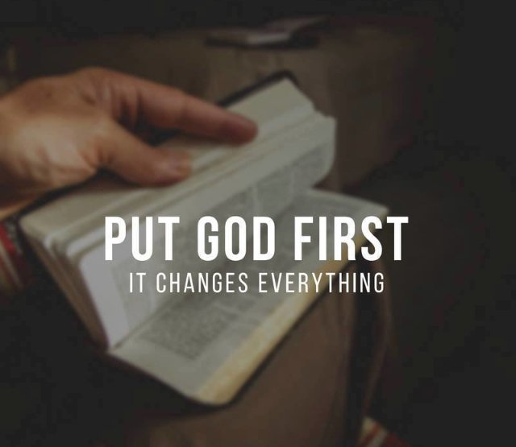
Repeat
I Lift My Offering to You
Let It Please You Oh Lord
This is My Seed
Although It Leaves My Hand
It will Never Leave My Life
You Will Multiply It!
Accept My Seed Oh Lord!

Slide 6
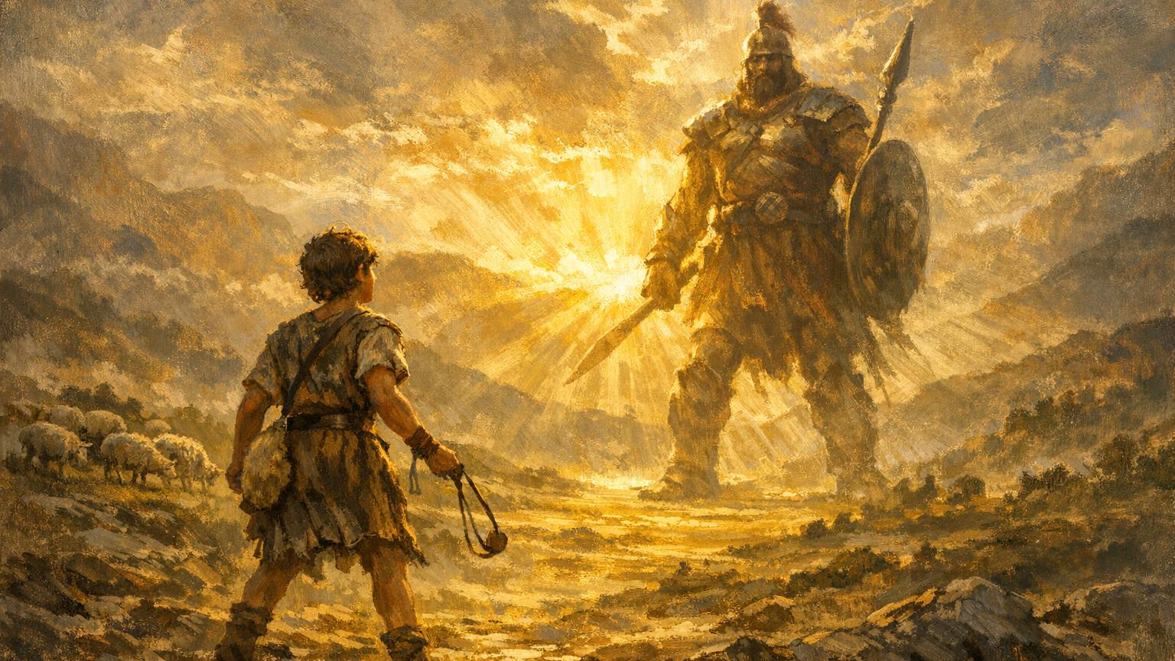
When Weakness
Becomes a Weapon
2 Corinthians 12:9

Slide 7
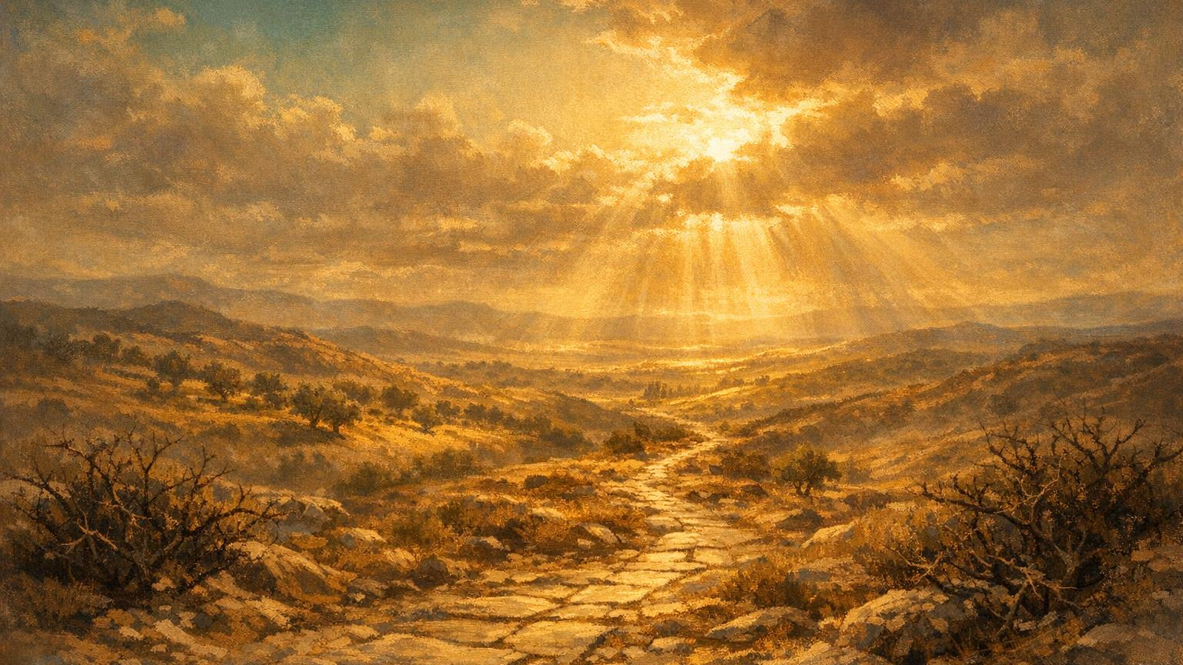
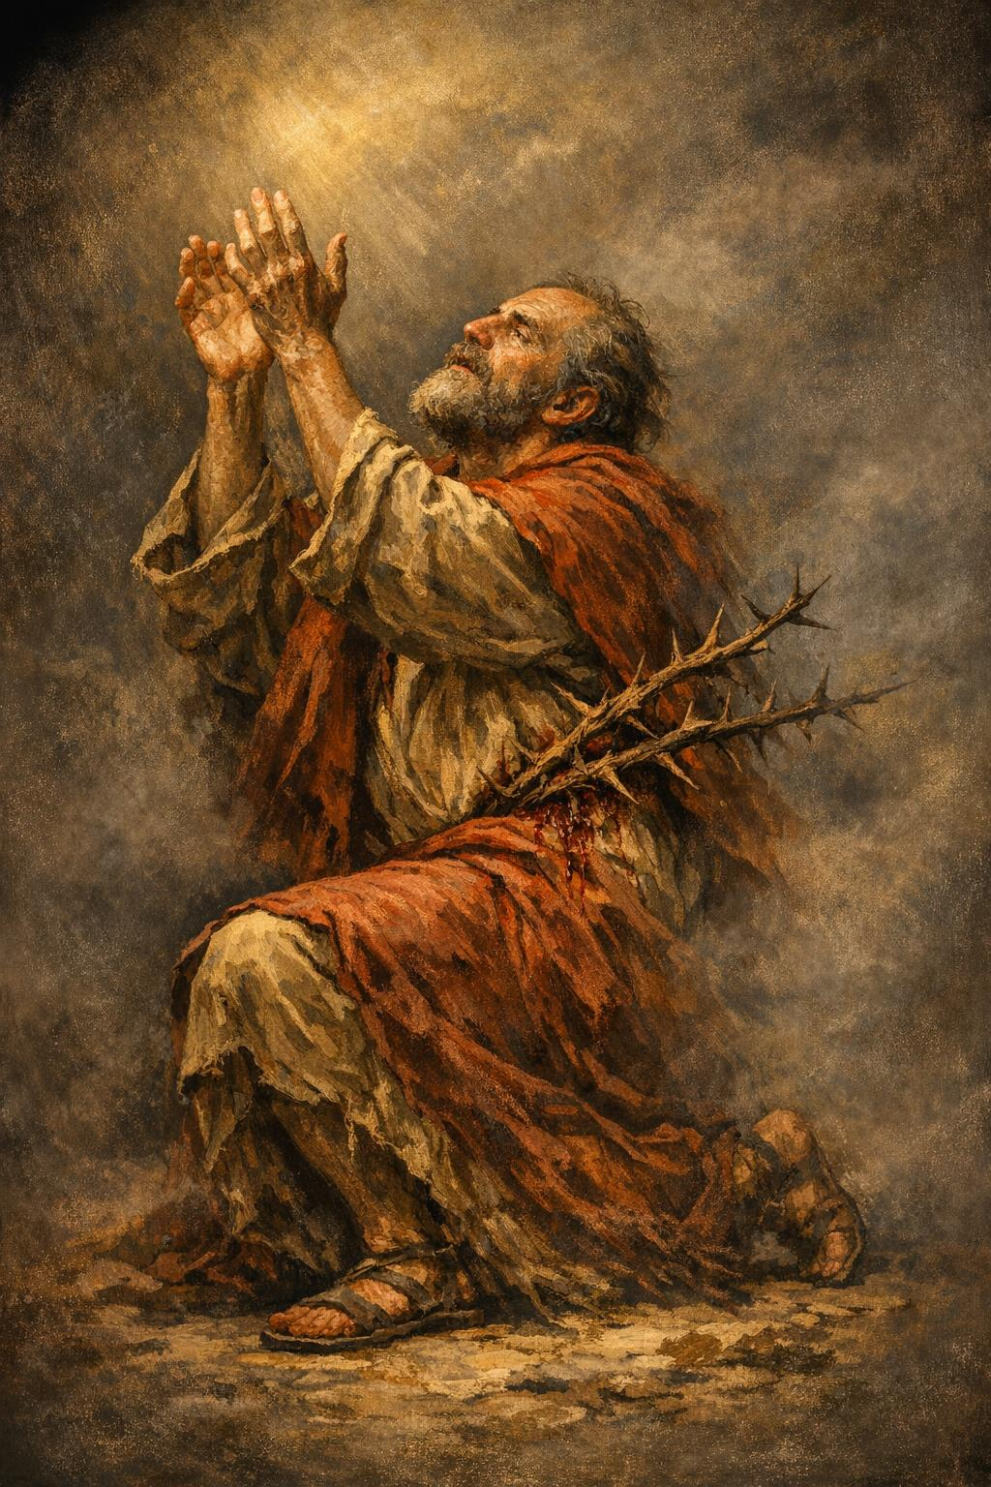
God Often Begins Where We End
Paul is pleading with God for Relief
He is Worn, Weary, and Wrestling
with a Thorn He Cannot Remove
And God Answers…
Not with Deliverance,
but with Revelation:

Slide 8
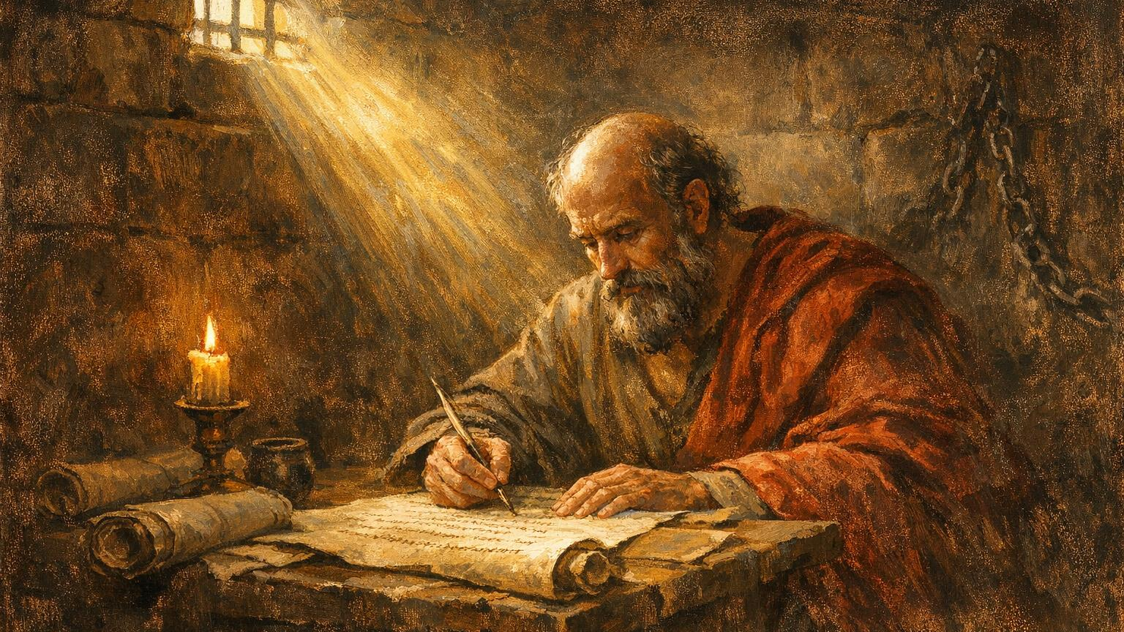
Key Verse
“My grace is sufficient for you,
for My power is made perfect in weakness.”
2 Corinthians 12:9

Slide 9
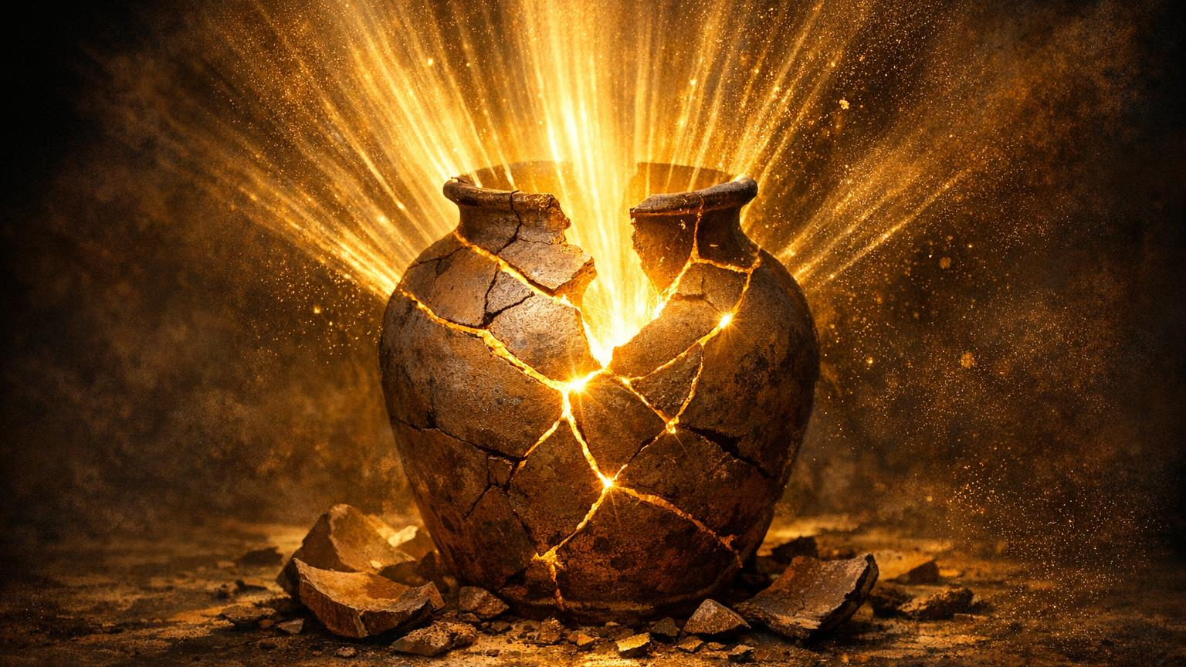
“My Grace is Sufficient…
My Power is Perfected…
in Your Weakness”
This is the Kingdom Paradox:
Where we stop…God Starts
Where we fall…God Stands
Where we break…God Builds

Slide 10
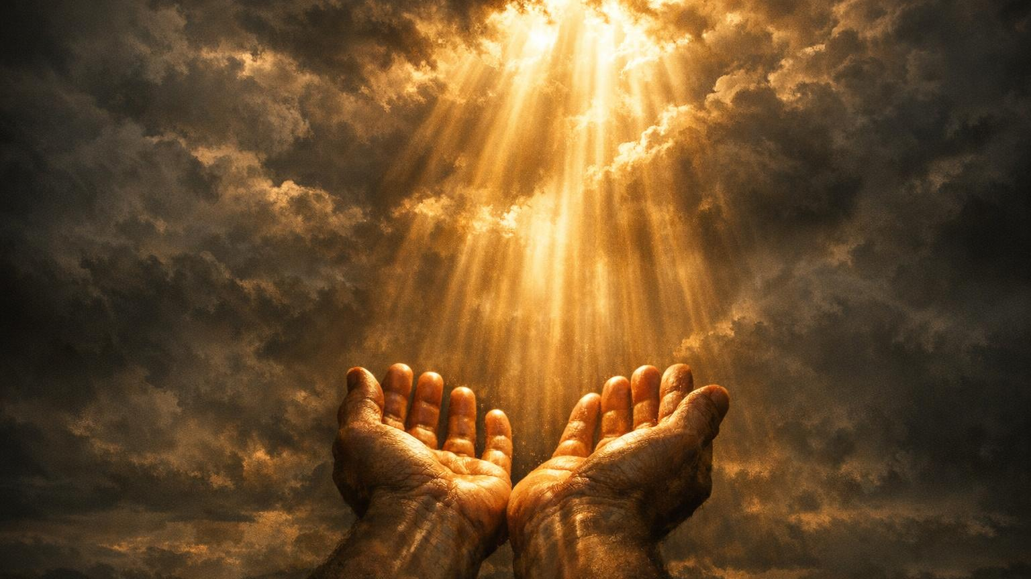
We Live In A World That Worships Strength, Hustle, And Self‑made Success.
But Heaven Operates By A Different Economy
One Where Weakness Is Not A Liability But
An Entry Point For Divine Power.

Slide 11
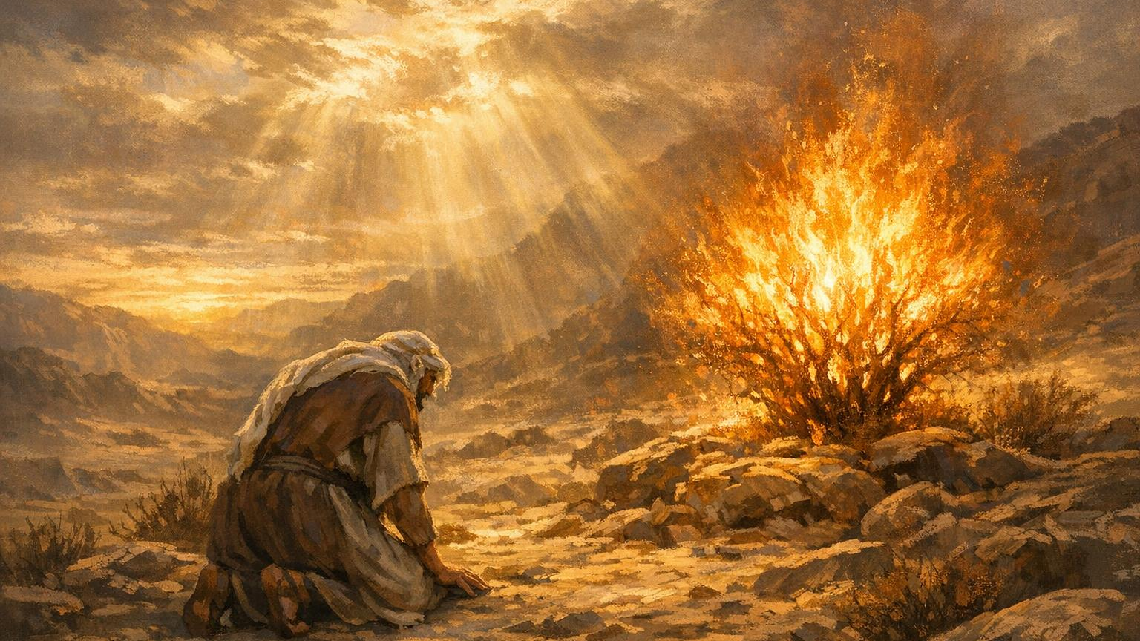
God Begins Where We End
Our Limits Create Space For His Power

Slide 12
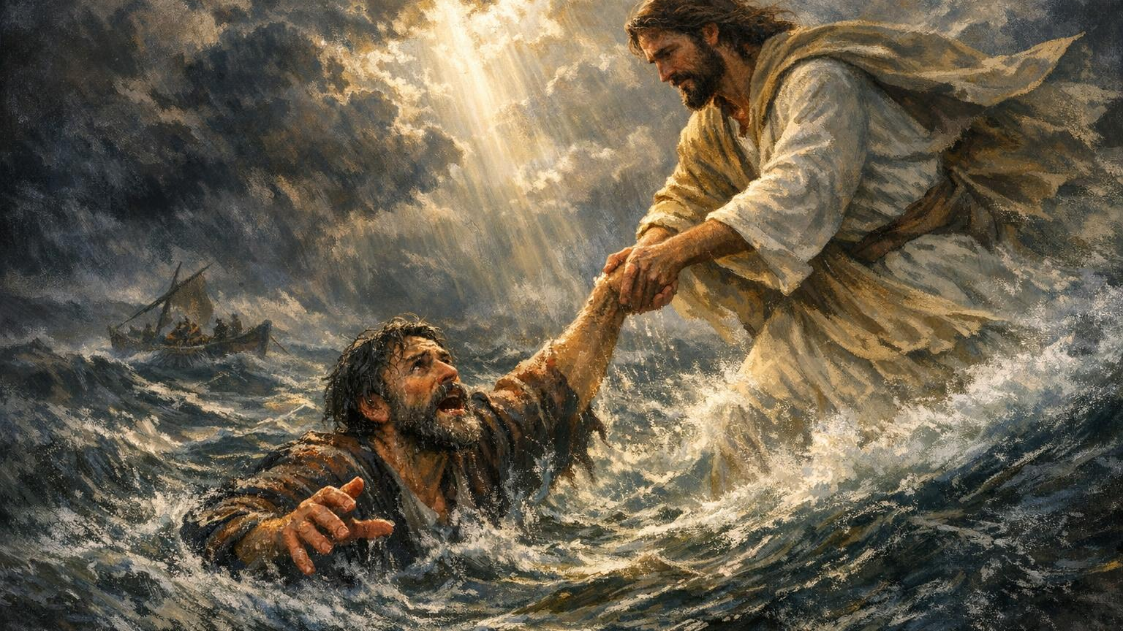
The Trap of Self‑Sufficiency
We try to carry what God never assigned
Exhaustion reveals misplaced dependence
Self‑Reliance replaces surrender

Slide 13
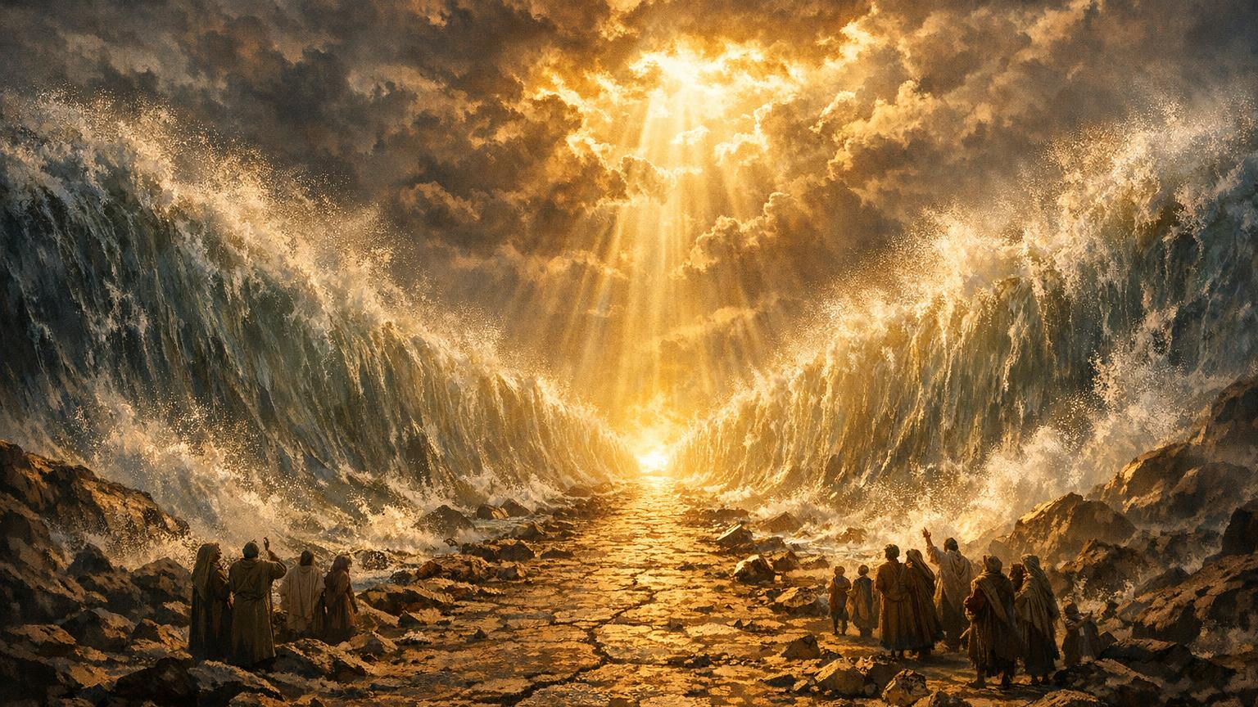
God Moves in Our Weakness
Red Sea:
God makes a way when none exists
Gideon:
God removes human strength to reveal His
Paul:
The thorn becomes a doorway to grace

Slide 14
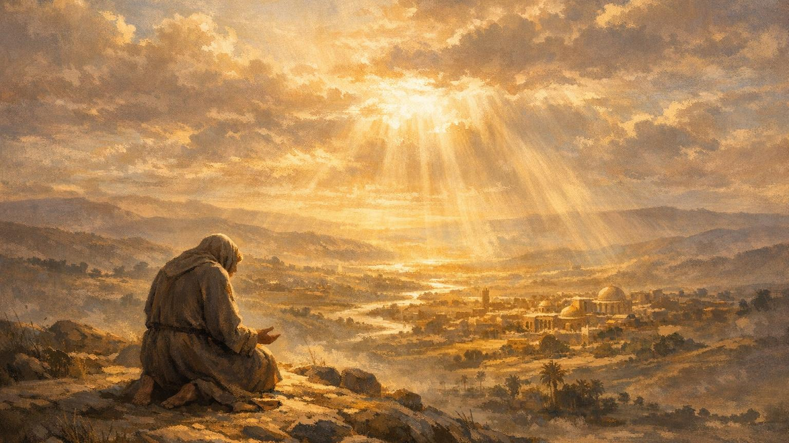
The Power of Surrender
Surrender Is Alignment, Not Defeat
Anxiety Exchanged For Faith
Control Replaced With Trust

Slide 15
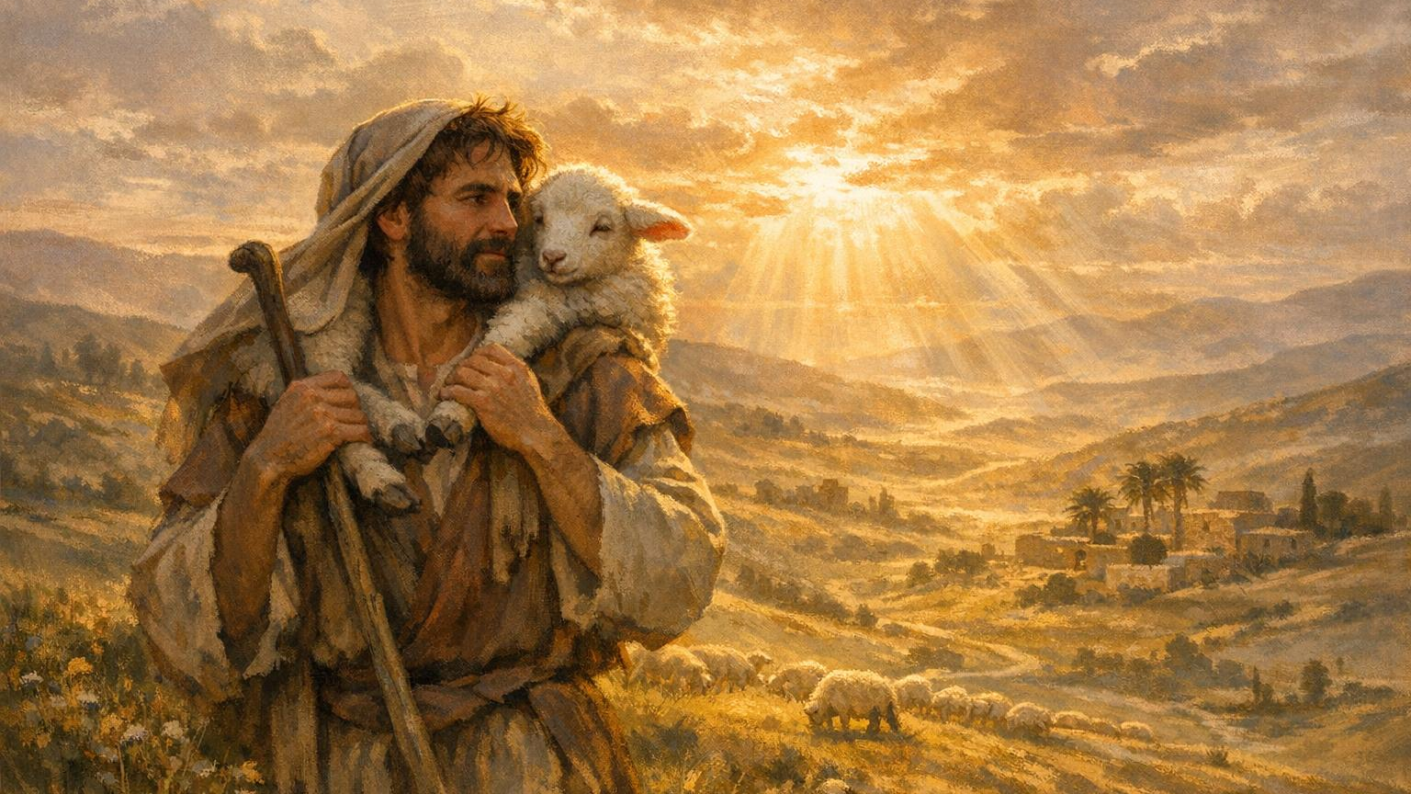
Grace Over Hustle
Hustle Drains; Grace Sustains
You Can’t Earn What God Freely Gives
His Strength Doesn’t Add To Yours—it Replaces It

Slide 16
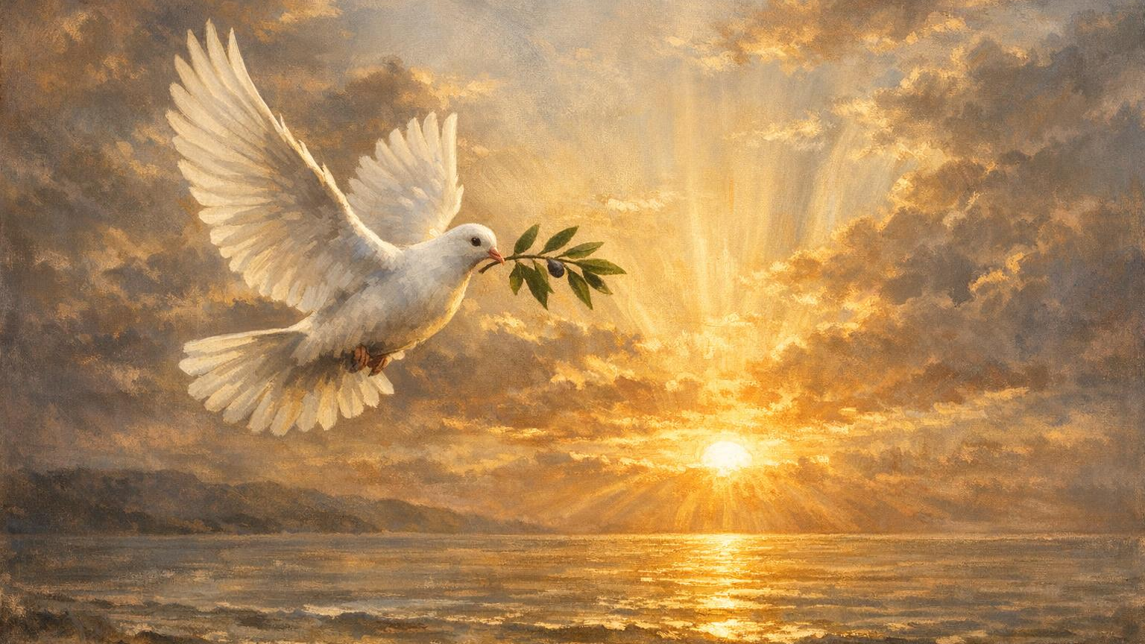
Resting in His Timing
Waiting is preparation, not punishment
God works in silence and strategy
Delay is not denial

Slide 17
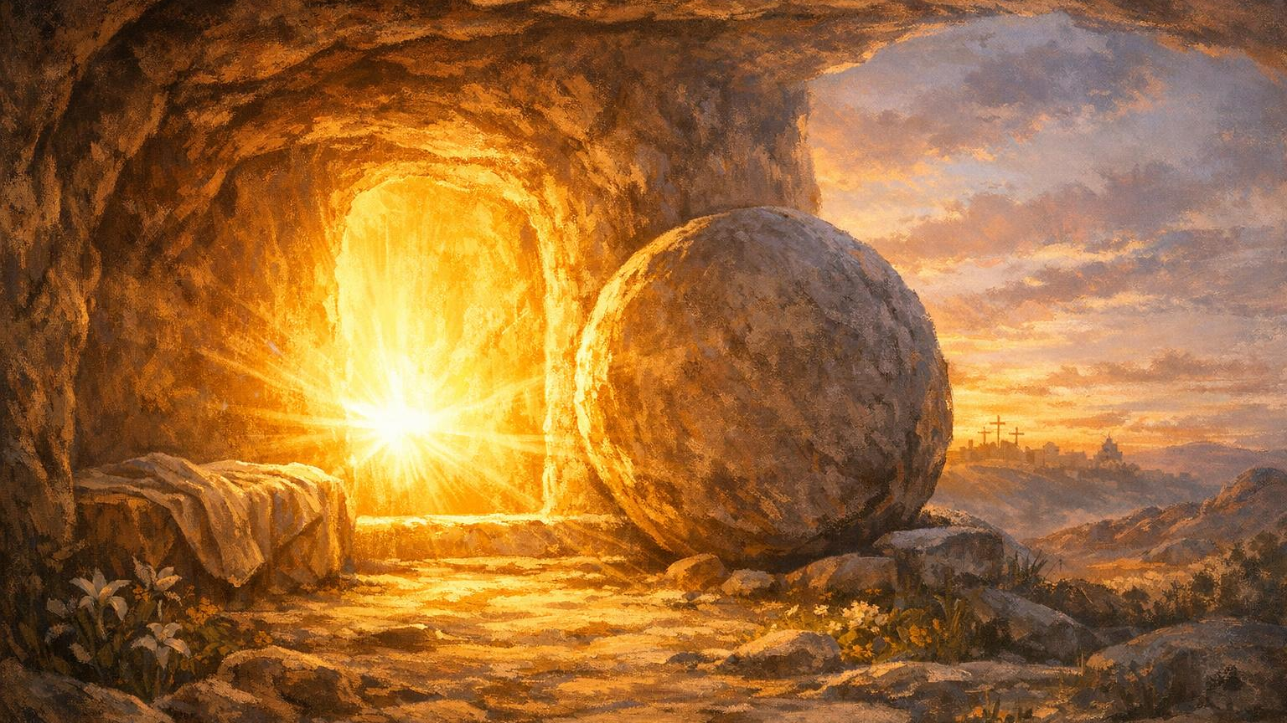
Your Breaking Point Is God’s Starting Line
Weakness Becomes The Doorway To Divine Power

Slide 18
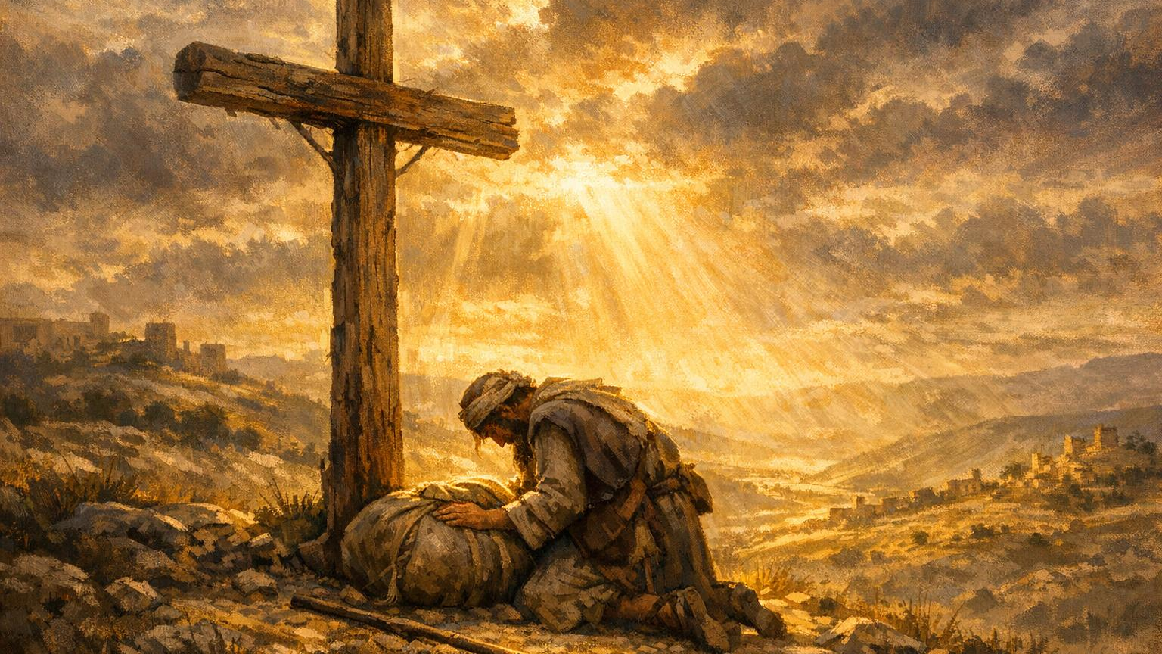
Come Surrender
Lay Down The Weight.
Let God Be Strong Where You Are Weak.
“I Can’t — But He Can.”

Slide 19
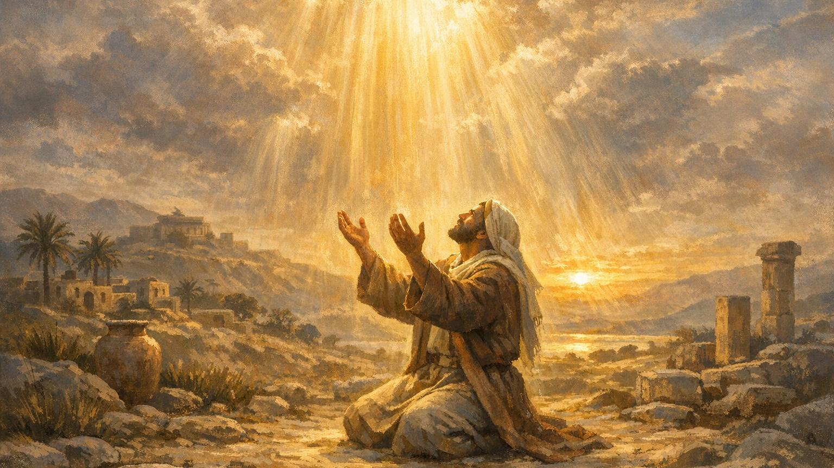
Lord, I bring You my weakness. I bring You my limits.
I bring You what I cannot carry.
Your grace is enough for me. Your power is perfected in me.
Where I am empty — fill me.
Where I am broken — heal me.
Where I am weary — strengthen me.
I surrender my striving.
I release my self‑reliance.
I lay down the weight I was never meant to carry.

Slide 20
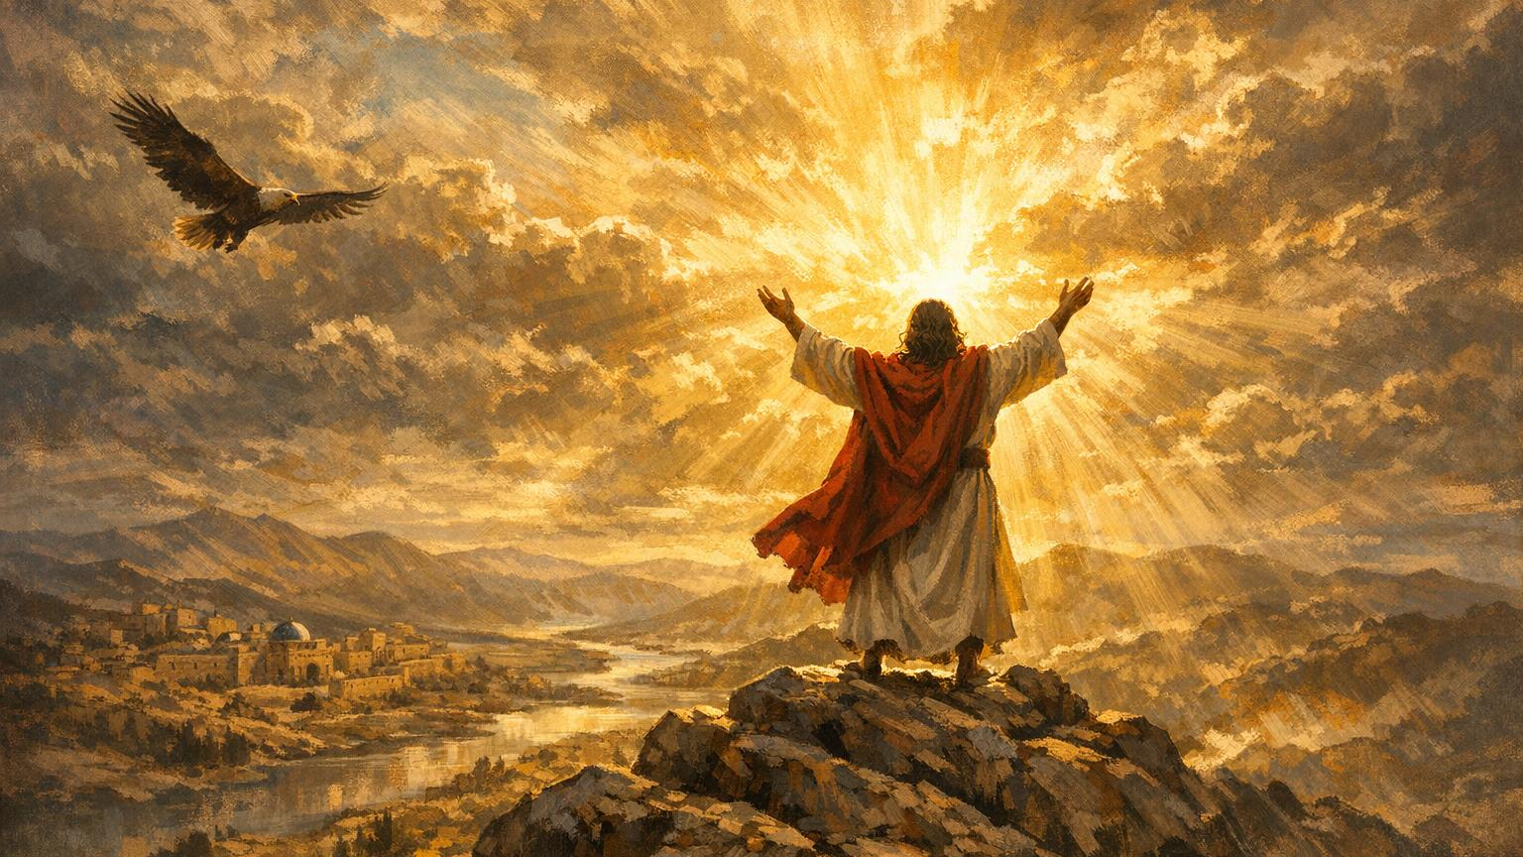
Today, my weakness becomes a weapon.
My surrender becomes my strength.
My dependence becomes my victory.
I declare: I can’t — but He can.
I won’t — but He will.
I am weak — but He is strong in me.
Grace is working. Power is rising. Christ is enough.
In Jesus’ name — AMEN.”**

Slide 21
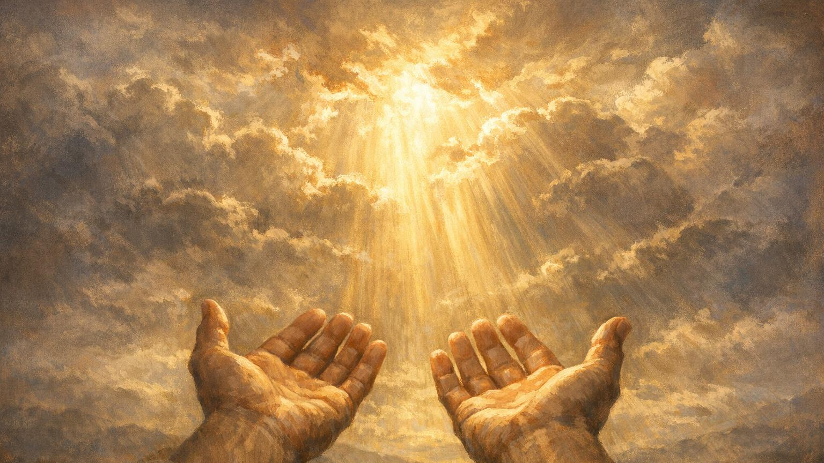
My grace is sufficient for you,
for My power is made perfect in weakness.”
2 Corinthians 12:9

Slide 23
A preacher was riding his bicycle down the street when he noticed a little boy standing in a yard next to the curb with a lawn mower. He asked the little fellow what he was doing, to which the little fellow replied, "I want to sell this mower so I can buy a bicycle."
The preacher said, "Well son I need a lawn mower and I have this bicycle. Maybe we can work out a trade. Why don't you ride my bicycle around the block and see what you think about it?"
The little boy went around the block and when he returned the preacher was sitting on the curb red faced and out of breath. The preacher said, "I have pulled on this rope since you left and I can't get this thing to start."
The little boy softly said, "You have to cuss."
The preacher replied, "I haven't cussed in so long I have forgotten how."
The little boy replied, "if you pull on that rope long enough you will remember."

