Slide 1


Slide 2

Spiritual Warfare
10% Satan’s Tactics
90% How We Respond
Remember…
With God We Are Not
Helpless
Hopeless
We Are Powerful!!

Slide 3

Repeat
These are the 2 Most Important Hours of My Week – Help Me to Cherish Them
I Am Here Today to Worship
Not to Be Entertained
I Am Singing to An Audience of One
Accept My Worship Oh Lord!

Slide 4

Repeat
I Lift My Offering to You
Let It Please You Oh Lord
This is My Seed
Although It Leaves My Hand
It will Never Leave My Life
You Will Multiply It!
Accept My Seed Oh Lord!

Slide 5
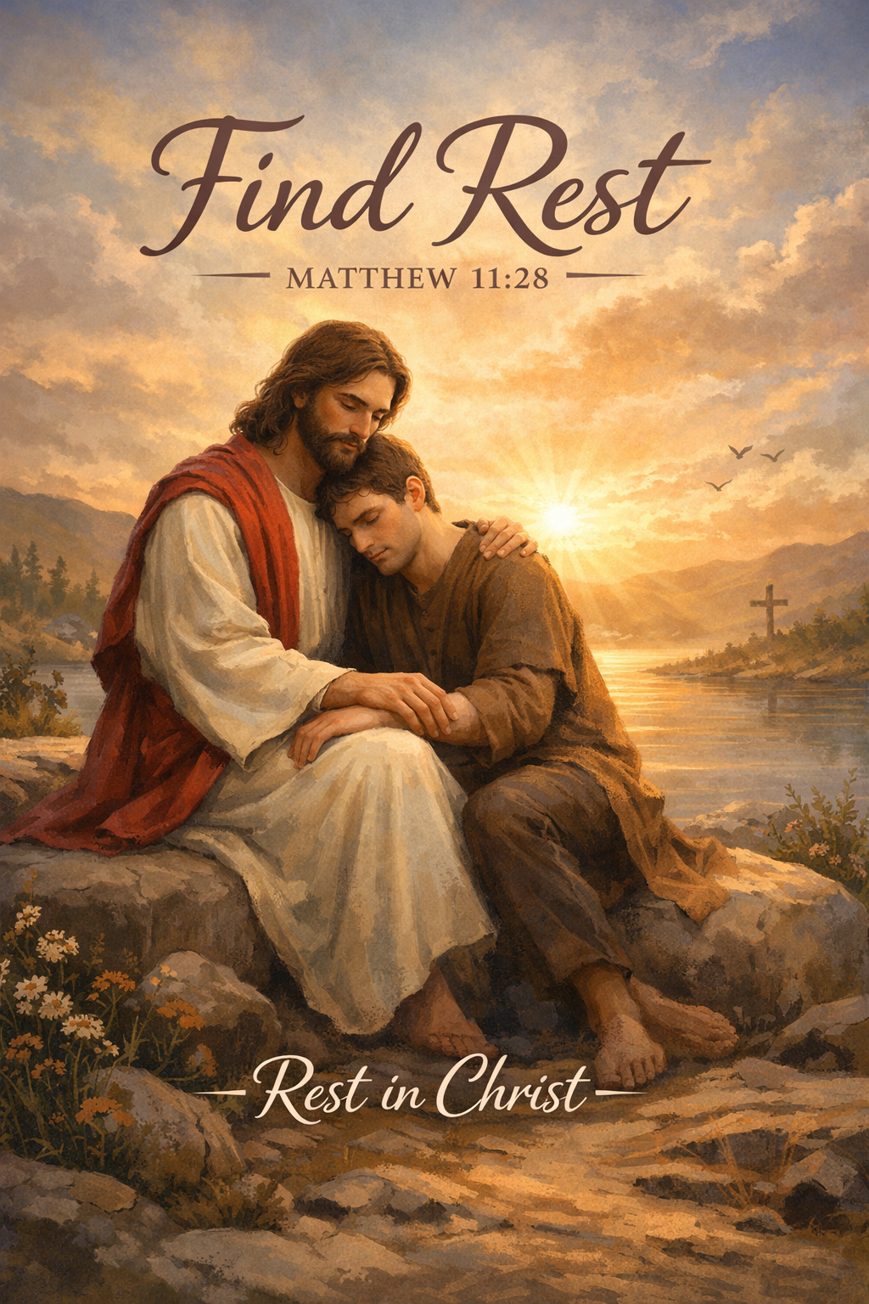
COME, TAKE, LEARN:
THE GOD WHO GIVES REST

Slide 6
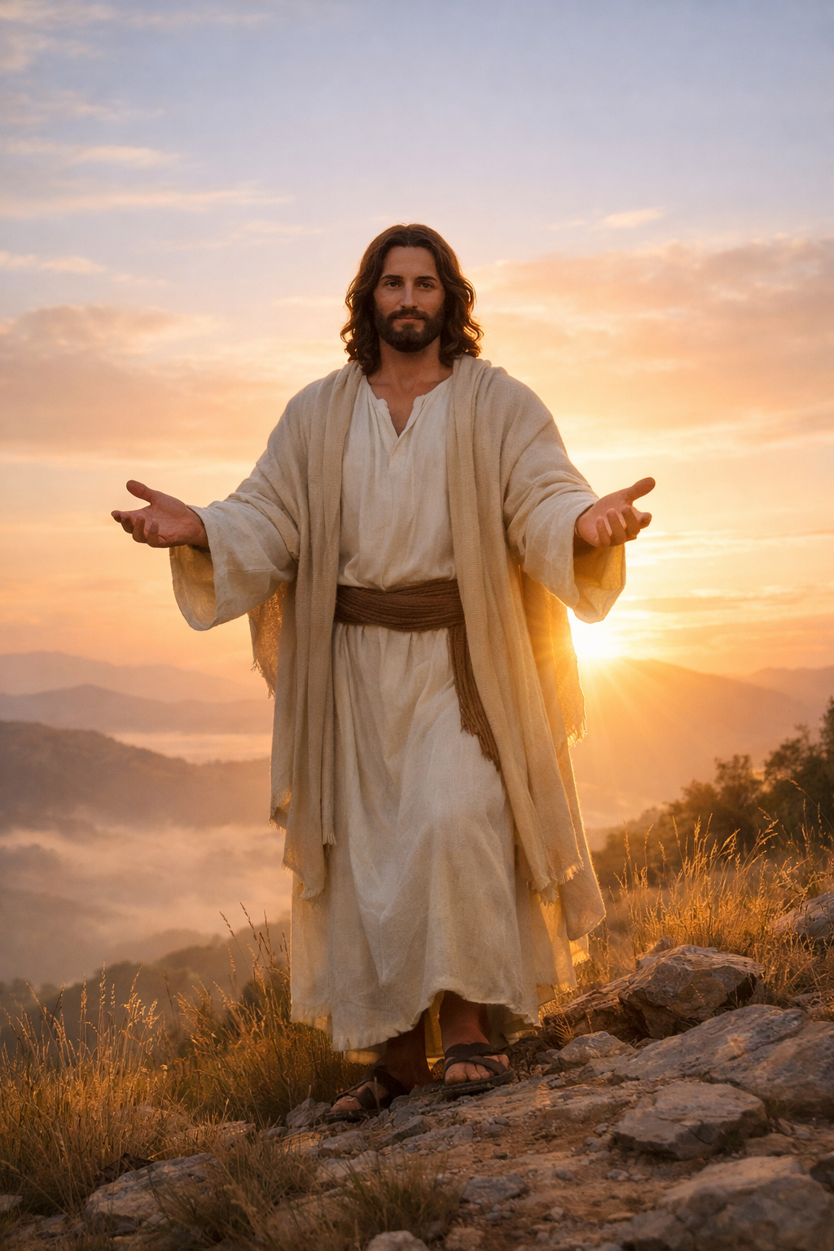
PART ONE
COME — Receive His Rest
Matthew 11:28
“Come to Me, all who labor and are heavy laden, and I will give you rest.”

Slide 7
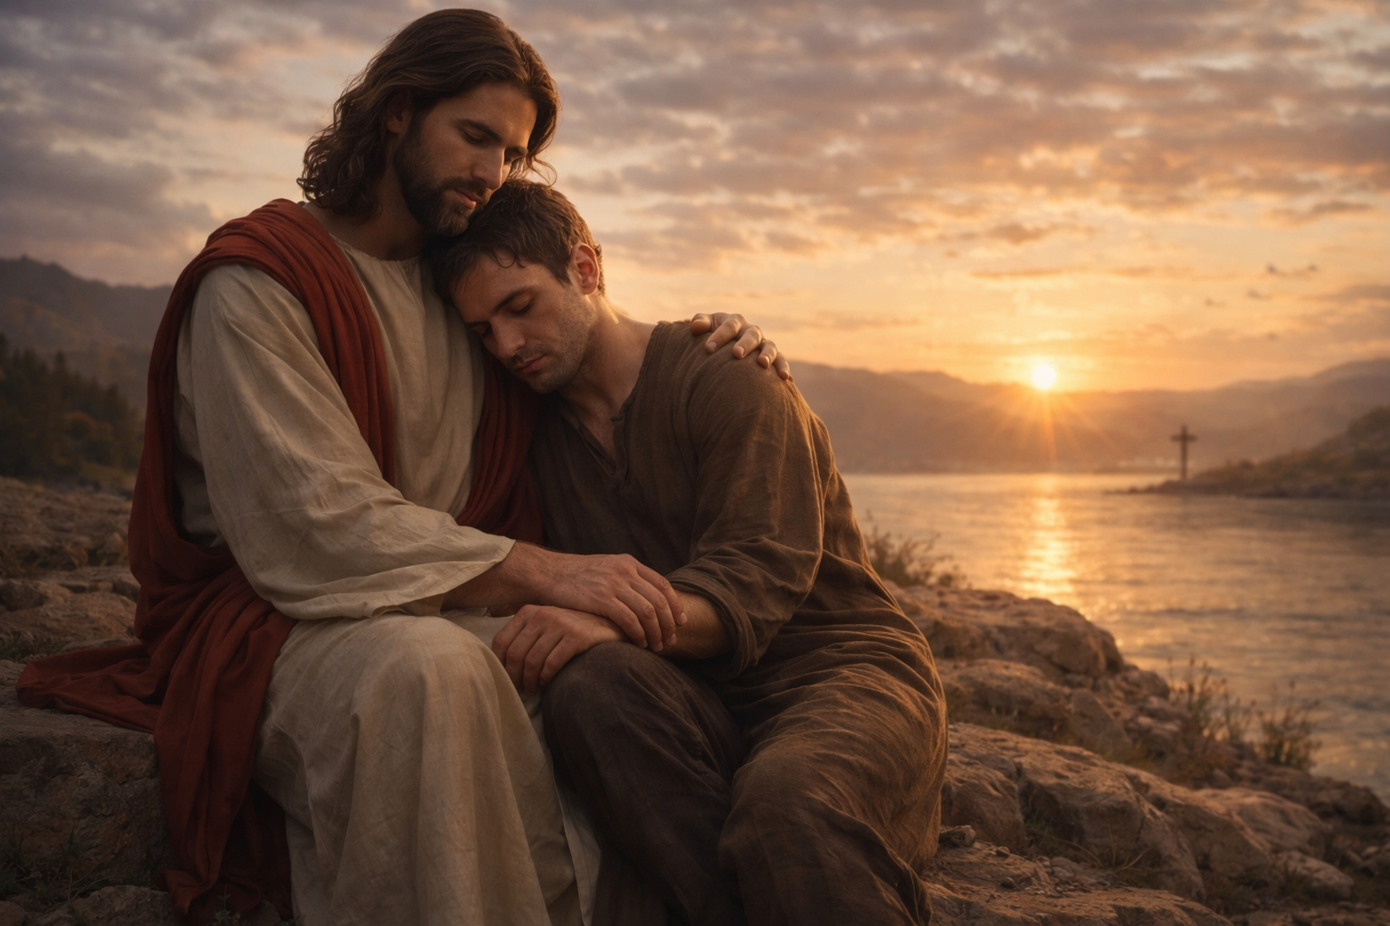
THE WEARY GENERATION
People Today Are Tired:
In Their …
bones
minds
emotions
spirits

Slide 8
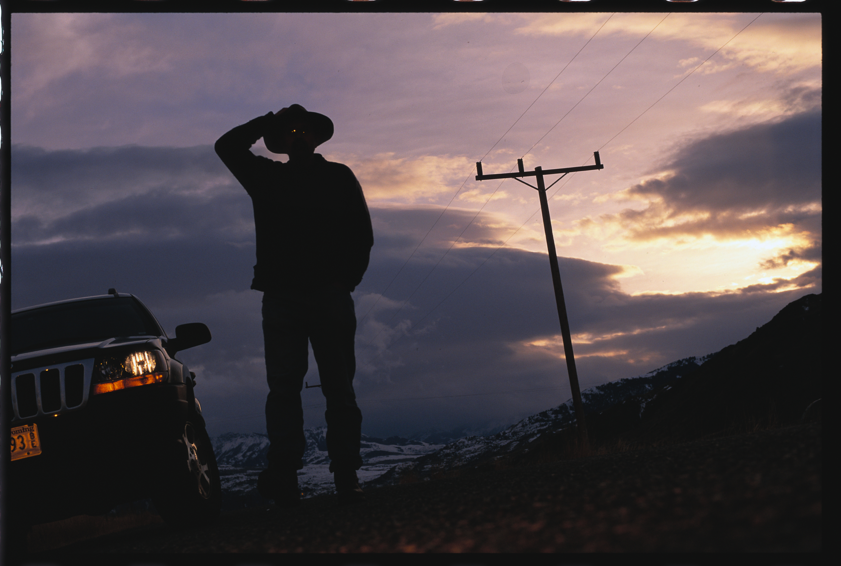
From Carrying:
  Anxiety
  Burdens
  Expectations
  Wounds
  Silent battles
  Jesus whispers: “Come to Me.”

Slide 9
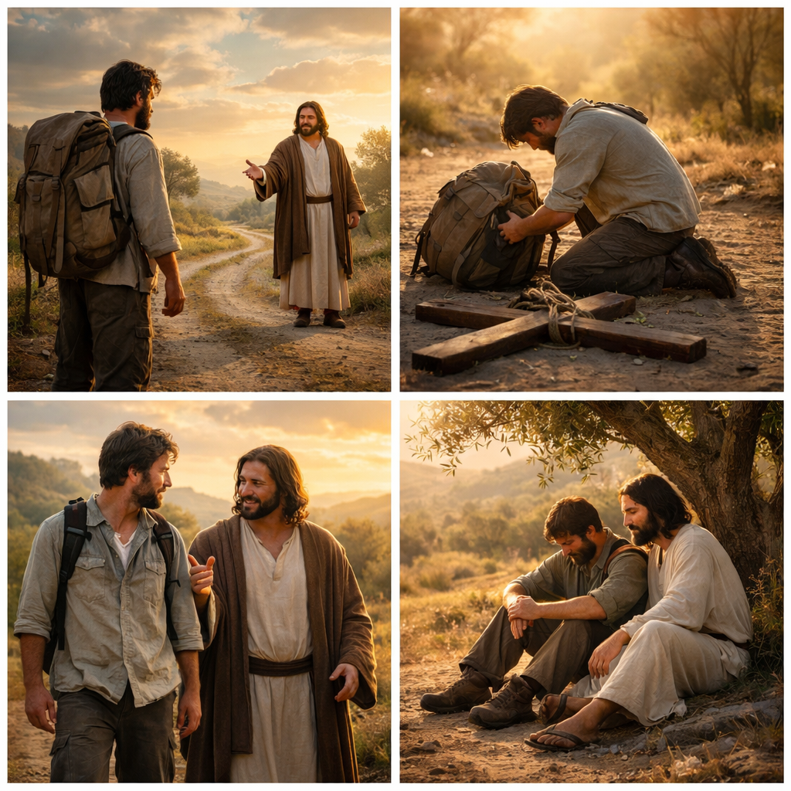
Matthew 11:28–30 reveals:
  Come — Invitation
  Take — Surrender
  Learn — Transformation
  Rest — Promise

Slide 10
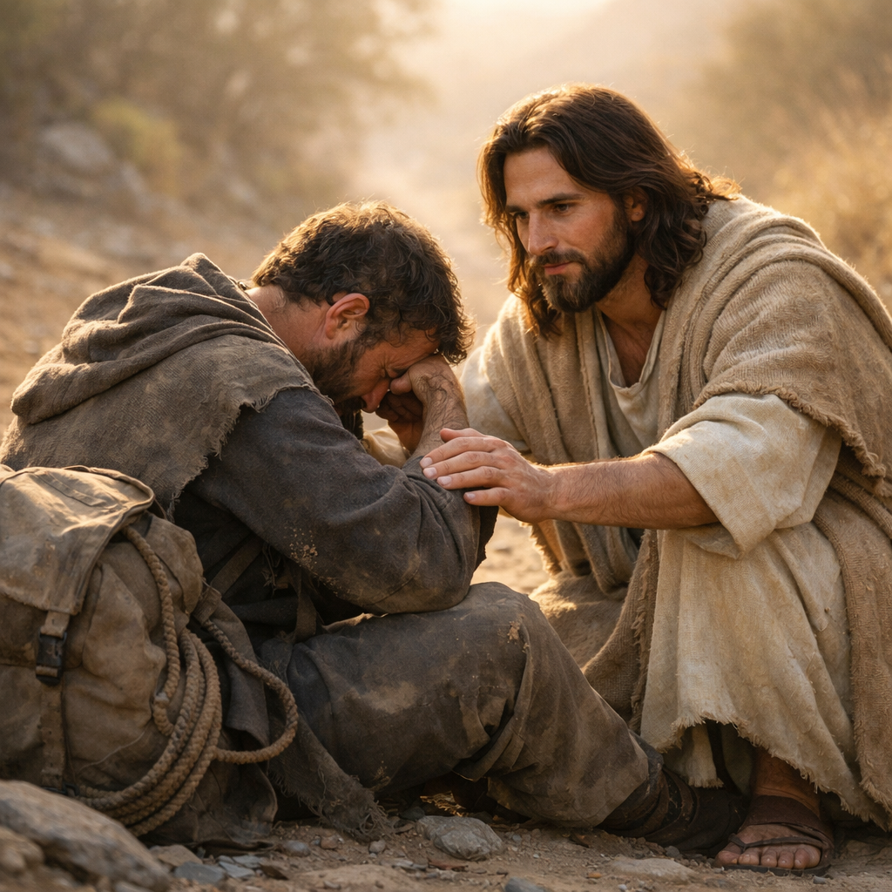
Greek: Come toward Me, into My presence.
Jesus does not say:
Come to religion
Come to rules
Come to rituals
Come to perfection
He says: “Come to Me”

Slide 11
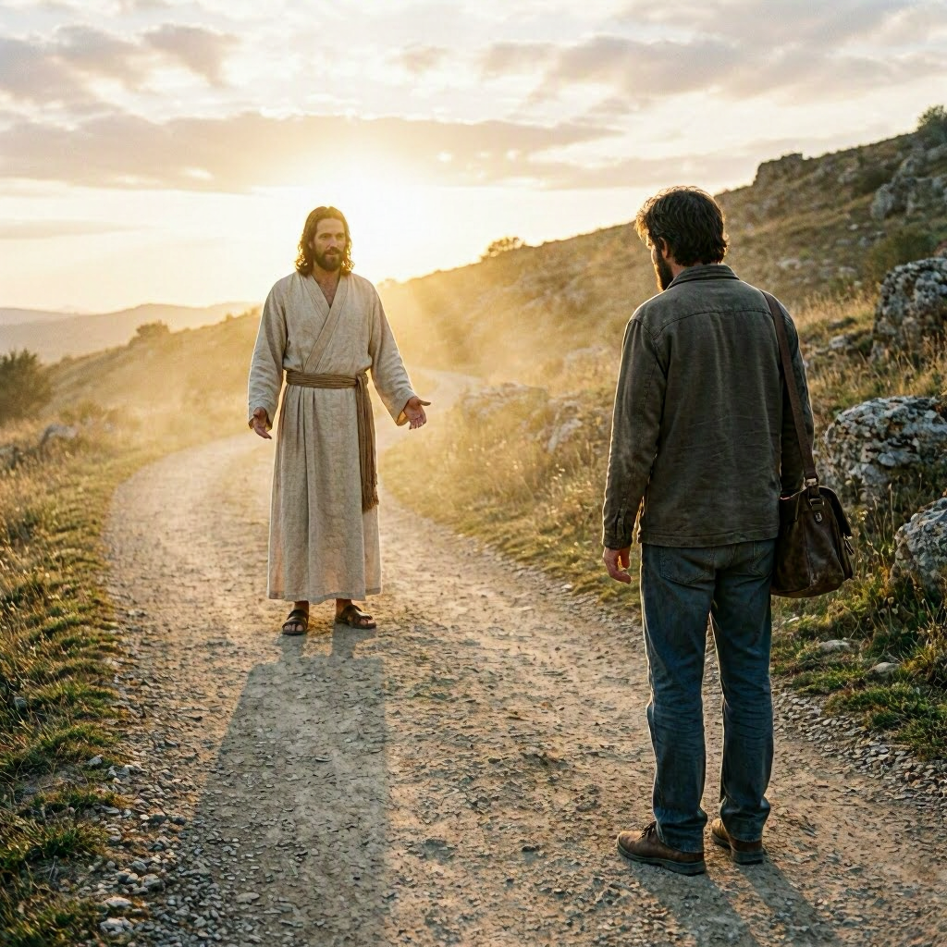
Insight:
His presence is a place where burdens break
Challenge:
What have you been coming to instead of Jesus?
Hope:
You don’t have to come perfect — just come

Slide 12
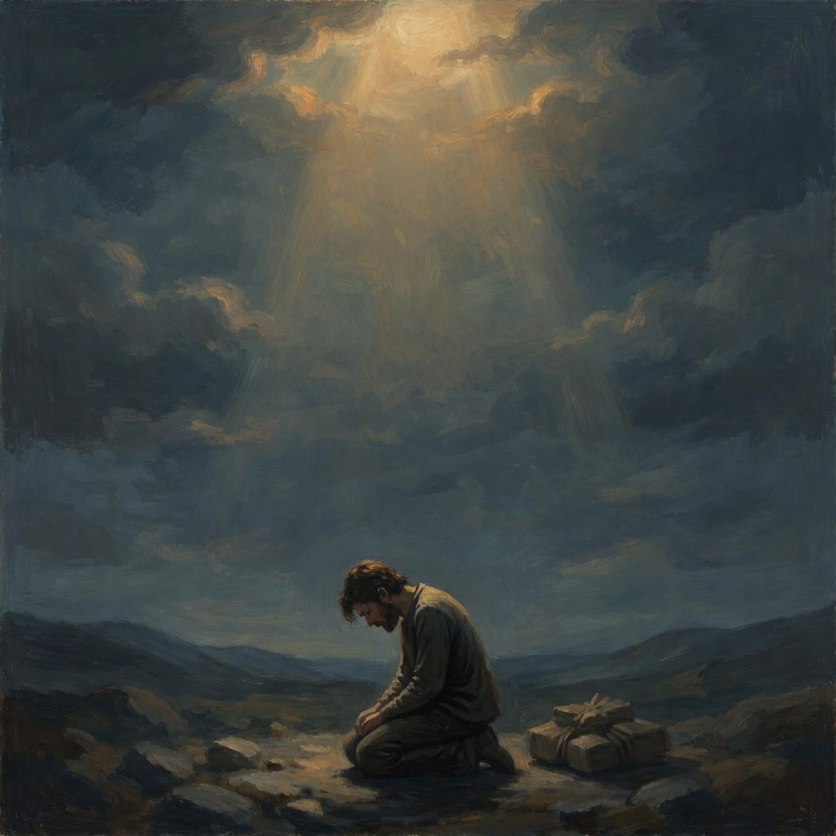
“ALL WHO LABOR AND ARE HEAVY LADEN”
      Greek- Labor — exhausted
      Heavy Laden — overloaded
Jesus calls the:
  overworked
  overwhelmed
  overburdened
  overlooked
  overthinking
  over‑responsible

Slide 13
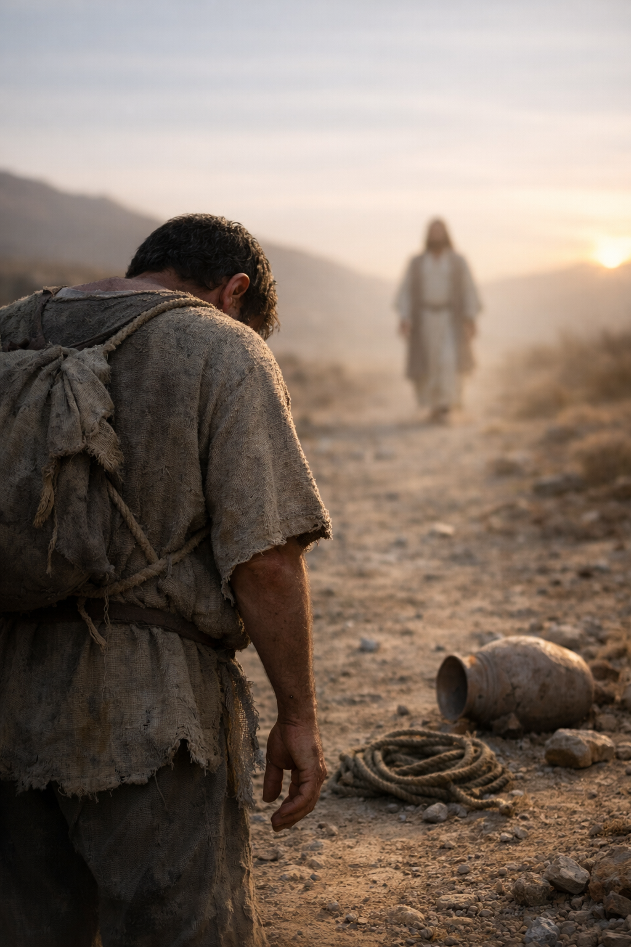
Insight:
Jesus calls the struggling, not the strong
Challenge:
What weight are you carrying that He never assigned?
Hope:
Jesus sees the weight you hide.

Slide 14
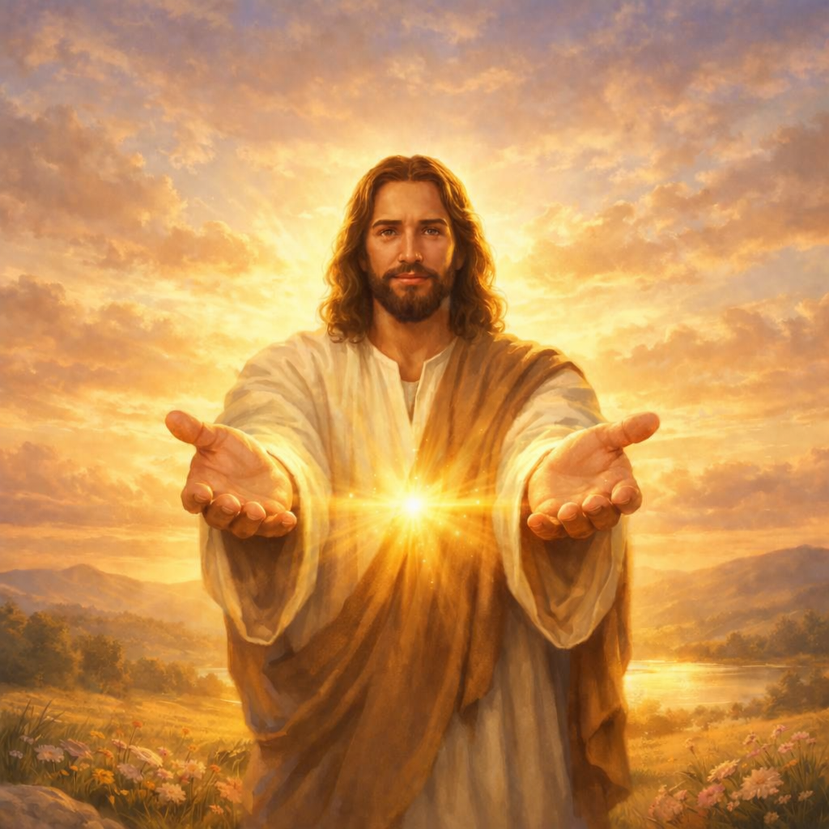
“I WILL GIVE YOU REST”
Greek: revive, refresh, restore.
This is soul rest, not sleep.
Jesus does not say:
“I will help you rest.”
He says: “I will GIVE you rest.”

Slide 15
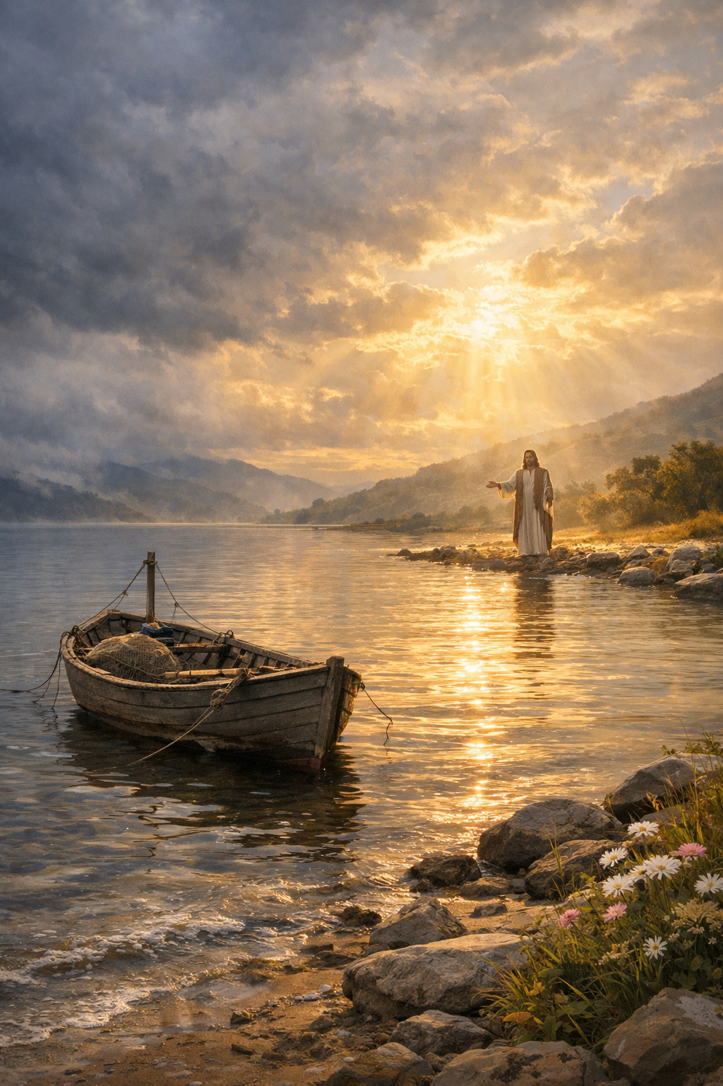
Insight:
Rest is the presence of Jesus in the storm.
Challenge:
Are you trying to earn what He wants to give?
Hope:
Rest is a gift!

Slide 16
R.E.S.T. in Jesus:
  Release — your burdens
  Embrace — His peace
  Surrender — to Christ
  Trust — His promise

Slide 17
ALTAR DECLARATION
Lord Jesus, I come to You just as I am.
I lay down my anxiety, my burdens, my silent battles.
I stop striving to earn what You freely give.
Today I receive Your rest — soul-deep Spirit-breathed.
I am weary no longer, for I have come to You.
In Jesus’ name, Amen.

Slide 18
PRAYER OF RECEIVING
Father, I open my hands to receive all You offer.
I receive Your peace where worry once ruled.
I receive Your grace in place of my striving.
I receive Your strength for every weary place.
What You give, I welcome; what I carry, I release.
In Jesus’ name, Amen.

Slide 19
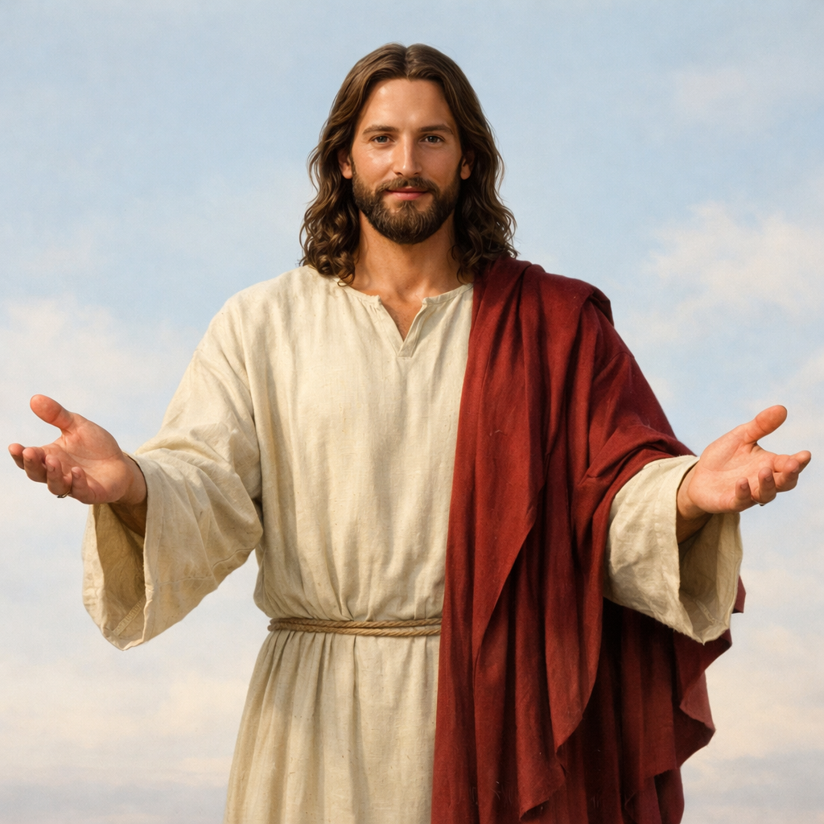

Slide 21
“I AM GENTLE AND LOWLY IN HEART”
Greek:
praus — strength under control
tapeinos — humble, approachable
This is Jesus’ only self‑description.
Pentecostal Insight: His heart is healing, not harsh.
Challenge: Do you believe He is gentle with you?
Hope: You are safe with Him.

Slide 22
PART TWO
TAKE & LEARN — Walk in His Freedom
Matthew 11:29—30
“Take My yoke upon you and learn from Me — and you will find rest for your souls.”
July 5

Slide 23
“TAKE MY YOKE UPON YOU”
Greek: airō — lift, embrace willingly.
A yoke = alignment, not punishment.
Jesus says:
“Stop pulling life alone.
Get in the yoke with Me.”
Pentecostal Insight: His strength becomes your strength.
Challenge: Whose yoke are you wearing?
Hope: Jesus breaks the yoke that was breaking you

Slide 24
“LEARN FROM ME”
Greek: manthanō — learn by staying close.
Jesus offers relationship, not a lecture.
Pentecostal Insight: You learn Jesus by walking with Him.
Challenge: Are you learning Jesus or just learning about Him?
Hope: Jesus is patient with your process.

Slide 25
Who's Your Daddy?
While the family was sitting around the dinner table, Jennifer, 5, turned to her brother Andy, 3, and pointed to her dad.
"That's not your real father," she said, startling the whole family.
"Yes, he is!" Andy replied.
"No, he's not," Jennifer insisted. "God is your heavenly father."
Then pointing at her dad, she said, "That's your homely father!"

Slide 26
“YOU WILL FIND REST FOR YOUR SOULS”
Greek: heurēsete — discover, encounter, experience.
This is felt rest, not theory.
Pentecostal Insight: The Spirit manifests peace.
Challenge: Are you surviving instead of resting?
Hope: Your soul can breathe again.

Slide 27
“MY YOKE IS EASY, MY BURDEN IS LIGHT”
Greek:
chrestos — kind, well‑fitting
elaphros — light, lifted
Jesus says:
“My yoke fits you.
My burden lifts you.
My way frees you.”
Pentecostal Insight: The Spirit lifts, not weighs down.
Challenge: Are you carrying a burden He didn’t design?
Hope: Jesus removes weight — He doesn’t add it.

Slide 28
THE THREE‑STEP RESCUE PLAN
COME — Bring your burden
TAKE — Align with Jesus
LEARN — Walk with Him
Result:
REST — Soul‑deep, Spirit‑breathed, Jesus‑given rest

Slide 29
R.E.S.T. in Jesus:
  Release — your burdens
  Embrace — His peace
  Surrender — to Christ
  Trust — His promise

Slide 30
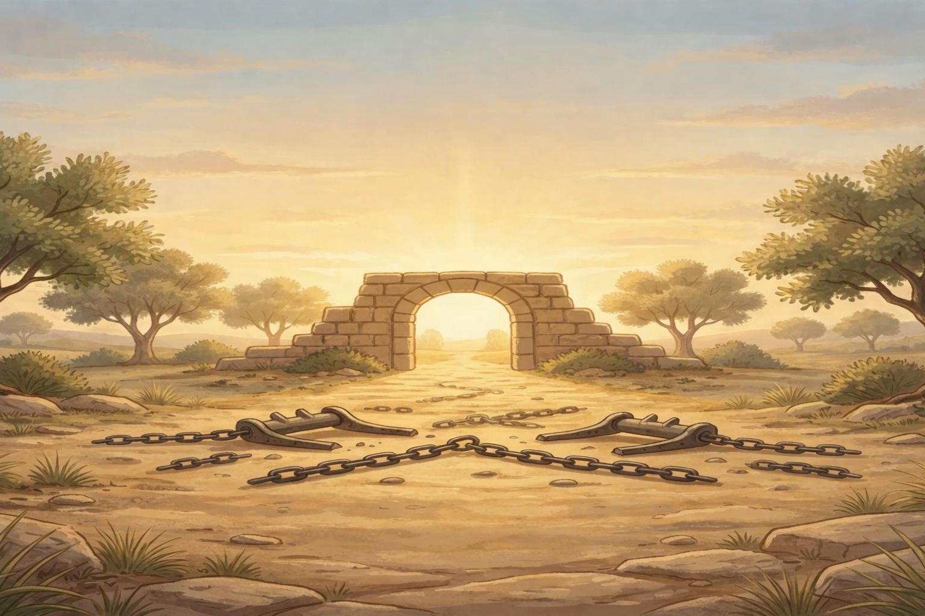
ALTAR DECLARATION
Part Two — Take & Learn
Lord Jesus, I take Your yoke upon me.
I will no longer pull life alone.
I choose to walk close and learn Your gentle and lowly heart.
Your yoke is easy and Your burden is light.
I am yoked to You, and my soul has found its rest.
In Jesus’ name, Amen.

