Slide 1


Slide 2

Spiritual Warfare
10% Satan’s Tactics
90% How We Respond
Remember…
With God We Are Not
Helpless
Hopeless
We Are Powerful!!

Slide 3

Repeat
These are the 2 Most Important Hours of My Week – Help Me to Cherish Them
I Am Here Today to Worship
Not to Be Entertained
I Am Singing to An Audience of One
Accept My Worship Oh Lord!

Slide 4
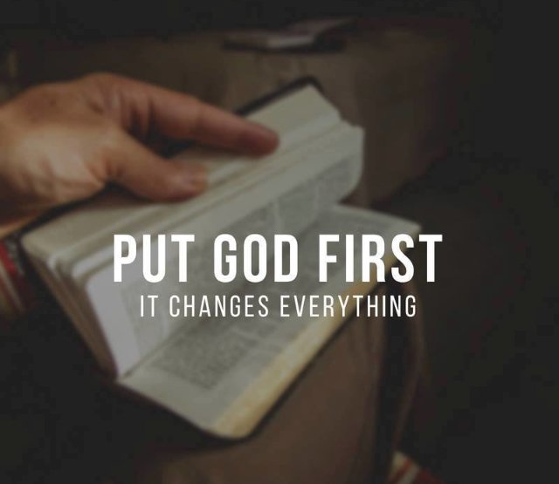
Repeat
I Lift My Offering to You
Let It Please You Oh Lord
This is My Seed
Although It Leaves My Hand
It will Never Leave My Life
You Will Multiply It!
Accept My Seed Oh Lord!

Slide 5
Are You Here To
Go Through The Service
Or Let
The Service Go Through You ?

Slide 6
A MESSAGE ON KINGDOM ALIGNMENT
WHEN PRIORITIES GET SHUFFLED
— And Soul Starts Saying
Something Is Missing
— ◆ —
MATTHEW 6:33

Slide 7
PART ONE
SOMETHING IS MISSING
“But seek ye FIRST the kingdom of God…”
Matthew 6:33

Slide 8
SOMETHING IS MISSING.
…In my marriage
…In my kids
…In my walk with God
In my joy…
…My peace…
…My purpose

Slide 9
MATTHEW 6:33
“But seek ye FIRST the kingdom of God, and His righteousness; and all these things shall be added unto you.”

Slide 10
DEFINITION
FIRST = PROTOS
The chief thing.
The governing thing.
The thing that orders everything else.

Slide 11
GREEK
THE WORD IS: FIRST — PROTOS
Not eventual.
Not convenient.
Not when life slows down.

Slide 12
PROTOS MEANS
THE CHIEF THING
THE GOVERNING THING
THE ORDERING THING

Slide 13
Whatever is FIRST sets the direction for EVERYTHING ELSE.
— ◆ —
God doesn’t bless DISORDER
God blesses DIVINE ORDER

Slide 14
THE CRY OF THE HEART
“Something Is Missing.”

Slide 15
People aren’t wicked — they are weary
They aren’t faithless — they are fragmented
They aren’t broken beyond repair —
they are buried
— ◆ —
The Spirit of God is calling His people back to Divine Alignment.

Slide 16
PAUSE & REFLECT
If everything in your life is running — but your soul still feels empty —
what have you actually been seeking first?

Slide 17
YOU DON’T NEED A NEW LIFE
YOU NEED A NEW ORDER

Slide 18
Not a new spouse — a New PRIORITY
Not a new church — a New ALIGNMENT
Not a new life — a NEW ORDER
Not a new God — put HIM BACK FIRST

Slide 19
Put Him back where He belongs —
FIRST.

Slide 20
SEARCH YOUR HEART
Be honest: if your calendar and your bank statement could preach, what would they say you truly worship?

Slide 21
WHEN GOD IS FIRST —
EVERYTHING ELSE FLOWS

Slide 22
Peace flows.
Wisdom rises.
Joy awakens.
Clarity comes.
The fire falls again.
Strength is renewed.

Slide 23
But if God is fourth…
squeezed in… optional…
then Everything Becomes Unstable.

Slide 24
“Life doesn’t ask permission to rearrange your heart.”

Slide 25
Work expands.
Stress increases.
Marriage gets routine.
Kids get busy.
Church becomes optional.
God becomes “later.”
— ◆ —
Not because God left —
because He got moved.

Slide 26
GOD’S ORDER #1
GOD FIRST #1
Matthew 22:37 — “Love the Lord your God with ALL your heart…”

Slide 27
NOT AN ACCESSORY
He is the axis of all life — the center around which everything else must orbit.
NOT PART OF LIFE
He is the POINT of life — not a chapter in your story, but the Author of it.

Slide 28
NOT OPTIONAL
He is the ordering force of everything — remove Him and all things come undone.
— ◆ —
“When God is first, everything else finds its rightful place.”

Slide 29
A DEEP CHALLENGE
Is God the axis your whole life turns on
or an accessory you reach for only when the crisis comes?

Slide 30
END OF PART ONE
HE IS FIRST — OR
…HE IS NOT LORD
Don’t leave this hour neutral: name the one thing sitting on His throne — and dethrone it today.

Slide 31
THE INVITATION
If God has been moved out of first place, come. Don’t wait for a better week — stand up and settle it at this altar.

Slide 32
The Altar Declaration — Part One
— ◆ —
Today I come off the fence.
I dethrone every idol that replaced God.
What I put first, I put under His feet.
My hunger returns — my fire is relit.
He is not later. He is FIRST.
Here I stand, realigned.

Slide 33
Who Is On First?
— ◆ —
Not my work. Not my name.
Not my comfort. Not my calendar.
I answer with my life, not my words.
Jesus Christ is on first.
He holds the throne — all else follows.
This is my order. I will not move it.
Amen.

