Slide 1


Slide 2

Repeat
These are the 2 Most Important Hours of My Week – Help Me to Cherish Them
I Am Here Today to Worship
Not to Be Entertained
I Am Singing to An Audience of One
Accept My Worship Oh Lord!

Slide 3
Are You Here To
Go Through The Service
Or Let
The Service Go Through You ?

Slide 4

BEAUTY FROM ASHES
The Daughters of Job — Job 42:10–15
Edward Church

Slide 5
BEAUTY FROM ASHES · JOB 42:14–15
A MAN STRIPPED OF EVERYTHING
Job lost his children, his health, his wealth —
and nearly his will to live.
But God was not finished.
The end of Job's story is not tragedy — it is TRIUMPH.

Slide 6
JOB 42:14–15
“He named the first daughter Jemimah, the second Keziah, and the third Keren Happuch.
Nowhere in all the land were there found women as beautiful as Job’s daughters, and their father granted them an inheritance along w- their brothers.”

Slide 7
WHY GOD NAMED THE DAUGHTERS
Names in Hebrew culture declared
IDENTITY and DESTINY
God restored not just Job's wealth —
He Restored LEGACY
Daughters received inheritance equal to sons
Radical in the Ancient World

Slide 8
JEMIMAH — THE FIRST DAUGHTER
THE NAME MEANS
“Bright as Day” · “Dove”
Symbol of Peace, Purity, and New Beginnings

Slide 9
JEMIMAH — THE INSIGHT
The dove — a Sign that the Waters of
Affliction have Receded. (Genesis 8)
The Holy Spirit Descended as a Dove.
The Presence and Power of God (Matt 3:16)

Slide 10
JEMIMAH — THE INSIGHT
The First Fruit of Restoration is
Not Wealth, nor Health
…it is PEACE.

Slide 11
“WHAT GOD NAMES — HE CLAIMS!”
Jemimah means Peace.
  When God restores you,
  He doesn’t just give you things back —
He gives you PEACE that Passes Understanding!
The DOVE of Heaven is Hovering Over Your Life RIGHT NOW.

Slide 12
WHAT HAS THE ENEMY STOLEN?
Lie #1
“You will never have peace again.”
Truth
→ HE NAMES YOU JEMIMAH — PEACE

Slide 13

WHAT HAS THE ENEMY STOLEN?
Lie #2
“Your best days are behind you.”
Truth
→ YOUR LATTER SHALL BE GREATER

Slide 14
WHAT HAS THE ENEMY STOLEN?
Lie #3
“God has forgotten your name.”
→ HE KNOWS YOU BY NAME (Isa 43:1)

Slide 15
GOD’S TRUTH OVER THE LIE
“The thief comes only to steal, kill and destroy…” John 10:10a
“…I have come that they may have life, and have it to the full.” John 10:10b
“I have called you by name — you are MINE.” Isaiah 43:1

Slide 16
KEZIAH — THE SECOND DAUGHTER
THE NAME MEANS
“Cassia”
a fragrant spice used in
Holy Anointing Oil
Exodus 30:24

Slide 17
KEZIAH — THE SECOND DAUGHTER
This name says:
God anointed what the enemy tried to bury
Keziah is proof that your pain was not wasted
…it produced a FRAGRANCE

Slide 18
YOUR SUFFERING HAS A SCENT
“Cassia only releases its fragrance under pressure.
So does the child of God.”
Named for the spice that anointed KINGS and PRIESTS.
You have been Crushed — but ANOINTED.

Slide 19
“YOUR PAIN WAS YOUR PREPARATION!”
Keziah was not named inspite of her
…father’s suffering
She was named BECAUSE of it.
The Anointing on your life came
OUT OF THE FIRE!
What the enemy Meant For Destruction,
God turned into PERFUME!

Slide 20
KEREN HAPPUCH — THE THIRD DAUGHTER
THE NAME MEANS
“Horn of Eye Paint” or “Horn of Beauty”

Slide 21
KEREN HAPPUCH — THE THIRD DAUGHTER
In Hebrew culture, beauty was associated with
Radiance, Abundance, and Honor.
The horn symbolizes Strength and Glory.

Slide 22
KEREN HAPPUCH — THE THIRD DAUGHTER
God saved Most Extravagant name for LAST.
After loss, shame, and suffering —
God gives Job a daughter named GLORY.

Slide 23
KEREN HAPPUCH — THE THIRD DAUGHTER
He Restores the Beauty
…That Pain Tried To Take.

Slide 24
HAVE YOU GIVEN UP ON YOUR BEAUTY?
God is Asking You Today
Have you stopped Believing…
…that Restoration is Possible for YOU?

Slide 25
HAVE YOU GIVEN UP ON YOUR BEAUTY?
Have you let grief Convince you
…that your BEST SEASON HAS PASSED?

Slide 26
HAVE YOU GIVEN UP ON YOUR BEAUTY?
Keren Happuch says: God saves the
GREATEST thing for LAST.
“For I know the plans I have for you — plans to prosper and not to harm.” Jer 29:11

Slide 27
THREE DIMENSIONS OF RESTORATION
1 JEMIMAH — Peace Restored
2 KEZIAH — Purpose Restored
KEREN HAPPUCH — Praise Restored
“the LORD blessed the latter part of Job’s life more than the former part.” Job 42:12

Slide 28
A PROGRESSIVE REVELATION
God gives Peace FIRST.
BEFORE the Blessings Come,
He CALMS the Storm Inside you.

Slide 29
A PROGRESSIVE REVELATION
Your suffering is Redeemed.
The fragrance of Anointing
rises from your ASHES.
The FINAL ACT of God is always MORE GLORIOUS than WHERE YOU BEGAN.

Slide 30
WHAT JOB 42:14–15 REVEALS ABOUT GOD
GOD OF NAMES —
He calls you by name.
GOD OF REVERSAL —
What was lost is not lost forever.
GOD OF INHERITANCE —
He includes you in His legacy.
GOD OF BEAUTY —
He makes beauty from broken pieces.

Slide 31
WHAT THIS MEANS FOR YOU — TODAY
RECEIVE your New Name —
Stop IDENTIFYING with your Pain
Start WALKING in your God-Given Destiny

Slide 32
WHAT THIS MEANS FOR YOU — TODAY
TRUST the Process —
Jemimah, Keziah, and Keren Happuch
came AFTER the suffering,
not during.

Slide 33
WHAT THIS MEANS FOR YOU — TODAY
RELEASE the Ashes —
God Cannot Build Your Beauty
while You Hold Onto Yesterday’s Rubble.

Slide 34
COME TO THE GOD WHO RESTORES
If the enemy has stolen
Your Peace, Fragrance, Beauty —
God is calling you to the altar RIGHT NOW.
He Restored Job. He Will Restore YOU.

Slide 35
COME TO THE GOD WHO RESTORES
“Though your beginning was small, your latter days will be very great.” Job 8:7
Who needs a word of restoration tonight?

Slide 36
SPEAK IT OVER YOUR LIFE
Repeat after me
“I am JEMIMAH —
I Walk in the Peace of God!”
“I am KEZIAH —
I Carry the Fragrance of the Anointing!”

Slide 37
SPEAK IT OVER YOUR LIFE
“I am KEREN HAPPUCH —
My Beauty is Being Restored!”
“The Latter Part of My Life
is GREATER than the Former!”

Slide 38
SPEAK IT OVER YOUR LIFE
“God Has Not Forgotten My Name
and He Will Not Forget My Story!”

Slide 39
TO GOD BE THE GLORY
He Restores. He Redeems. He Renames.
“And the LORD blessed the latter part of Job’s life more than the former part.” Job 42:12
BEAUTY FROM ASHES
THE DAUGHTERS OF JOB

Slide 40
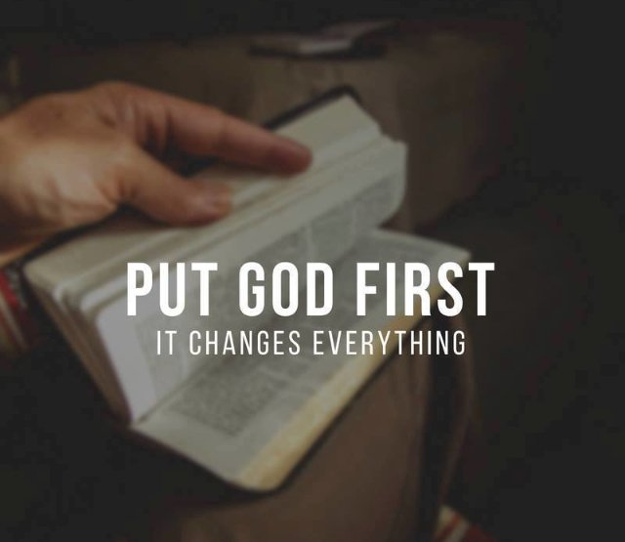
Repeat
I Lift My Offering to You
Let It Please You Oh Lord
This is My Seed
Although It Leaves My Hand
It will Never Leave My Life
You Will Multiply It!
Accept My Seed Oh Lord!

Slide 41

Spiritual Warfare
10% Satan’s Tactics
90% How We Respond
Remember…
With God We Are Not
Helpless
Hopeless
We Are Powerful!!

