Slide 1


Slide 2

Spiritual Warfare
10% Satan’s Tactics
90% How We Respond
Remember…
With God We Are Not
Helpless
Hopeless
We Are Powerful!!

Slide 3

Repeat
These are the 2 Most Important Hours of My Week – Help Me to Cherish Them
I Am Here Today to Worship
Not to Be Entertained
I Am Singing to An Audience of One
Accept My Worship Oh Lord!

Slide 4
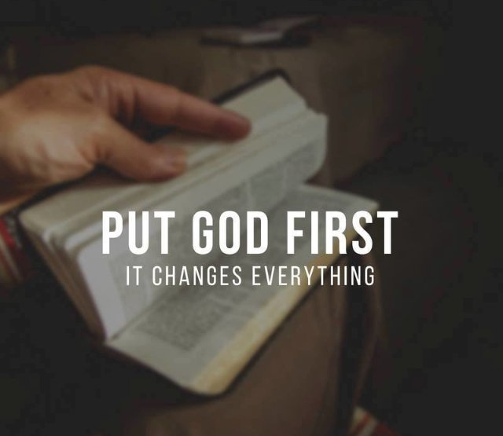
Repeat
I Lift My Offering to You
Let It Please You Oh Lord
This is My Seed
Although It Leaves My Hand
It will Never Leave My Life
You Will Multiply It!
Accept My Seed Oh Lord!

Slide 5
Are You Here To
Hide Behind the Service
Or Let
The Service Expose and Heal Your Wounds ?

Slide 6
GETTING BACK UP
Don't Just Lay There
Micah 7:8
A Message for Everyone Who Has Ever Been Knocked Down

Slide 7
PART ONE
WHEN I FALL
THE TRUTH ABOUT THE FLOOR.
Everybody falls.
Nobody schedules it.
Micah wrote from the valley, not the mountaintop.
First- we tell the truth about the floor.
God meets you exactly where you landed.

Slide 8
Rejoice not against me, O mine enemy: when I fall,
I shall arise;
when I sit in darkness,
the LORD shall be a light unto me.
Micah 7:8 (KJV)
Read it slowly
Let it land
This verse was written for this exact moment in your life

Slide 9
SOMEBODY IN THIS ROOM
— Has been carrying something too heavy to name.
— Has been smiling on the outside and breaking inside.
— Has fallen and is ashamed that anyone found out.
— Has prayed and wondered if God even heard.
— Has almost given up on getting back up.

Slide 10
SOMEBODY IN THIS ROOM
This sermon is for you.
You are not here by accident.
God sent this word to your exact address today.

Slide 11
WHY WE FALL
— Sin pulls us past every line we swore we would not cross.
— Grief strips the strength right out of our bones.
— Betrayal enters through doors we left unlocked.

Slide 12
WHY WE FALL
— Exhaustion quits before the victory arrives.
— Pressure cracks what we believed was unbreakable.
— Spiritual drift is always silent until the fall is deafening.

Slide 13
WHY WE FALL
Powerful Truth —
You did not fall because God forgot you.
You fell because you are human.
God already planned your rise before
the fall ever happened.

Slide 14
HE DID NOT SAY IF OR MAYBE
When I fall...
I SHALL ARISE
This is a Spirit-Breathed Declaration
backed by the Resurrection Power of God.
Say It Out Loud. Heaven Is Listening.
Hell Is Trembling.

Slide 15
WHY WE STAY DOWN
— Shame convinces us the floor is all we deserve.
— Fear whispers that everyone is watching.
— The enemy repeats: This is where you belong now.
— We tried to rise before and hope got expensive.
— We feel too tired, too broken, too far from grace.
— WE FORGOT THAT GOD NEVER ONCE LEFT THE ROOM.

Slide 16
WHY WE STAY DOWN
The floor feels familiar
But it was never your home
CHALLENGE —
Which Lie Has Had The Most Power Over You?
Call It Out By Name.

Slide 17
THE CONTEXT OF THE FALL
Micah was not on a mountaintop.
He was in the valley — just like you.
God Does Not Wait For Your Circumstances To Improve.
He speaks Through the Broken,
the Bent, and
the Barely Standing.

Slide 18
NOT VICTORY — VULNERABILITY
THE ENEMY EXPECTED
MICAH CHOSE
Silence
Prayer
Surrender
Declaration
Defeat
Holy Defiance
CHALLENGE —
What are you choosing right now:
Silence or Declaration?
Open your MOUTH before you open the Door to Despair.

Slide 19
The enemy saw the fall.
God saw the future rise.
Ephesians 2:10 — You are His workmanship,
created in Christ Jesus for good works.
CHALLENGE —
Stop replaying what the enemy said.
Start declaring what God says about your future.

Slide 20
WHEN I FALL
Hebrew — to collapse, to drop,
to lose all strength, to be cast down.
God Never Promised A Life Without Falling.
The Spirit was not shocked.
He was Already At The Bottom —
WAITING TO LIFT YOU.

Slide 21
THEY ALL FELL. THEY ALL ROSE.
DAVID
Fell into sin. Rose as the man after God's own heart
PETER
Fell with a curse on his lips. Rose Preached The Sermon That Birthed The Church At Pentecost.
ELIJAH
Fell begging God to let him die. Rose to anoint kings/ train a generation of prophets.

Slide 22
THEY ALL FELL. THEY ALL ROSE.
SAMSON
Fell through lust and compromise. Rose in his Final Breath to destroy More Of The Enemy than in his Entire Lifetime.
THE PRODIGAL
Fell face-first in a pigpen. Rose to find his father already running down the road toward him.
They ALL had a Powerful Moment when,
the Spirit Overrode Failure and Ignited their Future.
CHALLENGE
Your name belongs on this list.
STOP DISQUALIFYING YOURSELF.

Slide 23
FALLING DOES NOT
✕ Disqualify you.
✕ Define you.
✕ Destroy you.
Falling is Human.
Rising is Holy.

Slide 24
YOUR FALL DOES NOT DEFINE YOU
The church has WOUNDED MORE PEOPLE
by Condemning The Fallen than the World Ever Has.
YOU ARE IN A SAFE PLACE.
CHALLENGE
Write the label shame gave you.
Cross It Out.
Write: Forgiven. Restored. Still called. Still chosen.

Slide 25
I SHALL ARISE
Hebrew: to stand, to be lifted,
to rise with strength and power.
Romans 8:11 —
The Spirit that raised Jesus from the dead lives inside you.
Your rise is not just possible. It is supernatural.

Slide 26
Grace Is the Lifting Power
Not Self-Powered. God-Powered.
▶ Grace Forgives you —
…it wipes the record clean.
▶ Grace Repositions you —
…back inside God's story.
▶ Grace Resurrects you —
…it raises what shame buried.

Slide 27
It does not lift you back to where you were.
It lifts you to where God always intended.
Power Truth —
When The Holy Ghost Lifts You,
He Releases The Version Of You …
… Enemy Has Always Feared.

Slide 28
CHALLENGE
Stop dragging yourself back to a floor
Grace Already Lifted You From.
Step 1 — Confess it.
Step 2 — Receive it.
Step 3 —Get Up! Now!

Slide 29
Come as you are. Come right now.
If you are tired of the floor — come.
If shame does all the talking — come.
If you fell in silence — come.
If you need to re/ dedicate your life to Christ — come
Nobody is judging. Heaven is waiting.
You do not have to clean yourself up to come.
Come — and let GRACE DO THE LIFTING.

Slide 30
ALTAR DECLARATION
Say it out loud right where you stand:
My fall is real — but it is not final.
I am not staying down on this floor.
Grace has already reached me here.
In Jesus' name — I receive the lifting.
Say it once for the fall.
Say it again for the rise.

Slide 31
GRACE ALREADY
REACHED THE FLOOR.
I did not fall out of God’s Hand.
I fell into His Mercy.
Shame said stay down. Grace said Stand Up.
My record is clean and My story is not finished.
Hold on to that — because Part Two is where you rise.

Slide 32
GETTING BACK UP
Micah 7:8

