Slide 1


Slide 2

Spiritual Warfare
10% Satan’s Tactics
90% How We Respond
Remember…
With God We Are Not
Helpless
Hopeless
We Are Powerful!!

Slide 3

Repeat
These are the 2 Most Important Hours of My Week – Help Me to Cherish Them
I Am Here Today to Worship
Not to Be Entertained
I Am Singing to An Audience of One
Accept My Worship Oh Lord!

Slide 4

I am Fre

Slide 5
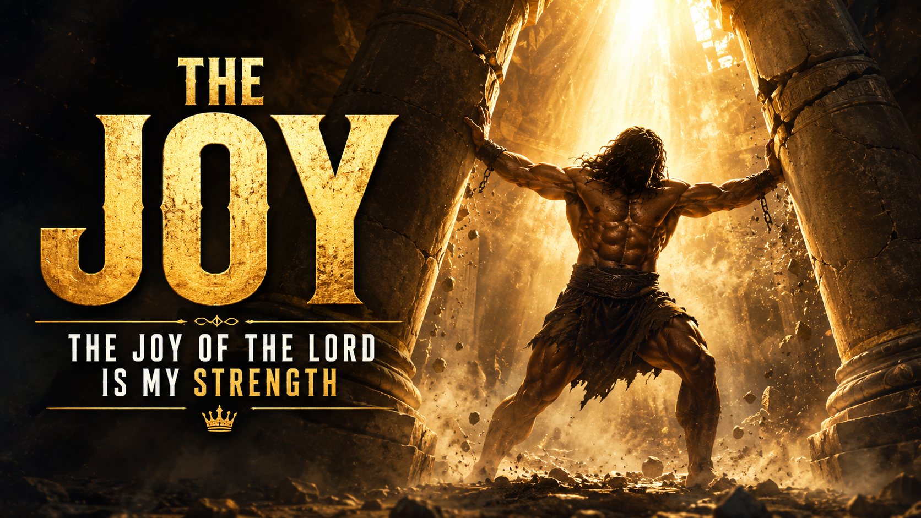
The Joy

Slide 6
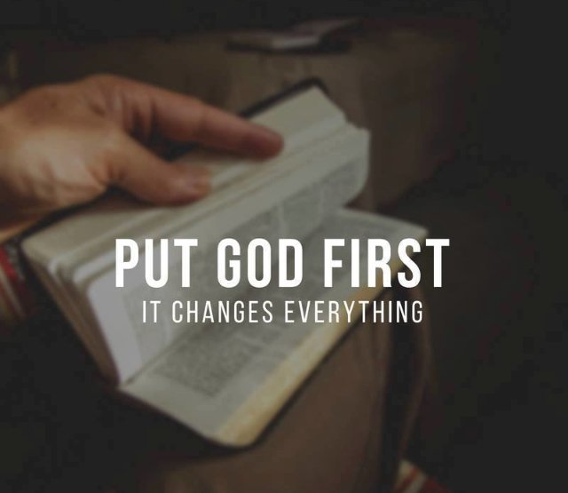
Repeat
I Lift My Offering to You
Let It Please You Oh Lord
This is My Seed
Although It Leaves My Hand
It will Never Leave My Life
You Will Multiply It!
Accept My Seed Oh Lord!

Slide 7
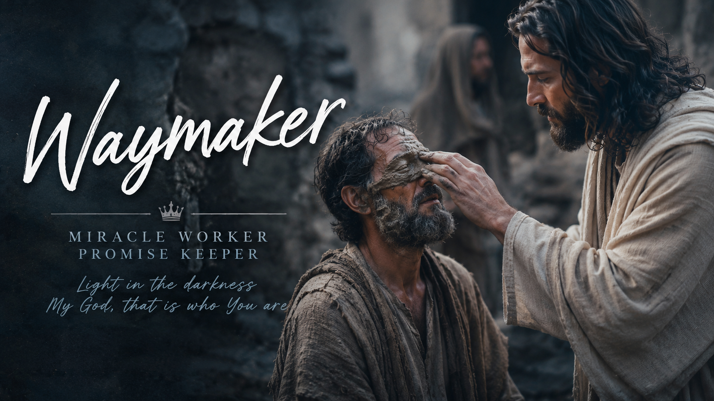
Waymaker

Slide 8
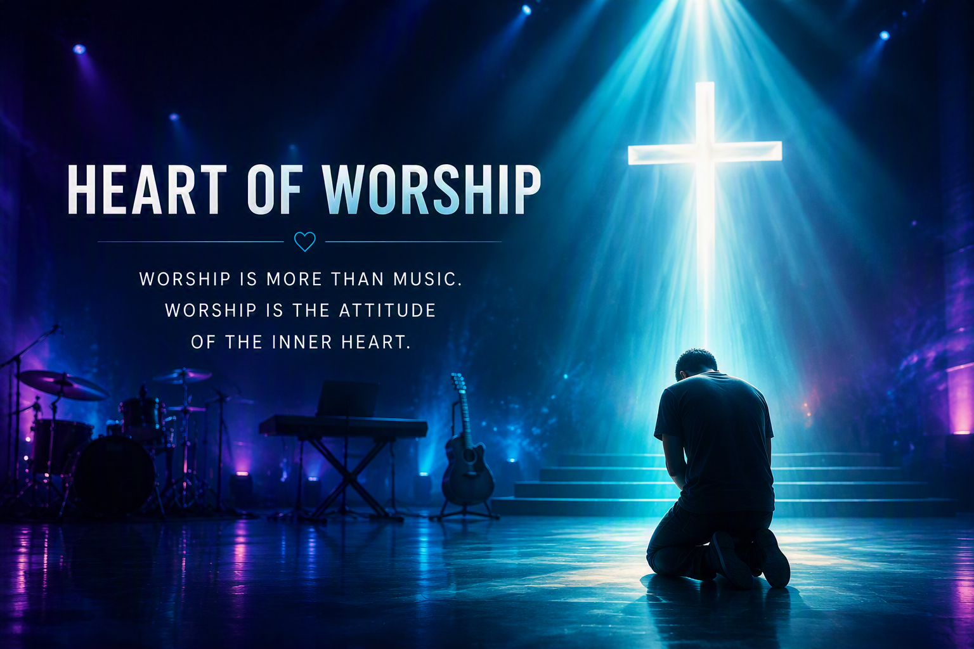
Hear of WOr

Slide 10
Are You Here To
Hide Behind the Service
Or Let
The Service Expose and Heal Your Wounds ?

Slide 11
PART TWO
I Shall Arise
Micah 7:8
When I Fall, I Shall Arise — The Comeback Begins Now

Slide 12
PART TWO
I SHALL ARISE
THIS IS THE COMEBACK
Part One told the truth about the fall
Part Two Declares the Truth about the Rise
The enemy CELEBRATED far TOO EARLY
What God RAISES UP is what hell ALWAYS FEARED

Slide 13
THE PREMATURE PARTY
THE ENEMY'S CELEBRATION
IS PREMATURE.
Micah looked the Enemy Dead In The Eye and said…
Do not rejoice over me.
NOT YET. NOT EVER!
The enemy threw a party BEFORE obituary was written.
God has already SIGNED the RESURRECTION NOTICE.

Slide 14
TWO DIFFERENT VIEWS
THE ENEMY SEES
GOD SEES
Your failure
Your collapse
Your worst moment
Your weakness
Your future
Your comeback
Your purpose
Your worship

Slide 15
TWO DIFFERENT VIEWS
THE ENEMY SEES
GOD SEES
People COUNTED YOU OUT Because They SAW THE FALL
God COUNTS YOU IN Because He PLANNED THE RISE
CHALLENGE
Who Is Defining Your Story:
The Enemy Or Your Father?

Slide 16
THE RISE
WHAT GETTING BACK UP
LOOKS LIKE
The Rise Is Not A Feeling
It Is A Decision
Acts 3:6 — Peter did not say I feel something rising.
He said: Rise and walk. In the name of Jesus — RISE.

Slide 17
THE RISE: FOUR DIMENSIONS
SPIRITUALLY
EMOTIONALLY
Reignite prayer.
Reopen the Word.
Walk back into worship…
…even when it costs you.
The enemy is terrified of a…
…wounded believer
…who still prays.
Your scars are not shame…
..they are proof you survived
Hope is the refusal to let pain
…have the final word.
You may rise with tears…
…That is STILL RISING.

Slide 18
THE RISE: FOUR DIMENSIONS
RELATIONALLY
IN YOUR CALLING
Forgive the ones who counted you out.
Set firm limits with anyone
still pulling you under.
Walk forward — even if you
walk forward alone.
Your fall did not cancel your assignment.
Your failure did not void your
anointing.
What God placed in you is
stronger than what life threw
at you.

Slide 19
THE RISE: FOUR DIMENSIONS
CHALLENGE —
Pick one dimension.
What one step will you take TODAY?
Not next week.
Today.

Slide 20
THE POWER MOMENT
The Rise After the Fall.
The God interrupts your grief …
…and turns your mourning into a war cry.
Joel 2:25- I will restore to you the years the locust has eaten.
This is not a promise for SOMEONE ELSE.
This is YOUR RESTORATION SEASON.

Slide 21
NOT I MIGHT. NOT I HOPE.
I SHALL ARISE!
This is faith. This is revival.
This is the refusal to die where you fell.
The Holy Ghost has not finished His work in you yet.
Every devil assigned to keep you down just heard you!
Say it again. Louder. Let it shake the atmosphere over you

Slide 22
FOUR ANCHORS OF HOPE
1.
God is not finished with you —
…as long as breath is in your body,
…purpose still lives in your future.
2.
Your fall is not final —
…failure is always an event, never an identity.

Slide 23
FOUR ANCHORS OF HOPE
3.
Your rise will be public
the same people who saw you fall
will watch God raise you back up
4.
Your comeback will exceed your collapse
God restores to the level He intended,
not the level you lost

Slide 24
FOUR ANCHORS OF HOPE
Zechariah 9:12- You are not a prisoner of your past
You are a prisoner of HOPE
CHALLENGE
Write one thing you still believe God for
Speak it out loud right now

Slide 25
This is your moment.
GET UP AGAIN
Not after the shame lifts
Not when people believe in you again
Not when the circumstances change
RIGHT NOW
The Holy Ghost is waiting for your will to move
One step of obedience activates His power

Slide 26
GET UP FROM
— Disappointment that told you God had forgotten you.
— Sin that said you had gone too far to come back.
— Grief that settled in like it owned the place
— Fear that froze every step you tried to take.
— Shame that made you hide from the God running to you
— The grave you thought was your permanent address.

Slide 27
GET UP !
You are Rising
You are Recovering
You are Returning
CHALLENGE
Name what you are getting up from today.
Name it — then RISE.

Slide 28
WHEN I FALL... I SHALL ARISE.
The darkness did not win.
The fall was not final.
The grave was not permanent.
You came in carrying the weight of the fall.
You leave carrying the declaration of your rise.

Slide 29
ALTAR DECLARATION
I am not defined by my fall.
I am not finished and I am not forgotten.
God's grace is lifting me right now.
I declare in Jesus’ Name
I SHALL ARISE.

Slide 30
LET US PRAY
Father, I come to You broken but believing.
I have fallen — but I refuse to stay down.
Your Word says when I fall, I shall arise.
I receive that promise right now by faith.
Lift me. Restore me. Reposition me.
Place me into everything You created me to be.
The enemy does not get the final word — You do.
And Your Word says — ARISE.
In the Name of Jesus — Amen.

Slide 31
THE FALL WAS NOT FINAL.
NOW GO AND RISE.
You came in carrying the weight of the fall.
You leave carrying the declaration of your rise.
Micah 7:8 — When I fall, I shall arise.
Go live it. Go declare it. GO RISE.

