Slide 1


Slide 2

Spiritual Warfare
10% Satan’s Tactics
90% How We Respond
Remember…
With God We Are Not
Helpless
Hopeless
We Are Powerful!!

Slide 3

Repeat
These are the 2 Most Important Hours of My Week – Help Me to Cherish Them
I Am Here Today to Worship
Not to Be Entertained
I Am Singing to An Audience of One
Accept My Worship Oh Lord!

Slide 4
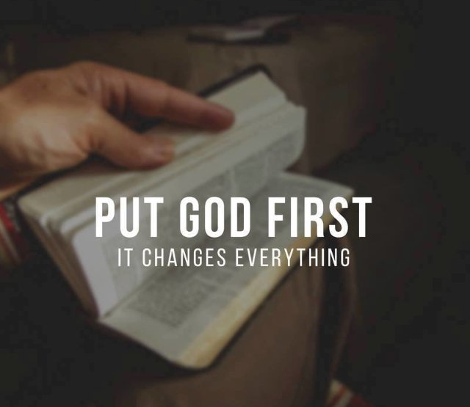
Repeat
I Lift My Offering to You
Let It Please You Oh Lord
This is My Seed
Although It Leaves My Hand
It will Never Leave My Life
You Will Multiply It!
Accept My Seed Oh Lord!

Slide 6
Edward Church
HOW LONG HAS IT BEEN
SINCE YOU JUST LAUGHED?
The Soulwork of Spiritual Resilience
For every wounded soul in the pew.

Slide 7
You cannot pour from an
EMPTY SOUL.
Resilience is the SACRED CAPACITY
to be BROKEN — and RISE.
— SPIRITUAL RESILIENCE

Slide 8



R
RESILIENCE DEFINED
What It Means to Bounce Back
Not absence of pain —
…presence of purpose
Not pretending —
…choosing to heal
Capacity to be bent —
…never broken

Slide 9
GENESIS 18 & 21
Sarah Laughed.
Twenty-five years of waiting.
Every silent year…
…a wound
God had not forgotten her name.
Neither has He forgotten yours.

Slide 10
LAUGH #1 — DISBELIEF
She Laughed to Herself
What Kind of Laugh?
GENESIS 18:12
Not joy.
A hollow laugh —
too good to be true.
Hidden.
Ninety years old.
Disappointed too many times to believe again.

Slide 11
CHALLENGE
Can I ask you something ?
How Many Times…
Have you had quiet laugh that says —
“Nice sermon, but you do not know my pain.”
God is not offended by your disbelief.
He waits for you to stop hiding it.
Bring Him your hollow laugh.

Slide 12
CHALLENGE
In Your Wilderness
Still standing?
Still praying?
Still showing up?
Do not quit in the middle of the story
It’s Not your destination.
It’s Your passage.

Slide 13
LAUGH #2 — THE WILDERNESS
Between Genesis 18 and 21 — there is silence.
The laugh of still waiting.
Another Sunday. Another season. Another year.
Same prayer.
Feels Like the Laugh is On Her
Sarah did not know chapter 21 was coming
But God was already there.

Slide 14

LAUGH #3 — THE LAUGH OF JOY
"GOD HAS BROUGHT ME LAUGHTER."
Genesis 21:6
Not nervous laughter. She refused to stop hoping until the promise found her.
She named him Isaac — Laughter.
What God restored, she could hold.
“All who hear will laugh with me.” — Genesis 21:6

Slide 15

CHALLENGE
Your joy is not just for you.
Sarah laughed — everyone heard.
Isaac walked as living proof.
When God restores your laugh,
will you let people hear it?
Your testimony is someone’s lifeline.

Slide 16



HOW RESILIENCE WORKS
The Four Movements of the Soul
1
ACKNOWLEDGE
—
Name the wound.
2
LAMENT
—
Grief to God first.
3
RECEIVE
—
Let others carry it.
4
RETURN
—
Different, not destroyed.

Slide 17




THE SCIENCE OF LAUGHTER
40%
STRESS HORMONES
80%
TRAUMA SURVIVORS
PROVERBS 17:22
“A merry heart does good like a medicine.”

Slide 18



PERMISSION TO LAUGH AGAIN
Why the Church Needs This Most.
Grief and joy are not opposites.
Laughter is not a betrayal.
Joy is not naive — it is defiance.
You have carried this long enough. God is not asking you to stay broken.

Slide 19




THE PRACTICES
Building a Resilient Soul.
SABBATH — Rest is obedience.
1
LAMENT — Scream at God.
2
COMMUNITY — Never alone.
3
HUMOR — Protect laughter.
4

Slide 20
THE ANCHOR
“
Even youths grow tired and stumble,
but those who hope in the Lord
will renew their strength.
”
— Isaiah 40:29

Slide 21
WHEN DID YOU LAST LAUGH?
Not cope. Not manage. LAUGH.
Sarah laughed in the dark.
Then she laughed again — and everyone joined in.
Your joy is an act of resistance.

Slide 22
THE DECLARATION
“
I am not broken beyond repair.
God is not finished with me.
I will not carry this alone.
My joy is coming back.
”
Say it out loud. Say it together.

Slide 23
THE DECLARATION · II
“
I will rest without guilt.
I will lament without shame.
I will laugh without apology.
The joy of the Lord is my strength.
”
Louder. One more time.

Slide 24
Go · Rest · Heal · Laugh
The Soulwork of Resilience
“The joy of the Lord is your strength.” — Neh 8:10
For every soul who wondered if God laughs.

