Slide 2
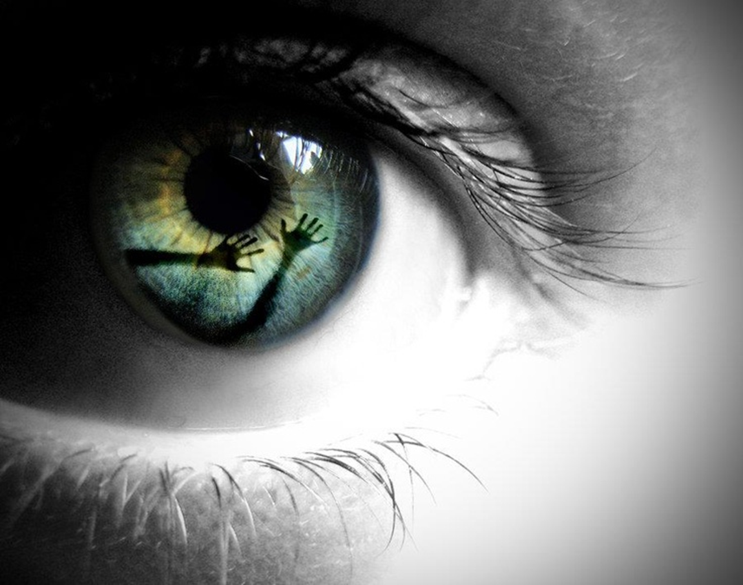
Shedding the…
…Perspective Trap
…in 2017
Matthew 4:1-11
New Year –New Mindset
Edward Church
January 1, 2017

Slide 3
Matthew 4:1-11 (KJV) ¹ Then was Jesus led up of the Spirit into the wilderness to be tempted of the devil. ² And when he had fasted forty days and forty nights, he was afterward an hungered. ³ And when the tempter came to him, he said, If thou be the Son of God, command that these stones be made bread. ⁴ But he answered and said, It is written, Man shall not live by bread alone, but by every word that proceedeth out of the mouth of God.
⁵ Then the devil taketh him up into the holy city, and setteth him on a pinnacle of the temple, ⁶ And saith unto him, If thou be the Son of God, cast thyself down: for it is written, He shall give his angels charge concerning thee: and in their hands they shall bear thee up, lest at any time thou dash thy foot against a stone. ⁷ Jesus said unto him, It is written again, Thou shalt not tempt the Lord thy God.
⁸ Again, the devil taketh him up into an exceeding high mountain, and sheweth him all the kingdoms of the world, and the glory of them; ⁹ And saith unto him, All these things will I give thee, if thou wilt fall down and worship me. ¹⁰ Then saith Jesus unto him, Get thee hence, Satan: for it is written, Thou shalt worship the Lord thy God, and him only shalt thou serve.
¹¹ Then the devil leaveth him, and, behold, angels came and ministered unto him.

Slide 4
The Perspective Trap
Short…
…Sweet
…To
…The
…Point
Satan Knows that God Seeks to…
  Use Us
  Empower Us
  Keep Our Eyes on Him
So in Order to Stop Us…
…Satan Uses Our Flesh
…to Set a Trap
…Involving Our Perspective

Slide 5
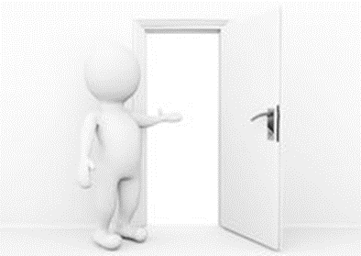
The Trap
Short…
…Sweet
…To
…The
…Point
The Trap Occurs…
…When We Get Eyes
      Off God
      Onto Self
      Out of Perspective

Slide 6

The Door
The Trap is Usually Set at the Door of Opportunity
  Door
    Self- Awareness (Where I’m At)
    Self- Identity (Who I Am)
    Self- Assessment (What I am to Do)
  Disrupt – the power of God flowing thru our lives
  Drain – our faith
  Deteriorate – our opportunity

Slide 7
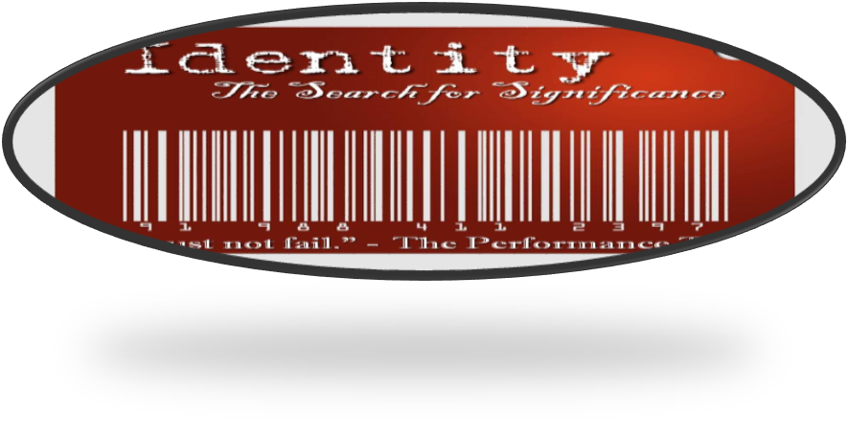
Jesus is Our Example…
…Under Pressure of the Perspective Trap
Direct Confrontation with the Devil…
  alone in the wilderness
  harsh circumstances, Jesus won
  entry points, our “Achilles’ heel”.
  exposes our vulnerabilities,
  else they won’t be very much of a temptation.
These are the same vulnerable areas we need to take heed to
Remember For we do not have a high priest who cannot sympathize with our weaknesses, but One who has been tempted in all things as we are, yet without sin. Heb 4:15

Slide 8

Jesus is Our Example…
…Under Pressure of the Perspective Trap
Heaven Opens. Spirit descends like a dove- The Father speaks
“This is my Son, whom I love; with Him I am well pleased.”
  • No Ministry or Miracle.
  Yet He receives affirmation he is deeply loved.
  Immediately –Mark says Driven by into Wilderness.
The devil Came with Three Powerful Temptations,
…Hitting At His Identity Before God
…throws the same temptations at us
He said to Jesus: "If you are the Son of God…

Slide 9
Lord Help Me…
…Get Out of My
…Perspective Trap

Slide 10
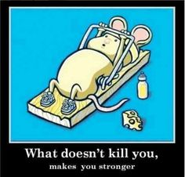
Trap #1: You Are “What You Do” (3)
YOU ARE WHAT YOU DO (Performance Trap)
The devil would like to you think that your value is in what you do.
Jesus had not yet begun His ministry at this point.
  He had nothing to show. (lowly carpenter
  For 30 years, He had done ‘nothing’ great.
  No one has yet to believe him?
Our culture asks the same question.
  Show me what you’ve achieved?
  What can you do?
We See Ourselves as Worthwhile Only IF…
  You don’t have to prove anything.
  You are already deeply loved and highly favored in God’s eyes.

Slide 11
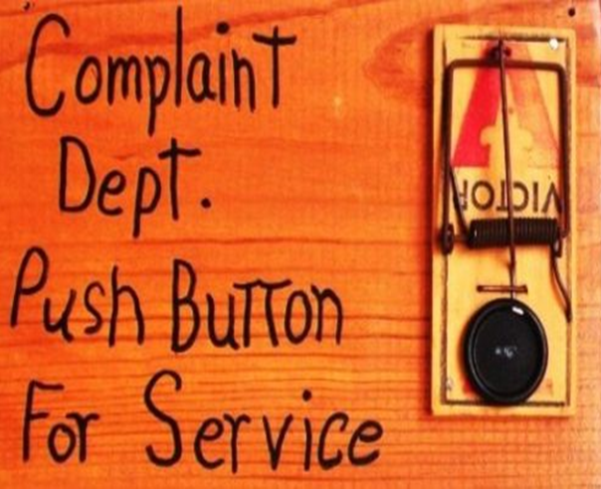
Trap #2: You Are “What Others Think” (6)
YOU ARE WHAT OTHERS THINK (Popularity Trap)
  Are you affected by what others think?
Throw Yourself down from highest spot of temple so people believe
  • He was an unknown. How could he think he had worth ?
  • He would so important that even angels will come and save him.
    We place a high premium what other people think of us
    What really matters - Who I am in Christ.
    Do your best to please God, not men.
True freedom comes when you don’t need to be big in other’s eyes.
• Rest in How God thinks of You -
Meditate Upon It Again And Again.

Slide 12
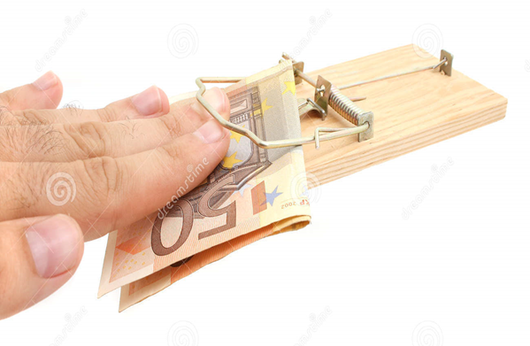
Trap #3: You Are “What You Have” (8-9)
YOU ARE WHAT YOU HAVE (Possession Trap)
Jesus was taken to see all the magnificence of the earth.
  • You look believe what you have defines you.
Our culture measures our success by WHAT YOU OWN.
  • We begin to compare –most money, nicest house?
  • Our sense of worth is tied to our possessing these things.
  • Nothing wrong with having things. But they don’t define us.
Jesus sees himself as the Son immensely loved by his Father
and found his personal fulfilment in hearing his Father say:
“You are my Son, whom I love; with you I am well pleased.”

Slide 13
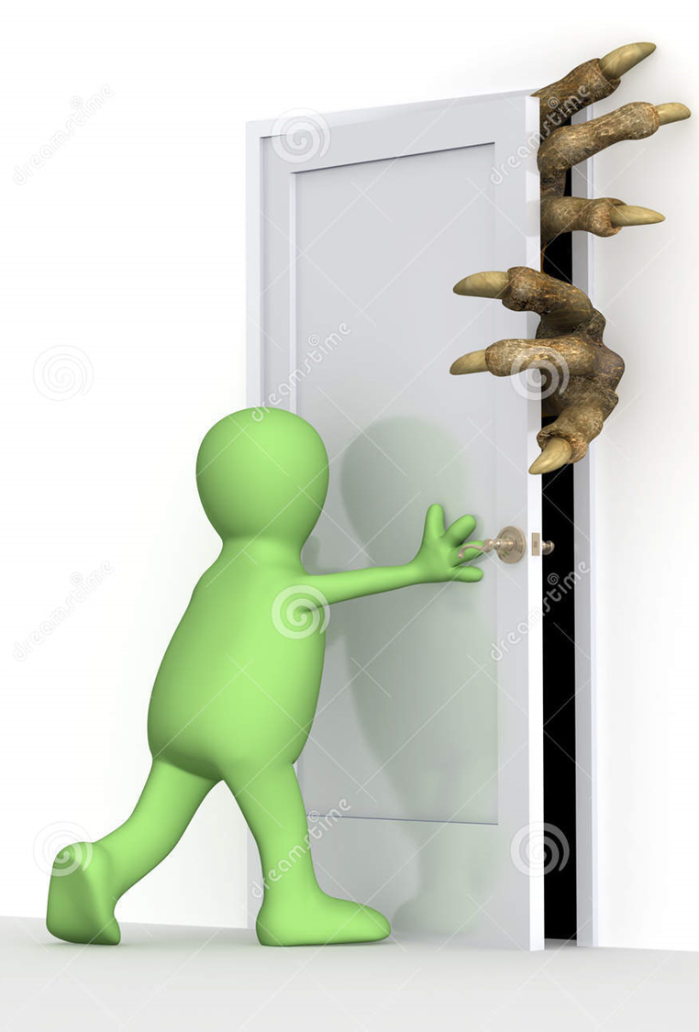
We Can Choose to Do the Same Today
  • Rest- in the love of the Father
  Reliable -as the true anchor for who we are.
  Relationship -your relationship with God your father
  • Repeat -Meditate on this truth all the time, / find Peace
Don’t be too caught up by WHAT YOU DO (performance), on WHAT OTHERS THINK (popularity), or WHAT YOU HAVE (possessions).
  • Be Confident of WHO you are in Christ.
Know that you are Deeply Loved, Highly Favoured and Blessed.

Slide 16
How to Close the Trap!
Answers to Close the Trap
#1-
#2-
#3-

Slide 17
Trap #1: You Are “What You Do” (3)
YOU ARE WHAT YOU DO (Performance Trap)
Don’t fall for such a trap. The devil would like to you think that your value lies in what you can do. It is a performance trap.
Jesus had not yet begun His ministry at this point. He had nothing to show. He had only been a carpenter. For thirty years, He had done ‘nothing’ great.
• When Nathanael got to hear that Jesus came from Nazareth, his response was: “Nazareth! Can anything good come from there?” (John 1:46)
• Jesus seemed like a ‘nobody’. No one has yet to believe him. What contribution can he make?
Our culture asks the same question. Show me what you’ve got. What have you achieved? Demonstrate to me your usefulness. What can you do?
• Over time, such a preoccupation causes us to value ourselves according to our achievement.
• We see ourselves as worthwhile IF we can do well at school, at work, in our relationships, and even in church ministries.
And if we don’t score enough successes, we either (1) force ourselves to work harder, longer, faster, to prove that we are somebody, or (2) enter into a depression, and feel sorry for being who we are.
• You don’t have to prove anything. You are already deeply loved and highly favored in God’s eyes.
Thomas Merton was a writer of a best-seller and was approached by a man who was compiling a book about SUCCESS, to contribute a statement of how he got to be a success.
Merton was actually angry. He replied, “I did not want to consider myself a success in any terms that had a meaning to me. I swore I had spent my life strenuously avoiding success. If it happened that I had once written a best-seller, this was a pure accident – due to inattention and because I was naïve. I would take very good care never to do the same thing again.
If I had a word to my contemporaries, it was surely this: Be anything you like… of every shape and form, but at all costs, avoid one thing, success.
I heard no more reply from him and I am not aware that my reply was published.
Merton understood how easily earthly success tempts us to find our worth and value OUTSIDE of God’s inexhaustible love for him, in Jesus Christ.
• Don’t read in too much of your achievements; they are yours because of God’s grace.
The devil went on to tempt Jesus a second time:
"If you are the Son of God," he said, "throw yourself down. For it is written: "`He will command his angels concerning you, and they will lift you up in their hands, so that you will not strike your foot against a stone.'" (4:6)

Slide 18
1. Performance
The devil tempts Jesus to prove who he is. “If you are the Son of God, tell these stones to become bread.” Jesus is hungry. He has done nothing. He is basically a nobody—a loser. Nobody believed in him. Prove it. Show me and everyone how great you are.
Our world still tempts us this way. What have you done? What have you achieved? What do you do? Worth is based on how well you perform at work, with your friends, at school, in your family, in your church, in any of your relationships.
I am what I do.
Our identity and our worth are derived from what we do. When we don’t perform, we work harder and longer or we get depressed or blame others. Jesus’ self-worth came from God the Father’s inexhaustible love.
Do you base your self-worth on your performance?

Slide 19
2. Possession
The devil took Jesus to see the magnificence and power of the earth. Look at all the stuff people have and how important that is. You don’t have any of that. Look at my power. Look at all the stuff that I have. All these things show who really is important. If you recognize this and worship me, I will give you everything. All this is yours.
But Jesus remembers who he is. He is not impressed with all the power and all the stuff. He knows what is truly most important. And he responds with scripture here and each time to remind the devil of what is truly important.
Our culture is measured by our possessions. Marketers spend 15 billion dollars a year seducing children and teens to believe that they need more. We compare ourselves to others. Our sense of worth is tied to our positions at work.
I am what I have.
Who has the best job? Who has the best education from the best school? The bumper stickers that say, “My child is an honor student at such and such school.” Degrees and awards. Who has the handsomest boyfriend? Who has the latest and best gadgets and toys?
When I first saw this I was a teenager and not really a follower of Jesus. I saw how important people’s cars were. They said how successful or cool they were. Often some of these people had wrecks for lives. Lame jobs. Hole in the wall apartments. But they drove a cool car. Nothing else really mattered but what you drove.
I am pulled by this temptation all the time. It is my stuff and my talents and my applause from others is what truly gives me worth. I have to keep reminding myself that God tells me, “You are my child, Mark, whom I love; with you I am well-pleased.”

Slide 20
3. Popularity
Some of us are more tempted popularity. We are addicted to what others think about us. Often it has little to do with being a star although that is what the devil tempted Jesus with. “If you are the Son of God, throw yourself off the top of this temple and command the angels to catch.” Jesus wasn’t concerned with popularity or how he looked in other people’s eyes. He didn’t need to put on a show. He didn’t need to prove anything. He didn’t need anyone’s approval.
Yet we do. In some form, we all look for approval and validation from others.
I am what others think.
Becoming emotionally mature, means getting to a place where we value others but we are not dependent on them to give us self-worth. We feel inferior so we do something for someone or give them a gift. We want them to appreciate what we have done. We want validated and told that we did good.
We don’t want to risk saying or doing the wrong thing. True freedom comes when we no longer need to be special in somebody else’s eyes.

Slide 21
Affirmation

Slide 23
Short Sweet To The Point
“The harvest is past, the summer is ended,
and we are not saved!”
Jeremiah 8:20
4 And he must needs go through Samaria.
5 Then cometh he to a city of Samaria, which is called Sychar, near to the parcel of ground that Jacob gave to his son Joseph.
6 Now Jacob's well was there. Jesus therefore, being wearied with his journey, sat thus on the well: and it was about the sixth hour.
7 There cometh a woman of Samaria to draw water: Jesus saith unto her, Give me to drink.

Slide 24
New Year –New Mindset
4 Attitudes that
Hinder the Harvest
John 4:27
Edward Church
Jan-15-17

Slide 25

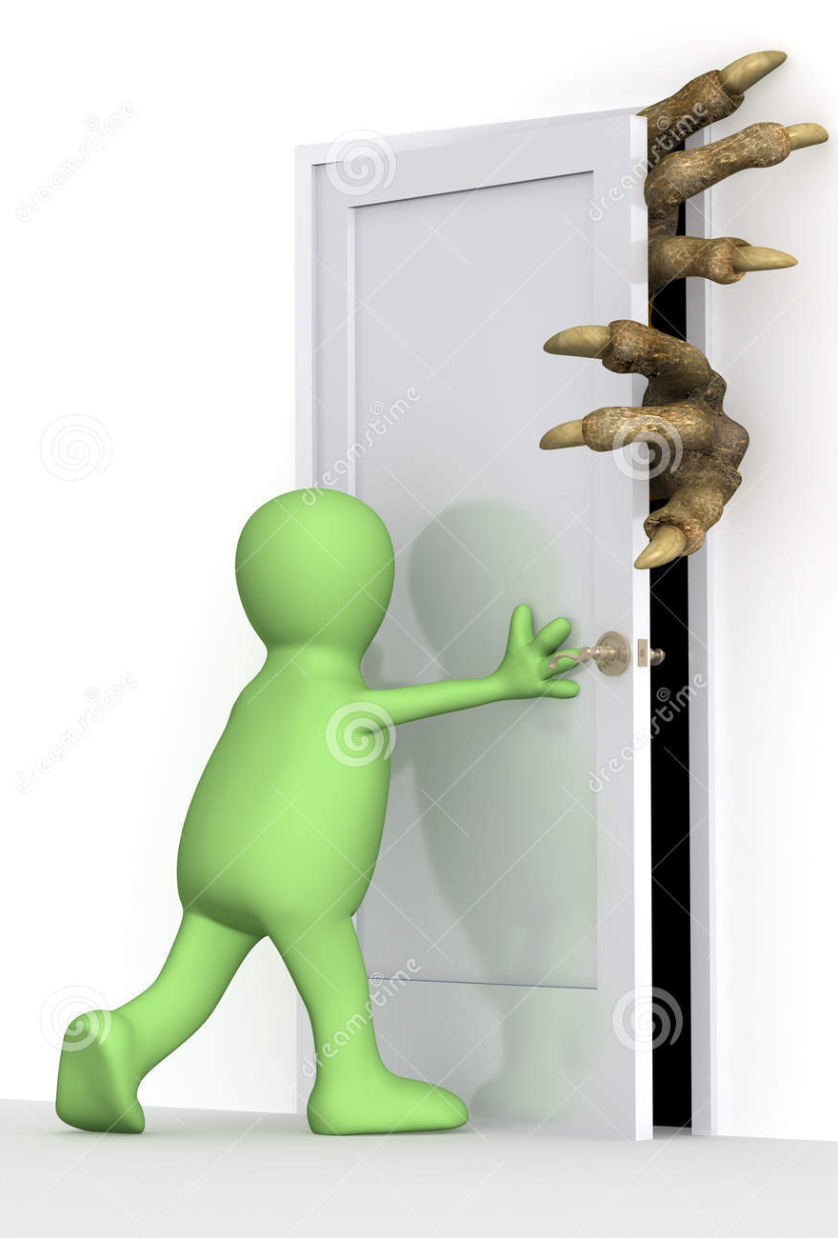


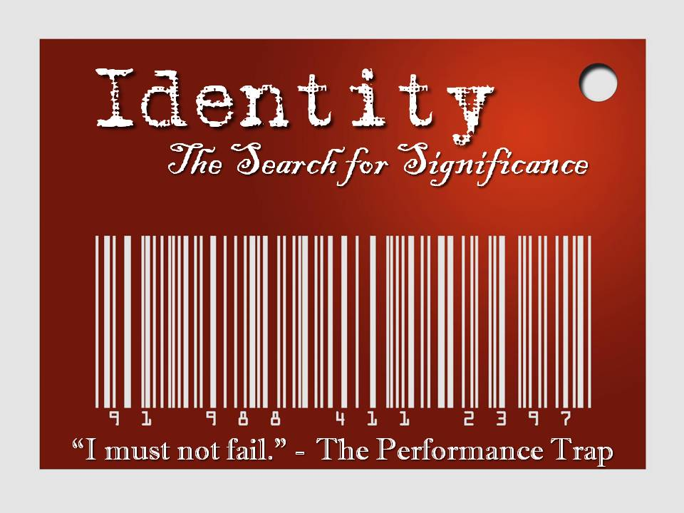

Slide 26
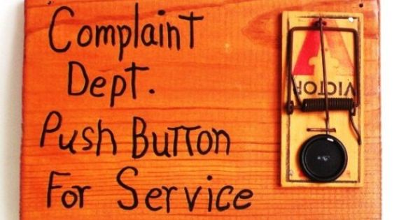
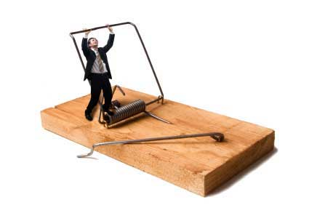
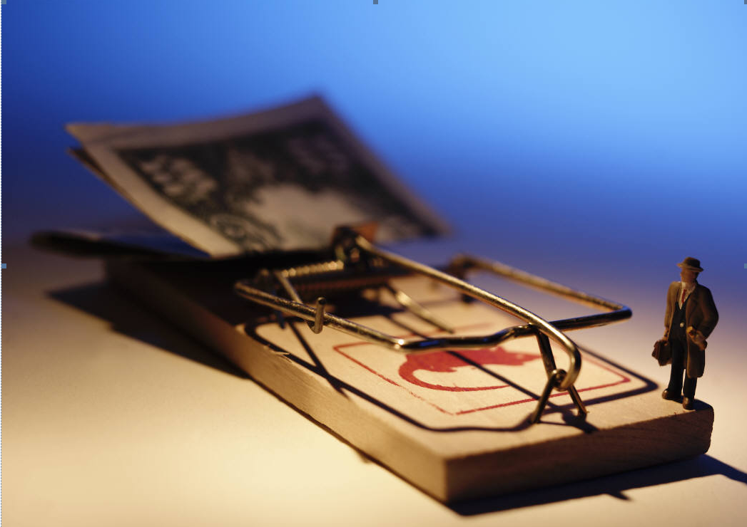
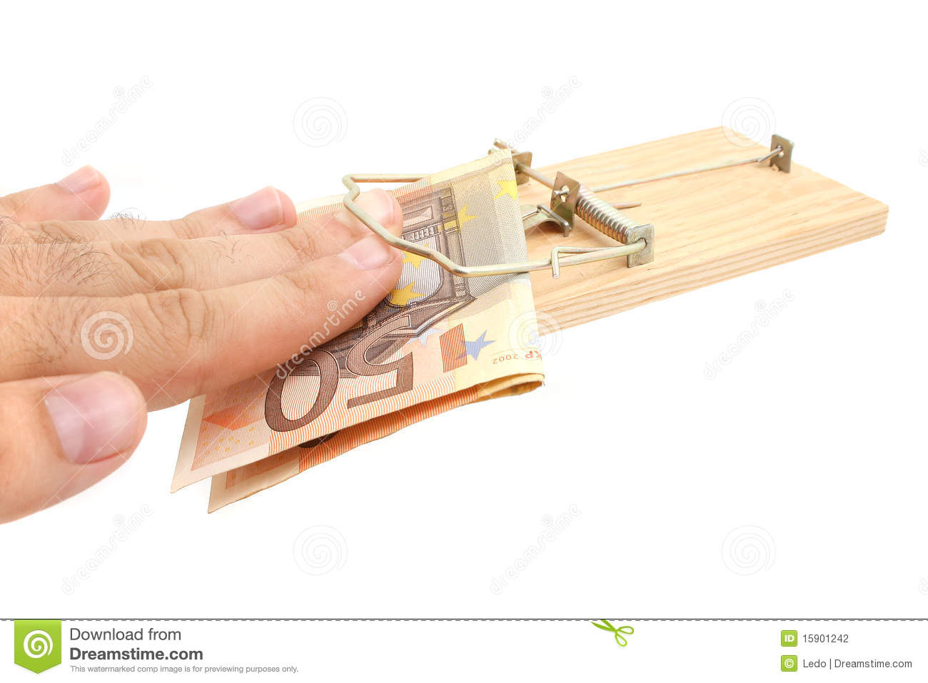


Slide 27
The Perspective Trap
Satan Knows that God Seeks to
  Use Us
  Empower us
The Trap is usually set at the Door of Opportunity
  Door
  Disrupt – the move and the power of God flowing thru our lives
  Drain –our faith
  Deteriorate –our opportunity
Here Jesus shows us a Powerful Example
• Even under a direct confrontation with the devil, alone in the wilderness, under harsh circumstances, Jesus won.
If the devil tempts Him these ways, it would possibly mean that these were good entry points, our “Achilles’ heel”.
• The baits exposes our vulnerabilities, else they won’t be very much of a temptation.
• There are the same 3 vulnerable areas that we need to take heed today.
Before the passage begins, we are given a snapshot of Jesus’ understanding of WHO He is.
• Heaven opens. The Spirit descends like a dove. And Jesus’ Father speaks audibly: “This is my Son, whom I love; with Him I am well pleased.”

Slide 28
Trap #2: You Are “What Others Think” (6)
YOU ARE WHAT OTHERS THINK (Popularity Trap) destroyed Saul- bleating of sheep
This is the popularity trap. Some of us are very affected by what others think.
Satan invited Jesus to throw himself down from the highest spot of the temple that people might believe in Him.
• Up to this point, no one noticed Jesus. He was, in effect, an unknown. How could he think he had worth and value?
• Let the people see that you are important, that even angels will come and lift you up on their hands.
[This text Psalm 91:11-12 - was taken out of context. It talks about trust God as your refuge, and when you walk in your ways God will protect you.]
Jesus is somebody so great that even angels will come and save him. The people will see how important he is.
• We like that to. We place a high premium on what other people think of us. We want to impress.
• We are all affected by this, including myself. I have to challenge this thought all the time.
When I started serving in this church, I was very conscious of how I perform, partly because of the prominent role I have as a pastor. I am very addicted to what others think. What should I say or not say in a meeting? How did my preaching go? Do they like what I am doing? I was tormented by these thoughts, constantly. My emotions go up and down depending on whether I had more compliments that week, or criticisms.
You cannot please everybody. Not even Jesus. Eventually, I’ve learnt to redirect my focus on God – to move away from what people think of me, to what God thinks of me. For that is what really matters - who I am in Christ. I seek to do my best to please God, not men. He is the One I am living for.
True freedom comes when you no longer need to be somebody special in other people’s eyes.
• It happens when we know very convincingly that we are deeply loved and highly favored by God.
You know why we fall for such a trap of popularity so easily? We are too pre-occupied with self – how do I look, how do I fare…
M. Scott Peck shared an interesting experience when he was 15 years old and meeting up with an old classmate. This was his reflections after the conversation:
“I suddenly realized that for the entire ten-minute period from when I had first seen my acquaintance until that very moment, I had been totally self-preoccupied. For the two or three minutes before we met all I was thinking about was the clever things I might say that would impress him.
During our five minutes together I was listening to what he had to say only so that I might turn it into a clever rejoinder. I watched him only so that I might see what effect my remarks were having upon him.
And for the two or three minutes after we separated my sole thought content was those things I could have said that might have impressed him even more. I had not cared a whit for my classmate.”
That was a 15-year old speaking, but the same dynamics continue in the 20s, 40s, 60s and 80s.
• Many remain trapped in living a pretend life out of an unhealthy concern for what other people think.
• Rest in how God thinks of you. Take delight in it. Meditate upon it again and again.
Lastly, for the third time the devil tempts Jesus - Matt 4:8-9
“Again, the devil took him to a very high mountain and showed him all the kingdoms of the world and their splendor. 9 "All this I will give you," he said, "if you will bow down and worship me."

Slide 29
Trap #3: You Are “What You Have” (8-9)
YOU ARE WHAT YOU HAVE (Possession Trap)
Jesus was taken to see all the magnificence and glories of the earth.
• It is a possession trap. It makes you look at what you have; believing that what you have defines you.
• “Look at what the world has to offer you. You don’t have anything now. How can you think you are somebody? How will you survive? No one notices you.”
• The devil plays on your fear. He hits at the source of your security.
Our culture measures our success by WHAT YOU OWN.
• Soon our identities depend on them. They become our status symbols and we feel that we cannot do we thought them.
• Our culture tells us possessions, wealth, the applause of men are what make us great.
We begin to compare – who has the most money, beautiful look, nicest house? highest grade
• Our sense of worth is tied to our possessing these things. Our sense of worth is tied to our positions at work. Are these the true measures of our worth?
• There is nothing wrong with having things. But just remember, they don’t define us.
Jesus sees himself as the Son immensely loved by his Father and found his personal fulfilment in hearing his Abba Father says: “You are my Son, whom I love; with you I am well pleased.”
• We choose to do the same today. Rest in the love of the Father as the true anchor for who we are. Put a premium on your relationship with God!
• Meditate on this truth all the time, and you’ll find yourself loving Him and obeying Him, just like Jesus.
Don’t be too caught up by WHAT YOU DO (performance), on WHAT OTHERS THINK (popularity), or WHAT YOU HAVE (possessions).
• Be confident of WHO you are in Christ. Know that you are deeply loved, highly favored and forever blessed.
• Then will you SURRENDER to Him and SUBMIT to His will without reservation.

Slide 30
How to Close the Trap!
Jesus overcame the temptations, so can we today.
Before the passage begins, we are given a snapshot of Jesus’ understanding of WHO He is.
• He is loved by the Father for WHO he is.
We are the beloved of God, not for WHAT we do or can do for Him, but for WHO we are.
• Understanding this love makes us secure. Knowing this love enables us to surrender to God.
• We are able to submit because we know we are fully loved. We are able to obey Him, even when His will seems so different from what we see, feel or figure out ourselves, because we know we are deeply loved.
This love anchors me. This love anchors my soul. I am fully secured and at peace, because I know I am deeply loved and highly favoured.
• Jesus enters into the desert with such an understanding.
• He does not need to do anything to prove he deserves to be loved. Jesus was anchored in His Father’s love for him.
The devil came with three powerful temptations, all hitting at Jesus’ understanding of his identity before God.
• The devil throws the same temptations at us today.
• He said to Jesus: "If you are the Son of God, tell these stones to become bread." (4:3)

