Slide 2
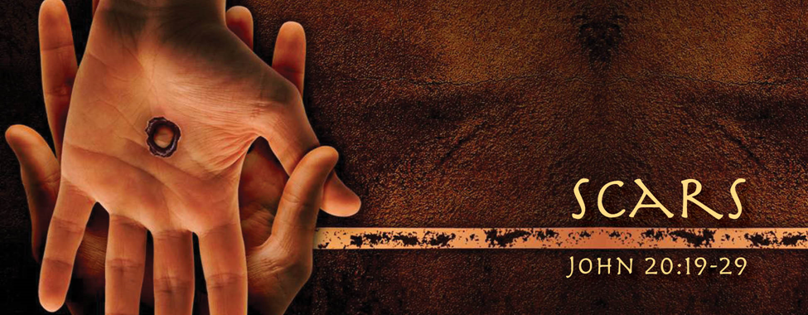
The Value of Scars
Jan 29, 2017
Edward Church

Slide 3
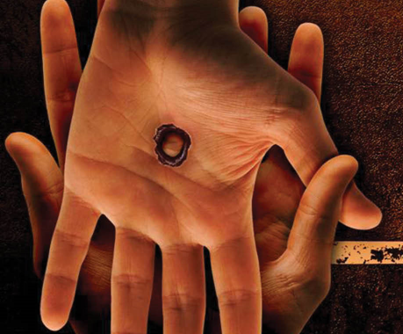
God Places A High Value On Scars…
Short…
…Sweet
…To
…The
…Point
In Heaven
…the Only Thing Man Made
…Are The Scars On Jesus
Placed There By Man..
…For Man
God
Allowed This..
Ordered This
Only Way To Fulfill His Plan

Slide 4
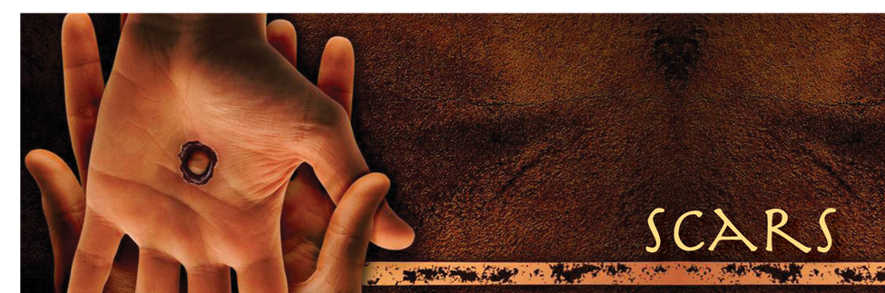
It Had Been Three Days Since…
…The Devastating Events
    Arrest
    Trial
    Scourging
    Crucifixion of Jesus
…Each Place Scars were Placed on Jesus
They Saw His Lifeless Body…
  taken down from the cross
  buried in a tomb
On the Third Day They Would Discover…

Slide 5
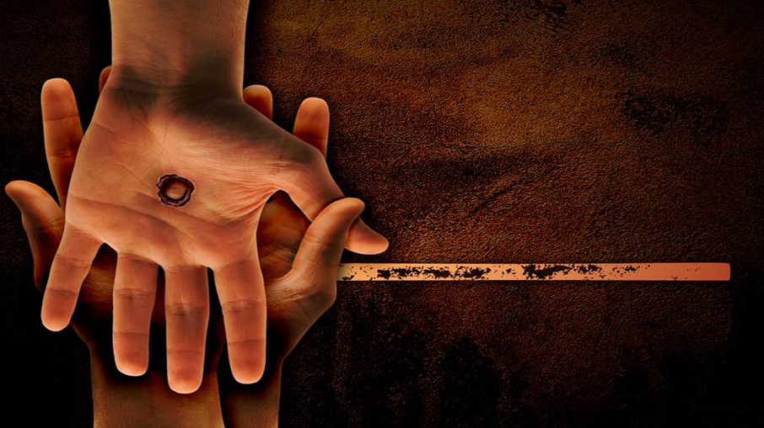
On the Third Day…
They Discovered Jesus Had…
      Risen
      Glorified Body
      ALL Things New
…Except – For the Scars
Why?
Those Scars Had…
  Purpose
  Power
  Priority

Slide 6
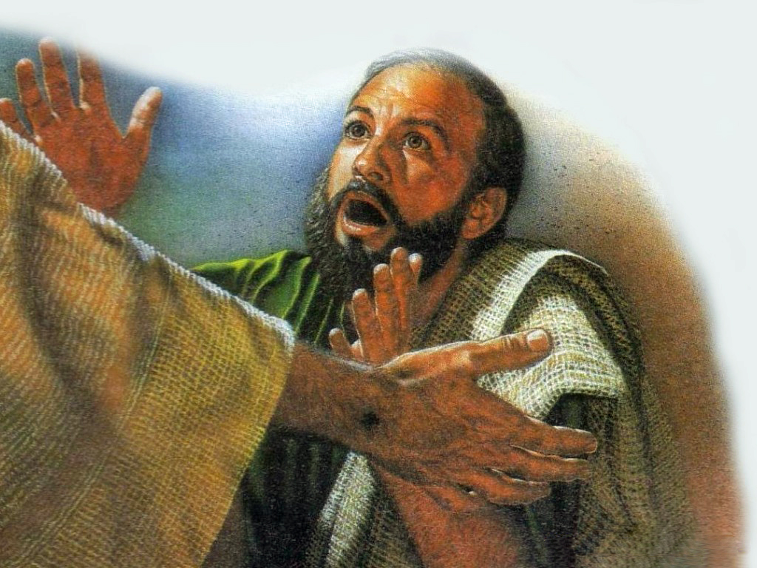
Indicates Identity…
…Purpose
Indicated That It Was Truly Jesus
….Hands- Feet- Side
Showed He Went Through Something
…Not a Joke, Dream, Game -Real Death
Thomas- “Unless I see the Scars”
When He Did –
  He Cried “My Lord and My God!”
  Same With Us –
  Show That We Have Been Thru BUT…
  …God was with us!

Slide 7
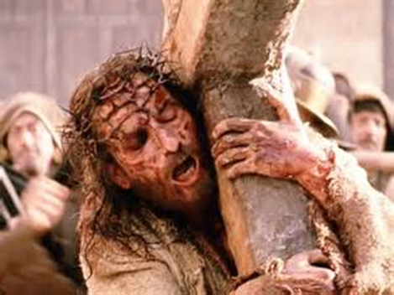
Indicates Point of Injury…
…Power
Point of Injury
Reminder of Pain
Proof You Have Been Through Something…
…But It Didn’t Stop You

Slide 8
Indicates Point of Healing…
…Priority
…He Never Takes Your Pain Lightly
He’s Been There…
  First…
…He Survived -He Arose!
  For Us…
…We Can Thrive
…Because He Arose..We Can Too!
  For Others…
…When they see us Rise
…It Brings Them Hope!

Slide 9
Because He Lives…
  I can Face Tomorrow!
  All Fear is Gone
  I Know He Holds the Future
  Life is Worth the Living
  Just Because He Lives

Slide 10
You May Think God Cant Use You
…Because Of Your Scars
Remember
God Wants To Use You
…Because Of Your Scars
Scars Don’t Diminish Your Value…
…It Increases Your Value

Slide 12

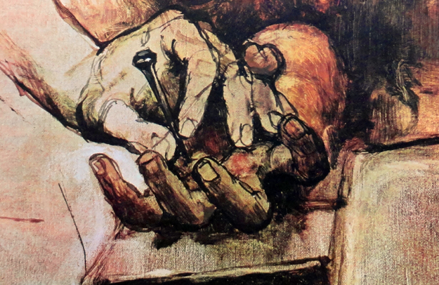
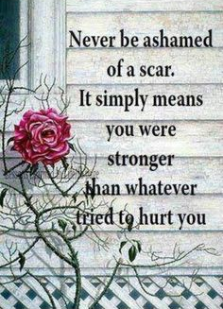

Slide 13
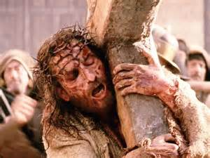
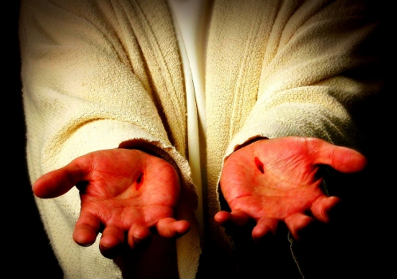

Slide 14
