Slide 2
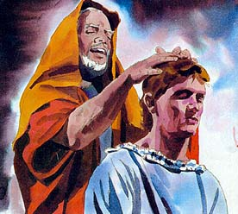
A Father’s Blessing
Father’s Day 2015
Genesis 27

Slide 3
The Fatherhood Cycle
4 years: "My Daddy can do anything”
7 ys: "My Dad knows a lot, a whole lot”
12 ys: "Oh, well - naturally - Father doesn't know that either”
14 ys: "Father? Hopelessly old-fashioned”
21 ys: "Oh, that man is so out-of-date. What did you expect?”
25 ys: "He knows a little bit about it - but not much”
30 ys: "Maybe we ought to find out what Dad thinks”
35 ys: "Let's ask Dad what he would do before we make a decision”
40 ys: "I wonder what Dad would have thought about that? He was pretty smart"
50 ys: "My Dad knew absolutely everything”
60 ys: "I'd give anything if Dad were here so I could talk this over with him…
…I really miss that man”

Slide 4


Slide 5
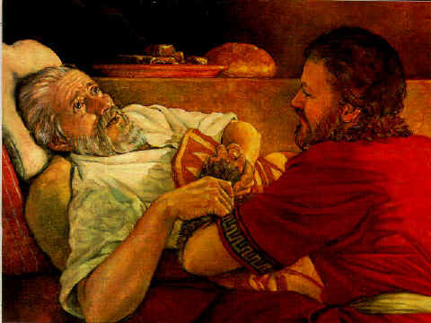
Story of a Son’s Deceit
Usual Focus
Mother and Son Conspiracy…
…to Deceive Isaac
…In Order to Rob
…the Blessing from Esau

Slide 6
Greater Story of a Father’s Blessing
Unusual Focus
Even Though He was Deceived…
…Look at the Power of a
…Father’s Blessing
It Goes Beyond…
  Value
  Words
    Settles
    Stirs
    Seals

Slide 7
“Meaningful Touch”
"Then his father Isaac said to him, ‘Come here, my son, & kiss me” (26)
The Message
  Understand That Words Are Not Enough
The Method
  Blessings Bestowed in Hebrew Culture Involves Touch…
… the Laying On of Hands, a Kiss, an Embrace that Conveys Acceptance/ Love
  Mark 10:13-15 brought children to Jesus..He interacted / "He blessed them."
It’s Important to Do That In Our Homes
  Small Children Can’t Communicate Love with Words
  Communicate Love by Touching Them/ Holding them Close.
Jacob was 40 years old when Isaac Touched / Kissed Him to Convey His Blessing
  No Matter Your Age, Personal Contact is Important

Slide 8
“A Spoken Message of Affection & Love”
“Ah, the smell of my son is like the smell of a field. . .” (27)
The Message
  Today’s Child Would Not Consider it a Compliment
  The Smell of a Field Ready for Harvest was a Great Smell.
    It was a Compliment, a Positive Message that Communicated His Love
The Method
  Don’t Be Quick to Criticize/ Remind Children of their Mistakes.
    Words of Criticism that Really Don’t Accomplish Much.
    All They Do is Cause a Child to Withdraw. "You dummy" "You’re lazy"
  There is Room for Constructive Criticism.
    But it’s More Important to Communicate Love Through Words that Say
      "You’re worth something. I’m glad that God gave you to us”
      Speak Life

Slide 9
“Assuring Them Of Their Value”
"May God give you of heaven’s dew / of earth’s richness an abundance of grain / new wine” (28)
The Message
  Isaac’s saying, "You’re special, so God will give you the best He has to give."
  Teach Your Children, "You’re so valuable that God died on the cross for you”
The Method
  But it’s Not Just By Words. We Teach this in a Number of Ways
  Turn Off the TV, Lay Aside the Paper/ Cell Phone Listen!
  Show Them-You’re a Valuable Part of Our Family. “I’m Glad God Gave You to Us”
  And Whenever You Need to Talk, I’m Here to Listen

Slide 10
“Picturing of a Future and Hope”
"May nations serve you & peoples bow down to you. Be lord over your brothers, & may the sons of your mother bow down to you. May those who curse you be cursed & those who bless you be blessed.“ (29)
The Message
Isaac is Helping Him to Raise his Sights/ See that His Future is Bright
The Method
Prov 22:6, "Train a child in the way he should go/ when he is old he will not turn fr. it."
  1st- Teach Them the Things of God/ when They’re Old They Will Not Forsake Them
  2nd- We’re to Help Our Children Find Their Niche / Help Them Develop
God Made Them Special
  Our Responsibility as Parents is to Help them Discover What They Are Good At,
  …Help Them Prepare for a Awesome Future.

Slide 11
“Commitment”
“And Isaac answered and said unto Esau, Behold, I have made him thy lord, and all his brethren have I given to him for servants; and with corn and wine have I sustained him: and what shall I do now unto thee, my son?” (37)
After Realizing He Had Given The Blessing Mistakenly to Jacob…
…Isaac Still Acknowledged a Commitment to What He Had Said.
Commitment Provides What is Needed for the Blessing…
…and Blessed One to Thrive.
This includes Prayer, Needs, and Opportunity for Development.
Our Kids Need to Know that We Are There for Them…
…No Matter the Circumstance

Slide 12
‘The Blessing’ Summed Up
Affection - Do you love me?
Acceptance - Can I be myself around you?
Attention - Are you watching me?
Approval - Did I do a good job? Am I a smart kid?
Affirmation - Are you proud of me?

Slide 13
“Picturing of a Future and Hope”
Too Many Dads are MIA when it comes to Genuine…
  Spiritual
  Emotional
  Physical
…Encouragement
If You Haven’t Lately….
…Step Up and Be Counted!!!

Slide 14
Father’s Day Challenge
Fathers…
…You Are Blessed
…to be a
…Blessing

Slide 17
“When I was a Boy”
4 yrs old My Daddy could do anything
5 yrs old My Daddy knows everything
6 yrs old My Dad is smarter than your dad
8 yrs old My Dad doesn’t exactly know everything
10 yrs old When my Dad grew up in the olden days things were sure different
12 yrs old My Dad doesn’t know anything about that, he’s too old to remember
14 yrs old My Dad is so old fashion
18 yrs old My Dad is really out of it
25 yrs old My Dad knows about that, but he should, because he’s been around so long
30 yrs old Maybe we should ask Dad?
35 yrs old I won’t do anything about that until I talk to Dad
40 yrs old I wonder how Dad would have handled this?
50 yrs old I’d give anything if Dad were here now, so I could talk this over with him

