Slide 2
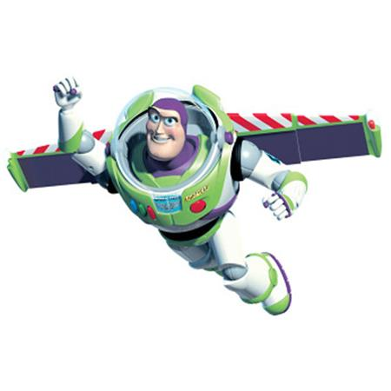
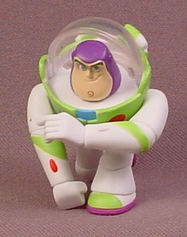
Who Is This?
To Infinity and Beyond!

Slide 3

To Infinity and Beyond
His…
Power
Plan
Passion
Principles
God Wants Us to Impact the World…
…from Infinity and Beyond!

Slide 4
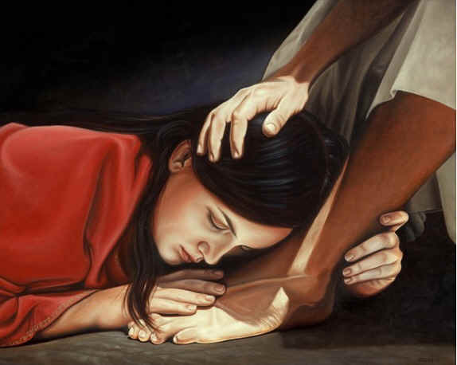
Excellent Lifestyle
To Infinity and Beyond
Pt 2
“She Did What She Could Do”
Mark 14:1-9
Aug 2, 2015
ECC

Slide 5
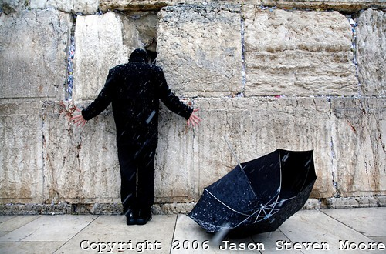
These Were Difficult Days For Jesus
Last Stages of Earthly Ministry
Celebration /Tragedy…
…Walking Hand in Hand
  Sought (seek to do harm)
  Craft (to Decoy –bait trap)

Slide 6
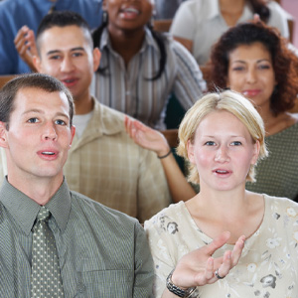
These Were Difficult Days For Jesus
Leaders Plotted His Death
He was Surrounded by..
…Critics & Enemies
He Found Comfort Through…
…Fellowship
One Woman Took Advantage of This
And She Did What She Could Do

Slide 7

Satan Desires to Halt the Work of God
Insufficient
    Ability
    Resources
Overload
    Trials
      Break Focus- trying to get by
Preoccupied
    Activity
      Break Focus - doing own thing

Slide 8
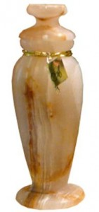
She Did What She Could Do...
…with What She Had (3)
Some Often..
“Think” …of what They Would Do
  Their Life Overshadowed by “What If ?”
  If I had certain talent, skill, ability
“Complain” …about what Others Do
  Their Life Overshadowed by “Why Them?”
“Complain” …about what Others Don’t Do
  Their Life Overshadowed by…
    …“Why Not Someone Else?”

Slide 9
She Did What She Could Do...
…with What She Had (3)
This Woman Did Something…
She:
“Sought out” of her Best
“Counted out” the Cost
“Gave out” Freely

Slide 10
Worship…
= “Worth-ship”
3 Words to Describe What She Had:
Ointment
(myrrh oil)
Spikenard
(nard-India + Pure-Unadulterated)
Precious
(ext expensive -very end limit …
..very costly)
She Did What She Could Do…
…with What She Had

Slide 11
She Did What She Could Do...
…while She Could Do It (3, 8)
Church Paralyzed by Procrastination
3 Signs(Words):
Some are Going to Do Something…
“Sometime”
“Tomorrow”
“Waiting for Right Time”
    She…
    Saw Opportunity
    Seized Opportunity
    Secured Opportunity

Slide 12
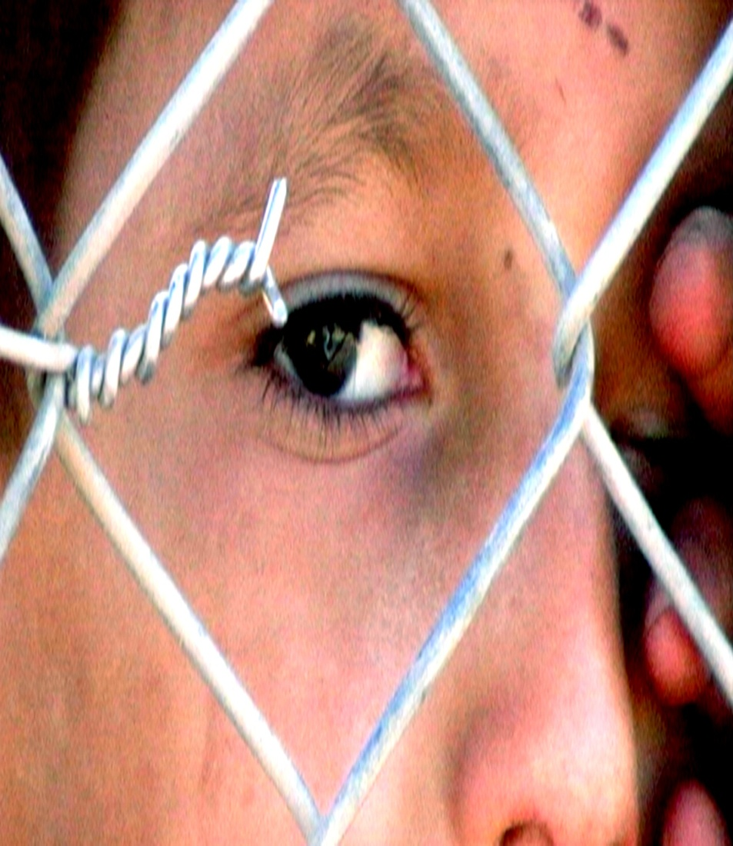
She Did What She Could Do...
…Regardless of the Critics (4, 5)
There is Always:
    Critics
    Chance
    Choice
      Saul (I Sam 15:24)
      David (I Sam 17)

Slide 13
She Did What She Could Do...
…for Jesus (6)
Her Motive was Right (7)
Her Actions were Right
  Unselfish (3)
  Compassionate (8)
  Prophetic (8)
She Set a Good Example (6)
She was Rewarded for her Sacrifice of Love (9)
Are We Doing What We Can Do?
…to Infinity and Beyond!!!!

Slide 16
Procrastination
Root = Fear
Reasons = Fear of…
1. Hurt - Judges 11- Jepthah
2. Failure Replay - Barabbas / Mark
3. Inability - Num 13
4. Change - Rev 2:1
5. Opinion - Gal 2:11
6. Success - easier to live in Excuses…
…than to Bear the Burden to Go Forward

