Slide 2
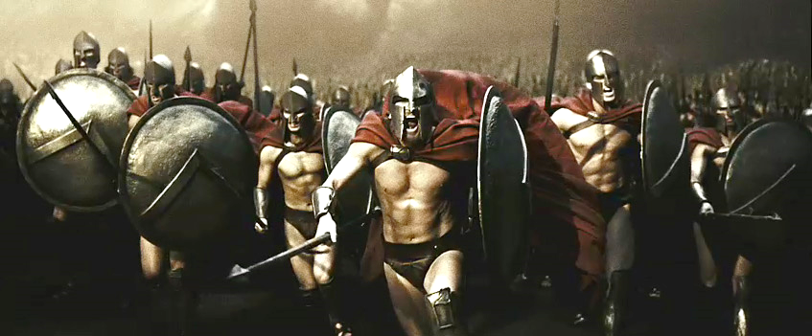
Getting Past the Giants
Edward
Sept 13, 2014
Numbers 13:30-14:4

Slide 3
Possess the Promise
This is What God told Israel when He Delivered Them
Take possession of the land and settle in it, because I have given it to you to occupy. -Num 33:53 NLT
Deuteronomy 1:21 (KJV)
²¹ Behold, the LORD thy God hath set the land before thee: go up and possess it, as the LORD God of thy fathers hath said unto thee; fear not, neither be discouraged.
Possess= to occupy (by driving out previous tenants, and possessing in their place); by implication to seize, to rob, to inherit; also to expel

Slide 4
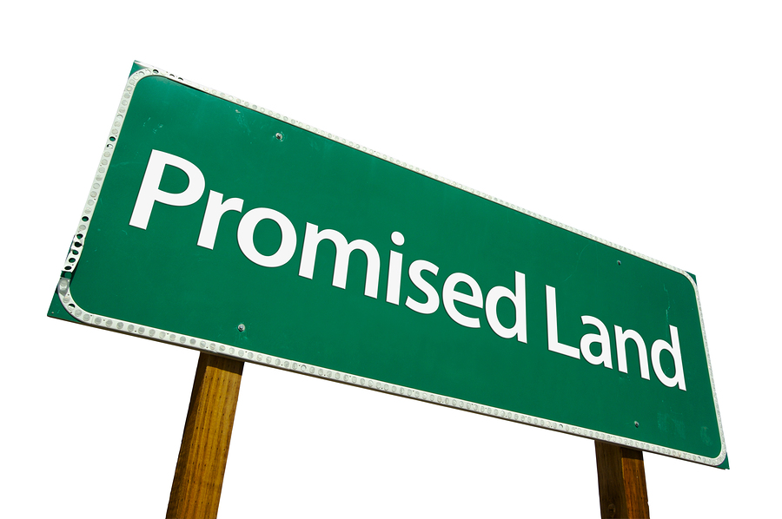
Promised Land
Place of…
  Hope
  Vision
  Opportunity
  Growth
  Life
  Battle –Satan Refuses to Accept Defeat

Slide 5
What Happened to Israel?
When Moses Sent Out Twelve Spies to Survey the Promised Land
  They were Shocked to Find Giants in the Land
  Ten of Them Gave a Bad Report…
  …Causing the Hearts of the People to Melt With Fear
  Fear Destroyed Faith, Which Led to Disobedience
  The Result was Forty Years in the Desert

Slide 6
Occupy
Israel had to get Past the Giants to Possess the Promised Land
The Lessons of Israel that Led to Forty Years of Desert…
…Teach us How to Get Past Our Giants
…And Boldly Take the Promised Land
Maybe You Are in the Facing Giants of…
  Fear
  Fatigue
  Failure
You Can Get Past Your Giants to Your Own Promised Land!

Slide 7
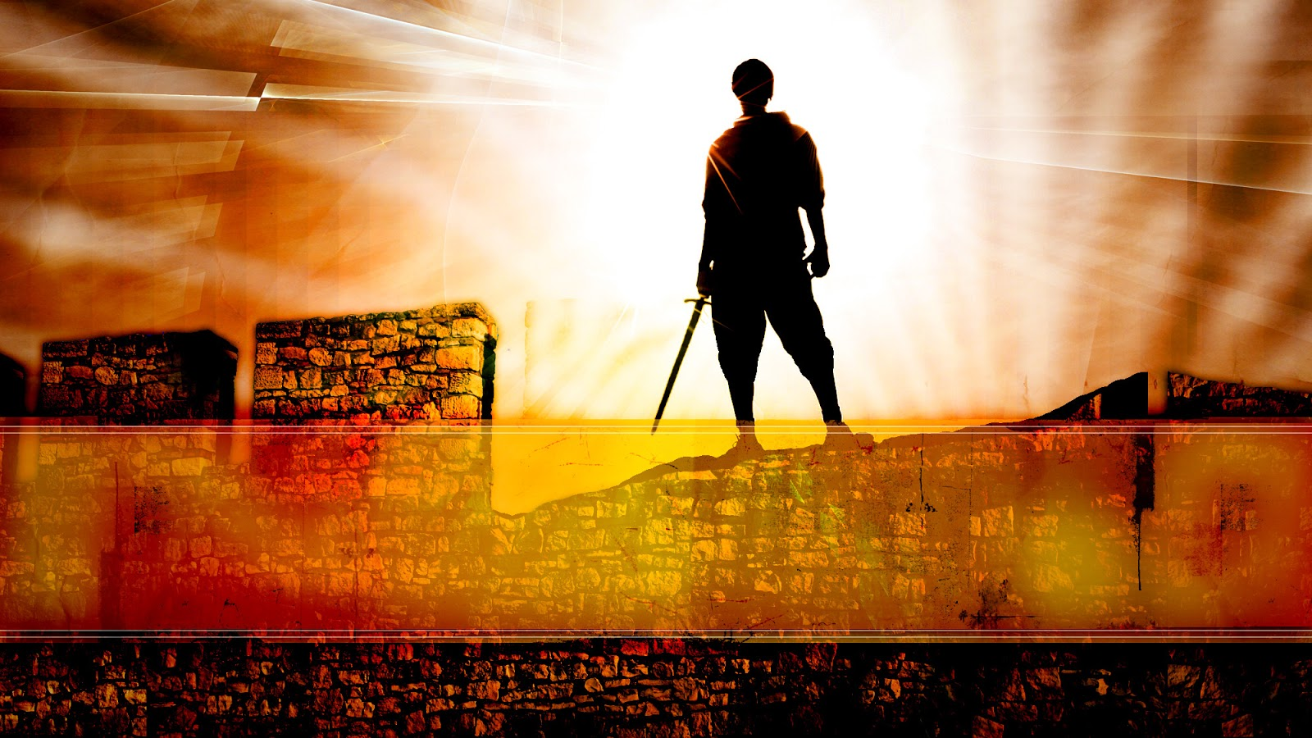
Occupy Til I Come
Occupy
Does Not Mean
  Take Up Space
It Does Mean
  Take a Stance
  Be Productive
  Take Back Lost …
  …Ground / Property
  Being Responsible

Slide 8
Giants Represent Barriers
Giants Represent Barriers to Our Canaan
  There Will Be Challenges
Question…
Do You Expect to…
  Possess Without a Challenge?
  See Promise Without a Fight?
Barriers Bring Frustration
  Whenever We Begin to Move Forward…
…We Confront Giants (Satan begins to push back)

Slide 9

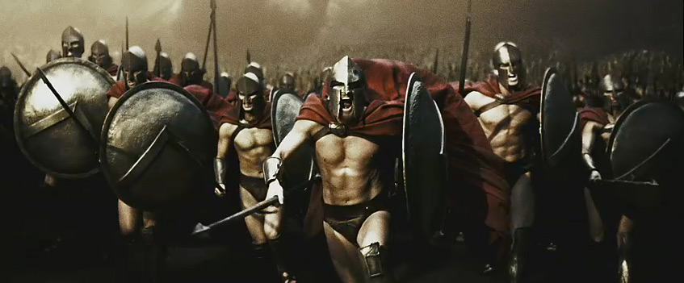
Giants = Barriers
Fear
Criticism
Fatigue
Injustice
Temptation
Failures
Problems
Doubt
Finances
Testing

Slide 10
Giants Represent Barriers
Remember…
Whenever We Begin to Move Forward…
…We Confront Giants (Satan begins to push back)
What is the Biggest Barrier to your Promise?
What is your Biggest Fear?
Here are the Lessons we Learn from Israel's Experience to…
…Help Us Defeat Our Own Giants

Slide 11
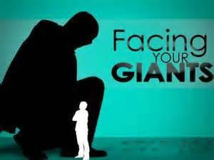
Giants Aren't Going to Go Away on Their Own
…You Must Drive Them Out (14:8-9)
We Cannot…
  Ignore our Giants Away
  Talk Our Giants Away
We Must Take Action…
  Be Intentional
  Be Disciplined
  Be Faithful
Faith Without Works Is Dead -James 2:17.
The Gift of Faith is Free, but the Life of Faith is a Fight
1 Timothy 6:12 (AMP) Fight the good fight of the faith; lay hold of the eternal life to which you were summoned and [for which] you confessed the good confession [of faith] before many witnesses.

Slide 12
Some Giants Have Been in the Land a Long Time…
…They Won't Leave Without a Fight (28)
These Giants had been in Canaan for Generations
  Negative
  Destructive
  Stubborn
You Must…
  Hold on to the Vision
  Refuse to Quit the Struggle
  Trust God for Strength / Results
Don't Get Discouraged When Everything Doesn't Change Overnight
  War Takes Longer and Costs More Than We Expect
  But Victory is Certain Through the Grace of God

Slide 13
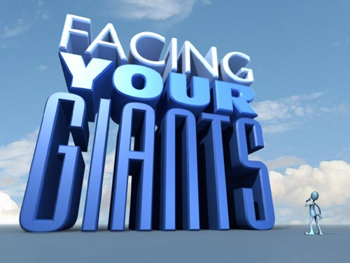
Magnify God, Not Your Giants (33)
When Problems are Exaggerated (focused on) …
…We Develop the "Grasshopper Syndrome”
  Joshua and Caleb had the Spirit of Faith (30)
  10 Spies had the Spirit of Fear (31)
We Need to Magnify God, Not Our Problems
Magnify His…
  Love
  Faithfulness
  Power
"Glorify the Lord with me; let us exalt his name together" -Ps. 34:3
Problems are Opportunities in Disguise for…
…God's Glory to Be Revealed

Slide 14
Run Toward the Giants, Not Away From Them (30)
Go Up at Once…
..Before Negative has a Chance to Infect
  Are You Infected or Affecting
  You Can Never Win a Battle in a Retreat Mode
David Refused to Retreat When He Faced A Giant
Run at Your Giant as David did: "I come against you in the name of the Lord Almighty" -1 Sam. 17:45
"David triumphed over the Philistine with a sling and a stone; without a sword" -1 Sam 17:50
It is Not the Size of Our Resources But of…
…Our Faith in God's Power that Wins the Day

Slide 15
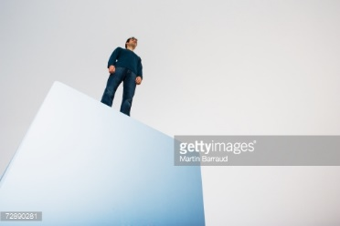
Occupy the Land When You Drive Out the Giants
Deliverance Needs to Be Followed By Discipleship
We Have to Grow in..
  Faith (bible)
  Words
  Deeds (action)
The Bible says we Need to Be Filled with…
  the Fullness of God -Eph 3:19
  the Spirit –Eph 5:18
  the Fruit of Righteousness -Phil 1:11
  Purpose -Col 1:9
  Fullness in Christ –Col 2:10

Slide 16
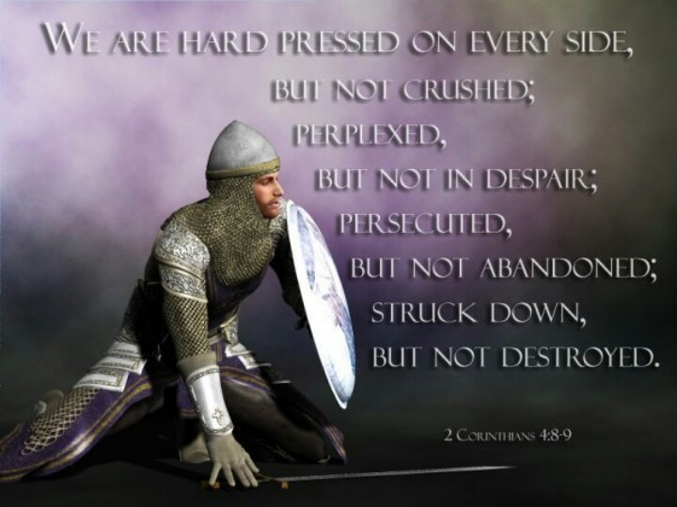

Slide 17
Joke- An inept golfer's ball flew into the rough and landed on an anthill.
He tried and tried to hit the ball back onto the fairway but each time he missed and hit the anthill. Ants went flying all over the place.
One ant turned to another and said, "If we are going to survive, we had better get on the ball."
Easy Eddie Lawyer to Al Capone
A lot of underhanded dealings
Decided he wasn’t making positive diff –so he turned Capone in
He died year later- riddled w- Bullets
Move Fwd –WWII – Navy squadron took off –pilot(Butch) noticed they forgot to fuel him so he turned back –just as he got there his Ships were under arial attack –he took them on by himself (1st medal of Honor)
Year later he died in aerial battle –his city wanted to rem his heroics –named airport after him- Butch O’hare – Chicago O’hare international
Butch O’hare was Easy Eddies Son

Slide 19

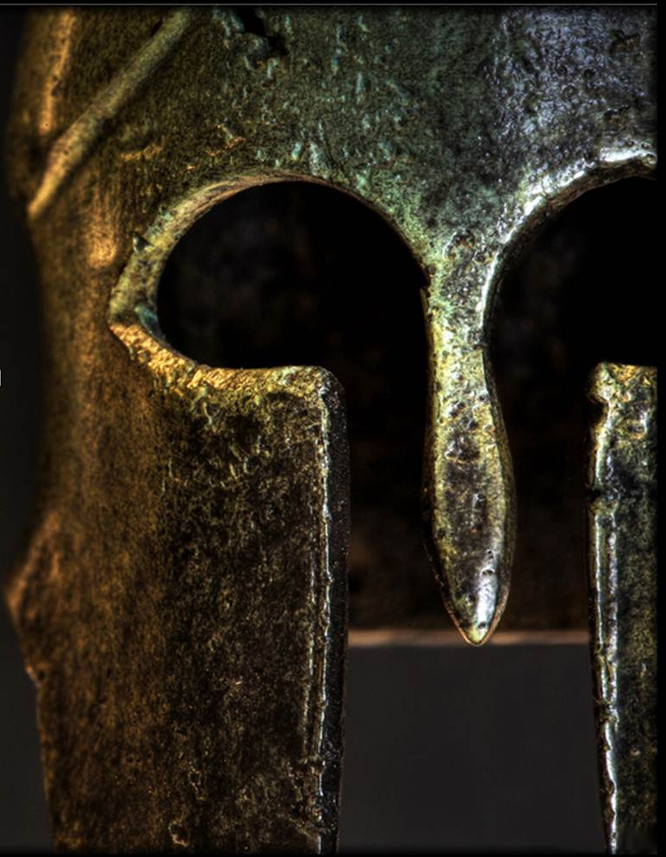

Slide 20
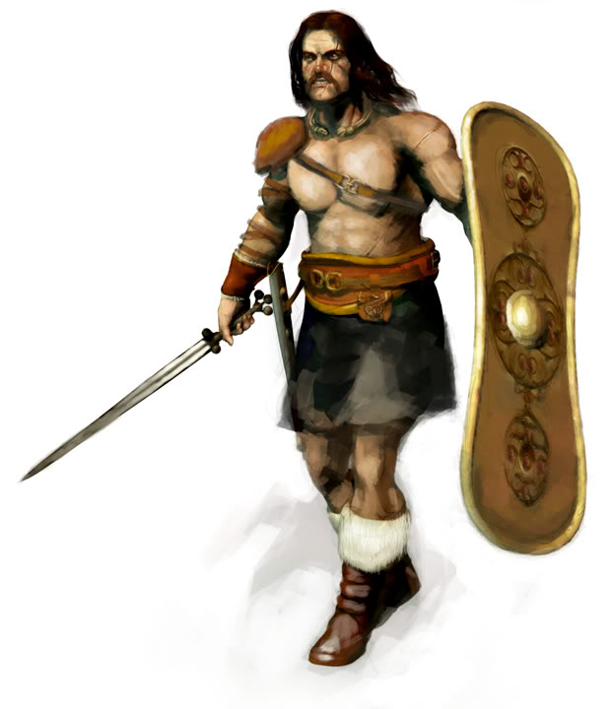

Slide 21


Slide 22
Some Giants Have Been in the Land a Long Time…
…They Won't Leave Without a Fight (28)
These Giants had been in Canaan for Generations
  Negative
  Destructive
  Stubborn
We must take two actions to defeat these generational giants.
  "Put off your old self" -Eph. 4:22
  "Put on the new self" -23-24
Don't get discouraged when everything doesn't change overnight
War takes longer and costs more than we expect,
But victory is certain through the grace of God

