Slide 2
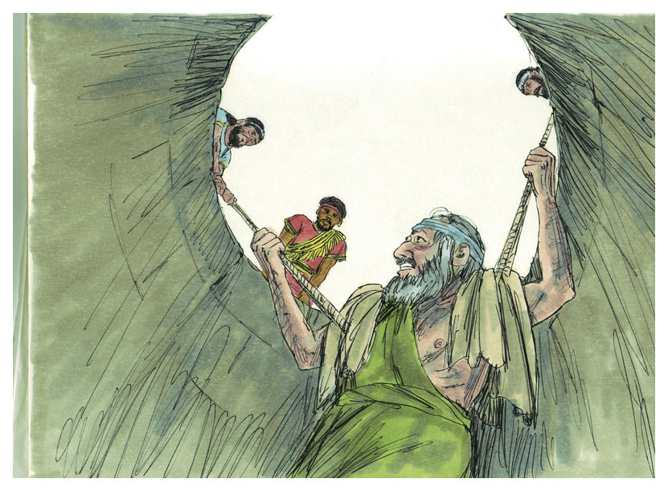
Hope at the
End of Your Rope
Jeremiah 33:1-3
Edward
Sept 20, 2015

Slide 3
What is Hope?
Hope= expectation, a thing longed for, Expecting God to Do Something
For Abe…
…Hope was Ram Caught in the Thicket
In the Midst of a Broken World...
…it was a Cross Covered Red in the Blood of Jesus
To Those Facing Tragedy and Loss
…the Empty Tomb Gives Us Hope
When We Have Hope…
Our Hearts Fill with a Spirit of Praise that Declares…
"With God All Things Are Possible."

Slide 4
Jeremiah 33:1-3 (KJV)
¹ Moreover the word of the LORD came unto Jeremiah the second time, while he was yet shut up in the court of the prison, saying,
² Thus saith the LORD the maker thereof, the LORD that formed it, to establish it; the LORD is his name;
³ Call unto me, and I will answer thee, and shew thee great and mighty things, which thou knowest not.
In his difficult circumstances Jeremiah…
…Learned Three Things About God
…That Gave Him Hope

Slide 5
The God of New Beginnings (1)
Jerusalem was Under Seige (587 B.C.) and Jeremiah was Imprisoned
The Word of Hope- "a Second Time”
Two Things
It was Not the End of Jeremiah
Nor the End for God’s People
  A New Beginning was at hand -33:4-9
  Zedekiah's Efforts to Save the Nation Would Fail
  God's Promise to Heal and Restore Would Not
The Word Came While Jeremiah was in Prison
  Adversity Could Not Hinder the Word of God
  "The word of God is not chained" -2 Tim 2:9

Slide 6
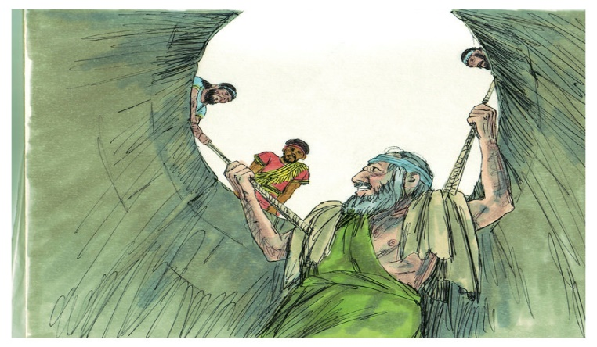
The God of New Beginnings (1)
God Still Has a Purpose
Isa 54:17, “No weapon that is formed against thee shall prosper; and
every tongue that shall rise against thee in judgment thou shalt condemn. This is the
heritage of the servants of the LORD, and their righteousness is of me, saith the LORD”
God Met Jeremiah Were He Was!
God Will Meet You Were You Are!
It is Not the End…
…But
…the Beginning!

Slide 7
The God Who Makes All Things Possible (2)
The Army Corps of Engineers have a Slogan:
"The difficult we do immediately; the impossible takes a little longer”
The Restoration of Jerusalem Appeared to Be Impossible
  Possible When Based On the Power of God -2; 32:17
  God Asks, "Is There Anything Too Hard For Me?" -32:27
Human History is the Record of God Making the Impossible Possible
  the Creation -Gen 1:1
  the Incarnation -Matt 1:23
  Miracles -John 14:12
  Salvation -Rom 5:8
  Resurrection -Matt 28:6

Slide 8
The God Who Makes All Things Possible (2)
God Still Has Power…
What Do You Have Pressing You Today!
There is Nothing…
…Too Hard For Our God!

Slide 9
The God Who Makes All Things Possible (2)
This is YAHWEH! = one of the translations = the One Who Promises
It is a Promise so Important, God Signs the Promise with His Own Name
4 times He signs “Yahweh,” just like a name on a contract, guaranteeing it
The One Who made Heaven/ Earth/ you and I and everything we see
  El-Shaddai – Almighty God
  El-Elyon – Most High God
  El-Berith – God of the Covenant
  El-Roi - The God Who Sees Me
Yahweh…
Jireh – The Lord will provide
Nissi – The Lord is my Banner
Shalom – The Lord is Peace
Rohi – The Lord is my Shepherd
Tsidkenu –The Lord our righteousness
Shammah – The Lord is There
The Ancient of Days

Slide 10
The God Who Answers Prayer (3)
God Told Jeremiah, "Call to me..."
  Possibility-- to Call on God Personally -Psalm 18:3
  Promise of God is Threefold…
Welcome of God. “I will answer thee.”
  God is Never too busy to pay attention to your prayer.
Works of God. “Show thee great . . . things.”
  God is a God of Great Power – nothing too hard!
Wisdom of God. “Show thee . . . mighty things, which thou knowest not.”
  unsearchable = inaccessible; beyond the grasp of human knowledge
  “walled up” = fortified cities of Canaan -Deut 1:28

Slide 11
The God Who Answers Prayer (3)
God Still Has Passion
1 Cor 2:9-10, “But as it is written, Eye hath not seen, nor ear heard,
neither have entered into the heart of man, the things which God hath
prepared for them that love him”
¹⁰ But God hath revealed them unto us by his Spirit: for the Spirit
searcheth all things, yea, the deep things of God.
There is Hope…
…at the End of Your Rope!

Slide 12
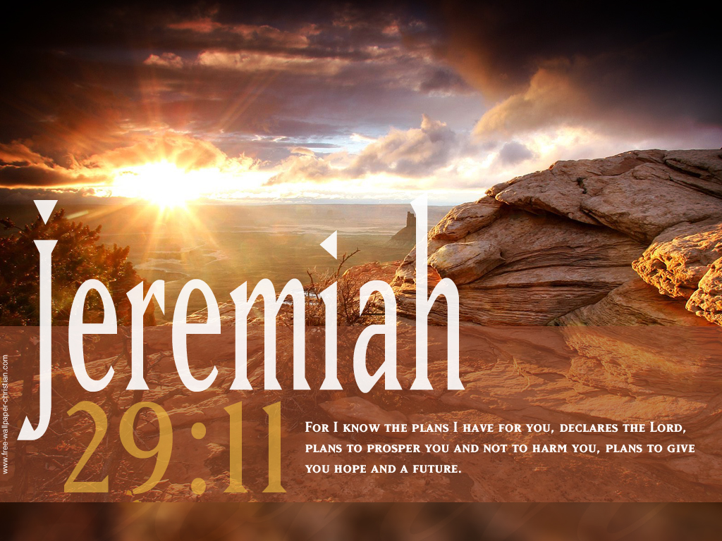

Slide 14
The God Who Answers Prayer (3)
God told Jeremiah, "Call to me..."
  Invitation - to Call on God Personally -Psalm 18:3
  Privilege - Heb 10:19-22
  Responsibility - James 5:16
"I will answer you." God answers prayer according to...
  His will (1 John 5:14, 15)
  Our faith (Matthew 9:29; Mark 11:24; Hebrews 11:6)
  His infinite resources (Philippians 4:19; Ephesians 3:20).
"I will... tell you great and unsearchable things."
unsearchable = inaccessible; beyond the grasp of human knowledge
    “walled up” = fortified cities of Canaan -Deut 1:28
God promises to reveal hidden things to us by His Spirit (1 Corinthians 2:9, 10).

Slide 15
The God Who Answers Prayer (3)
God told Jeremiah, "Call to me..."
  Invitation –challenge -Possiblity-- to Call on God Personally -Psalm 18:3
Response-Promise- of God. “I will answer thee, and show thee great and mighty things, which thou knowest not.” The response of God is threefold here. There is the welcome of God, the works of God, and the wisdom of God in His response.
First, the welcome of God. “1 will answer thee.” Do not fear that God is too busy and important to pay attention to your prayer. Unlike many men in important places, God will give you a hearing. He welcomes your prayers.
Second, the works of God. “Show thee great . . . things.” God is a God of power. “Great” here emphasizes the power of God to do mighty works on your behalf. We do not pray to a weak God. He is not limited by circumstances but by our lack of calling upon Him. It is our failure to call upon Him that limits Him working in power on our behalf.
Third, the wisdom of God. “Show thee . . . mighty things, which thou knowest not.” unsearchable = inaccessible; beyond the grasp of human knowledge
    “walled up” = fortified cities of Canaan -Deut 1:28
God promises to reveal hidden things to us by His Spirit (1 Corinthians 2:9, 10).

Slide 16
Encouragement to Pray
“Call upon me, and I will answer thee, and show thee great and mighty things, which thou knowest not.” (Jeremiah 33:3)
Scripture gives many encouragements to pray. From the Old Testament through the New Testament, men are repeatedly encouraged to pray. The verse before us is one of those Scripture texts which gives much encouragement to pray. In this verse of encouragement is the requirement of man and the response of God
Requirement of man. “Call upon me.” This is a command to pray. Some are reluctant to pray, for they think God does not care about their praying. But God cares enough about our praying to command us to pray. Our verse says it is a requirement. And if God requires you to pray, you should not be reluctant to pray. In fact failure to pray is disobedience. Do not hesitate to come to God in prayer. He wants you to pray, yea even commands you to pray. That should certainly encourage any reluctant soul to go to God in earnest prayer.
Response of God. “I will answer thee, and show thee great and mighty things, which thou knowest not.” The response of God is threefold here. There is the welcome of God, the works of God, and the wisdom of God in His response.
First, the welcome of God. “1 will answer thee.” Do not fear that God is too busy and important to pay attention to your prayer. Unlike many men in important places, God will give you a hearing. He welcomes your prayers.
Second, the works of God. “Show thee great . . . things.” God is a God of power. “Great” here emphasizes the power of God to do mighty works on your behalf. We do not pray to a weak God. He is not limited by circumstances but by our lack of calling upon Him. It is our failure to call upon Him that limits Him working in power on our behalf.
Third, the wisdom of God. “Show thee . . . mighty things, which thou knowest not.” The word mighty has wide meaning. Here is involves the meaning of revelation of things which we do not know. For the prophet Jeremiah this was a revelation of the future of Israel. For us it is illumination of the Scriptures to help us know and understand the Bible.
Daily Bible Reading: Sermonettes #1.

Slide 17
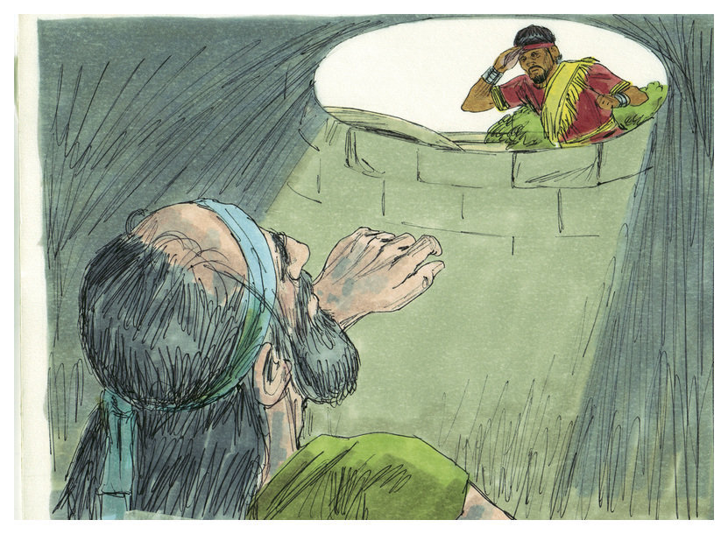

Slide 19
The God Who Makes All Things Possible (2)
This is YAHWEH! = one of the translations = the One Who Promises
It is a promise so important, so great, that God signs the promise with His own name.
4 times He signs His name, “Yahweh,” just like a name on a contract, guaranteeing it will be performed.
The Creator of heaven and earth. The One Who made you and I and everything we see. GOD!
  El-Shaddai – The Almighty God
  El-Elyon – The Most High God
  El-Berith – God of the Covenant
  El-Roi The God Who Sees me
    Yahweh…
      Jireh – The Lord will provide
      Nissi – The Lord is my Banner
      Shalom – The Lord is Peace
      Rohi – The Lord is my Shepherd
      Tsidkenu – The Lord is our righteousness
      Shammah – The Lord is There
      The Ancient of Days

Slide 20
The God Who Makes All Things Possible (2)
WHO PROMISES
But with the command comes a promise. It is a promise so important, so great, that God signs the promise with His own name. 4 times in verses 1 & 2 He signs His name, “Yahweh,” just like a name on a contract, guaranteeing it will be performed.
This is no wimpy little god making this promise. This is no wimpy little know nothing, hear nothing, do nothing god. This is YAHWEH! This is the Creator of heaven and earth. The One Who made you and I and everything we see. GOD!
**##** Tell somebody, “God is GOD!” Tell somebody, “My GOD isn’t a wimp!” He is God! Creator of heaven and earth. Maker of all we see. He is the inventor of dirt.
He is:
El-Shaddai – The Almighty God
El-Elyon – The Most High God
El-Olam – The God of Eternity
El-Berith – God of the Covenant
El-Roi The God Who Sees me
He is Elohim
Yahweh-Jireh – The Lord will provide
Yahew-Nissi – The Lord is my Banner
Yahweh-Mekaddesh – The Lord Who Sanctifies
Yahweh-Shalom – The Lord is Peace
Yahweh-Sabaoth – The Lord of Hosts
Yahweh-Rohi – The Lord is my Shepherd
Yahweh-Tsidkenu – The Lord is our righteousness
Yahweh-Shammah – The Lord is There
He is Adonai – Our Lord
The Ancient of Days
The Rock, our Refuge, a Fortress, a Shield, the Sun, the Purifier.
God is our King, our Judge, and our Shepherd. He is Abba, our Father. He is the Father of Mercies, the Father of Lights, and the Father of Glories.
He is the Great I AM. He is the King of Kings and the Lord of Lords.
That God. The God Who created the heavens and the earth. The God Who formed man from the dust of the ground. The God Who sent waters to flood the earth;
fire and brimstone to destroy Sodom & Gomorrah, and His Son Jesus Christ to die for our sins. That God makes a promise.

