Slide 2

Your Attitude Determines Your Altitude -pt1
Philippians 4:4-7
Edward Church
October 11, 2015

Slide 3
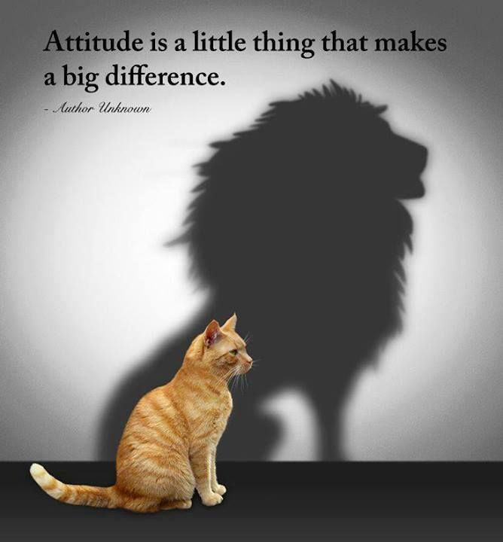
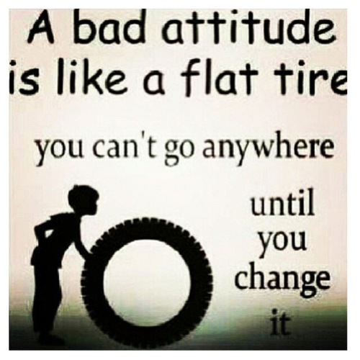
The Power of Attitude
It Has Been Said…
Nothing Can Stop a Person W- the Right Attitude
Nothing Can Help a Person W- the Wrong Attitude

Slide 4
Attitude is the EYE of your Soul!
  Your attitude determines how you view life
Attitude is the FACE of your Life!
  Your attitude determines how you appear to others
Attitude is the EAR of your Mind!
  Your attitude determines how you understand your world
Attitude is the VOICE of your Heart!
  Your attitude will determine how you relate to those around you
Attitude is the Prophet of your Future!
  It Determines Your Destiny
  It Also Determines How High You Fly!!!

Slide 5


Slide 6
Paul had the Right Attitude…
…From a Prison in Rome He Writes:
"Rejoice in the Lord always. I will say it again: Rejoice!" (4)
Your Attitude Determines Your Altitude
An Attitude is a Mental Disposition or Outlook…
…a Way of Looking at Yourself and the World
It Can Be Defined as a Mental, Emotional, and Physical Posture
  That Means that Life is Lived from “the Inside Out”
Our Level of Joy is Based More On What is Going On Within Us…
…Than What's Going On Around Us

Slide 7
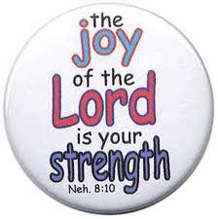
Joy is an Unconquerable Sense of Gladness
It Overcomes Adversity, Disappointment, Tragedy, Failure, and the Harsh Experiences of Life, Enabling Us to…
“mount up with wings like eagles, to run and not grow weary, and to walk and not faint” -Isa. 40:31.
Joy is the Promise of God to His people, / the Work of the Holy Spirit in Our Hearts When We…
  Turn Over Our Trials to God
  Live In the Confidence that He Is Able
When You Have this Kind of Joy, You Know By Experience…
"The joy of the Lord is your strength" -Neh. 8:10

Slide 8
I don’t know about you but I’ve got to Praise Him…
Because He’s Almighty…
Because He Blessed Me…
Because He Cares for me
Because He Delivered me…
Because He Erased the penalty of sin that was against me…
Because He Forgave me…
Because He Gave me eternal life…
Because He Heard my cry…
Because He Justified me…
Because He Kept me…
Because He Loves me…
Because of His Mercy…
Because He Never left me…
Because He Opened doors for me…
Because He Paid the price for me…
Because Redeemed me…
Because He Saved and Sanctified me…
Because He Took my place at Calvary…
Because of His Undying love for me…
Because He gave me Victory…
Somebody ought to praise in this place… (Why?) Because there’s Power In Your Praise…

Slide 9
Attitudes
Attitudes Can Be…
  Realistic or Unrealistic
  Positive or Negative
  Productive or Unproductive
In Philippians, Paul Continually Underscores the Need for a Spiritual Attitude If We Are to Keep Our Joy
It's Easy to Get Caught Up in Negative If We Don't Guard Our Hearts
Paul Shares Three Aspects Of Real Joy In This Passage

Slide 10

Joy Is an Upward Attitude (4:4)
We must REJOICE
  Rejoice= full of cheer, calmly happy, well off
Rejoice in the LORD
  Not in Things, Circumstances
    Real Joy comes from the Real Joy Giver!
Rejoice in the Lord ALWAYS
  It’s Easy to Rejoice in the Lord When You Are in Church
    All the Time
    In All Things
    Through the good and the bad!!!
    REJOICE in the LORD, ALWAYS!!!

Slide 11
Joy Is an Upward Attitude (4:4)
#1 - We must REJOICE!!!
lighten up
This word ?rejoice? means to be ?full of cheer, calmly happy, or well off!?
-Is that something that you could say of yourself?
-Are you full of cheer, or well off?
A resounding presence that should come from us is that we a cheerful and joyous?
-And we will remember from a message several weeks ago??being happy? is temporary?but ?joy? only comes from God and is everlasting, not contingent upon what happens to us!
-I want the joy! I want to be able to rejoice!!!
#2 - We must REJOICE in the LORD!!!
We are to rejoice in THE LORD!
-Not in things?
-Not in circumstances?
-Not in people?
-Not in good fortune?
-Not in anything that this world may bring?
*Again, that leads to evidences of HAPPINESS and not True Joy!
*Echoing again the true need for joy, and not happiness?
Real Joy comes from the real joy giver!
-God?the eternal One!
*And wouldn?t His joy be eternal as well?! You bet!
-This world is temporary?and that is why it can only offer temporary happiness!
*Makes sense doesn?t it???
*You can only give what you have!
So then, our FOREMOST ATTITUDE is that we must REJOICE?
We must REJOICE in THE LORD?
And we must do that?
#3 - ALWAYS!!!
Now?here we come to where the rubber meets the road?
It is easy to rejoice in the Lord when you are in Church?with Church folks?and during Church activities?
But the STING comes when Paul wrote down this unforgiving word?ALWAYS?
-All the time?
-Every time?
-In all things?
-Through the good and the bad!!!
Yes! REJOICE in the LORD, ALWAYS!!!
How many are ready to say it??Lord! I do need an ATTITUDE ADJUSTMENT!?

Slide 12
In the Face of…
Depression- Joy Says, "All things work together for good to those who love God"-Ro 8:28
Suffering- “ “ "Though [God] slay me, yet will I trust Him" -Job 13:15
Fear- “ “ "Yea, though I walk through the valley of the shadow..." -Ps. 23:4
Impossibilities- Joy Says, "With God all things are possible" -Matt. 19:26; Mark 10:2
Failure- joy says, "Though I have fallen, I will rise" -Mic. 7:8
Financial Loss- Joy Says, "I have never seen the righteous forsaken or their children begging bread" -Ps. 37:25
Death-” “, "O death, where is thy sting? O grave, where is thy victory?" -1 Cor. 15:55
Unanswered Prayer, Joy Says, "[His] grace is sufficient for you" -2 Cor. 12:9
Inadequacy, Joy Says, "I can do all things through Christ" -Phil. 4:13
Challenges, Joy Says, "Thanks be to God, who gives us the victory" -1 Cor. 15:57

Slide 13
Joy Is an Outward Attitude (4:5)
"Let your gentleness be evident to all"
Gentleness= "kindness, fairness, forbearance, patience" in Relationships
It Means We Are…
  Approachable, Easy to Get Along with, and Gracious.
  Considerate of Others and Their Feelings -2 Cor. 10:1
  "Great Power Under Great Control"
That's we need to show others if we expect to be filled with joy.
If we are harsh with others, we will only make ourselves miserable.
If we sow joy, we will reap joy!
If we seek to make others happy, we will in turn be happy

Slide 14
How to Be Perfectly Miserable
Think about yourself
Talk about yourself
Use the words I, me, and mine as often as possible
Evaluate yourself continually in the opinion of others
Listen greedily to what people say about you
Expect to be appreciated
Be suspicious
Be jealous and envious
Be sensitive to slights
Never forget a criticism
Trust nobody but yourself
Demand consideration and respect
Sulk if people are ungrateful for favors you do for them
Never forget a service you rendered
Be on the lookout for a good time for yourself
Avoid responsibility as much as u can
Do as little as possible for others
Put yourself 1st in all decisions/ plans
Spend most of your prayer time praying about yourself
Be selfish

Slide 15
Joy Is an Inward Attitude (6-7)
Keeping Your Joy Comes From Total Faith and Trust in God
"Do not be anxious about anything, but in everything, by prayer and petition, with thanksgiving, present your requests to God. And the peace of God... will guard your hearts and your minds in Christ Jesus"
Don't Be Anxious…
to worry and fret needlessly
to choke or to strangle
It Doesn't Refer to the Appropriate Concern in Real Threats But…
Random Thoughts of Fear Preoccupied With…
…Everything that Could Possibly Go Wrong.

Slide 16
Joy Is an Inward Attitude (6-7)
“Pray with Thanksgiving”
Tell God every detail of your needs in earnest and thankful prayer
When We Pray w- Thanksgiving in Advance of the Answer…
…it Shows that We Truly Believe God is Going to Handle
…the Things We Put in His Hand
You Can Trust that God Will Answer Every Prayer According to…
…His Wisdom, Power, and Goodness

Slide 17
John teaches us to get up again: "Even if good people fall seven times, they will get back up" (Proverbs 24:16).
GOD NEVER DESTINED YOU TO BE A FAILURE
God did not…
…spare you from alcoholism
…deliver you from the demons of drug addiction
…see you through the darkest hours of your life
…hold your hand and carry through that bitter divorce
…overshadow you with His love during your times of loneliness
…reach down from Heaven and touch your afflicted body
…conquer death, hell and the grave for you to roll over now and give up
God told Adam and Eve to subdue the earth and have dominion over it; to be fruitful and multiply.
Paul reminds us in Ephesians that God has blessed us with every spiritual blessing – not withholding one.

Slide 18
Joy Is an Inward Attitude (6-7)
“The peace of God will guard your heart”
Peace= to join together- set at one again
  The Source of this Peace is Inward, Not Outward
His Peace Will Guard Your Hearts And Minds
  Guard – standing a military post to prevent a hostile invasion
  Hearts – the deepest part of our being – the inner man
  Minds – our thoughts
God’s Peace Will Stand Guard Over Our Spirit and Thoughts…
…to Prevent a Hostile Invasion of Worry
Attitude is Contagious, is Yours Worth Catching?

Slide 19
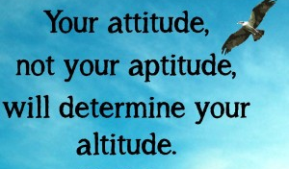
Rejoice in the Lord

Slide 21
Jokes
Parachute training - 4 things you need to know
Eagle raised in chicken coop
40 yrs camped by promised land –how many times over 40 yrs did they pass the entrance?

Slide 22
As a woman was walking down the street one day, she heard a voice yell, "Stop! If you take one more step you'll be killed!" She stopped, and seconds later a brick fell from a building right in front of her. A minute or two later she started to cross the street, when the same voice bellowed. "Halt! Don't cross the street now!" Suddenly an out-of-control truck sped by as it ran a red light and never slowed down.
Shaken, the woman said, "Who are you?"
The voice replied. "I'm your guardian angel. I imagine you have some questions for me."
"I sure do." the woman said. "Where were you on my wedding day?

Slide 25
His peace will guard your hearts and minds
“Guard” – standing a military post to prevent a hostile invasion
“Hearts” – the deepest part of our being – the inner man
“Minds” – our thoughts
In other words when we practice right praying, God’s peace will stand guard over our spirit and thoughts to prevent a hostile invasion of worry.
"Attitude is Contagious, is yours worth catching?"

Slide 26
Joy Is an Upward Attitude (4:4)
  What is the best thing that can happen today?
  What is the worst thing that can happen today?
  What can I do today to make sure that the best thing does happen?
  What can I do today to make sure that the worst thing doesn't happen?
Regardless of what happens, God has promised to keep you, to watch over you, and to provide for you. The worst thing that can happen in this life is for it to end, but then we will find ourselves in the eternal presence of God where we will dwell in the house of the Lord forever. The pain of the present must always be weighed in the balance of the hope we have of eternal life.

Slide 27
Joy Is an Upward Attitude (4:4)
When faced with worries and anxieties that rob you of your joy, ask yourself four questions in light of the faithfulness of God, and you will overcome the negative to experience new joy:
  What is the best thing that can happen today?
  What is the worst thing that can happen today?
  What can I do today to make sure that the best thing does happen?
  What can I do today to make sure that the worst thing doesn't happen?

Slide 28
Joy Is an Upward Attitude (4:4)
Paul says, "Rejoice in the Lord always"
Our joy is "in the Lord" and Comes from Perpetual Praise
Praise and Thanksgiving is the Normal Response from the...
  Creature to the Creator -Ps. 139:14
  Redeemed to the Redeemer -Col. 1:12-14
  Citizen to the King -Ps. 145:1-4
  Child to the Father -Rom. 8:14-17

Slide 29
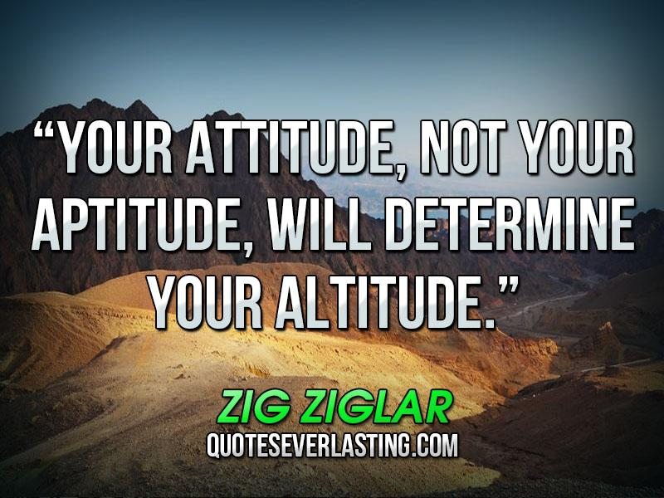
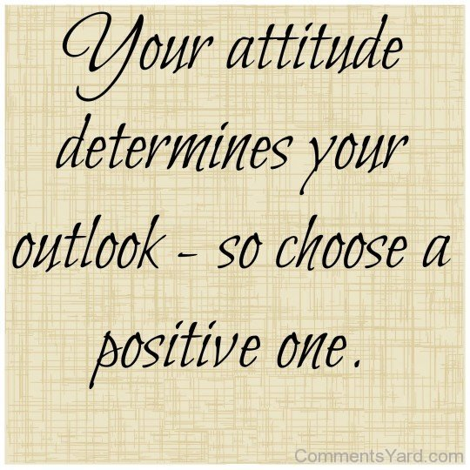

Slide 30
