Slide 2
Seven Words for Relationships (Weather Proofing) pt 2
Assorted Scriptures
Edward Church
Nov 22, 2015

Slide 3
What Do Our Marriages Look Like?
After the Strain of…
Children
Work
In-Laws
Out-Laws
Life
It’s Easy to Lose Our Focus…
…Lose Sight of Each Other
There are Seven Words that, if Applied to Our Marriages, have the Power to make this year the Best Year we have ever Experienced as a Couple.

Slide 4
1st Three Words
Initiate -“Do not withhold good from those to whom it is due,
when it is in your power to do it” -Prov 3:27
Prioritize - “Do nothing from selfish ambition or conceit, but in humility count others more significant than yourselves
Communicate - “From a wise mind comes careful
and persuasive speech” -Prov 16:23

Slide 5
Initiate
Remember the Courtship?
Make an Effort to Woo Your Spouse All Over Again
So Many Marriages Fall Apart Because…
…People Just Stop Trying
“Do not withhold good from those to whom it is due, when it is in your power to do it” -Prov 3:27

Slide 6
Prioritize
What Is Your Top Priority?
It’s Where You Devote The Majority Of Your Time / Energy
Your Phone and Updating Your Facebook Status Can Wait.
“Do nothing from selfish ambition or conceit,
but in humility count others more significant than yourselves”
-Phil 2:3

Slide 7
Communicate
In a Successful Marriage, You Have to Fight The Urge to Not Talk
Don’t Allow Things to Fester.
Instead, Keep an Open Line of Communication.
Speaking Redemptive Words…
…Actually Resolve Situations / Improve Our Relationship
“From a wise mind comes careful and persuasive speech”
-Prov 16:23

Slide 8
Listen
The Most Important Part Of Communicating…
…Doesn’t Involve Speaking
…But Listening
Your Spouse Wants(Needs) to Be Heard.
How Can You Know What He or She Is Feeling…
…If You Don’t Take The Time to Listen
Many Of Us Are Too Quick to Interject Before…
…The Other is Finished Speaking
“…let every person be quick to hear, slow to speak, slow to anger” -James 1:19

Slide 9
Forgive
Don’t Hold Onto Things
You Only Harm Yourself
When Your Spouse Does Something, Refer To #3 And #4
Then, Let It Go. Forgive Them and Move On
“Put on then, as God’s chosen ones, holy and beloved, compassionate hearts … and, if one has a complaint against another, forgiving each other; as the Lord has forgiven you, so you also must forgive” -Col 3:12-13

Slide 10
Love
Without Love, There Is No Marriage.
That’s Why We Must Keep the Spark Alive.
Set Aside More Time to Date Your Spouse.
When You Are Out…
…Try Your Best to Make Sure Kids/ Grandkids Aren’t Topic Of Conversation.
“And above all these put on love, which binds everything together in perfect harmony” -Col 3:14

Slide 11
Pray
a Successful Marriage Consists Of Three People:
Husband
Wife
God
Involve Him More, Even in the So-called “Little Things”
“Seek the Lord and his strength; seek his presence continually!”
-I Chron 16:11

Slide 12
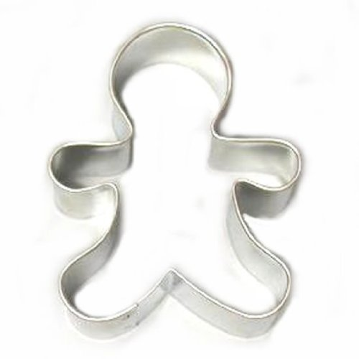
Wrap It Up
Stop…
Take Your Spouse Off Your Potter’s Wheel
Drop…
Turn Them Over to the Master Potter
Roll…
Quit Focusing on the Negative ONLY
Find Some Positives and Roll On!

Slide 13
There is 100 % Opportunity for Your Marriage to…
Do more than Survive…
…But to Thrive

Slide 18
what do our marriages look like? More importantly, where does our marital health rank on the list of To-Do’s? Instead of our bodies and physical appearance being top priorities, what if we put that focus on our marriages instead?
The hardest part of parenting, that no one seems to want to warn you about, is the strain children have on your marriage. Children can come between you and your spouse. For us, it’s quite literal. I can’t seem to hug my wife without my 4-year-old butting in between us to make a “sandwich.”
As the years go by, the children naturally become our focus, making it easy to lose sight of each other. We don’t take the time or energy necessary to stay connected.
But, this trend can be stopped if you give your marriage a “check up.” I believe there are seven words that, if applied to our marriages, have the power to make this year the best year we have ever experienced as a couple.

