Slide 2
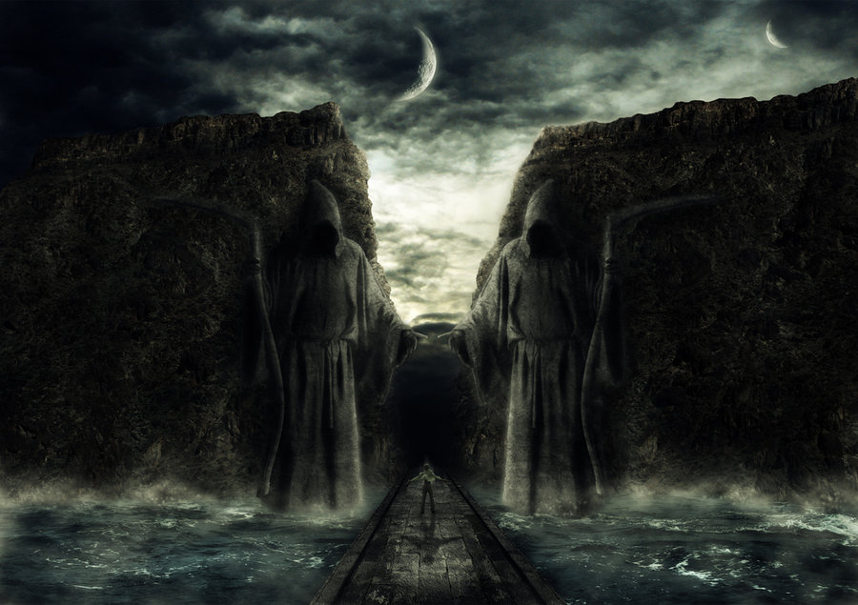
Passing Through
Dark Valleys pt 2
(Dealing with Adversity)
Psalms 23:4
Edward Church
Dec 13, 2015

Slide 3
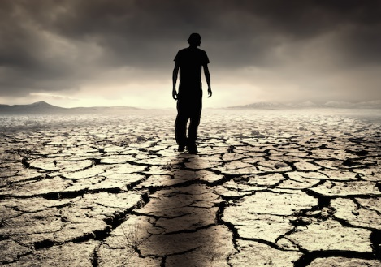
What Do You Get in a Land(life) Where All You Have Is…
…Sunshine Every Day
…and No Rain?
“a Desert”

Slide 4
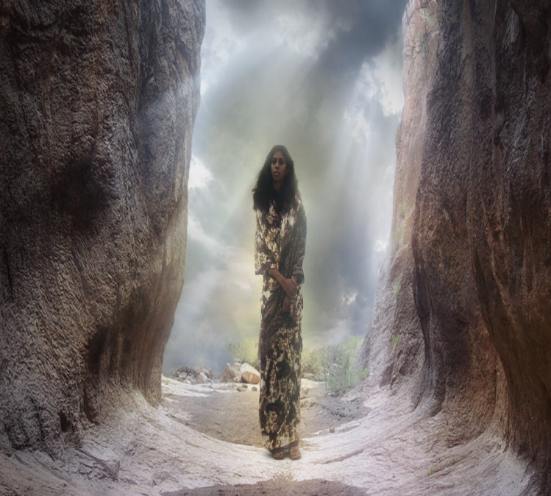
Dark Valleys Are…
Unavoidable
"Mankind is born for trouble as surely as sparks fly upward." Job 5:7
Unpredictable
  You can’t plan them or time them (usually worst poss time)
  "Disaster after disaster is reported, for the whole land is destroyed. Suddenly my tents are destroyed, my tent curtains, in a moment." -Jeremiah 4:20 (HCSB)
Impartial
"He causes His sun to rise on the evil and the good, and sends rain on the righteous and the unrighteous." -Matt 5:45 (HCSB)

Slide 5
Dark Valleys Are…
Temporary
  Valleys…
    have an end
    don’t last forever
    are not our permanent residence
"The suffering won’t last forever. It won’t be long before this generous God who has great plans for us in Christ—eternal and glorious plans they are!—will have you put together and on your feet for good" -1 Peter 5:10 (MSG)

Slide 6
Dark Valleys Are…
Have a Purpose
"You rejoice in this, though now for a short time you have had
to be distressed by various trials so that the genuineness of
your faith—more valuable than gold, which perishes though
refined by fire—may result in praise, glory, and honor at the
revelation of Jesus Christ." -1 Peter 1:6-7 (HCSB)
  God Can Teach You Character
  He Wants To Change You, Mature You
  Faith Is Built In The Valleys Of Life

Slide 7
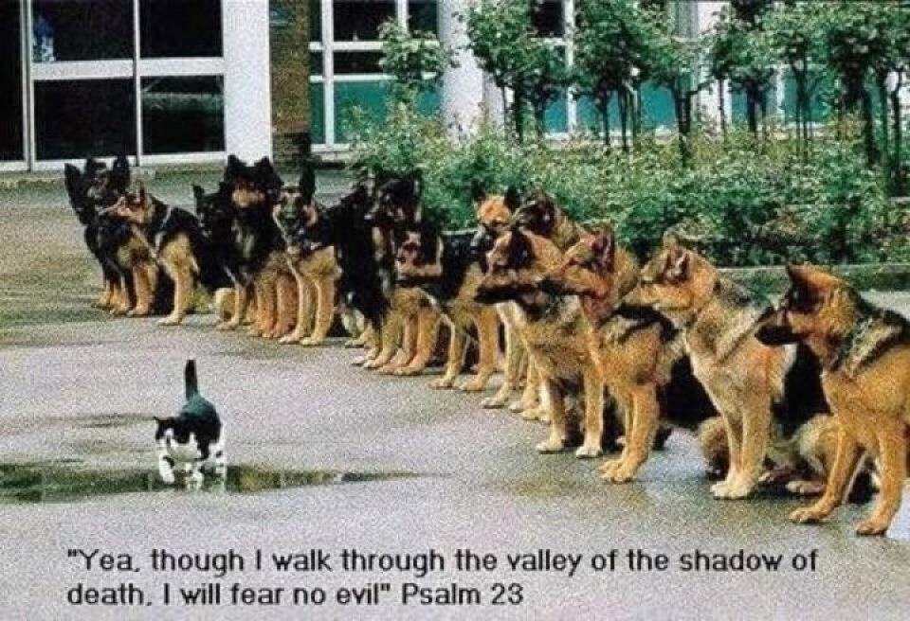
What Do You Do When…
…You Go Through Dark Valleys? (4)
Remain Calm- “Even though I walk through the valley...”
  "I walk" - not "I run through it" or "I panic/ run the other way"
Refuse To Be Discouraged- “I will fear no evil”
  Will implies a Choice, a Decision.
  Focus on God's Power Rather than on your Valley (problem)

Slide 8
What Do You Do When…
…You Go Through Dark Valleys? (4)
Remain Calm- “Even though I walk through the valley...”
Refuse To Be Discouraged- “I will fear no evil”
Rest In God’s Presence- “For You are with me”
    God Promises to be with you every step of the way
Rely on God’s Protection/ Guidance-“Your rod /staff comfort me”

Slide 9
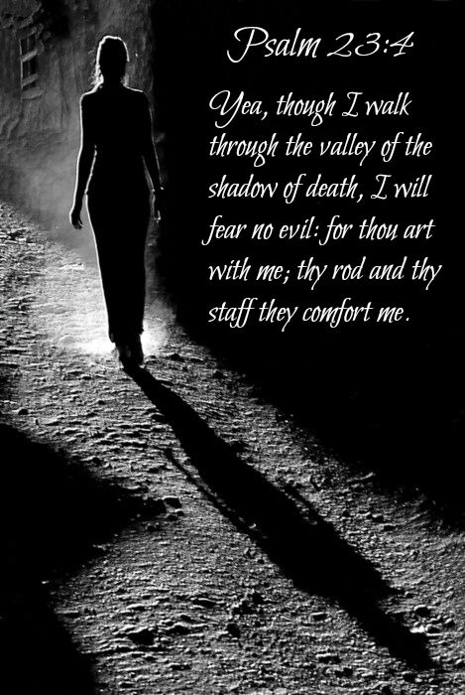
Shadows…
are always Bigger Than Reality
  Fear is always greater than the problems you face
cannot Hurt You
  Shadows can not hurt you – they can only scare you
only appear when there is a Light Source
  there is light at the end of the tunnel
  God is light – and in Him there is no darkness
  Trust Him

Slide 11
What Do You Do When…
…You Go Through Dark Valleys? (4)
Remain Calm- “Even though I walk through the valley...”
  "I walk" - not "I run through it" or "I panic/ run the other way"
Refuse To Be Discouraged- “I will fear no evil”
  "I will not fear evil". Will implies a choice, a decision.
  Focus on God's power rather than on your Valley (problem)

Slide 12
What Do You Do When…
…You Go Through Dark Valleys? (4)
Remain Calm- “Even though I walk through the valley...”
Refuse To Be Discouraged- “I will fear no evil”
Rest In God’s Presence- “For You are with me”
    God Promises to be with you every step of the way
Rely on God’s Protection/ Guidance-“Your rod /staff comfort me”

Slide 13
Shadows…
are always Bigger Than Reality
  Fear is always greater than the problems you face
cannot Hurt You
  Shadows can not hurt you – they can only scare you
only appear when there is a Light Source
  there is light at the end of the tunnel
  God is light – and in Him there is no darkness
  Trust Him

Slide 14
End pt 1

Slide 15
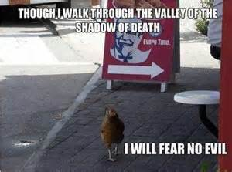


Slide 17
Dark Valleys Are…
Have a Purpose
  God has a reason for taking you through dark valleys.
  valley full of doubt, despair, discouragement, or defeat
  financial valleys, relationship, emotional, spiritual valleys
  God Promises .. You will get through them in time
Every Problem Has a Purpose
  little ones, inconsequential ones, irritating ones.
  God can teach you character
  He wants to change you, mature you
  Faith is Built in the Valleys of Life

Slide 18
What Do You Get in a Land(life) Where All You Have Is…
…Sunshine Every Day
…and No Rain?
“a Desert”
  Balance -none
  Blocked- growth stunted
  Blank- Unthankful
  Bland- boring

Slide 19
Examples of Life's Valleys
The Valley of…
  Calamity -Josh. 7:26
  Weeping -Ps. 84:6
  Trouble -Hosea 2:15
  Deep Darkness -Ps. 23:4

